Slide 1

Azure Data Transformation: Unlocking Business Insights with Scalable Solutions
In today's data-driven world, organizations are collecting vast amounts of data from multiple sources. However, raw data alone holds little value until it is transformed into meaningful insights. This is where Azure Data Transformation plays a critical role, providing a robust suite of tools for ingesting, processing, and transforming data to support real-time analytics, AI-driven insights, and business intelligence reporting.
kW
by Kimberly Wiethoff

Slide 2

What Is Azure Data Transformation?
1
Extracting
Data is pulled from various sources, including cloud applications, IoT devices, and enterprise systems.
2
Cleansing and Filtering
Raw data is cleaned and filtered to ensure accuracy and relevance.
3
Enriching
Datasets are enhanced with additional context to provide more comprehensive insights.
4
Aggregating and Summarizing
Data is combined and summarized to support analytics and reporting needs.

Slide 3



Azure Data Factory (ADF)
Fully Managed
90+ Data Sources
Flexible Options
Cloud-based ETL service for orchestrating data movement and transformation across hybrid environments.
Connects to a wide variety of data sources, enabling comprehensive data integration.
Supports both ETL and ELT pipelines, with low-code and code-based transformation options.
Azure Data Factory is ideal for use cases such as migrating on-premises databases to the cloud, offering a versatile solution for data transformation needs.

Slide 4
Azure Synapse Analytics
End-to-End Analytics
Key Features
Azure Synapse Analytics integrates big data processing with SQL-based data warehousing, providing a comprehensive solution for complex data transformations on large datasets.
Handles structured and unstructured data
Supports serverless and dedicated compute pools
Integrates seamlessly with Power BI and AI models

Slide 5

Azure Databricks
Unified Analytics Platform
Optimized Performance
Designed for both batch and real-time transformations, with auto-scaling and collaborative notebooks for efficient data processing.
Azure Databricks combines Apache Spark-based big data processing with machine learning capabilities, ideal for advanced analytics and AI/ML-powered transformations.
Language Support
Supports multiple programming languages including PySpark, Scala, SQL, and R, offering flexibility for data scientists and analysts.

Slide 6

Azure Stream Analytics
1
Real-Time Event Processing
Azure Stream Analytics enables businesses to analyze data as it flows in from IoT devices, logs, and applications, supporting real-time decision-making.
2
SQL-Based Transformations
Offers familiar SQL-based transformations for processing streaming data efficiently.
3
Scalable Performance
Handles millions of events per second, integrating seamlessly with Event Hubs, IoT Hub, and Azure Functions.

Slide 7
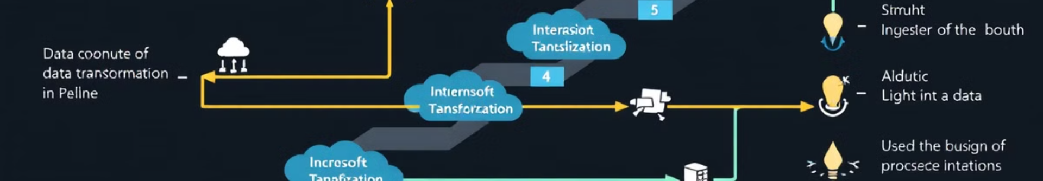
Azure Data Transformation Pipeline: Step-by-Step
Load Data
Transform Data
Transformed dataset is loaded into Azure Synapse Analytics and visualized in Power BI dashboards.
Store Data
Azure Databricks, Synapse Analytics, and Stream Analytics perform data cleansing, enrichment, and aggregation.
Ingest Data
Raw data is stored in Azure Data Lake Storage for processing.
Azure Data Factory pulls sales data from on-premise SQL databases, cloud applications, and IoT sensors.

Slide 8



Best Practices for Azure Data Transformation
Choose the Right Tools
Optimize for Performance
Ensure Data Quality
Match Azure services to your specific data transformation needs, considering factors like batch vs. real-time processing.
Utilize partitioning, indexing, and caching techniques to speed up data processing and improve efficiency.
Implement robust data validation, anomaly detection, and error-handling mechanisms to maintain data integrity.
Following these best practices ensures efficient and effective data transformation processes in Azure.

Slide 9
Security and Automation in Azure Data Transformation
Secure Your Data
Automate Workflows
Leverage Azure Key Vault, RBAC (Role-Based Access Control), and encryption to protect sensitive information throughout the transformation process. Implementing robust security measures is crucial for maintaining data integrity and compliance.
Utilize Azure Logic Apps and Data Factory pipelines to schedule and monitor transformations. Automation streamlines processes, reduces manual errors, and ensures consistent data transformation across your organization.

Slide 10
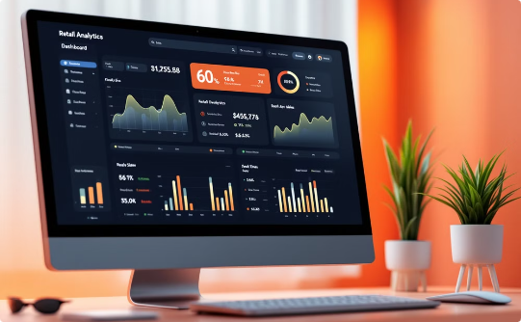

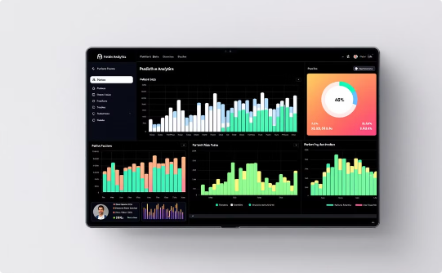
Real-World Applications of Azure Data Transformation
Retail Analytics
Smart City Management
Healthcare Insights
Process sales transactions from multiple locations in real-time, enabling dynamic pricing and inventory management.
Analyze data from IoT sensors to optimize traffic flow, energy consumption, and public services.
Transform patient data to predict health risks and improve treatment outcomes.

Slide 11




The Future of Azure Data Transformation
AI Integration
Edge Computing
Enhanced AI capabilities for automated data cleansing and predictive analytics.
1
Increased support for data transformation at the edge for IoT scenarios.
2
Blockchain Integration
4
Quantum Computing
Leveraging blockchain for secure and transparent data lineage.
3
Exploration of quantum algorithms for complex data transformations.
As Azure continues to evolve, we can expect even more powerful and innovative data transformation capabilities, further empowering businesses to derive value from their data assets.

Slide 12

Conclusion: Empowering Data-Driven Decision Making
Actionable Insights
Operational Optimization
Azure's data transformation capabilities enable organizations to unlock valuable insights from their raw data.
Transformed data drives efficiency improvements and informed decision-making across business operations.
Competitive Edge
Leveraging Azure for data transformation provides a scalable and flexible foundation for innovation and growth.
Whether dealing with big data analytics, AI-driven insights, or real-time data processing, Azure provides the tools needed to streamline end-to-end data transformation workflows. How is your organization leveraging Azure for data transformation? Let's connect and discuss strategies for maximizing the value of your data!

