Slide 1
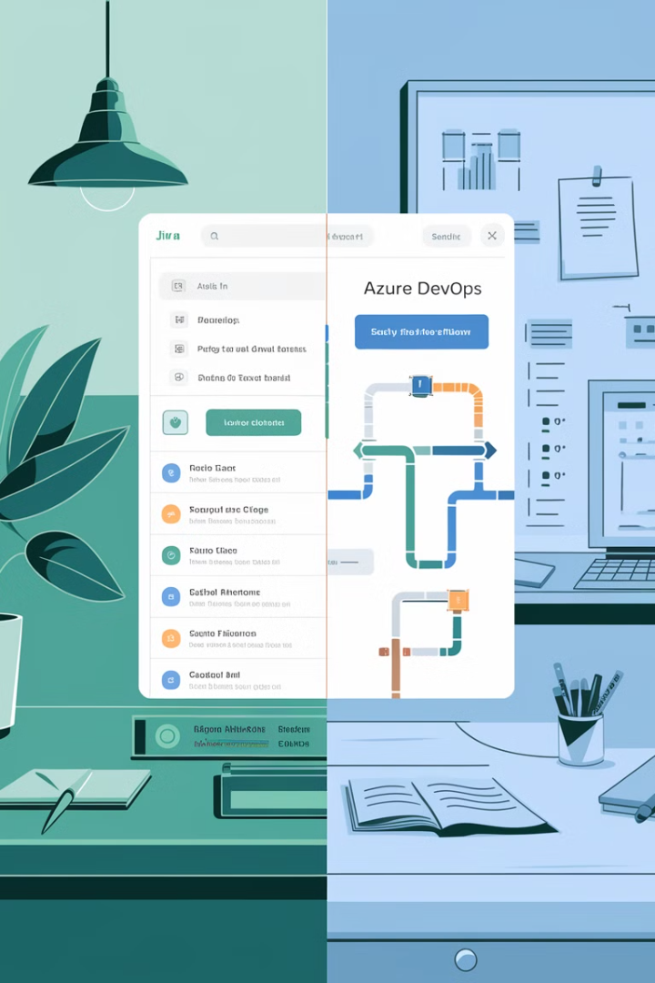
Jira vs. Azure DevOps: A Guide for IT Managers
Selecting the right project management tool is crucial for IT managers to deliver projects efficiently, maintain collaboration, and ensure seamless development workflows. This presentation compares Jira and Azure DevOps (ADO), two popular tools in this space, across several key factors to help IT managers decide which tool aligns best with their development and project management needs.
kW
by Kimberly Wiethoff

Slide 2
Overview of Jira and Azure DevOps
Jira
Azure DevOps (ADO)
Developed by Atlassian, Jira is widely adopted for agile project management. Initially created for bug tracking, it has grown into a comprehensive tool supporting Scrum, Kanban, and other agile methodologies.
A suite of development tools from Microsoft, ADO integrates project management capabilities with development pipelines, testing, and CI/CD. It excels in providing a complete ecosystem for software development, especially for teams working in the Microsoft stack.

Slide 3
Agile Project Management
Jira
Azure DevOps
Highly regarded for agile management with built-in features for Scrum and Kanban boards, sprint planning, backlog management, and reporting. Offers extensive customization options.
Supports agile workflows with sprints, Kanban boards, and backlogs. Focuses on integrating agile practices with the entire development lifecycle.

Slide 4
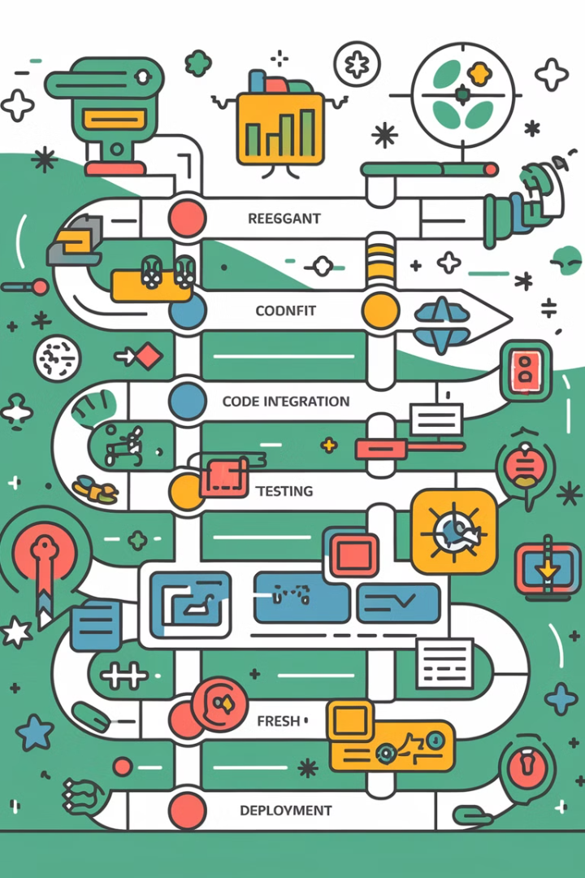
DevOps Integration and CI/CD
Azure DevOps Advantage
Built-in integration with Microsoft ecosystem. Best-in-class CI/CD pipeline tools. Automate builds, run tests, and deploy code directly.
Jira Integration
No native CI/CD tools. Can integrate with other DevOps tools like Bamboo, Jenkins, or GitLab. Requires more configuration and separate management.
Key Takeaway
Azure DevOps is superior for strong DevOps framework with end-to-end automation. Jira works well with third-party tools but requires more effort to manage integration.

Slide 5
Integration with Other Tools
Jira
Azure DevOps
Key Takeaway
Wide range of integrations, including seamless connections to other Atlassian tools and third-party tools like Slack, GitHub, Jenkins, and Trello.
Integrates best with Microsoft ecosystem, including Azure Cloud, Visual Studio, GitHub, and Active Directory. Optimized for teams using Microsoft technologies.
Jira offers broader integration for diverse teams. Azure DevOps is ideal for organizations heavily invested in the Microsoft ecosystem.

Slide 6
User Interface and Usability
Jira
Azure DevOps
User-friendly interface, but feature-rich which can be overwhelming. Highly intuitive for agile teams once set up. May require more time to configure and get accustomed to.
Streamlined interface with clean layout for managing boards, repos, and pipelines. More straightforward for development teams, especially those familiar with Microsoft services.

Slide 7
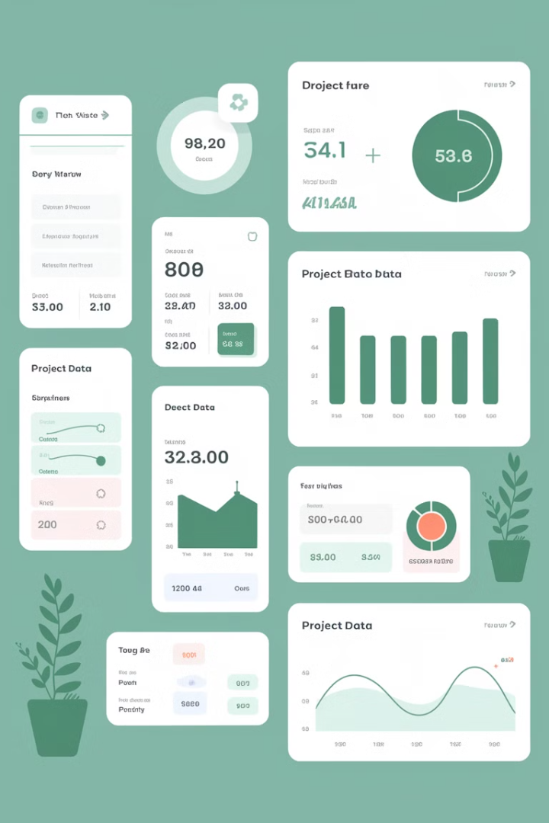
Reporting and Analytics
Jira
Azure DevOps
Advanced reporting for agile teams with burndown charts, velocity charts, sprint reports, and more. Offers third-party plugins to enhance reporting capabilities.
Robust reporting with dashboards, burn-down charts, and cumulative flow diagrams. Provides in-depth insights into the entire DevOps lifecycle.
Key Takeaway
Both offer excellent reporting. Azure DevOps excels at providing deeper insights into the full DevOps lifecycle, while Jira is stronger in agile-focused reports.

Slide 8
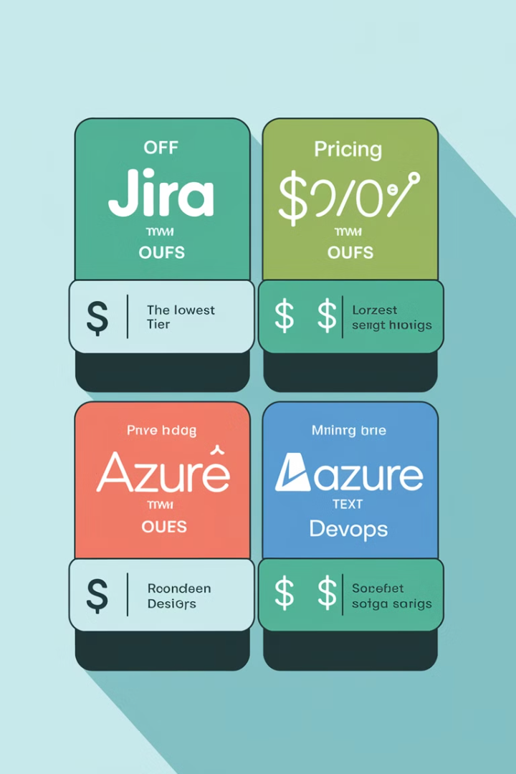
Pricing Models
1
Jira
Subscription-based pricing model based on number of users. Different tiers for Cloud or Data Center versions. Costs can rise significantly for large teams.
2
Azure DevOps
Flexible pricing model, especially for teams using Microsoft Azure services. Basic features free for up to five users, with charges for premium features.
3
Key Takeaway
Azure DevOps can be more cost-effective for small teams or companies using Azure. Jira pricing can become expensive as teams grow, but offers flexibility for agile-focused organizations.

Slide 9
Support and Community
Jira
Azure DevOps
Vast global user base with extensive community of developers. Multiple support channels including forums, knowledge bases, and direct support depending on pricing plan.
Benefits from Microsoft's enterprise-level support, extensive documentation, and large community, particularly within the Microsoft developer network.

Slide 10
Choosing the Right Tool
Assess Your Needs
1
Consider your team's focus, existing tech stack, and project requirements.
Evaluate Features
2
Compare agile capabilities, DevOps integration, and reporting tools.
Consider Integration
3
Analyze how each tool fits with your current workflow and other tools.
Weigh Costs
4
Factor in pricing models and long-term scalability.
Make Your Decision
5
Choose the tool that best aligns with your team's goals and workflow.

Slide 11
Conclusion: Jira vs. Azure DevOps
Choose Jira if:
Choose Azure DevOps if:
Your team is heavily focused on agile methodologies, requires flexible integrations with various tools, or needs a dedicated project management solution with strong support for agile frameworks.
You need an end-to-end development lifecycle tool that integrates seamlessly with the Microsoft ecosystem and offers powerful DevOps capabilities for continuous integration, deployment, and cloud management.
Both tools can drive success, but the right choice depends on how well it aligns with your team's workflow, technology stack, and long-term goals.

