Slide 1

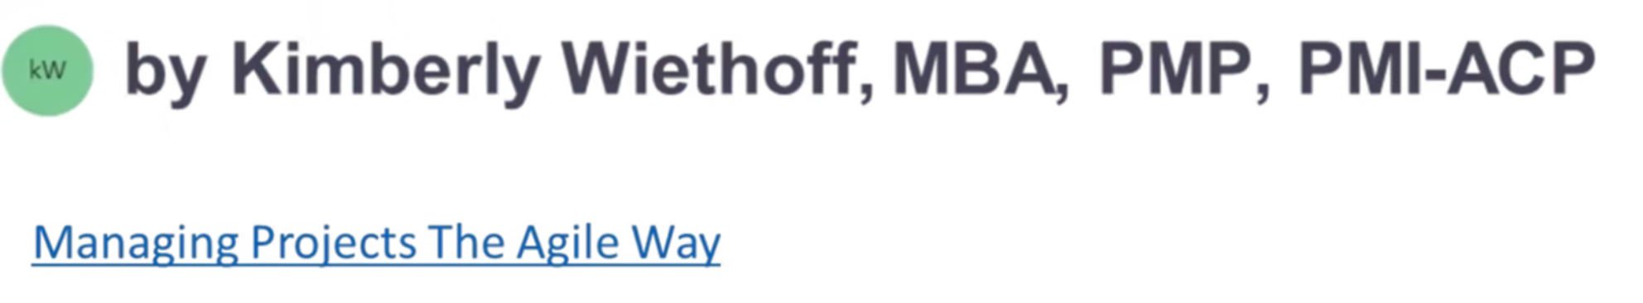
Essential Tools for Distributed Agile Teams
Digital collaboration is the glue that keeps distributed Agile teams aligned and productive. The right tools don't just support Agile—they enable it.
#Agile #DistributedTeams #RemoteWork #Scrum #DigitalTransformation #ProjectManagement #ProgramManagement #DevOps #AgileTools #Leadership #TeamCollaboration #ContinuousDelivery #PMO #TechnologyLeadership #Innovation

Slide 2




Communication: The Team Lifeline
Slack
Microsoft Teams
Zoom
Real-time messaging, team channels, and integrations with Jira and GitHub. Perfect for asynchronous stand-ups.
Video meetings and document collaboration within the Microsoft ecosystem. Streamlines workflow in Windows environments.
High-quality video conferencing for sprint planning and retrospectives. Essential for cross-time zone team bonding.

Slide 3
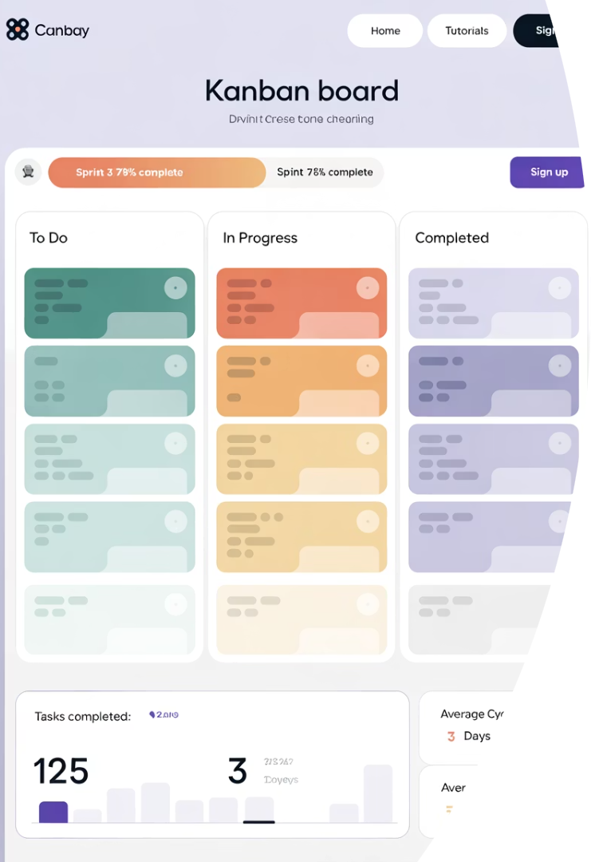



Work Management & Agile Boards
Jira
Gold standard for Agile teams. Customizable boards, backlogs, and built-in reporting make sprint management seamless.
Azure DevOps
Combines code repositories, CI/CD, and Agile boards. Ideal for technical teams using Microsoft tools.
Trello
Simple, visual Kanban boards great for smaller teams. Low learning curve with powerful automation capabilities.

Slide 4
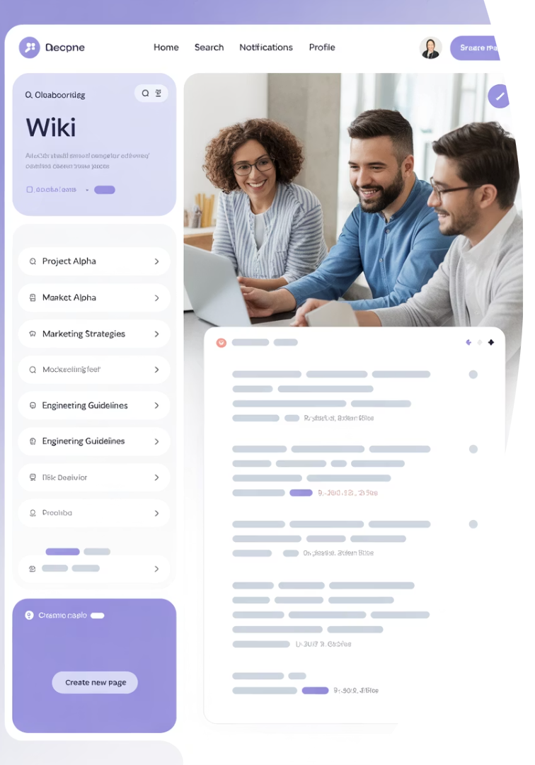
Documentation & Knowledge Sharing
Confluence
Notion
Pairs perfectly with Jira. Ideal for project wikis, retrospectives, and technical specifications. Supports rich content.
All-in-one workspace gaining popularity for flexibility. Combines docs, databases, and tasks in a single platform.
Google Workspace
Docs, Sheets, Slides, and Drive provide intuitive real-time collaboration. Universal accessibility across devices.

Slide 5






DevOps & CI/CD Integration
Bitbucket + Pipelines
Seamlessly integrates with Jira for visibility from code to deployment. Strong Atlassian ecosystem integration.
GitHub + Actions
Code version control with integrated CI/CD workflows. Industry standard with robust community support.
GitLab
End-to-end DevOps platform. Ideal for teams that want everything in one comprehensive tool.

Slide 6
Reporting & Metrics Dashboards
Power BI
EazyBI for Jira
Jira Dashboards
Creates powerful dashboards by pulling data from Jira, DevOps, or custom databases. Highly customizable visualizations deliver executive-ready reports.
A specialized add-on providing deep-dive Agile metrics. Offers pre-built templates for sprint velocity, cycle time, and team capacity planning.
Built-in widgets for velocity charts, sprint burndowns, and more. Quick setup with no additional cost or integration requirements.

Slide 7





Communication Best Practices
Mix Synchronous & Asynchronous
Balance real-time meetings with asynchronous updates. Record important sessions for team members in different time zones.
Document Decisions
Capture key decisions in shared spaces. This creates transparency and reduces misunderstandings across distributed teams.
Establish Core Hours
Define overlap times when all team members are available. Schedule crucial ceremonies during these windows.
Foster Team Connection
Create virtual spaces for casual interaction. Virtual coffee breaks and team-building activities build trust across distances.

Slide 8








Optimizing Work Visibility
Transparency
Make work visible to everyone
Real-time Updates
Keep boards current throughout the day
Detailed Tasks
Include context, acceptance criteria, and blockers
Clear Filters
Enable easy discovery of relevant work

Slide 9
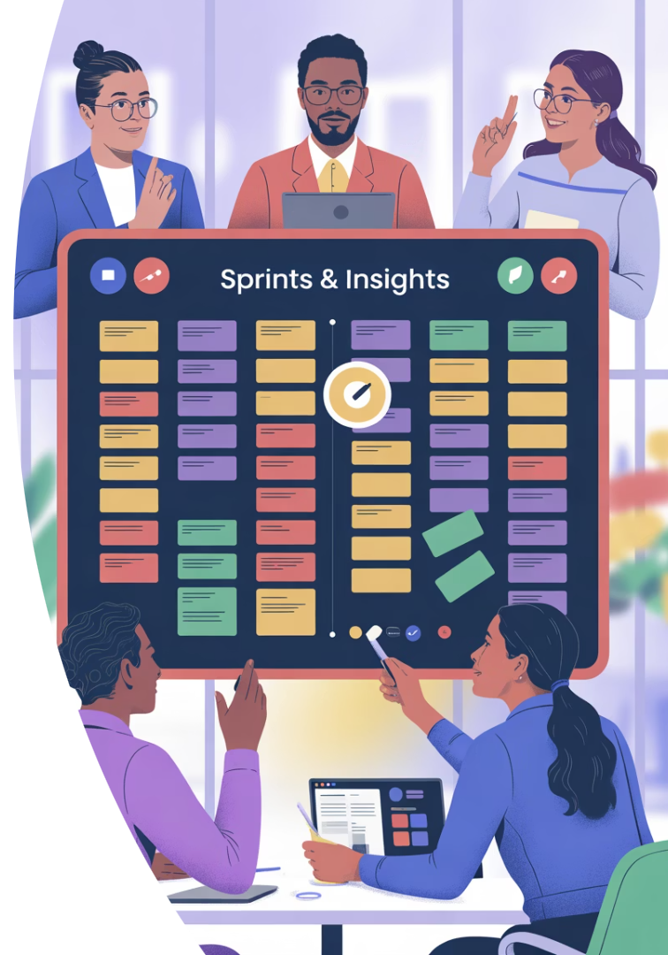
Virtual Ceremonies That Work
Daily Standups
Keep to 15 minutes. Use video to maintain connection. Consider asynchronous formats for teams across many time zones.
Sprint Planning
Use screen sharing to review the backlog. Collaborative estimation tools help reach consensus on story points.
Retrospectives
Digital whiteboards enable anonymous feedback. Virtual sticky notes encourage honest reflection on team performance.
Demos
Record demonstrations for stakeholders who cannot attend. Use feature flags to show work-in-progress safely.

Slide 10




Tool Selection Strategy
Assess Team Needs
Identify communication and workflow gaps
Evaluate Integrations
Ensure tools work together seamlessly
Consider Learning Curve
Balance powerful features with ease of adoption
Measure Impact
Track productivity improvements after implementation

Slide 11



Building Trust Remotely
Collaborative Problem-Solving
Virtual Team Building
Knowledge Sharing
Use digital whiteboards for brainstorming. Shared creativity builds stronger connections between team members.
Schedule regular non-work activities. Online games and virtual coffees create personal connections across distances.
Rotate presentation duties for tech talks. Sharing expertise builds respect and camaraderie among team members.

Slide 12




Cross-Time Zone Collaboration
Map Time Zones
Create a visual representation of everyone's working hours. Identify and maximize overlap periods for synchronous work.
Rotate Meeting Times
Share the burden of off-hours meetings fairly. No single region should always adjust their schedule.
Document Everything
Maintain detailed notes and recordings. Team members should never miss critical information due to time differences.
Plan Handoffs
Structure work to flow across time zones. Clear status updates enable seamless transitions between regions.

Slide 13
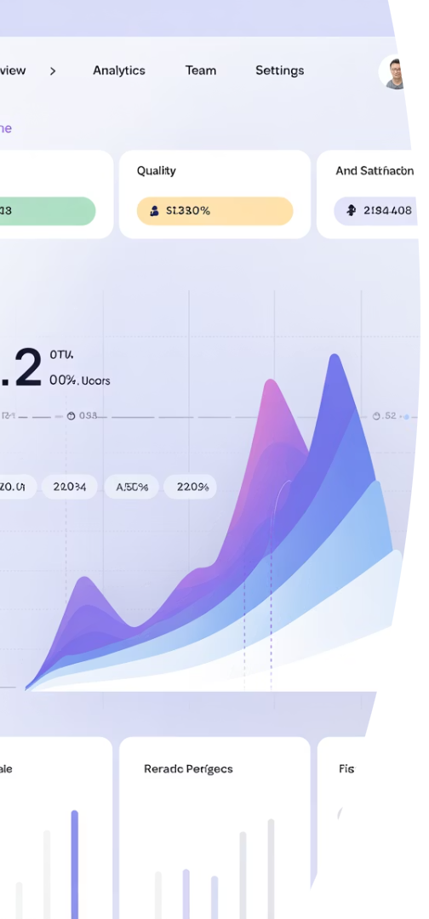
Measuring Distributed Team Success
Metric
Purpose
Tool
Cycle Time
Measure work completion efficiency
Jira, EazyBI
Team Velocity
Track delivery predictability
Jira, Azure DevOps
Quality Metrics
Monitor defect rates
SonarQube, Power BI
Team Health
Assess collaboration effectiveness
Surveys, Retrospectives
Lead Time
Evaluate idea-to-production speed
GitLab, GitHub Actions

Slide 14
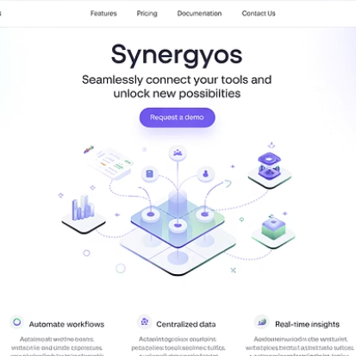
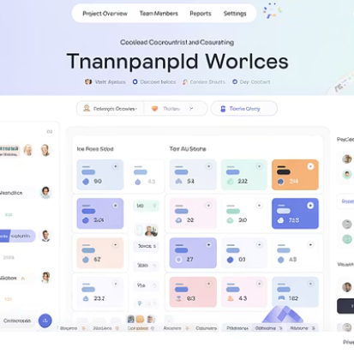

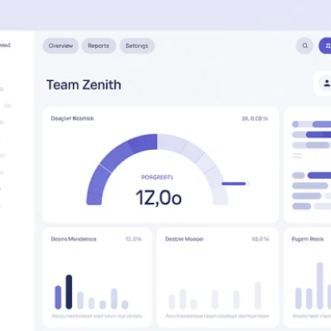
Key Takeaways
Choose tools that integrate seamlessly. Prioritize transparency in all aspects of work. Balance synchronous and asynchronous communication. Measure success with meaningful metrics.
With the right tools and intentional practices, distributed Agile teams can achieve exceptional results across any distance.

