Slide 1
Managing Microsoft Dynamics 365 CRM Implementation Projects
Successful CRM implementations require thoughtful planning, stakeholder alignment, and disciplined execution. Follow these proven tips to navigate your Dynamics 365 implementation journey.
kW
by Kimberly Wiethoff

Slide 2
Start With Clear Business Objectives
Define Measurable Goals
Focus on Business Outcomes
Start with the "why" before technology. Identify specific metrics you aim to improve.
Increase lead conversion? Improve customer retention? Standardize service workflows?
Align With Company Strategy
Ensure CRM goals support broader organizational objectives and growth plans.

Slide 3
Engage All Stakeholders Early
Marketing
Sales
Campaign management and lead nurturing requirements
Pipeline management and opportunity tracking needs
Customer Service
Case management and customer communication needs
Finance
IT
Reporting and revenue tracking needs
System integration and security requirements

Slide 4
Document Current Processes
Identify Existing Workflows
Map out how teams currently work before configuring the system.
Pinpoint Pain Points
Document specific challenges the CRM implementation should address.
Spot Automation Opportunities
Identify manual processes that can be streamlined through Dynamics 365.
Assess Data Requirements
Determine what data needs migration, cleaning, or restructuring.

Slide 5
Prioritize User Experience
User Adoption
The ultimate goal of good UX design
Intuitive Workflows
Processes that match how teams actually work
Familiar Terminology
Using business-specific language throughout
Clean Interface
Simple, uncluttered screens focused on essential functions
A technically perfect CRM will fail if users resist it. Conduct user journey mapping and UI/UX workshops before go-live.

Slide 6
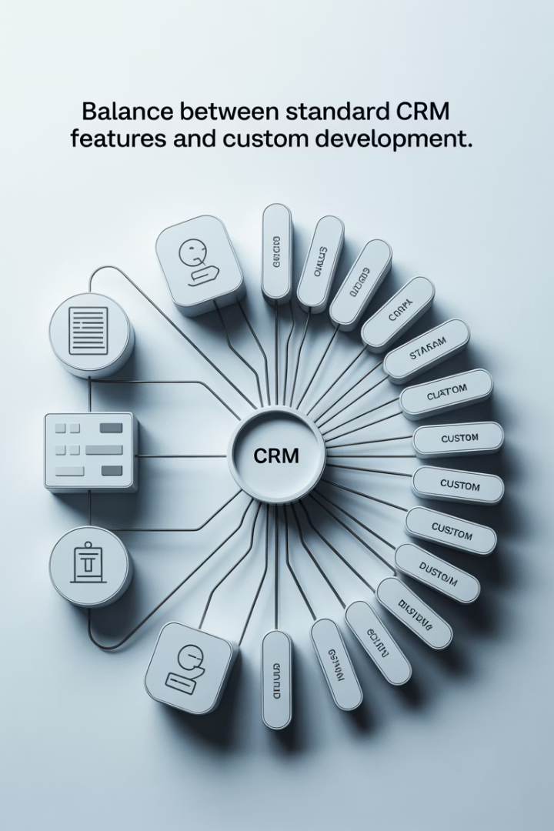
Avoid Over-Customization
Start With Out-of-Box Features
Risks of Over-Customization
Dynamics 365 offers robust functionality without customization. Leverage standard features first.
Higher maintenance costs
Upgrade complications
Extended implementation time
This approach minimizes technical debt and simplifies future upgrades.
User confusion
Support challenges

Slide 7
Plan a Phased Rollout
Phase 1: Core CRM
Lead & Opportunity Management
Basic account structure and pipeline visibility
Phase 2: Service
Case Management
Knowledge base and service workflows
Phase 3: Marketing
Marketing Automation
Campaign management and lead scoring
Phase 4: Analytics
Advanced Reporting
Power BI dashboards and predictive insights

Slide 8
Clean and Migrate Data Carefully
Assess Current Data
Evaluate quality, completeness, and relevance of existing data.
Clean and Standardize
Remove duplicates, standardize formats, and enrich incomplete records.
Map to New Schema
Create field mapping between old systems and Dynamics 365.
Test Migration
Run test migrations and validate data integrity before final transfer.

Slide 9
Invest in Training
Role-Based Training
Multiple Formats
Develop specialized training paths for different user roles and departments.
Offer live sessions, recorded videos, and self-paced guides to accommodate all learning styles.
Champions Network
Ongoing Support
Identify and empower internal champions who can support peers and gather feedback.
Provide quick reference guides, knowledge base, and help desk resources for continuous assistance.

Slide 10
Change Management Strategies
Communicate Value
Share benefits for individuals and teams
Address Resistance
Identify and resolve concerns proactively
Provide Resources
Offer training, guides, and support channels
Celebrate Wins
Recognize adoption and improvement milestones

Slide 11
Strategic System Integration
Microsoft 365
Power BI
Email, calendar, and document integration with Outlook, Teams, and SharePoint
Business intelligence and advanced reporting capabilities
ERP Systems
Custom Applications
Financial data integration with Business Central or Finance & Operations
Integration with industry-specific tools using Power Platform

Slide 12
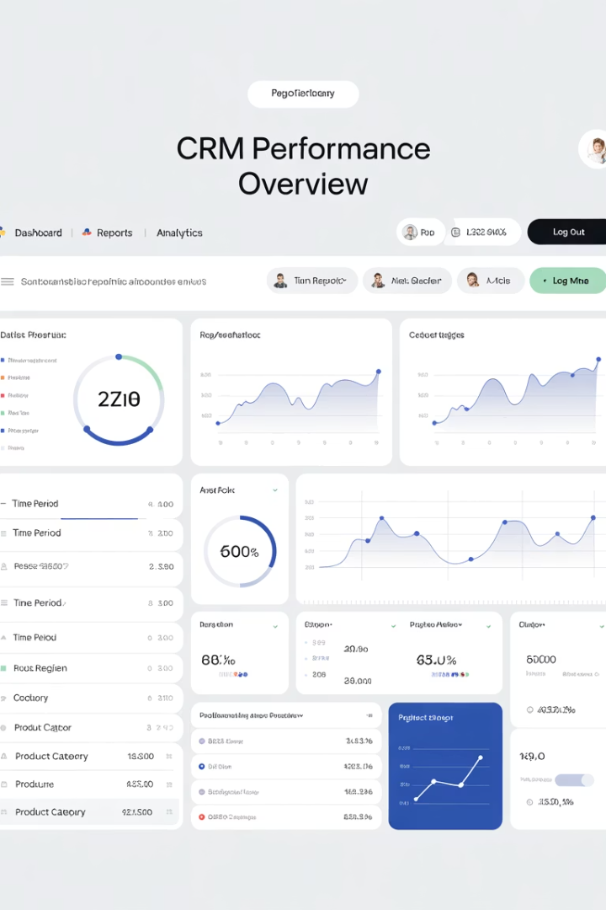
Measure Success Post-Go-Live
42%
28%
Adoption Rate
Productivity Gain
Daily active users vs. total users
Time saved on key processes
15%
36%
Lead Conversion
Case Resolution
Improvement in sales performance
Faster customer service delivery

Slide 13
Common Implementation Challenges
Challenge
Solution Approach
User Resistance
Enhanced change management and demonstrating personal benefits
Data Quality Issues
Thorough data cleaning and validation processes
Scope Creep
Strict change control and phased implementation approach
Integration Complexity
Start with critical integrations, test thoroughly
Performance Issues
Regular optimization and load testing

Slide 14
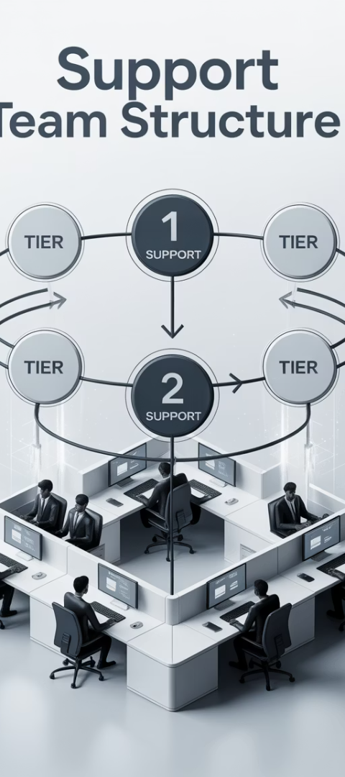
Building a Support Model
Establish Support Tiers
Create Level 1 (basic), Level 2 (advanced), and Level 3 (development) support structure.
Define clear escalation paths between support levels.
Document Solutions
Build knowledge base of common issues and resolutions.
Create troubleshooting guides for support staff.
Continuous Improvement
Analyze support tickets to identify system enhancement opportunities.
Schedule regular updates based on user feedback and needs.

Slide 15
Key Takeaways for Success
Define Clear Business Goals
Begin with strategic objectives, not technical features.
Focus on User Adoption
Success depends on users embracing the system.
Take a Phased Approach
Implement gradually to manage complexity and risk.
Measure and Optimize
Track KPIs to demonstrate value and guide improvements.

Slide 16
Final Thoughts
A successful Dynamics 365 CRM implementation isn't just about standing up software—it's about driving transformation in how your business engages with customers. As a project manager, your role is to align people, processes, and technology to deliver a solution that's adopted, scalable, and measurable.
With clear goals, strong change management, and disciplined execution, you'll not only go live—you'll go live successfully.

