Slide 1
Navigating Microsoft Azure Certifications: Your Path to Cloud Mastery
Welcome to your comprehensive guide to Microsoft Azure certifications. As cloud computing continues to transform the technology landscape, having the right certification can significantly boost your career opportunities and demonstrate your expertise to employers. This presentation will help you understand the Azure certification ecosystem and choose the path that best aligns with your career goals and current skill level.
kW
by Kimberly Wiethoff

Slide 2
Why Azure Certifications Matter
Validate Your Skills
Career Advancement
Certifications provide concrete proof of your technical knowledge and hands-on experience with Azure services, helping you stand out in the job market.
Azure-certified professionals earn 15-20% more than their non-certified peers, with opportunities spanning across industries as cloud adoption grows.
Industry Recognition
Microsoft certifications are globally recognized credentials that demonstrate your commitment to professional development and technical excellence.

Slide 3
Azure Certification Pathway Overview
Expert Level
Advanced architecture and specialized skills
Associate Level
Role-based technical implementation
Fundamentals Level
Core concepts and cloud basics
Microsoft has structured their Azure certifications into three distinct tiers, creating a clear progression path for IT professionals. Each level builds upon knowledge gained in previous certifications, allowing you to gradually advance your expertise from cloud fundamentals to specialized roles requiring deep technical knowledge.

Slide 4
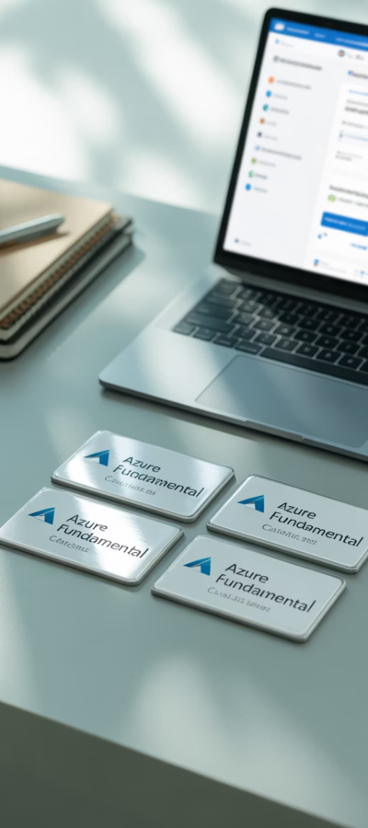
Fundamentals Certifications
AZ-900: Azure Fundamentals
AI-900: AI Fundamentals
Cloud concepts, core services, security, pricing, and support options for beginners and non-technical stakeholders.
AI workloads, machine learning basics, computer vision, natural language processing, and Azure AI services.
DP-900: Data Fundamentals
SC-900: Security Fundamentals
Core data concepts, relational and non-relational data models, and analytics workloads in Azure.
Security, compliance, and identity concepts across Microsoft's cloud services and solutions.

Slide 5
AZ-900: Azure Fundamentals Deep Dive
Perfect Starting Point
Exam Format
Preparation Resources
Ideal for beginners with no prior cloud experience, business stakeholders, and sales professionals who need to understand Azure's capabilities.
40-60 questions in multiple formats, including multiple choice, drag-and-drop, and scenario-based questions. 85 minutes to complete with a passing score of 700/1000.
Microsoft Learn offers free training modules, practice assessments, and virtual training days to help you prepare effectively for the exam.

Slide 6
Associate Level Certifications
AZ-104: Administrator
Manage Azure subscriptions, secure identities, implement storage solutions, configure virtual networks, and backup resources.
AZ-204: Developer
Develop solutions using Azure compute, storage, security, and API integration, plus implement authentication and secure cloud data.
Security Series (SC-200/300/400)
Specialized certifications for security operations, identity management, and information protection across Microsoft services.
DP-203: Data Engineer
Design and implement data storage, processing, and security using Azure data services like Synapse Analytics and Data Factory.

Slide 7
Expert Level Certifications
AZ-305: Azure Solutions Architect Expert
AZ-400: DevOps Engineer Expert
This premier certification validates your ability to design end-to-end solutions across compute, network, storage, security, and deployment. It requires understanding infrastructure components, application architecture, data flow, and business requirements.
This certification demonstrates your ability to combine people, processes, and technologies to continuously deliver valuable products and services. Key focus areas include:
Implementing CI/CD pipelines
Managing infrastructure as code
Prerequisites include: experience with Azure administration, DevOps processes, and governance, plus recommended AZ-104 knowledge.
Implementing security and compliance
Configuring monitoring solutions

Slide 8
Specialty Certifications
AZ-720: Support Engineer for Connectivity
Troubleshoot hybrid cloud networking issues, VPN connections, ExpressRoute, and cross-cloud connectivity scenarios.
AZ-500: Security Engineer
Implement security controls, manage identity, protect networks, secure data, and respond to security incidents across Azure environments.
AZ-800/801: Windows Server Hybrid
Administer and integrate Windows Server environments with Azure services and implement hybrid identity solutions.

Slide 9
Certification Costs and Time Investment
Certification Level
Exam Cost (USD)
Preparation Time
Validity Period
Fundamentals
$99
20-40 hours
Does not expire
Associate
$165
80-120 hours
1 year
Expert
$165 per exam
120-200 hours
1 year
Specialty
$165
80-120 hours
1 year
Costs can vary by region and currency. Microsoft often offers exam discounts through training events and learning challenges. Time investment depends on your existing knowledge and hands-on experience with Azure.

Slide 10
Choosing Your Certification Path
Assess your current role
Consider your current responsibilities and immediate career goals
Identify target skills
Determine what skills will add the most value to your career
Map to certification
Select the certification that best aligns with your career path
Create a study plan
Develop a realistic timeline with dedicated study sessions

Slide 11
Recommended Paths by Role
New to Cloud
Start with AZ-900 to build foundational knowledge, then choose a role-based associate certification based on your career interests.
System Administrator
Begin with AZ-104 to validate your ability to manage Azure resources, then consider AZ-500 for security specialization or AZ-305 to advance to architecture.
Developer
The AZ-204 certification is your primary target, followed by AZ-400 to demonstrate DevOps expertise or AI-102 if you're working with AI solutions.
Data Professional
Start with DP-900 for fundamentals, then pursue DP-203 to validate your data engineering skills on the Azure platform.

Slide 12
Preparation Best Practices
Join Study Communities
Take Practice Exams
Get Hands-On Experience
Use official Microsoft practice assessments and third-party practice tests to familiarize yourself with the exam format and identify knowledge gaps before your actual exam.
Connect with other certification candidates through Microsoft Learn Community, Reddit's r/AzureCertification, or study groups to share resources, ask questions, and stay motivated.
Use Official Microsoft Resources
Create a free Azure account and implement the concepts you're learning. Real-world practice is crucial for understanding how services work together and developing troubleshooting skills required for the exams.
Microsoft Learn provides free, interactive training modules specifically designed for each certification. These modules include hands-on exercises in sandbox environments where you can practice without a subscription.

Slide 13
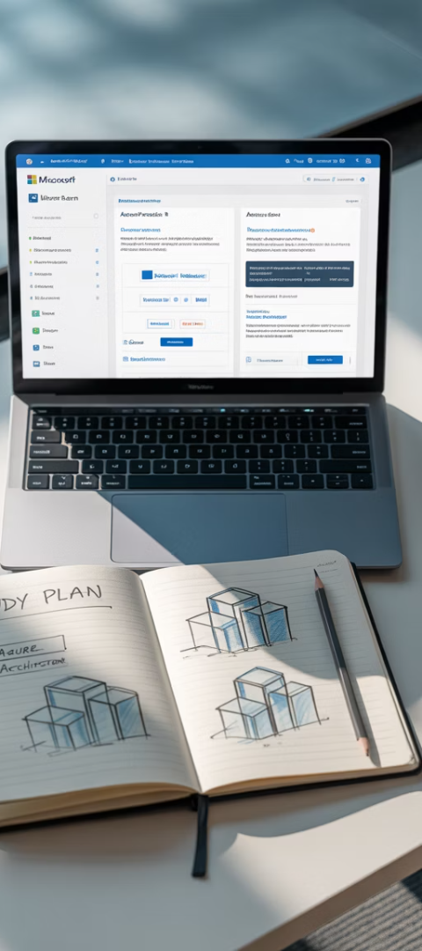
Next Steps and Resources
100+
30+
$0
Free Training Modules
Certification Options
Azure Free Account
Spanning fundamentals, associate, expert, and specialty levels to match your career goals
Includes 12 months of popular free services plus $200 credit for the first 30 days
Available on Microsoft Learn covering all certification areas with guided hands-on exercises
Ready to start your Azure certification journey? Visit the Microsoft Learn platform to access free training paths tailored to each exam. Schedule your exam through the Microsoft Certification Dashboard, where you can also view available discounts and special offers. Remember that consistent practice and hands-on experience with Azure services are key to certification success.

