Slide 1


AI Won't Replace Program Managers—But AI-Enabled Program Managers Will Replace Everyone Else
Kimberly Wiethoff, MBA, PMP, PMI-ACP
Artificial Intelligence is reshaping how organizations plan, execute, and govern complex programs. Capabilities that once demanded hours of manual effort can increasingly be completed in minutes—raising an urgent question across our profession: will organizations eventually need fewer program managers?
The competitive divide won't be between humans and machines. It will be between professionals who know how to work effectively with AI and those who don't.
#ArtificialIntelligence #AILeadership #ProgramManagement #ProjectManagement #AITransformation #DigitalTransformation #PMO #AIGovernance #AgenticAI #PredictiveAnalytics #EnterpriseTransformation #TechnologyLeadership #ExecutiveLeadership #FutureOfWork #Leadership

Slide 2
The Traditional Program Management Model Is Changing
For decades, program managers have spent a significant percentage of their time collecting and organizing information—gathering updates, reconciling schedules, chasing action items, and consolidating data so executives can understand what is happening. All of that work has value. But much of it is also highly administrative.
AI is beginning to change that equation. Imagine a program environment where Jira, Azure DevOps, ServiceNow, financial systems, and meeting transcripts are analyzed continuously—and your day begins with a prioritized view of what requires attention:
Schedule & Dependencies
Risk & Resources
Decisions & Stakeholders
Milestones showing early signs of slippage and dependencies likely to affect critical-path activities
Risks whose probability is increasing and resource constraints developing across multiple initiatives
Unresolved decisions, incomplete actions, and stakeholders whose priorities may be drifting out of alignment
The program manager's role doesn't disappear. The starting point for the work changes. Instead of discovering what happened, we spend more time determining what should happen next.

Slide 3
AI Handles Data. Leaders Provide Direction.
What AI Can Do
What That Unlocks for You
Summarize large volumes of project information
Identify patterns and anomalies across data sources
Generate executive summaries from raw updates
Extract decisions and actions from meeting transcripts
Flag risks and missing information automatically
Execute multi-step workflows and escalate exceptions
Enterprise programs generate enormous amounts of information. Traditionally, program managers have served as human integration engines. AI is exceptionally well-suited to that aggregation work—which frees program managers to redirect their attention toward work that creates greater value.
The question becomes: What could you accomplish if you recovered five to ten hours every week currently spent compiling, formatting, reconciling, and chasing information?
That time could be invested in stakeholder conversations, scenario planning, risk mitigation, team development, and solving the problems that actually threaten business outcomes. That is where program managers create value that technology alone cannot provide.

Slide 4



The Role Is Evolving from Reporting to Decision Intelligence
For years, the most common question asked of a program manager was "What's the status?" Program managers became experts at answering it—green, yellow, red; on track, at risk, delayed. But executives increasingly need something more valuable than a description of what has already happened. They need decision intelligence.
Status Reporting
Analytical Insight
Decision Intelligence
Describing what has already happened: milestones missed, budget versus actual, planned versus completed
AI identifies patterns, surfaces anomalies, and models potential outcomes across complex program data
The program manager synthesizes data, applies judgment, and recommends: "Here's what I recommend and why."
AI can identify patterns and analyze scenarios. But data alone doesn't make a decision. Someone still needs to understand business context, challenge assumptions, and navigate organizational implications. That is the program manager of the future.

Slide 5
AI Makes Great Program Managers Even Better
One of the biggest misconceptions surrounding AI is that access to information is equivalent to experience. It isn't. AI can process millions of data points faster than any human. But program leadership requires much more than processing information.
Organizational Trust
Contextual Judgment
Human Leadership
AI doesn't walk into a steering committee where two senior leaders have competing priorities and create alignment without damaging either relationship
AI doesn't recognize unwritten organizational rules or understand why a technically correct solution may be organizationally impossible
AI doesn't build trust with a team that has experienced failure, or inspire people through a difficult transformation
Experienced program managers develop something extremely valuable over time: Judgment. We learn when a "green" status isn't really green. We learn when a small issue signals a much larger problem. AI can provide another source of intelligence. Experience determines what we do with it.

Slide 6

Predictive Leadership Is the Next Competitive Advantage
Traditional program management has historically been retrospective—focused on explaining what happened and why. AI creates an opportunity to move toward predictive leadership.
Retrospective
Predictive
"We missed the milestone. Here's why."
"Our indicators suggest a high probability of missing the milestone six weeks from now. Here are the three factors driving it and the actions I recommend today."
Imagine knowing which projects are beginning to slip before deadlines are missed. Imagine identifying resource constraints weeks before they affect delivery. The program manager moves from reporter of outcomes to predictor and influencer of outcomes.

Slide 7
From Reactive Risk Management to Continuous Risk Intelligence
Traditional risk registers often depend on people manually identifying risks and remembering to update them—resulting in a static document reviewed periodically rather than a living representation of program uncertainty. AI can help create a more dynamic approach by continuously analyzing signals across your program environment.
Recurring Dependency Mentions
Vendor Date Drift
Defect Volume Increase
A vendor's delivery dates have moved repeatedly, signaling a pattern rather than a one-time delay
Defect volumes are increasing while testing capacity is simultaneously decreasing
The same dependency has appeared in three consecutive meetings without resolution
Resource Bottleneck
Historical Pattern Match
Several teams depend on the same scarce technical resource across parallel workstreams
Similar programs historically experienced problems under comparable conditions
None of these signals automatically mean the program will fail. But they give the program manager something incredibly valuable: earlier visibility. And in complex enterprise programs, earlier visibility means more options.

Slide 8
AI Can Strengthen Governance—If We Govern AI
How AI Strengthens Governance
Questions Program Leaders Must Now Answer
Monitors compliance and flags policy exceptions
Identifies missing documentation automatically
Evaluates whether stage-gate activities have occurred
Summarizes audit evidence and improves portfolio transparency
Tracks governance requirements across multiple programs
Who is accountable for AI-generated recommendations?
How do we validate AI outputs before executive decisions?
How are AI decisions documented and audited?
When must a human remain in the decision loop?
How do we detect bias, hallucinations, or inaccurate outputs?
What happens when an AI agent acts incorrectly?
AI governance is quickly becoming part of enterprise governance. Future program managers won't simply need to know how to use AI—they'll need to know how to use it responsibly.

Slide 9
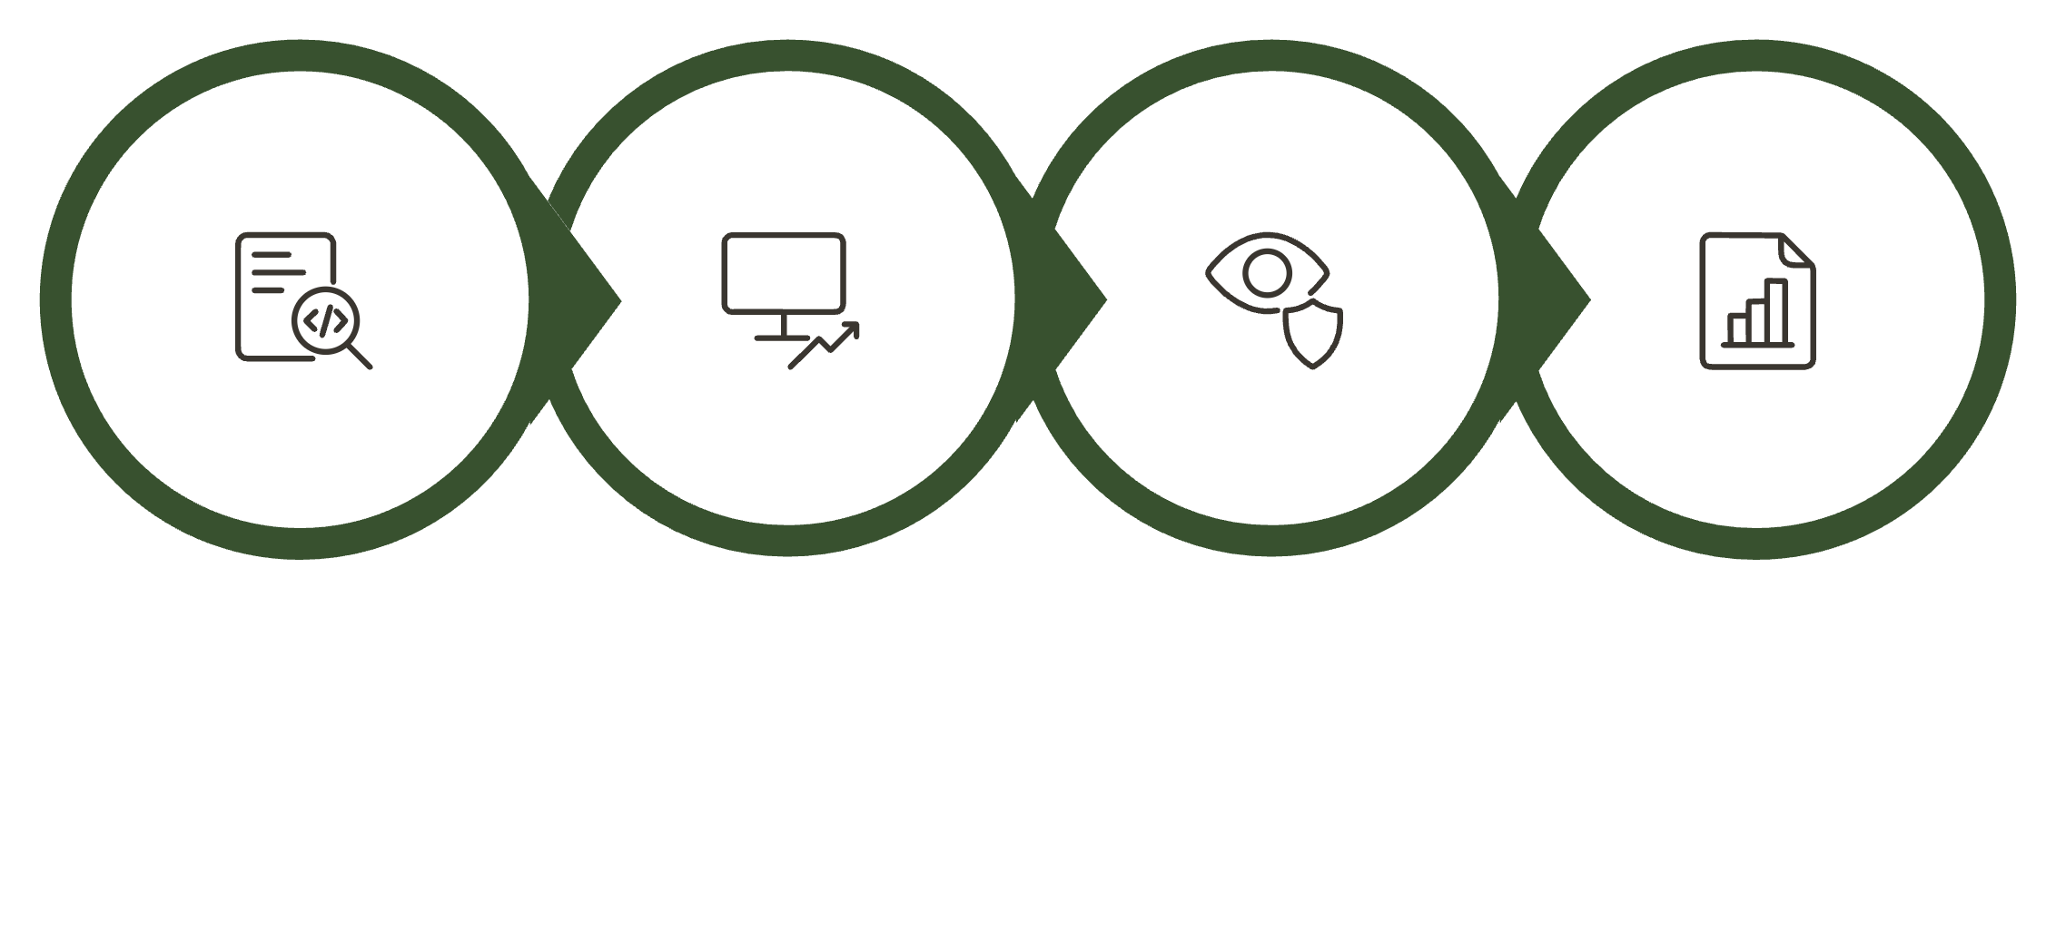
AI Agents Will Change the Program Management Operating Model
Generative AI copilots are only the beginning. The next major shift is agentic AI—systems capable of performing multi-step tasks with increasing levels of autonomy. Rather than just answering questions, AI agents take action across systems.
Analyze
Act
Monitor
Report
The program manager of tomorrow may coordinate not only human teams, vendors, executives, and business stakeholders—but also a collection of specialized AI agents. This creates an entirely new leadership challenge requiring a critical capability: knowing what should be automated, what should be augmented, and what must remain human-led.

Slide 10
The Skills That Matter Most Are Changing
As AI automates more administrative work, the capabilities that distinguish exceptional program managers become increasingly human. Technical fluency still matters—program managers should understand what AI can and cannot do. But the differentiating capabilities are fundamentally about leadership.
Stakeholder Leadership
Strategic Thinking
Critical AI Judgment
Build executive trust, influence without authority, navigate organizational complexity, and facilitate difficult decisions under uncertainty
Connect technology investments to business strategy, challenge assumptions, and balance speed, innovation, governance, and risk
Evaluate AI-generated recommendations critically and make informed decisions with incomplete or imperfect information
AI doesn't make leadership less important. It makes leadership more visible. When administrative work becomes easier to automate, a program manager's value is measured not by how efficiently they produce the report—but by what they do with the information.

Slide 11
What Does an AI-Enabled Program Manager Look Like?
Being AI-enabled doesn't mean occasionally using ChatGPT to summarize meeting notes. It means intentionally integrating AI into your program management operating model—and maintaining accountability for every output.
Accelerate and Synthesize
Validate and Challenge
Remain Accountable
Use AI to analyze large volumes of project data, identify risk patterns, generate scenario analyses, and prepare executive communications faster than manual approaches allow
Don't simply accept what AI produces. Validate it, provide missing context, recognize when the model lacks information, and know when human judgment must override an automated recommendation
The goal isn't to become dependent on AI. It's to use AI as a force multiplier for human capability—while remaining fully accountable for program outcomes

Slide 12
The Productivity Gap Will Become Difficult to Ignore
Program Manager A
Program Manager B
Spends several hours each week manually consolidating status reports, reviewing spreadsheets, preparing meeting summaries, tracking actions, and searching through project documentation.
Uses AI to accelerate administrative work and redirects those hours toward stakeholder engagement, strategic analysis, risk mitigation, team coaching, and scenario planning.
Limited time for stakeholder engagement
Risk identification is mostly reactive
Capacity for strategic analysis is constrained
Scenario planning is infrequent
Identifies risks earlier and more consistently
Prepares executives with better decision intelligence
Evaluates more scenarios before decisions are made
Has capacity to think and lead strategically
Over one week, the difference may not appear dramatic. Over a year, it becomes significant—potentially hundreds of additional hours invested in higher-value work. Program Manager B isn't working harder. They are operating with greater leverage. And leverage compounds.

Slide 13
Organizations Must Evolve Too
The responsibility doesn't fall entirely on individual program managers. Organizations must create environments where responsible AI adoption can actually occur.
The Risk of Over-Restriction
What Responsible Enablement Looks Like
The Competitive Implication
Some organizations remain so concerned about AI-related risk that employees are prohibited from using even basic generative AI tools. Concerns around privacy, security, intellectual property, and compliance are legitimate. But avoiding AI entirely isn't a long-term strategy.
Organizations that create these guardrails will be able to innovate faster than those that simply say "Don't use AI." Responsible adoption requires both innovation and governance—not one at the expense of the other.
Approved enterprise AI platforms, clear acceptable-use policies, human-in-the-loop requirements, data classifications, auditability standards, AI literacy training, and defined accountability frameworks

Slide 14
Five Questions Every Program Manager Should Be Asking
You don't need to transform your entire operating model overnight. Start by identifying where AI could remove friction from the work you already perform.
01
02
03
Where does repetitive work consume the most time?
Where do you gather information instead of analyzing it?
Which risks do you usually discover too late?
Those activities are often strong candidates for automation—status consolidation, action tracking, documentation preparation
AI may help accelerate synthesis and pattern recognition, freeing you for higher-value interpretation
Those may be strong opportunities for predictive monitoring and early-warning signal detection
04
05
What information do executives repeatedly ask for?
Which decisions require human judgment no matter what?
AI-enabled dashboards, summaries, or decision-support tools may significantly improve executive visibility
Those are the areas where your leadership must remain firmly in control—know them and protect them

Slide 15
The Best Program Managers Will Learn to Partner with AI
The question isn't whether AI will become part of program management. It already has. The better question is: How will we choose to use it?
Identify Risks Earlier
Improve Forecasting
Use AI to surface signals before they become problems, shifting from reactive to proactive program leadership
Model alternative scenarios and analyze historical patterns to make better predictions about outcomes
Strengthen Governance
Reclaim Strategic Time
Automate compliance monitoring, documentation tracking, and audit evidence while maintaining human accountability
Automate low-value administrative work to create more time for stakeholder relationships and strategic thinking
The greatest opportunity isn't using AI to perform the same work slightly faster. It's using AI to fundamentally change where program managers spend their time and attention.

Slide 16





The Future PMO Will Measure Outcomes, Not Activity
If AI can automate reporting, status consolidation, documentation, and portions of governance, PMOs must reconsider how they define their value. The future PMO cannot simply be the organization that collects templates and asks teams for weekly status updates. It must become an intelligence and decision-support function.
Portfolio Value & Strategic Alignment
Predictive Risk & Investment Prioritization
Ensuring investments connect directly to business strategy and measurable outcomes
Surfacing risks early and directing capital toward highest-value initiatives
Organizational Readiness & Resource Optimization
AI Governance & Executive Decision Support
Ensuring the organization has capacity, capability, and alignment to execute at scale
Establishing responsible AI frameworks while delivering intelligence that leaders need to act
AI can automate process. The PMO must provide purpose.

Slide 17
Final Thoughts
Technology has transformed program management many times. We have moved from spreadsheets to integrated platforms, from static reports to real-time dashboards, from manual tracking to automated workflows, and from traditional delivery to Agile, DevOps, and now AI-enabled program management. AI is simply the next evolution—but it may be one of the most significant.
What Won't Change
What Will Change
Successful transformation has always been driven by people who make better decisions, anticipate problems, align organizations, and deliver meaningful outcomes
The tools available to those leaders—and the speed at which the gap grows between those who adopt them responsibly and those who don't
AI won't replace great program managers.
But AI-enabled program managers are going to raise the standard for everyone else.

Slide 18
