Slide 1
The Future of Remote Work in 2025
Remote work is no longer a trend—it's a permanent shift. As we enter 2025, the workplace continues to evolve in response to technology, employee expectations, and global labor dynamics.
kW
by Kimberly Wiethoff

Slide 2
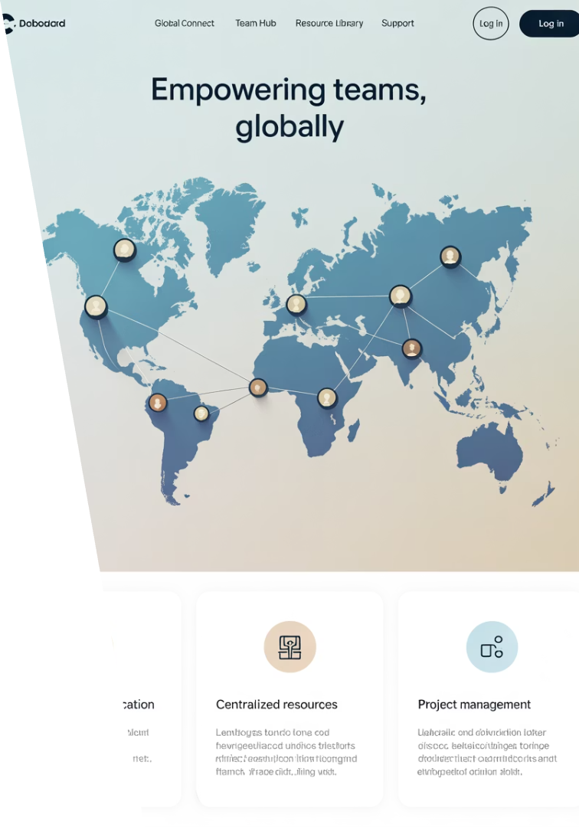
Remote-First Is the New Default
Company Transition
Global Pioneers
Organizations are moving from remote-friendly to remote-first operations.
GitLab, Automattic, and Zapier have long championed this model.
Talent Focus
Expect less emphasis on geography and more focus on outcomes.

Slide 3
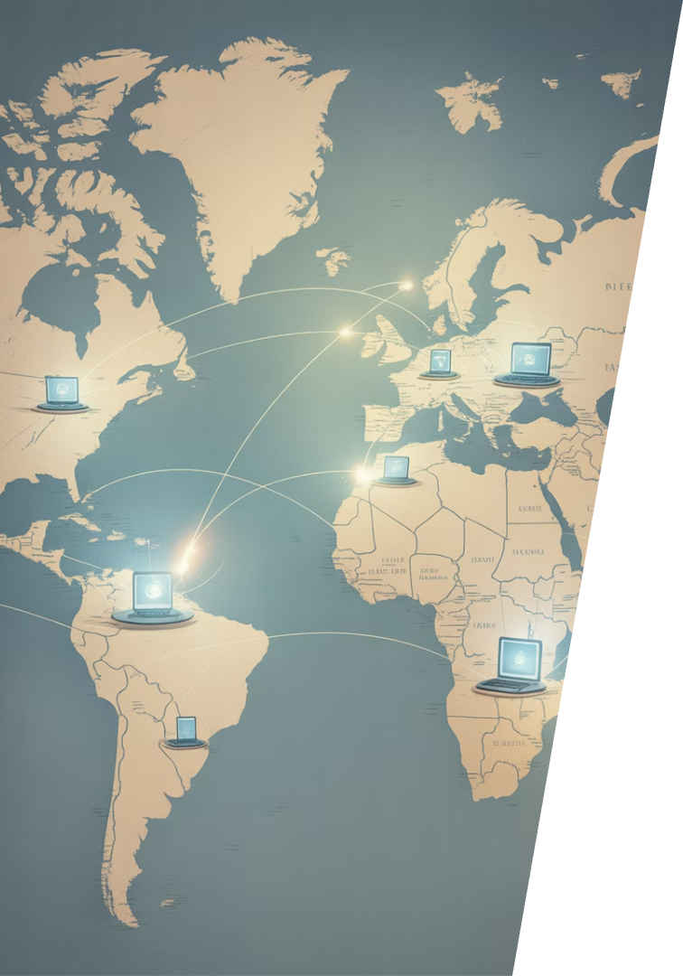
Global Talent Pools Are Expanding
25%
90M
Digital Job Growth
Total Roles
Expected increase in global digital jobs by 2030
Projected digital positions worldwide by 2030
24/7
Global Coverage
Companies can now operate across all time zones

Slide 4
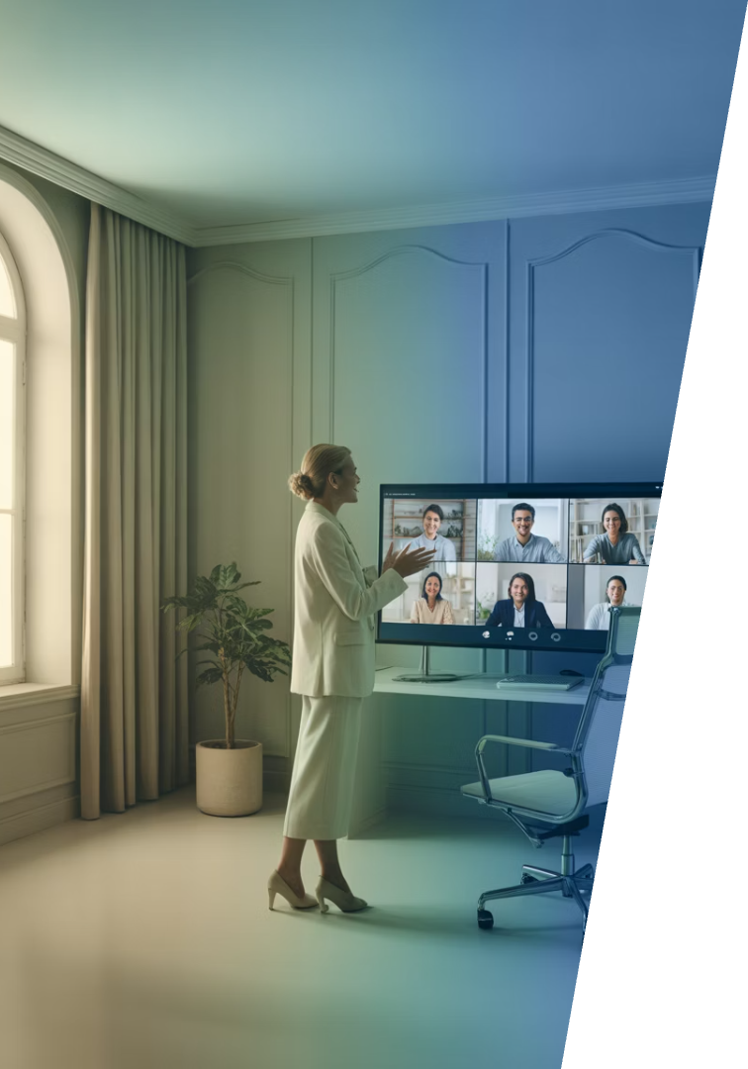
Staying Competitive Globally
Build International Skills
Develop expertise that translates across borders and cultures.
Focus on Communication
Master clear writing and effective virtual presentations.
Highlight Cross-Cultural Experience
Showcase your ability to work with diverse teams worldwide.

Slide 5
The Evolving Hybrid Model
Remote Work
Office Time
Full flexibility in location and schedule
Strategic in-person collaboration
Continuous Adaptation
Team Choice
Regular evaluation of what's working
Employees decide what works best

Slide 6
Adapting to Hybrid Success
Asynchronous Work
Clear Documentation
Learn to collaborate effectively across time zones without requiring immediate responses.
Document your work thoroughly so others can follow your process and decisions.
Tool Mastery
Become proficient in both virtual and in-person collaboration tools.

Slide 7
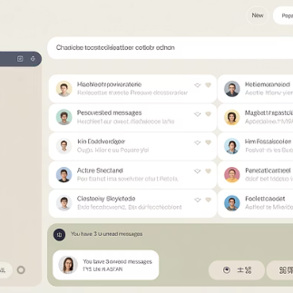
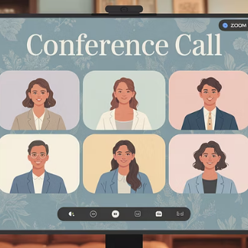
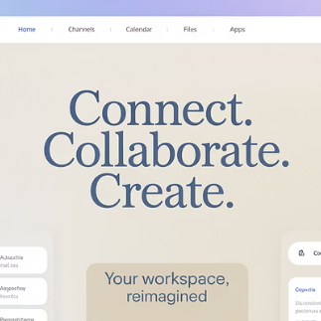
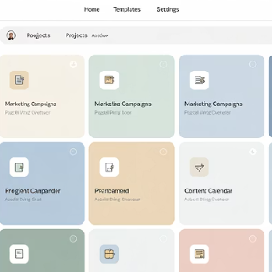
Digital Fluency: The Essential Skill
In 2025, proficiency in digital collaboration tools isn't optional—it's foundational. The modern remote worker must navigate digital workspaces efficiently.

Slide 8
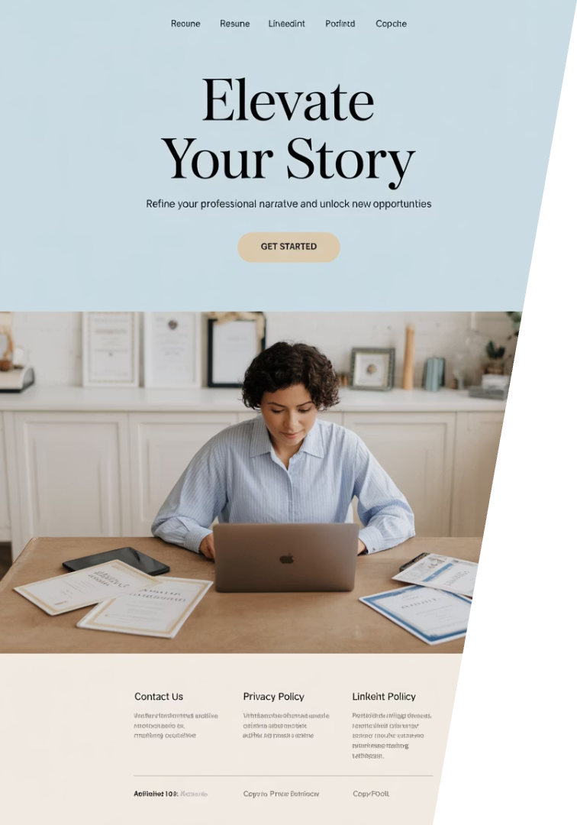
Showcasing Your Digital Skills
Update Resume
Highlight your tech stack familiarity
Enhance LinkedIn
Feature digital collaboration achievements
Get Certified
Earn credentials in key platforms
Document Outcomes
Show how you've used tools successfully

Slide 9
Remote Culture and Mental Health
Virtual Team-Building
Companies are investing in creative ways to build connections remotely.
Mental Health Days
Dedicated time off for wellbeing is becoming standard practice.
Camera-Optional Meetings
Reducing video fatigue while maintaining connection.

Slide 10
Maintaining Wellbeing Remotely
Work-Life Boundaries
Set clear start and end times
Team Engagement
Stay connected through regular check-ins
Advocacy
Champion healthy remote practices

Slide 11
Virtual Career Growth
Performance Metrics
Promotions based on measurable outcomes rather than office presence.
Digital Portfolio
Online showcase of your work and achievements.
Cross-Functional Projects
Visibility through collaboration across departments.
Regular Feedback
Proactive requests for input on your performance.

Slide 12
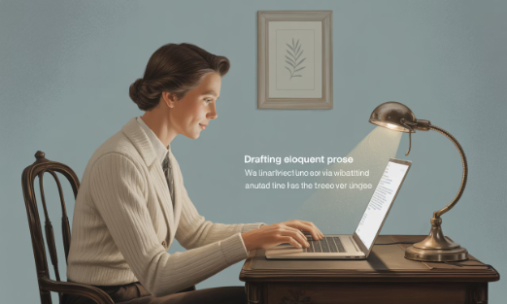
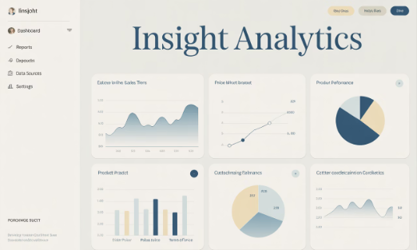
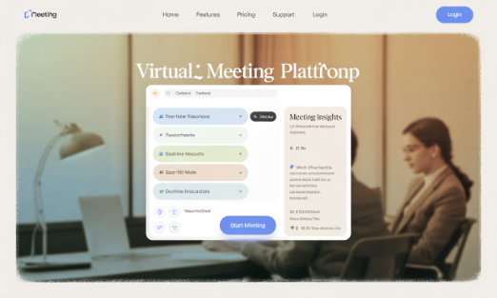
AI Transforming Remote Work
AI Writing Assistants
Automated Analysis
Meeting Enhancement
Tools like ChatGPT and Notion AI help draft emails, reports, and documentation faster.
AI systems process data and generate insights that previously required hours of human work.
AI tools transcribe, summarize, and even prepare meeting materials automatically.

Slide 13
The Return-to-Office Tension
Company Mandates
Employee Resistance
Some organizations in finance, tech, and media are requiring office returns.
Workers value flexibility and autonomy gained during remote work.
Talent Migration
Negotiation
Top performers may move to companies with remote-first cultures.
A new balance is forming between operational goals and worker expectations.

Slide 14
The Future Is Flexible
Global
Work transcends geographic boundaries
Digital
Technology enables new collaboration methods
Flexible
Adaptability becomes the core strength
Evolving
Continuous change defines the new normal

Slide 15
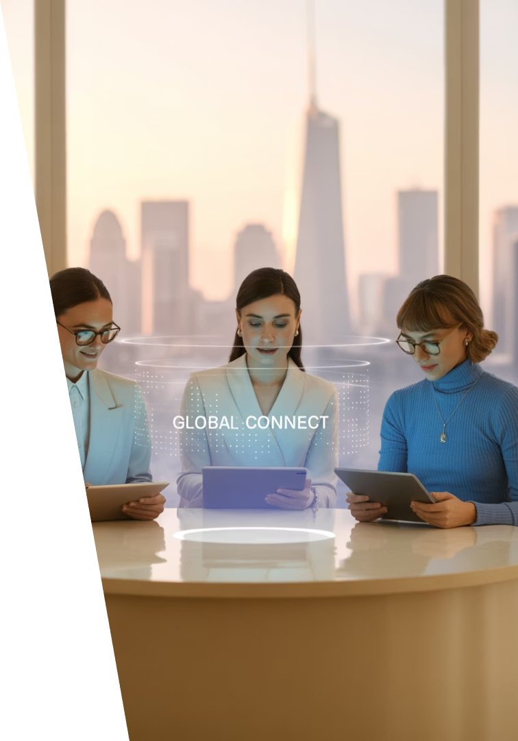
Final Thoughts
The future of work is not just remote—it's flexible, digital, global, and constantly evolving. In 2025, successful professionals won't just adapt to remote work—they'll embrace it, master it, and help shape what's next.
Whether you're job hunting, leading a team, or simply planning your next move, staying ahead of remote work trends will empower you to navigate the workplace of the future with confidence.

