Slide 1

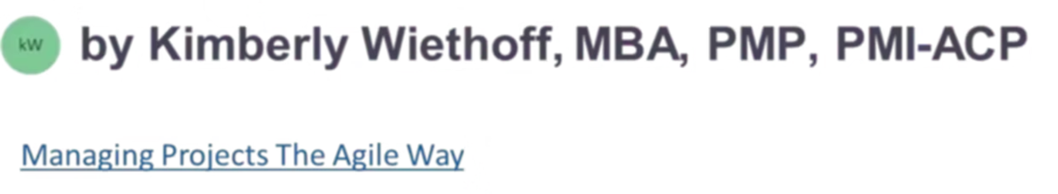
Soft Skills for Project Management Success
While technical skills help project managers measure progress and analyze performance, soft skills are essential for leading teams, managing relationships, and ensuring project success. Project managers spend 75-90% of their time communicating, making interpersonal abilities crucial to their effectiveness.
This presentation explores the critical soft skills every project manager needs, from communication and collaboration to time management and problem-solving. Through real-world examples and practical applications, we'll discover how these skills create the foundation for successful project delivery.
#SoftSkills #ProjectManagement #CommunicationSkills #EmpathyInLeadership #ActiveListening #TeamCollaboration #LeadershipDevelopment #EmotionalIntelligence #Adaptability #ConflictResolution #StakeholderEngagement #EffectiveCommunication #TeamMotivation #AgileLeadership #ProjectSuccess

Slide 2





The Power of Effective Communication
Active Listening
Understanding what others are saying prevents misunderstandings and builds trust with team members and stakeholders.
Empathy
Putting yourself in others' shoes helps you understand not just what they're saying, but why they're saying it.
Clarity
Speaking clearly and articulating your message ensures information is properly understood and acted upon.
Building Processes
Creating dedicated communication channels allows team members to get updates and find answers efficiently.

Slide 3










Creating an Effective Communication Plan
Clear Purpose
Define communication goals
Project Needs Outline
Document requirements
Communication Needs
Identify channels and methods
Timelines & Frequency
Establish schedules
Roles & Responsibilities
Assign accountability
A well-structured communication plan serves as the foundation for project success. By clearly defining these five elements, project managers can ensure information flows effectively between all stakeholders, preventing misunderstandings and keeping everyone aligned with project goals.

Slide 4





Communication in Action: A Real Example
Situation
A business analyst reported that a developer wasn't meeting requirements. The developer preferred to work quickly, leading to misunderstandings.
Task
Address the communication breakdown between team members that prevented them from meeting acceptance criteria.
Action
The PM ensured requirements were clearly stated, had the developer document questions in the story, and facilitated backlog grooming meetings to clarify expectations.
Result
Both team members improved their collaboration - the developer slowed down to understand requirements, while the analyst prepared better documentation.

Slide 5

The Art of Team Collaboration
Cultural Foundation
Open Communication
Collaboration is influenced by company culture. Some organizations provide formal training while others assume it will happen naturally. Project managers must foster an environment where collaboration is valued and expected.
Team members should maintain open lines of communication and share information others need to complete their tasks. Achieving team consensus when establishing goals and methods is critical for project success.
Recognition & Accountability
Recognizing contributions when team members play key roles builds motivation. Addressing challenges as a team and creating space for acknowledging mistakes strengthens collaborative bonds.

Slide 6




Collaboration in Action: A Real Example
Situation
A software developer reported an impediment during the daily standup that was blocking progress on their assigned tasks.
Task
The impediment needed to be removed quickly to allow the developer to continue with sprint assignments.
Action
The project manager invited knowledgeable team members to stay after the standup to discuss potential solutions to the impediment.
Result
The team collaboratively brainstormed multiple solutions, helping the developer move forward more quickly than if they had worked alone.

Slide 7







Mastering Time Management
Establishing Timelines
Work Breakdown
Setting realistic deadlines, milestones, and goals for the project and individual tasks
Defining activities, sequencing them logically, and estimating required resources
2
Team Focus
Prioritization
Keeping team members focused on overall goals and individual responsibilities
Organizing tasks with highest ROI at the top and others in order of importance

Slide 8



Time Management in Action: A Real Example
Situation
Developers were constantly interrupted by stakeholder meetings
Task
Create 3-4 hours of uninterrupted focus time daily
Action
PM limited meetings to mornings and had developers block afternoon calendars
The result was transformative: developers gained focused work time, the project manager served as a buffer by attending stakeholder meetings and relaying information during daily standups, and the team became more productive and capable of meeting sprint objectives.

Slide 9





Problem Solving & Analytical Thinking
Problem Solving
Decision Making
Analytical Thinking
Forecasting
Identifying issues and developing effective solutions before they impact the project timeline
Evaluating options and making timely choices that keep the project moving forward
Anticipating potential issues and preparing contingency plans before problems arise
Breaking down complex situations into manageable components for clearer understanding

Slide 10

Project Estimation in Action: A Real Example
Result
Action
Management received realistic time estimates showing the deadline couldn't be met for all stories, allowing for prioritization of the most important tasks.
Task
The PM implemented story sizing using the Fibonacci scale, compared stories within each size category, broke down larger stories, and established best/worst case completion times.
Situation
Develop estimated completion times for backlog stories to provide management with realistic projections.
An Agile team was working on unestimated stories with no clear completion timeline, while facing pressure from management to meet a specific deadline.

Slide 11
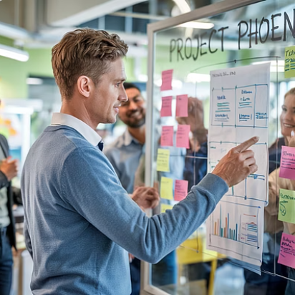

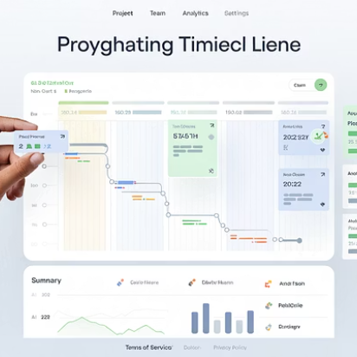

Embracing Flexibility
Managerial flexibility is the ability to adapt to changing demands and unexpected challenges. Project managers must regularly assess situations with all stakeholders, explore alternative approaches, and identify potential risks. With limited resources and no project buffers, PMs must make subtle schedule adjustments when unexpected events occur.
Flexibility requires involving stakeholders in situation analysis, thoroughly investigating alternative methods, and identifying and mitigating risks for all approaches. Change is inevitable in project management, and adapting to it requires both personal and procedural flexibility.

Slide 12
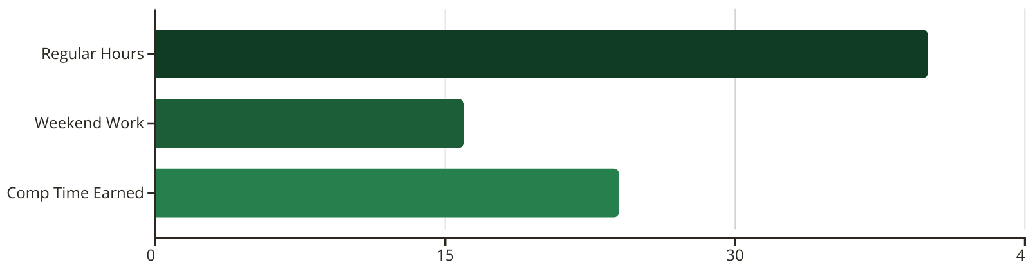
Flexibility in Action: A Real Example
When a team faced a tight deadline working at full capacity, the project manager had to negotiate a solution. After management confirmed the deadline couldn't be extended, the PM secured approval for compensatory time off for team members willing to work weekends.
This flexible approach allowed the team to meet the strict deadline while ensuring they would be rewarded with time off afterward. The project was delivered on time, management was able to move forward, and team members could schedule days off when convenient, demonstrating how flexibility and compromise can resolve seemingly impossible project constraints.

Slide 13



Additional Essential Soft Skills
Conflict Resolution
Emotional Intelligence
Leadership & Motivation
Project managers must address conflicts quickly and fairly to maintain team harmony and productivity. This requires understanding different perspectives, finding common ground, and facilitating constructive conversations that lead to resolution.
Understanding and managing your own emotions while recognizing and influencing others' emotions is crucial for building trust. Project managers with high EQ can navigate complex interpersonal dynamics and create psychological safety within teams.
Effective project managers inspire their teams through clear vision, consistent coaching, and recognition of achievements. They understand individual motivations and create environments where team members can thrive and develop professionally.

Slide 14

Bringing It All Together: The Complete PM Toolkit
75-90%
5
3+
Communication Time
Core Skill Areas
Supporting Skills
Communication, collaboration, time management, problem-solving, and flexibility
Conflict resolution, emotional intelligence, and leadership
Percentage of a PM's time spent communicating according to PMBOK
Successful project management requires balancing technical expertise with well-developed soft skills. By cultivating these abilities, project managers can lead teams effectively, navigate challenges, and consistently deliver successful projects that meet stakeholder expectations.
Remember that soft skills development is an ongoing journey. Continuously seek feedback, practice self-awareness, and look for opportunities to strengthen these crucial abilities throughout your project management career.

