Slide 1
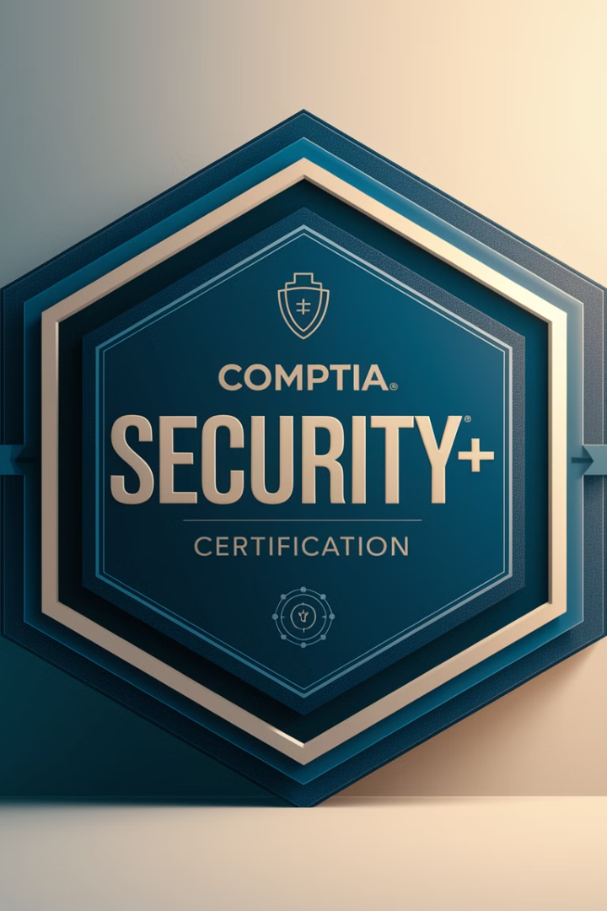
How to Study for and Pass the CompTIA Security+ Certification Exam
The CompTIA Security+ (SY0-701) certification is a highly recognized entry-level cybersecurity credential, validating essential security skills for IT professionals. Whether you're entering the cybersecurity field or enhancing your IT security knowledge, passing the Security+ exam requires strategic preparation and a solid understanding of security principles. This presentation will guide you through what to expect on the exam, how to prepare effectively, and tips to ensure your success.
kW
by kimberly Wiethoff

Slide 2
Understanding the Security+ Exam
1
Exam Overview
2
Vendor-Neutral Certification
The SY0-701 exam consists of 90 questions (multiple-choice and performance-based) with a 90-minute time limit. The passing score is 750 on a scale of 100-900, and the exam cost is approximately $392 USD, with discounts available for students and military personnel.
Security+ is a vendor-neutral certification covering essential cybersecurity concepts. It tests your ability to identify, assess, and mitigate security threats, making it an excellent starting point for IT and security professionals.
3
Key Skills Tested
The exam evaluates your knowledge of core security principles, threat identification, risk assessment, and mitigation strategies. It's designed to validate foundational security skills essential for IT professionals.

Slide 3
Security+ Exam Domains
Threats, Vulnerabilities, and Mitigations (22%)
General Security Concepts (12%)
2
Attack types, vulnerabilities, risk assessments, and threat intelligence.
Core security principles, least privilege, threat actors, and cybersecurity frameworks.
1
Security Architecture (18%)
3
Network security, cloud security, and system hardening.
Security Program Management and Governance (20%)
5
Security Operations (28%)
4
Security policies, risk management, compliance (GDPR, HIPAA, NIST).
Incident response, forensics, logging, SIEMs, and security controls.

Slide 4
Study Materials for Security+
CompTIA Security+ Study Guide
Official Exam Objectives
Professor Messer's Videos
Comprehensive books by CompTIA or Darril Gibson covering all exam domains in detail.
Download the official objectives to understand exactly what's tested on the exam.
Free, high-quality YouTube lectures explaining key Security+ concepts.
Jason Dion's Practice Exams
Available on Udemy, great for realistic practice and identifying weak areas.

Slide 5
Creating a Study Plan
Weeks 1-2: Foundations
1
Read a Security+ study guide and take notes. Watch Professor Messer's videos for an overview of key concepts.
2
Weeks 3-4: Deep Dive into Domains
Focus on encryption, network security, and threat mitigation. Use CompTIA labs or set up a virtual lab. Take chapter quizzes to reinforce learning.
Weeks 5-6: Practice Tests & Weak Areas
3
Take full-length practice exams to simulate test conditions. Review wrong answers and revisit weak areas. Memorize key ports, encryption standards, and security frameworks.
4
Weeks 7-8: Final Review & Exam Readiness
Revisit hard topics like PKI, SIEMs, and incident response. Take final mock exams until consistently scoring 85% or higher. Review exam objectives to ensure full coverage.

Slide 6
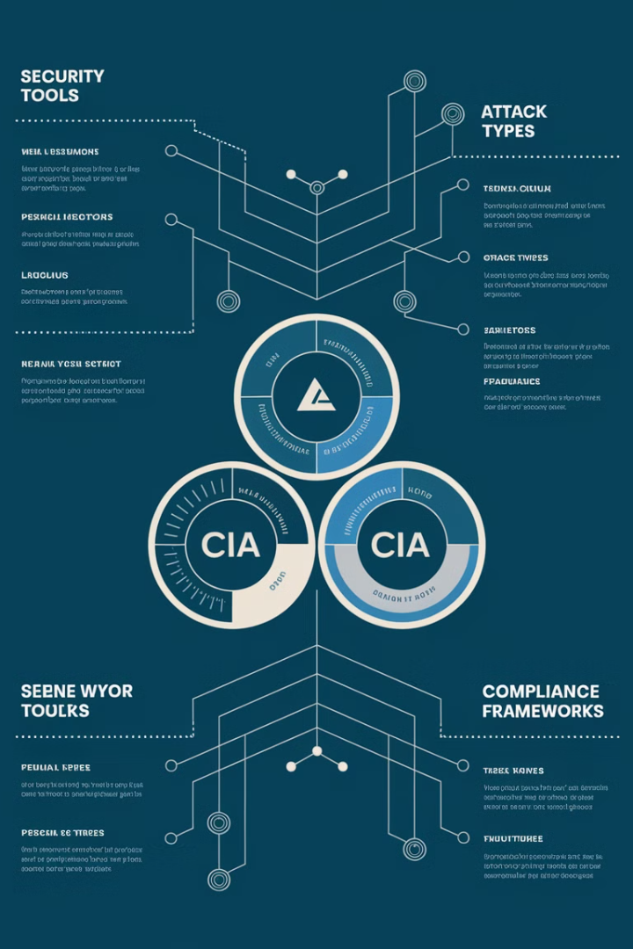
Mastering Key Security+ Concepts
CIA Triad
Understand the core principles of Confidentiality, Integrity, and Availability in information security.
Security Tools
Know the functions and applications of firewalls, IDS/IPS, SIEM, encryption protocols, and VPNs.
Attack Types
Learn about various attack methods including phishing, malware, social engineering, SQL injection, and XSS.
Compliance Frameworks
Understand key frameworks like NIST, ISO 27001, HIPAA, and GDPR and their implications for security.

Slide 7
Hands-On Practice for Security+
Virtual Labs
Network Analysis
Vulnerability Scanning
Set up a virtual lab environment using tools like VirtualBox or VMware. Install Kali Linux, Windows Server, and other relevant operating systems to practice security configurations and attacks.
Use Wireshark to capture and analyze network traffic. Practice identifying normal vs. suspicious packets, and understand common protocols in depth.
Familiarize yourself with tools like Nmap and OpenVAS. Conduct vulnerability scans on test systems and interpret the results.

Slide 8
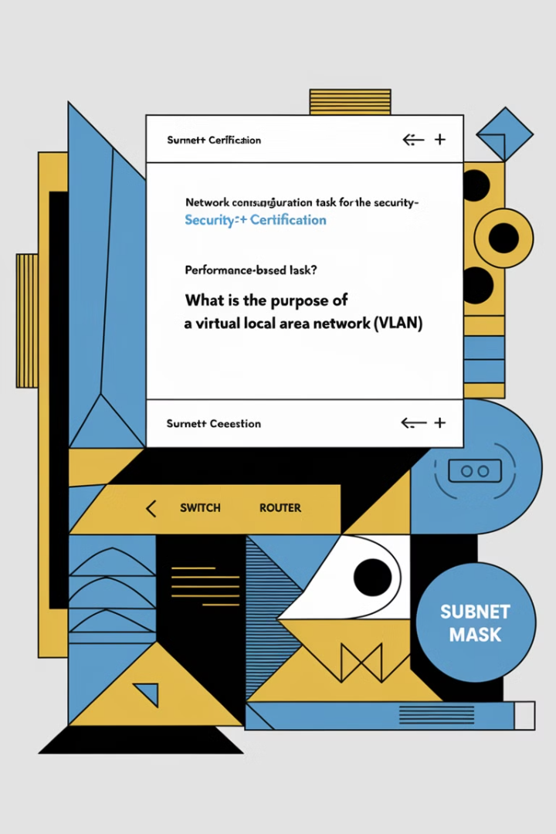
Performance-Based Questions (PBQs)
Understand PBQ Format
PBQs are scenario-based questions that test your ability to perform tasks in simulated environments.
Practice Common Scenarios
Familiarize yourself with configuring firewalls, analyzing log files, and setting up secure network topologies.
Time Management
PBQs often appear at the beginning of the exam. Plan to spend about 5-10 minutes on each PBQ to ensure you have enough time for multiple-choice questions.
Read Instructions Carefully
Pay close attention to the specific requirements of each PBQ. Misunderstanding the task can lead to lost points.

Slide 9
Exam Day Strategy
Tackle PBQs First
Answer performance-based questions at the beginning to avoid time pressure later.
Use Process of Elimination
If unsure about an answer, eliminate obviously incorrect options to improve your odds.
Manage Time Wisely
Aim to spend less than one minute per question. Mark difficult ones to revisit later if time allows.
Think Like an Analyst
For action-based questions, choose the most secure and least disruptive option.

Slide 10
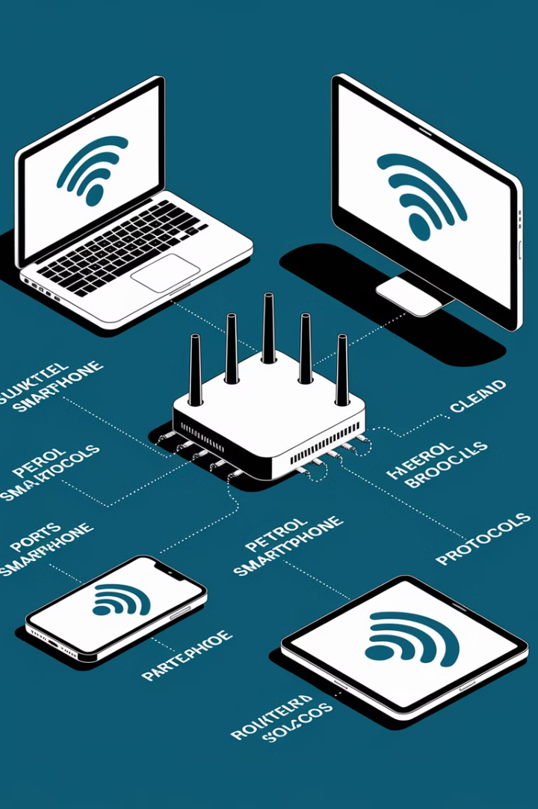
Key Ports and Protocols
Port
Protocol
Description
22
SSH
Secure Shell for remote access
80
HTTP
Unencrypted web traffic
443
HTTPS
Encrypted web traffic
3389
RDP
Remote Desktop Protocol
53
DNS
Domain Name System
Memorizing common ports and protocols is crucial for the Security+ exam. Understanding their functions and security implications will help you answer questions related to network security and troubleshooting.

Slide 11
Encryption and PKI
Asymmetric Encryption
Symmetric Encryption
Uses public and private key pairs. Slower but solves key distribution issues.
Uses the same key for encryption and decryption. Fast but key distribution can be challenging.
2
1
Hashing
One-way function to create a fixed-size output. Used for integrity checking and password storage.
3
5
Certificate Authorities
Digital Signatures
Trusted entities that issue and manage digital certificates in a PKI system.
4
Combines hashing and asymmetric encryption to provide authentication and non-repudiation.

Slide 12
Incident Response Process
Preparation
Develop incident response plans and conduct regular training exercises.
Identification
Detect and analyze events to determine if they constitute a security incident.
Containment
Isolate affected systems to prevent further damage or data loss.
Eradication
Remove the threat and restore systems to a known good state.
Recovery
Bring affected systems back online and monitor for any recurring issues.
Lessons Learned
Review the incident and update procedures to prevent similar future occurrences.

Slide 13
Risk Management
Risk Acceptance
1
Acknowledging and accepting the potential consequences of a risk.
Risk Mitigation
2
Implementing controls to reduce the impact or likelihood of a risk.
Risk Transfer
3
Shifting the risk to another party, often through insurance or outsourcing.
Risk Avoidance
4
Eliminating the risk by avoiding the activity that could cause it.
Understanding risk management strategies is crucial for the Security+ exam. You should be able to identify appropriate risk responses for various scenarios, considering factors like cost, feasibility, and organizational impact.

Slide 14
Career Benefits of Security+
Entry Point for Cybersecurity
Government and DoD Jobs
Security+ serves as an excellent foundation for starting a career in the growing field of cybersecurity.
The certification is a requirement for many Department of Defense and government positions.
Foundation for Advanced Certs
Industry Recognition
Security+ provides a strong base for pursuing more advanced certifications like CISSP or CEH.
The certification is widely recognized and valued in the IT and cybersecurity industries.

Slide 15
Final Thoughts and Next Steps
1
Consistent Study
Maintain a regular study schedule, focusing on understanding concepts rather than mere memorization.
2
Practice Hands-On Skills
Utilize labs and practical exercises to reinforce your theoretical knowledge with real-world applications.
3
Take Practice Exams
Regularly assess your readiness with practice exams, aiming for consistent scores of 85% or higher before scheduling the real exam.
4
Stay Current
Keep up with the latest cybersecurity trends and updates to the Security+ exam objectives.
With dedicated preparation and the right approach, you can successfully pass the Security+ exam on your first attempt. This certification will open doors to exciting opportunities in the cybersecurity field. Good luck on your Security+ journey!

