Slide 1

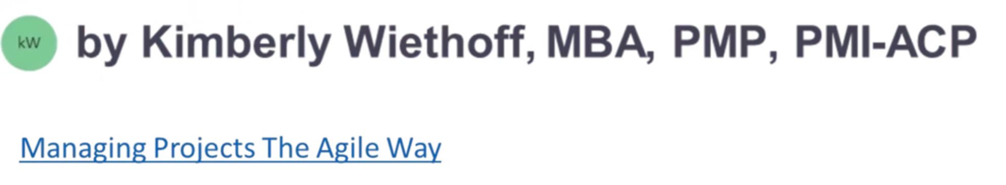
Foundations of Project Management: Essential Skills for Success
A comprehensive 2-day workshop designed to equip professionals with practical project management skills, applicable methodologies, and essential tools for successful project delivery.
#ProjectManagement #PMTraining #ProfessionalGrowth #AgileLeadership #BusinessTransformation #CareerDevelopment #LeadershipExcellence

Slide 2
Workshop Overview
1
2
3
Audience
Format
Outcomes
Professionals new to project management
Interactive 2-day workshop
Master core project management concepts
Blend of theory and hands-on exercises
Team leads or functional managers managing projects informally
Create essential project documentation
Real-world case studies and applications
Aspiring project managers seeking practical skills
Develop both predictive and adaptive approach skills
Templates and resources to implement immediately
Build confidence in leading projects effectively

Slide 3
Learning Objectives
By the end of this workshop, participants will be able to:
1
Define Project Fundamentals
Understand what constitutes a project and explain the crucial role of a project manager in driving successful outcomes.
2
Apply Core Processes
Implement essential project management processes across the entire project lifecycle, from initiation to closing.
3
Create Key Artifacts
Develop professional project documentation including charters, schedules, risk registers, and stakeholder maps.
4
Understand Agile Approaches
Explain the fundamentals of Agile methodologies and determine when to apply adaptive approaches to projects.
5
Demonstrate Leadership
Apply effective communication and leadership techniques that drive project success and team performance.

Slide 4
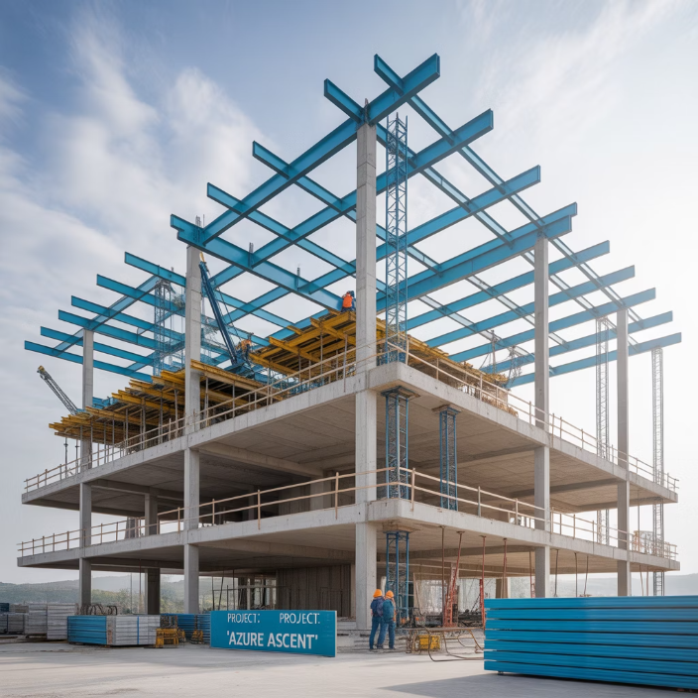
What is a Project?
A project is a temporary endeavor undertaken to create a unique product, service, or result. Understanding what makes something a project versus ongoing operations is fundamental to effective management.
Key Characteristics of Projects:
Defined beginning and end (temporary)
Creates something unique
Progressively elaborated
Projects are temporary with defined endpoints, unlike ongoing operations
Requires resources (people, time, money)
Has constraints and uncertainties

Slide 5




The Project Manager's Role
Orchestrator
Communicator
Coordinates team members, resources, and activities to achieve project objectives. Keeps all moving parts synchronized and working together harmoniously.
Ensures effective information flow among team members, stakeholders, and sponsors. Creates clarity around goals, progress, and expectations.
Balancer
Risk Manager
Manages competing constraints of scope, time, cost, quality, resources, and risk. Makes trade-off decisions to maintain project viability.
Identifies potential threats and opportunities, develops response strategies, and monitors risk events throughout the project lifecycle.
The most successful project managers blend technical knowledge with strong leadership and interpersonal skills. They adapt their approach based on project type, organizational culture, and team dynamics.

Slide 6





Project Lifecycle & Process Groups
Initiating
Define project purpose and objectives, secure authorization, identify stakeholders
Planning
Develop detailed roadmap: scope, schedule, budget, resources, risks, quality
Executing
Coordinate people and resources to implement the plan and produce deliverables
Monitoring & Controlling
Track progress, measure performance, identify variances, implement corrections
Closing
Formalize acceptance, document lessons learned, release resources

Slide 7

Project Approaches: Predictive vs. Adaptive
Predictive (Waterfall)
Adaptive (Agile)
Sequential phases with minimal overlap
Iterative cycles with frequent reassessment
Detailed upfront planning
Change control process for scope modifications
Progressive elaboration of details
Embraces change as a constant
Well-defined requirements at the start
Requirements evolve through collaboration
Formal documentation throughout
Minimal viable documentation
Best for: Construction, manufacturing, regulated industries, projects with clear requirements and low uncertainty
Best for: Software development, creative work, research, projects with unclear requirements or high uncertainty

Slide 8

Project Initiation: Setting the Foundation
Business Case
Project Charter
Stakeholder Analysis
Justification for the project
Formal authorization document
Identifying and understanding key players
Problem/opportunity statement
Project purpose and objectives
Cost-benefit analysis
High-level requirements
Power/interest grid
Alternative solutions considered
Assumptions and constraints
Engagement strategies
Key stakeholders
Communication preferences
Success criteria
Workshop Exercise: Participants will develop a project charter for a sample case study (product launch) that will be used throughout the remainder of the workshop.

Slide 9
Planning: Work Breakdown Structure
The Work Breakdown Structure (WBS) is a hierarchical decomposition of the total scope of work to be carried out by the project team to accomplish the project objectives and create the required deliverables.
WBS should be developed collaboratively with the team to ensure all work is identified and nothing is overlooked.
Key Benefits of the WBS:
Breaks complex projects into manageable components
Clarifies scope boundaries
Provides framework for schedule and budget development
Helps assign responsibility more clearly
Creates accountability at the work package level
The lowest level of the WBS represents work packages that can be scheduled, cost estimated, monitored, and controlled.

Slide 10
Project Planning: Scheduling Essentials
A well-developed schedule provides a roadmap for project execution, monitoring, and control. It communicates what work needs to be performed, which resources will perform it, and when activities should be completed.
Activity Definition & Sequencing
Duration Estimation
Schedule Development
Analogous estimating (based on similar past projects)
Critical path identification (longest sequence of activities)
Identify specific activities needed to produce deliverables
Parametric estimating (based on statistical relationships)
Resource leveling and optimization
Determine logical relationships between activities
Buffer/contingency allocation
Three-point estimating (PERT): (Optimistic + 4x Most Likely + Pessimistic) ÷ 6
Milestone identification
Define dependencies: Finish-to-Start, Start-to-Start, etc.

Slide 11

Risk Management: Anticipating the Unexpected
Effective risk management increases the likelihood of project success by identifying potential problems before they occur and implementing proactive response strategies.
Response Strategies:
For Threats: Avoid, Transfer, Mitigate, Accept
The Risk Management Process:
For Opportunities: Exploit, Share, Enhance, Accept
Identify Risks: Brainstorm potential threats and opportunities
Projects without formal risk management typically experience more problems, delays, and budget overruns.
Analyze Risks: Assess probability and impact
Plan Responses: Develop strategies for each significant risk
Implement Responses: Execute planned strategies
Monitor Risks: Track identified risks and identify new ones

Slide 12
Monitoring & Controlling: Keeping Projects on Track
Performance Measurement
Change Control
Status Reporting
Schedule variance (SV): Are we ahead or behind schedule?
Formal process for evaluating change requests
Regular cadence (weekly/biweekly)
Accomplishments vs. planned work
Cost variance (CV): Are we under or over budget?
Impact analysis on triple constraint
Issues requiring attention
Documentation of approved changes
Upcoming milestones and activities
Earned Value metrics: SPI, CPI, EAC, ETC
Risk status updates
Communication to stakeholders
Quality metrics: defects, customer satisfaction
Baseline updates
Monitoring and controlling is not about micromanagement, but rather about collecting the right data to make informed decisions and taking corrective actions when necessary. The process should be right-sized for the project's complexity and risk profile.

Slide 13
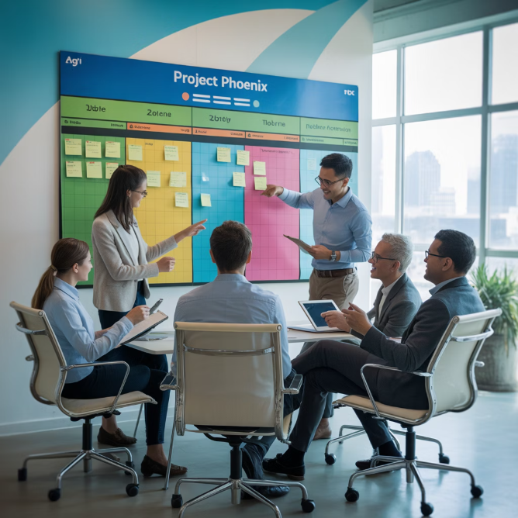

Agile Project Management
Agile approaches focus on delivering value early and often through iterative development, customer collaboration, and embracing change. The Agile Manifesto values:
Individuals and interactions over processes and tools
Working products over comprehensive documentation
Customer collaboration over contract negotiation
Responding to change over following a plan
Popular Agile Frameworks:
Many organizations use hybrid approaches, combining predictive and agile elements based on project needs and organizational context.
Scrum: Sprints, daily stand-ups, product backlog
Kanban: Visualize workflow, limit work in progress
Scrumban: Hybrid approach combining elements of both

Slide 14
Project Closure: Finishing Strong
Project closure is often rushed or neglected, but it's crucial for organizational learning and professional development. A proper closure ensures that all contractual obligations are met and resources are formally released.
Verify Scope Completion
Administrative Closure
Knowledge Transfer
Confirm all deliverables have been completed and accepted by stakeholders. Address any outstanding items or defects.
Complete all financial activities, close contracts, archive documentation, and release team members to other assignments.
Ensure operational teams have the necessary information, training, and documentation to maintain project deliverables.
Lessons Learned
Celebration
Conduct retrospective sessions to identify what went well, what didn't, and what could be improved for future projects.
Recognize team achievements and contributions. Celebrate successes to build morale and motivation for future projects.

Slide 15

Workshop Takeaways & Next Steps
Key Takeaways
Resources Provided
Project management is both a science (processes, tools) and an art (leadership, communication)
Project Charter template
WBS worksheet
Tailor your approach to the specific project needs and constraints
Risk Register template
Documentation should be "just enough" to support project success
Status Report template
Stakeholder engagement is critical throughout the project lifecycle
Stakeholder Analysis matrix
Continuous improvement comes from reflection and applying lessons learned
Recommended reading list
Next Steps
Apply these techniques to a small project within the next 30 days to reinforce learning and build confidence in your project management abilities.

