Slide 1

Magic ToDo: The AI-Powered Productivity Hack for Project Managers
A revolutionary approach to task management for agile teams and neurodivergent professionals
kW
by Kimberly Wiethoff

Slide 2





Today's Agenda
The Challenge
Why traditional to-do lists fall short
Magic ToDo Solution
How AI transforms task management
Benefits & Features
Why PMs and neurodivergent teams love it
Real-World Applications
Success stories and implementation tips

Slide 3

The Problem We All Face
Ever stared at a massive task thinking:
"Where do I even start?"
Whether you're managing projects, organizing sprints, or just planning your day, breaking down complex tasks can be paralyzing.

Slide 4

The Project Manager's Dilemma
In today's fast-paced agile environments, project managers face constant challenges:
Overwhelming to-do lists that paralyze action
Difficulty breaking down complex tasks
Balancing ceremonies with actual productivity
Supporting diverse thinking styles on teams
Translating big goals into concrete steps
Traditional task management often creates more cognitive load than it relieves

Slide 5
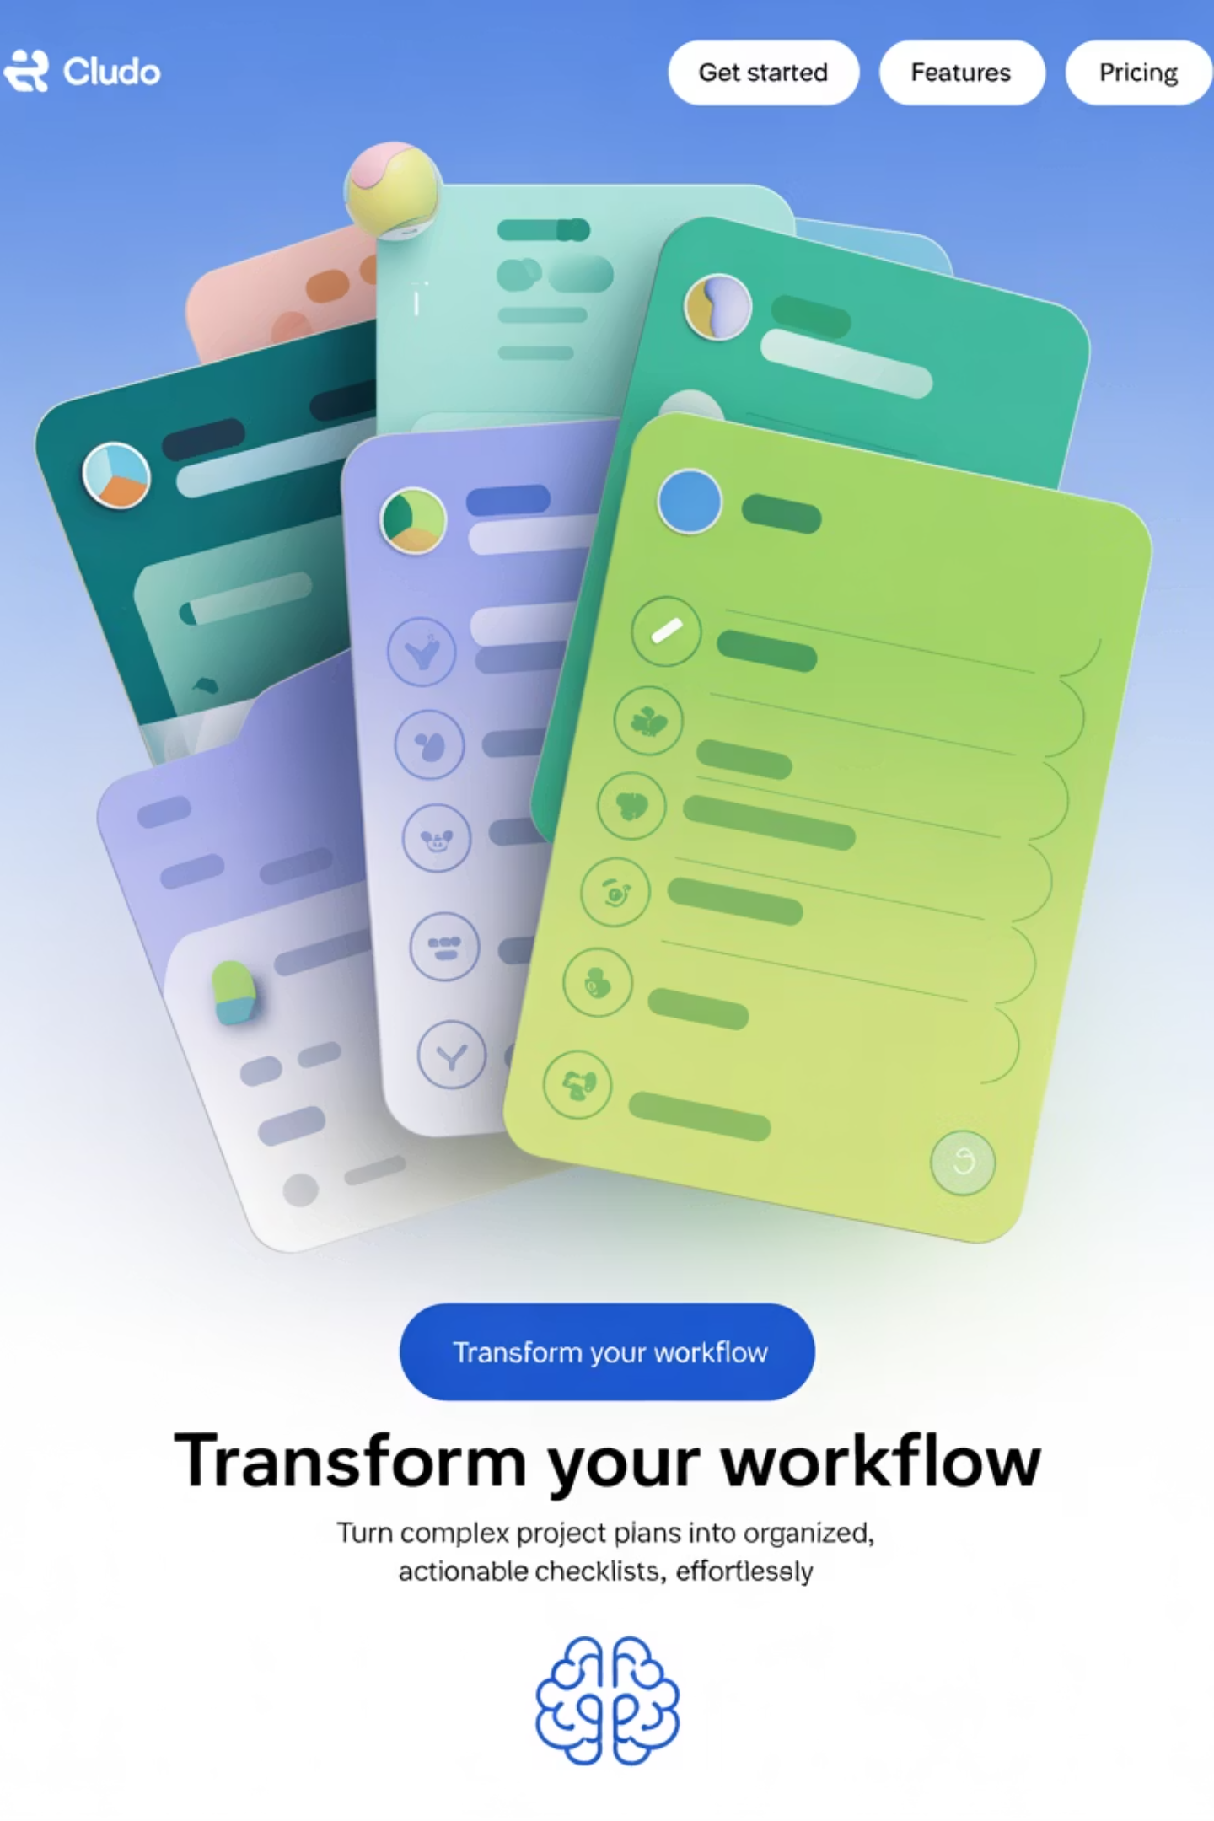



Introducing Magic ToDo by Goblin.tools
An AI-powered assistant designed to break down complex tasks into manageable steps
Especially powerful for neurodivergent brains but beneficial for anyone seeking clarity and momentum
AI-Powered
Leverages artificial intelligence to intelligently break down any task into logical steps
Accessibility-Focused
Originally built for neurodivergent users (ADHD, autism) but helpful for everyone
No Installation
Works entirely in your browser - no downloads, signups, or logins required

Slide 6

How Magic ToDo Works
Input Your Task
Type in a big, overwhelming task or project goal
AI Processing
Magic ToDo analyzes and structures the work
Get Actionable Steps
Receive a logical sequence of manageable subtasks
Customize & Refine
Adjust complexity, simplify language, or break down further

Slide 7

Detailed Instructions
1
Visit Goblin.Tools
Go to https://goblin.tools in any web browser
2
Select Magic ToDo
Click on "Magic ToDo" from the available tools
3
Enter Your Task
Type your overwhelming task into the input box
4
Adjust Difficulty
Slide left for high-level or right for detailed breakdown
5
Click the Magic Wand
Watch as AI transforms your task into actionable subtasks

Slide 8
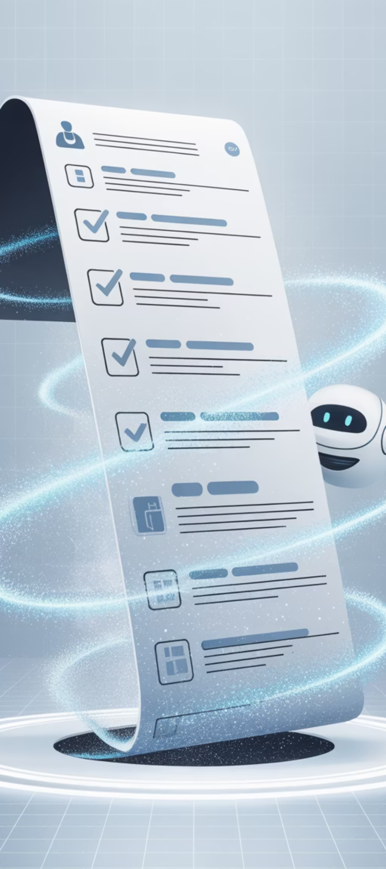
See the Magic in Action
The Complex Task:
Magic ToDo Transforms It Into:
"Prepare stakeholder presentation for Agile quarterly review, including metrics, roadmap updates, and retrospective outcomes."
Gather sprint metrics from Jira and Power BI
Summarize key outcomes from last retrospective
Update the roadmap in Confluence
Create slide deck and circulate draft for review
Schedule presentation time with stakeholders

Slide 9
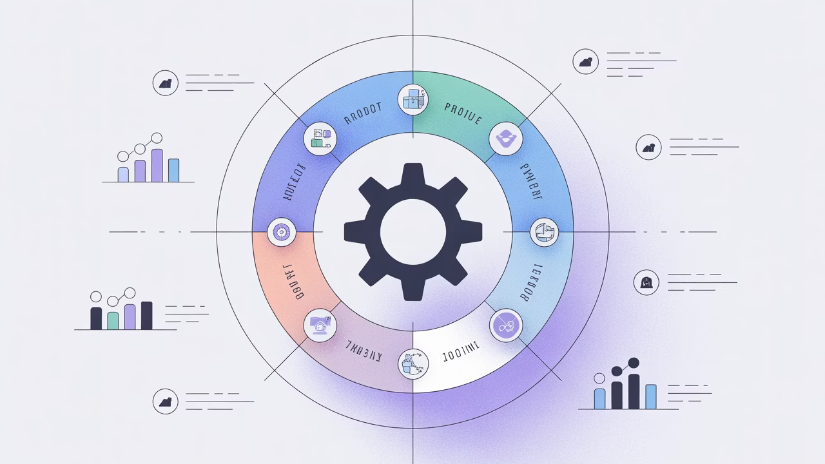




Benefits for Project Managers
Reduces Mental Load
Backlog Grooming Aid
Breaks down complex items without the cognitive overhead of manual task analysis. Project managers can offload the mental strain of decomposing large initiatives, allowing them to focus on strategic thinking and team coordination instead of getting lost in details. This reduction in cognitive load helps prevent burnout and decision fatigue during high-pressure sprints.
Refine epics or user stories into actionable subtasks with consistent granularity. Magic ToDo ensures that all work items are properly sized for sprint planning, eliminating the common challenge of inconsistent story points or hidden complexity. This leads to more accurate capacity planning and fewer mid-sprint surprises that derail timelines and team morale.
Teaching Tool
Fast Onboarding
Show junior team members how to structure work logically and plan efficiently. By demonstrating AI-generated task breakdowns, project managers can help new team members understand work decomposition best practices without extensive coaching sessions. The tool serves as a consistent model for how to approach complex tasks, establishing common planning patterns across the organization and accelerating team member development.
Create comprehensive onboarding plans instantly for new team members. Rather than manually crafting individualized onboarding sequences, project managers can generate tailored plans that adapt to different roles and experience levels. This not only saves significant time in preparation but ensures a consistent onboarding experience that covers all critical knowledge areas, resulting in faster time-to-productivity and greater team integration for new hires.

Slide 10

Friendly Features
Designed With Neurodivergent Needs in Mind:
Simplifies complex language for clarity
Reduces decision fatigue with structured steps
Provides visual organization patterns
Adjustable complexity levels for different processing needs
Removes ambiguity from tasks
Creates consistent task structures

Slide 11
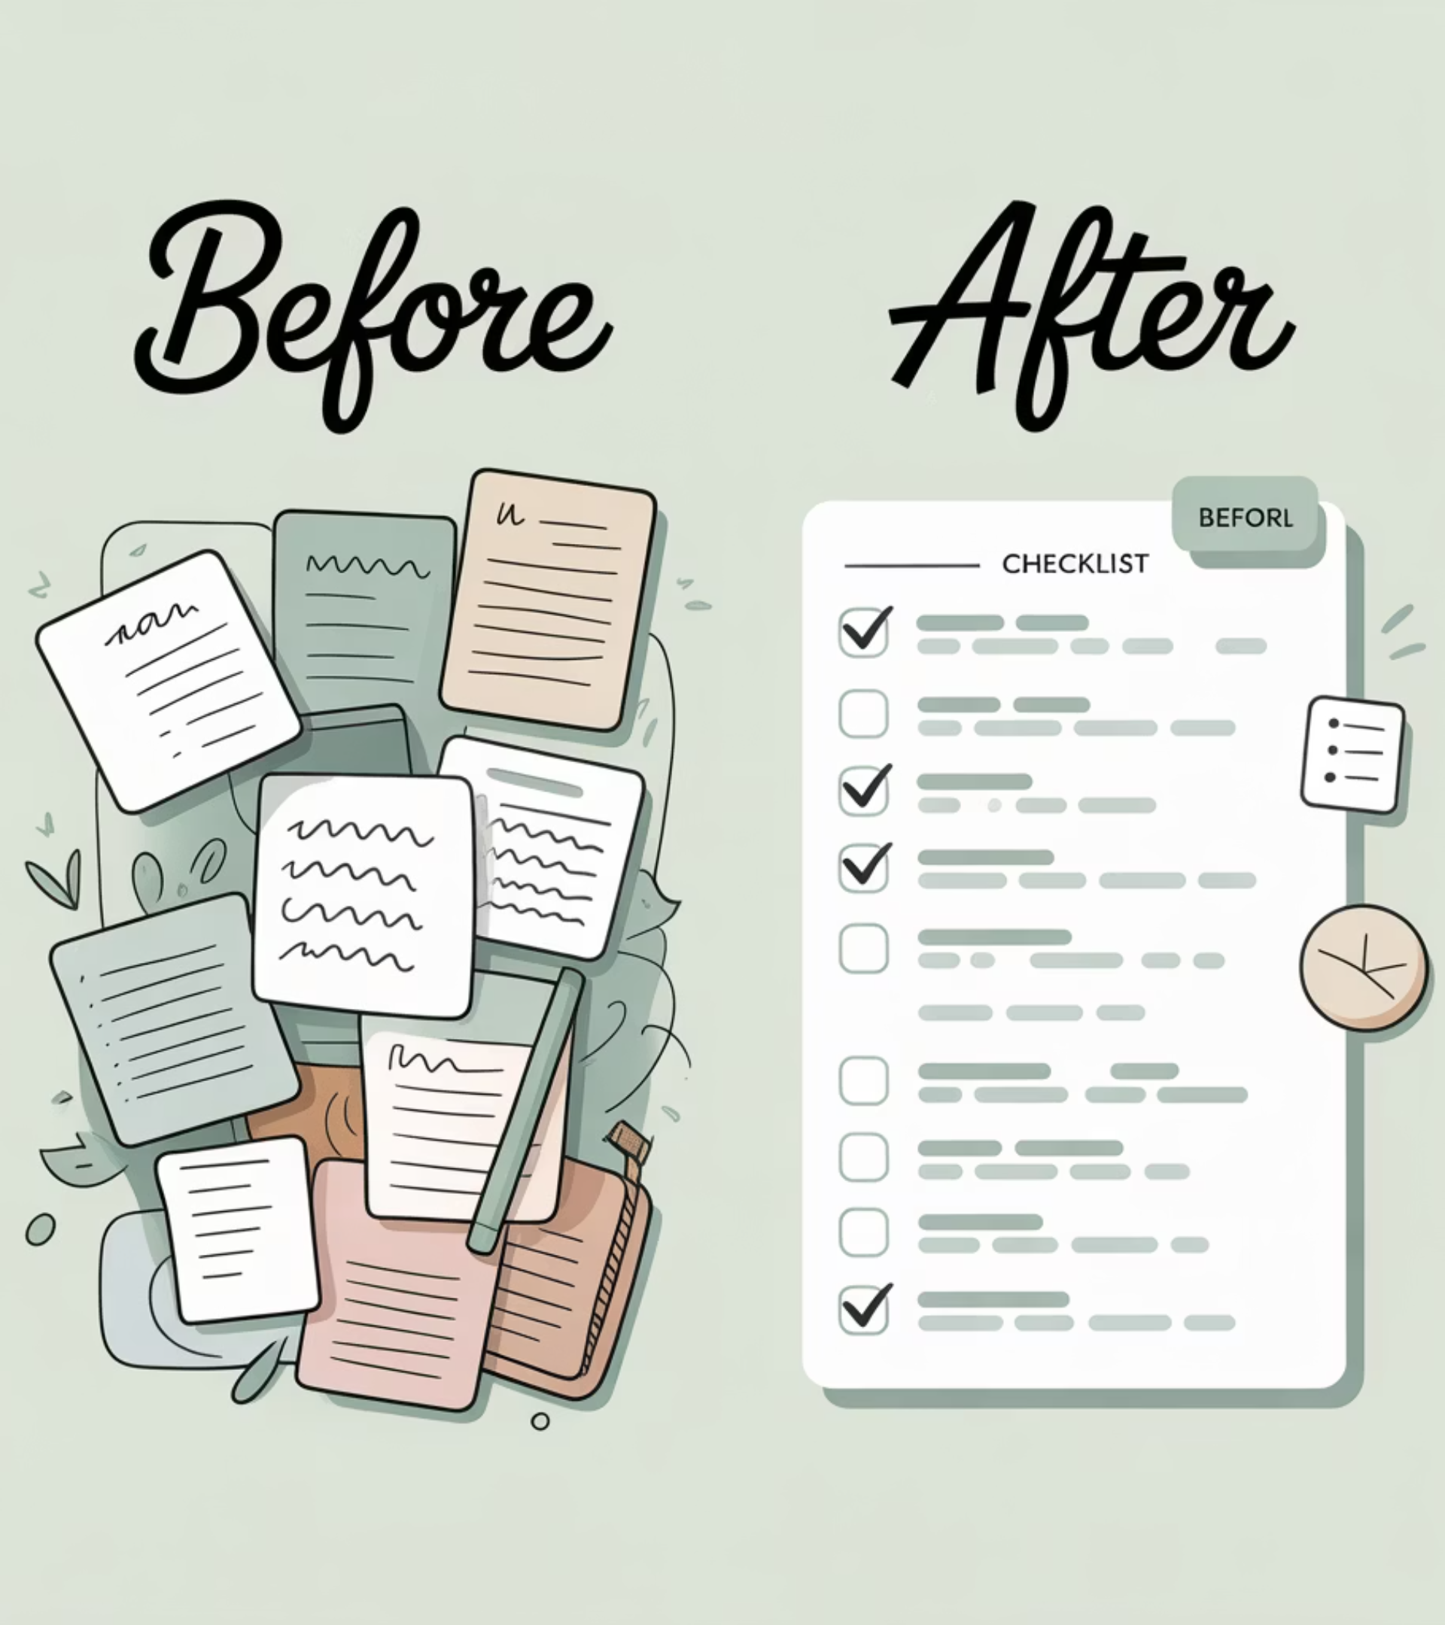
Example: From Chaos to Clarity
Original Task:
"Prepare for sprint planning meeting"
Magic ToDo Breakdown:
Review previous sprint results
Identify team capacity for next sprint
Prioritize backlog items
Create meeting agenda
Prepare visual aids for discussion
Book meeting room and send invites

Slide 12

Real-World Success Story
"During a recent sprint planning session, I used Magic ToDo to prep an onboarding plan for a new QA tester. Instead of writing everything manually, I input: 'Create onboarding plan for new QA team member starting next week.' In seconds, it delivered a sequence that I could copy into Jira as subtasks."
30+
100%
∞
Minutes Saved
Task Coverage
Stress Avoided
Per planning session
No steps forgotten
Immeasurable benefit

Slide 13








Perfect Alignment with Agile Principles
Responding to Change
Simplifying Work
Quickly reorganize tasks when priorities shift without manual rework
Transform complexity into clarity with AI assistance
Value Delivery
Supporting Individuals
Free up mental resources for higher-level thinking and innovation
Accommodate different thinking styles and processing needs

Slide 14

Implementation Ideas
Sprint Planning
Documentation
Break down user stories into tasks
Generate step-by-step guides
Generate consistent acceptance criteria
Create testing protocols
Create developer onboarding plans
Personal Productivity
Retrospectives
Break down your own complex assignments
Convert action items into specific steps
Convert meeting notes to action items
Structure improvement initiatives
Plan conference presentations

Slide 15

Practical Applications
Complex Project Planning
Break down new initiatives into phases and deliverables before formal planning begins
Stakeholder Communication
Quickly generate structured outlines for reports, presentations, and updates
Onboarding Processes
Create detailed checklists for bringing new team members up to speed
Retrospective Planning
Generate discussion points and action items for team improvement sessions

Slide 16
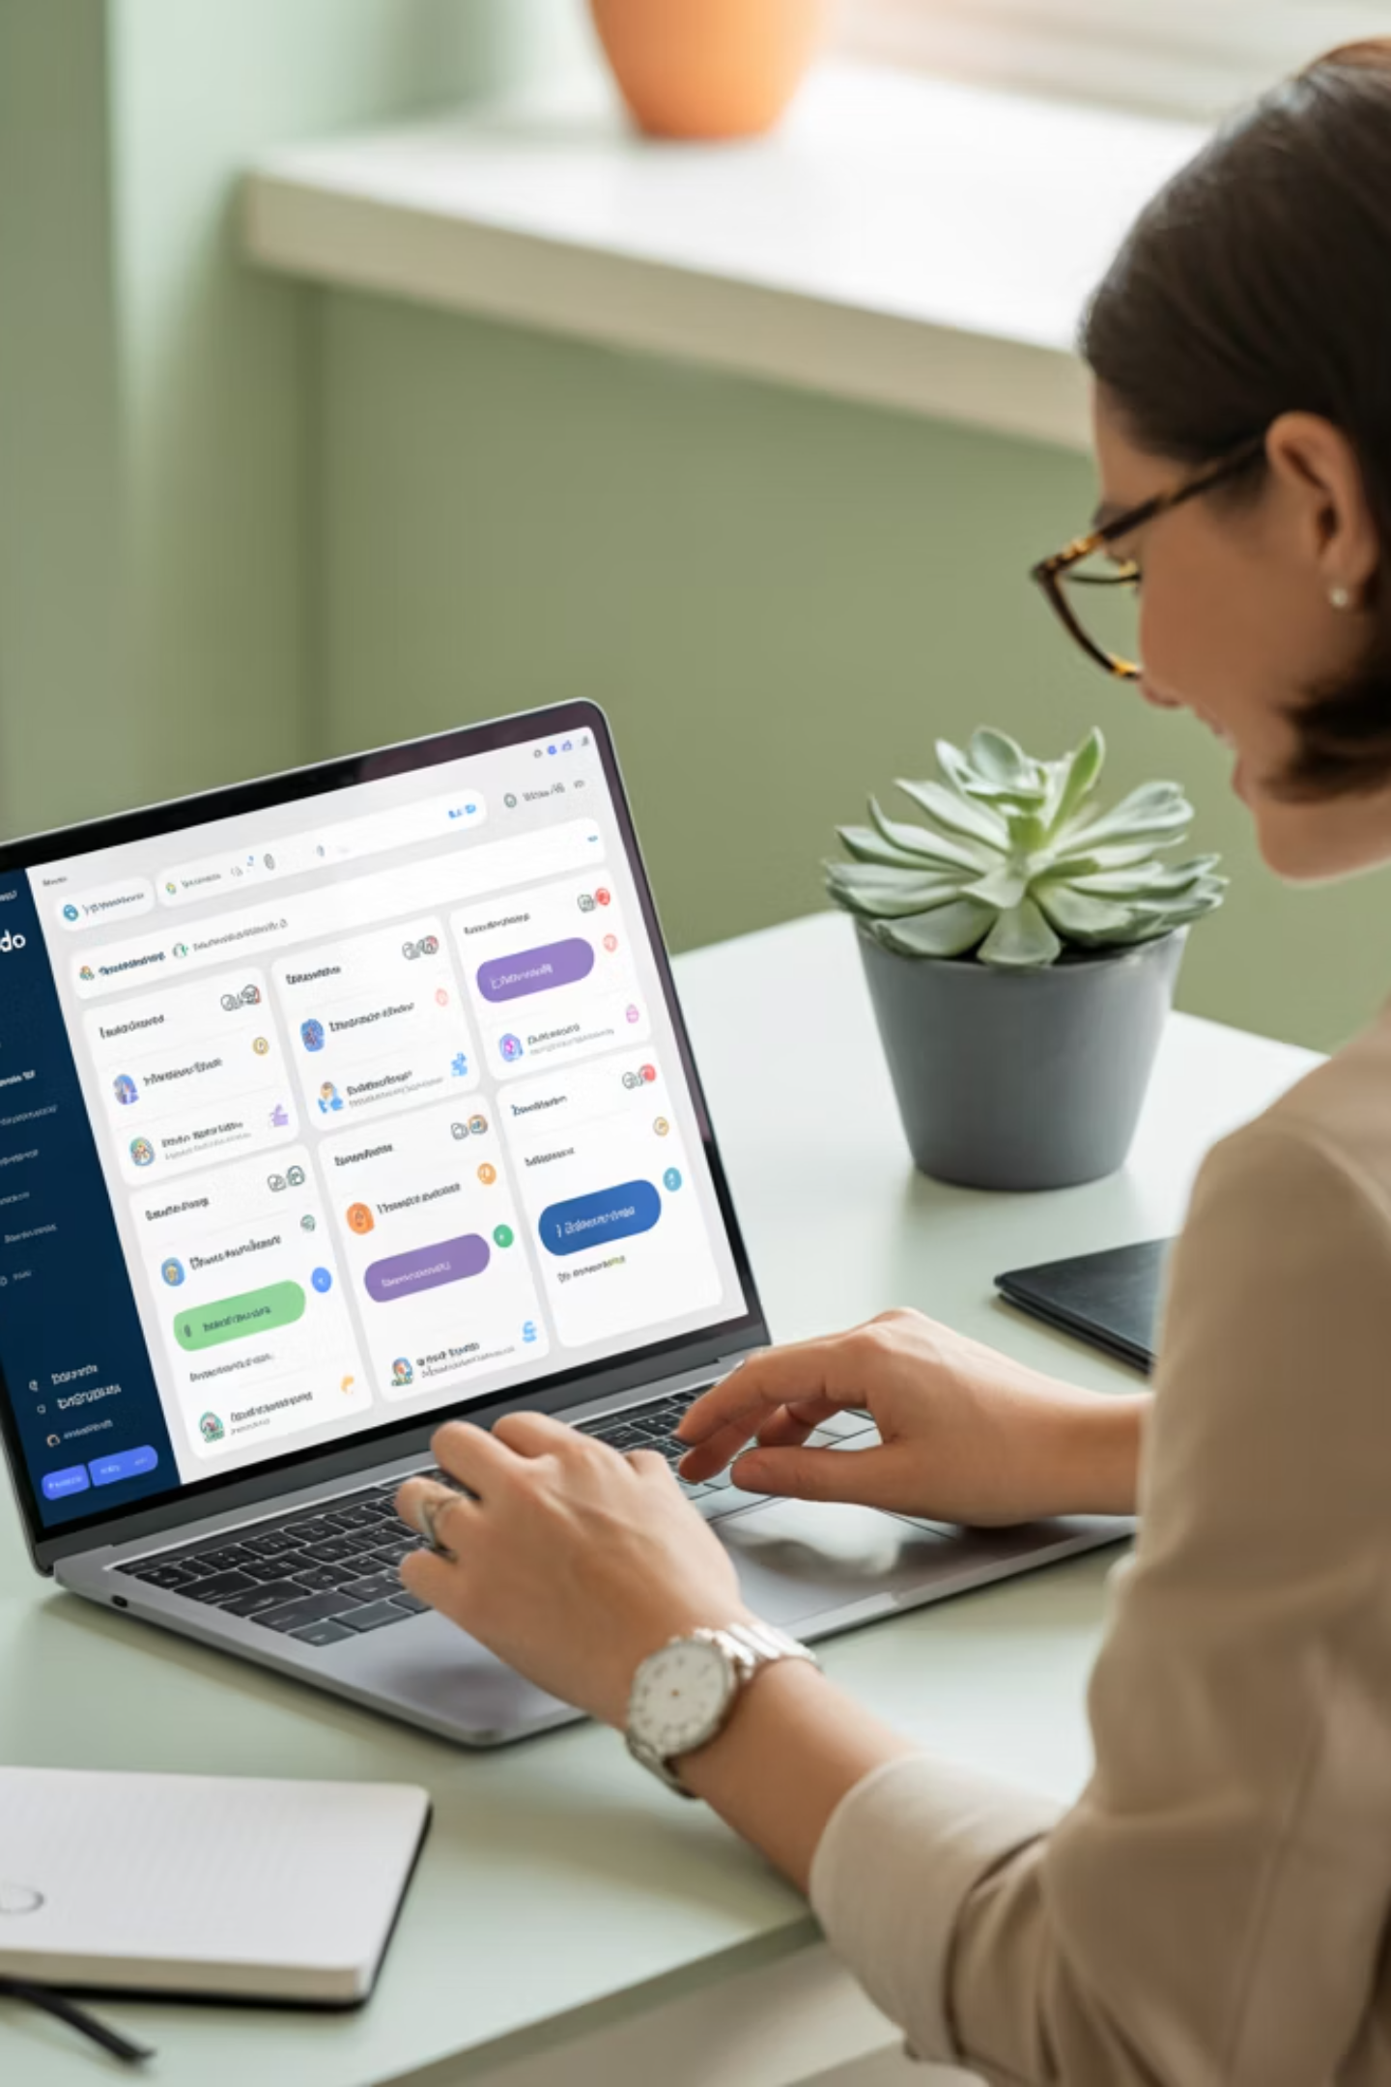
Pro Tips for Maximum Benefit
Export your breakdown to your favorite task manager (Notion, Trello, Jira)
Use it for repetitive tasks to ensure consistency
Try it live during team meetings for collaborative planning
Adjust the difficulty slider based on task complexity and team experience
Customize the generated tasks to match your specific workflow

Slide 17
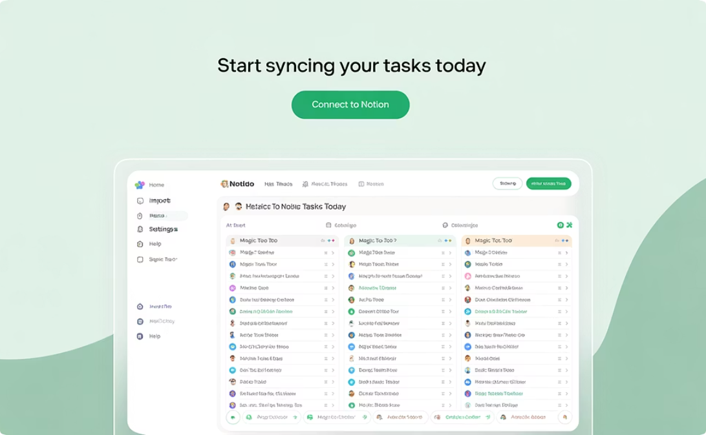
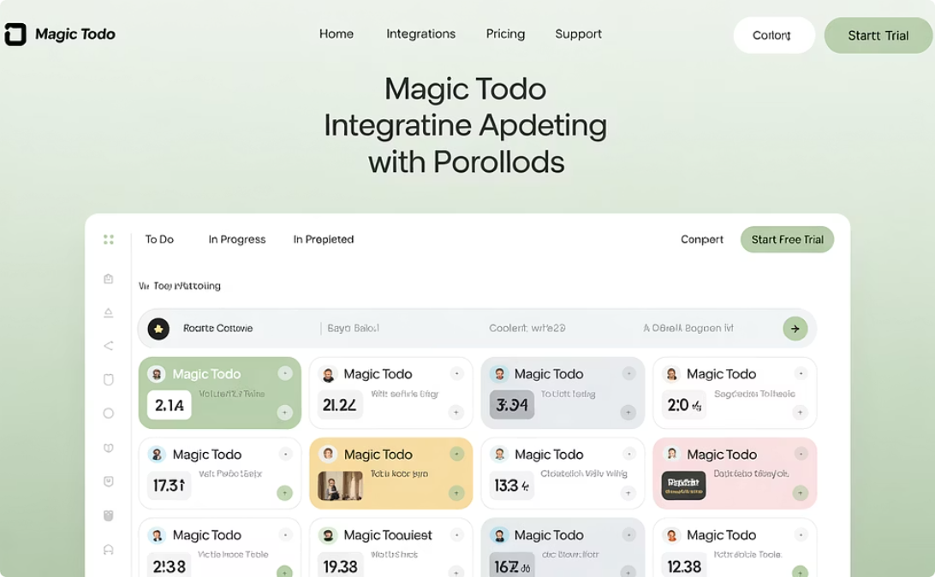
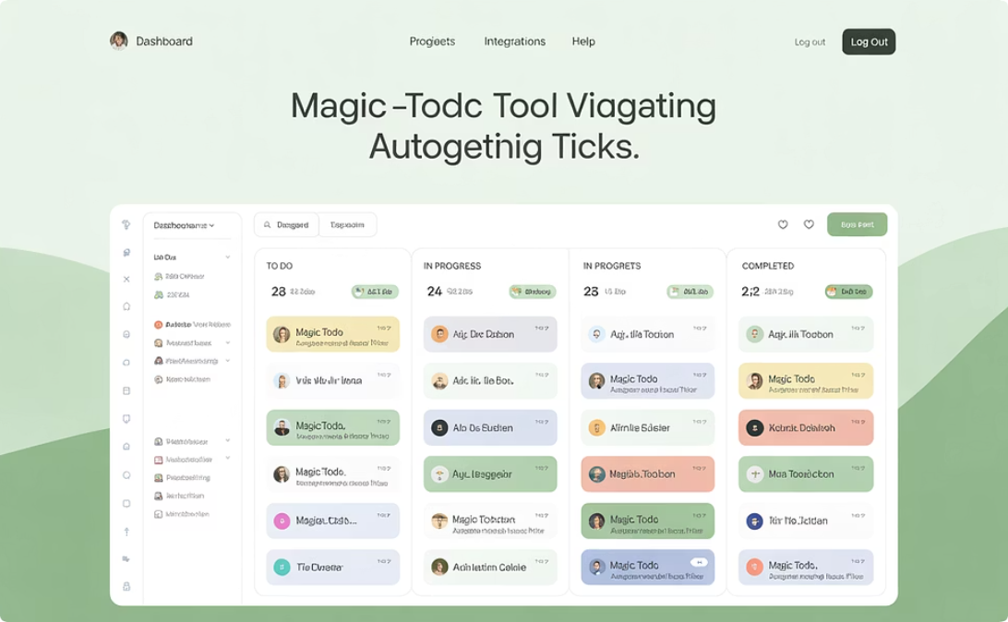
Integration With Your PM Toolkit
Notion
Trello
Jira
Copy tasks directly into your Notion workspace for team collaboration
Transfer breakdowns into Trello cards for visual project management
Convert generated tasks into Jira tickets for agile workflow tracking

Slide 18



Start Using Magic ToDo Today
Transform the way your team approaches tasks and project planning
Let a little Goblin magic free your brain for what matters most: delivering value.

