Slide 1


Delegation in the Digital Age
Leveraging Tools and AI to Assign, Track, and Trust in Today's Connected Workplace
#AgileLeadership #Delegation #DigitalTransformation #ProjectManagement #AI #AgileTeams #LeadershipDevelopment #EmpoweredTeams #WaysOfWorking #ManagingProjectsTheAgileWay

Slide 2

The Evolution of Leadership
Traditional Delegation
Digital Delegation
Verbal instructions in meetings
Structured task management platforms
Email chains with unclear ownership
Real-time progress visibility
Spreadsheet tracking systems
Automated workflows and reminders
Limited visibility into progress
AI-powered insights and recommendations
Manual follow-ups and check-ins
Integrated communication and documentation
This approach worked in co-located teams but breaks down in our distributed, fast-paced digital workplace where context gets lost and accountability becomes murky.
Modern tools create transparency, reduce friction, and enable leaders to scale their impact while empowering teams to work with greater autonomy and clarity.

Slide 3

Why Digital Delegation Matters
In today's remote-first world, traditional delegation creates bottlenecks, misalignment, and frustration

Slide 4
The Four Pillars of Digital Delegation
Clarity
Transparency
Assignments become visible, structured, and trackable with clear ownership, deadlines, and success criteria. No more guessing what "ASAP" means or who's responsible for what.
Everyone can see ownership and progress in real time, eliminating the need for status meetings and reducing information silos across distributed teams.
Detailed task descriptions
Shared dashboards and boards
Clear acceptance criteria
Real-time progress updates
Defined deliverables and timelines
Cross-functional visibility
Accountability
Scalability
Automated reminders and intelligent dashboards ensure commitments are met while reducing the administrative burden on leaders and team members.
Leaders can manage complex, multi-team initiatives without becoming bottlenecks, enabling growth and reducing single points of failure in critical processes.
Automated deadline reminders
Multi-project oversight
Progress tracking metrics
Cross-team coordination
Performance analytics
Reduced manual intervention

Slide 5
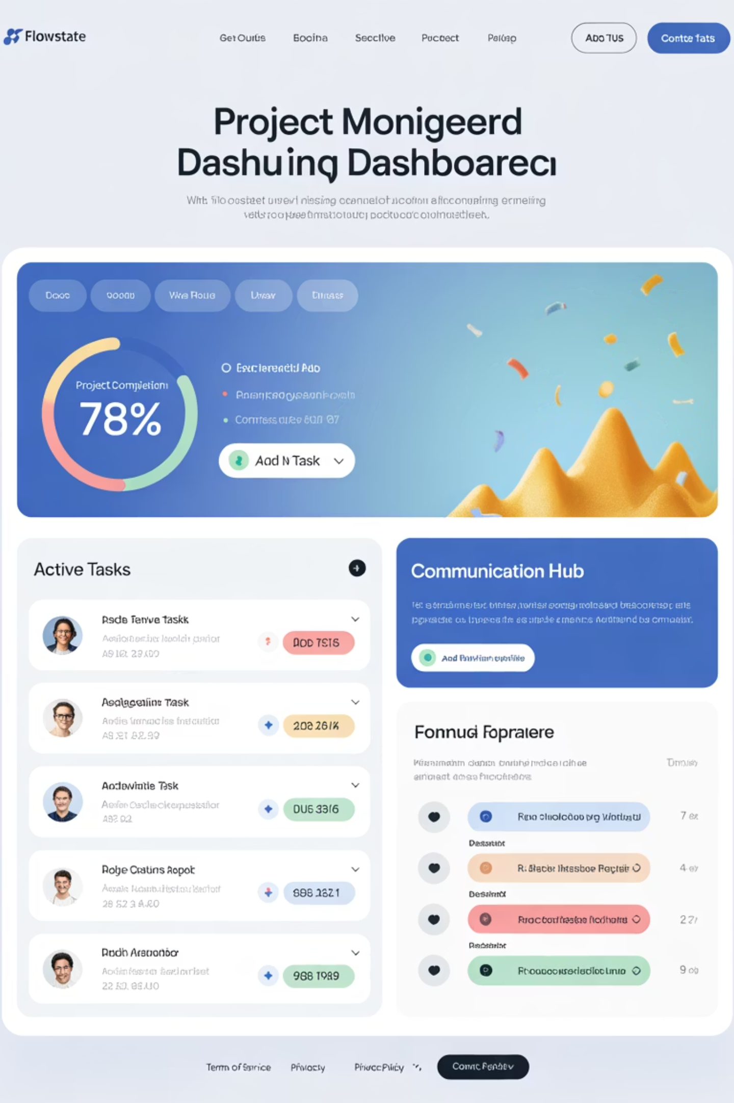
Chapter 1: Tools That Transform
The digital delegation toolkit has evolved rapidly, offering leaders sophisticated options for every aspect of task assignment, tracking, and team coordination. Let's explore the four categories of tools that are revolutionizing how we delegate work.

Slide 6


Agile Project Management Platforms
Modern project management platforms transform delegation from informal conversations into structured, trackable assignments. These tools make work visible through intuitive boards, detailed task cards, and comprehensive reporting capabilities.
Key Platforms
Jira – Enterprise-grade with advanced workflow customization
Azure DevOps – Integrated development and project management
Trello – Simple Kanban boards for straightforward task management
Asana – Flexible project views with timeline and calendar integration
Delegation Benefits
Clear task ownership and due dates
Detailed acceptance criteria
Progress visualization through burndown charts
Automated status updates and notifications
Pro Tip: Use templates for recurring delegation patterns to ensure consistency and reduce setup time for similar projects.

Slide 7
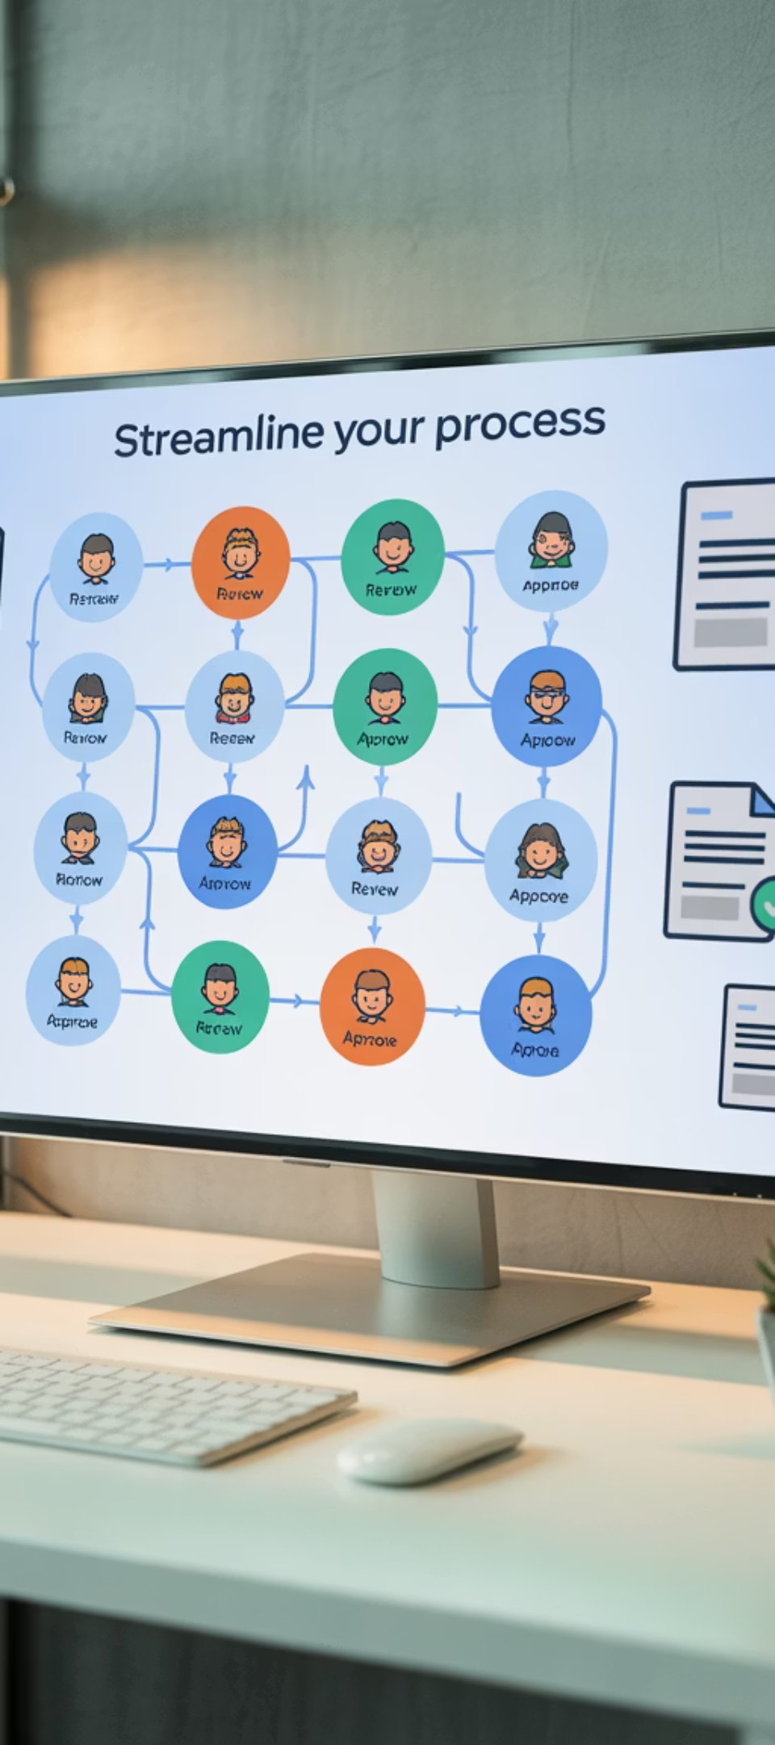



Workflow Automation Tools
ServiceNow
Enterprise service management with sophisticated approval workflows and automated task routing based on complex business rules.
Monday.com
Visual workflow builder that automates repetitive delegation patterns, reducing manual handoffs and ensuring consistent processes.
Zapier
Connects disparate tools to create seamless delegation workflows, automatically creating tasks and notifications across platforms.
These automation tools excel at handling recurring delegation patterns. Instead of manually assigning the same types of tasks repeatedly, leaders can set up workflows once and let the system handle the routing. This approach is particularly powerful for standard processes like customer onboarding, content approval, or incident response.

Slide 8
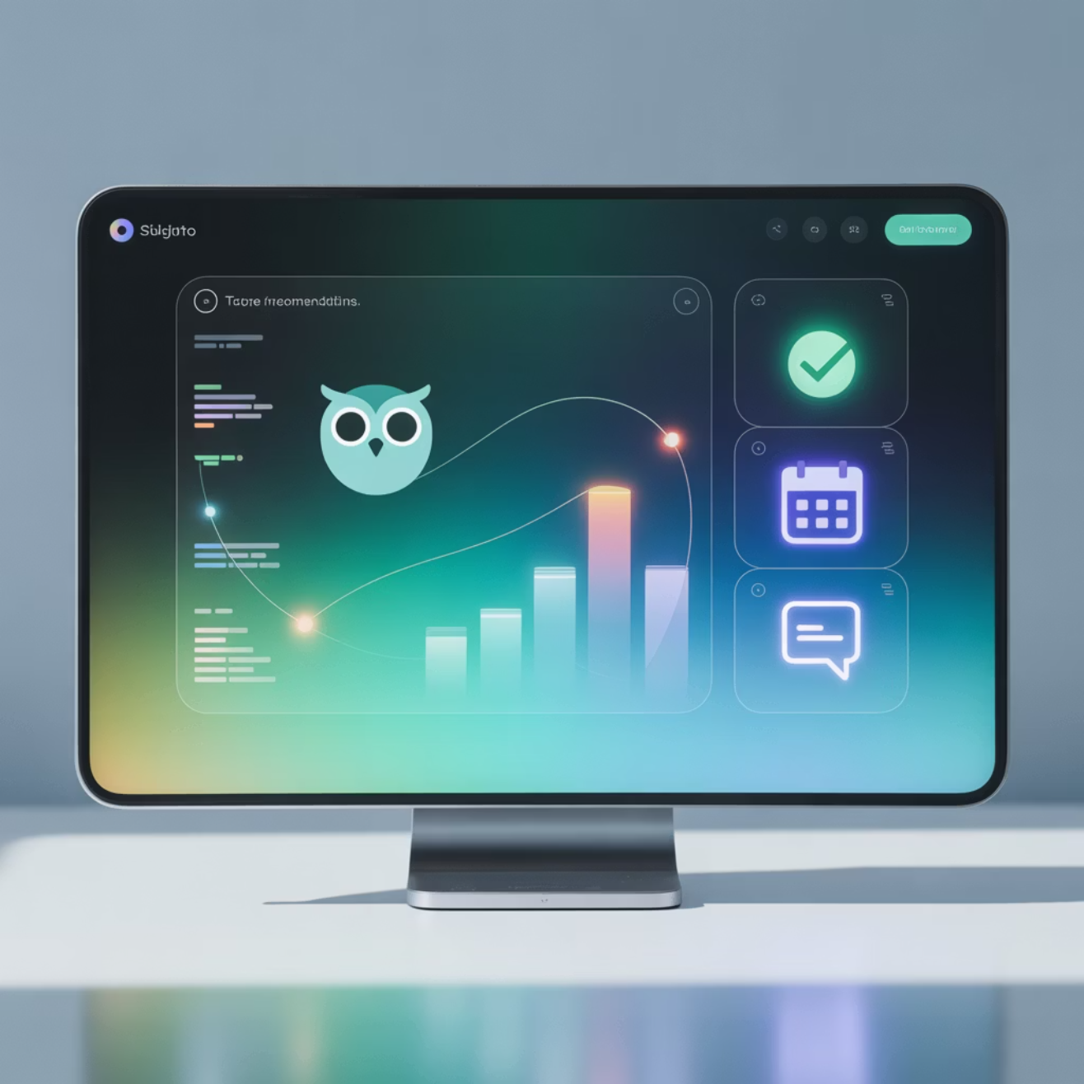
AI-Powered Delegation Assistants
Intelligence Meets Delegation
AI copilots and task analyzers are revolutionizing how we approach delegation by adding predictive intelligence to the process. These tools don't just manage tasks—they help leaders make smarter delegation decisions.
Smart Task Breakdown
ClickUp AI breaks complex projects into actionable subtasks
Magic ToDo provides intelligent task prioritization
Notion AI suggests optimal task structures and timelines
Workload Intelligence
Capacity analysis prevents team burnout
Skill-based assignment recommendations
Predictive deadline analysis
Historical performance insights
"AI transforms delegation from a manual process into a data-informed leadership practice that optimizes both individual performance and team outcomes."

Slide 9



Collaboration Hubs
Microsoft Teams
Slack
Confluence
Integrated workspace combining chat, video calls, file sharing, and task management. Delegated work stays connected to context through persistent conversations and shared channels, ensuring nothing gets lost in translation.
Channel-based messaging with powerful integrations to project management tools. Automated task creation from conversations and real-time notifications keep delegation transparent and actionable across distributed teams.
Knowledge management platform that ensures delegated tasks come with complete context. Documentation travels with assignments, reducing back-and-forth clarification and enabling autonomous execution.
The power of collaboration hubs lies in their ability to keep context attached to tasks. When you delegate through these platforms, team members have immediate access to relevant discussions, documents, and decision history—eliminating the common problem of "I need more information to get started."

Slide 10
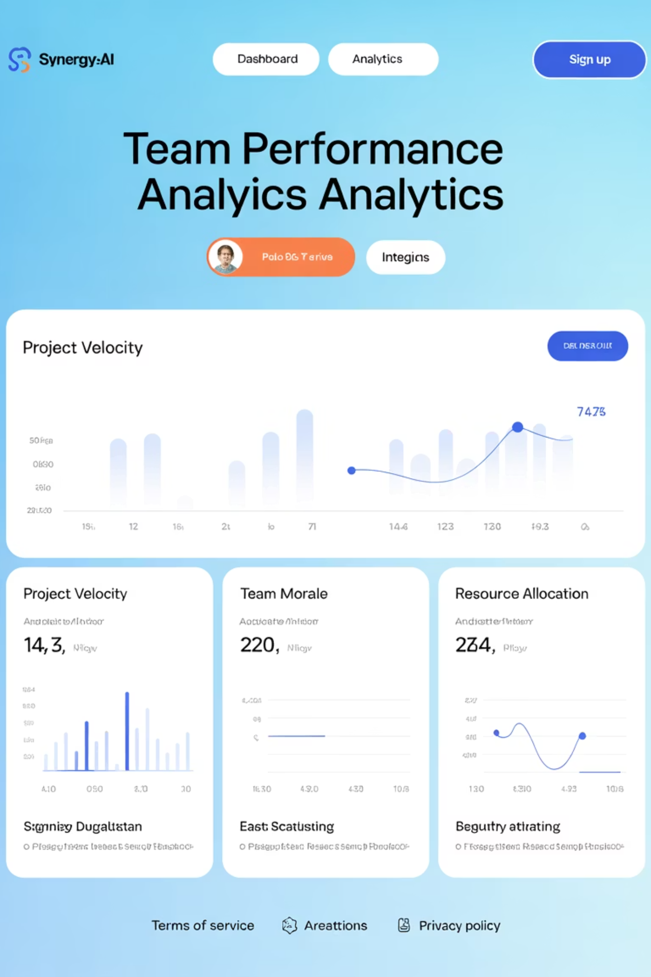
Chapter 2: AI's Strategic Role
From Reactive to Predictive
Artificial Intelligence elevates delegation beyond simple task assignment into strategic workforce optimization. Modern AI tools provide leaders with unprecedented insights into team capacity, performance patterns, and optimal task distribution.

Slide 11

AI-Powered Delegation Intelligence
01
02
Smart Assignment Recommendations
Workload Risk Analysis
AI analyzes team member skills, current workload, historical performance, and availability to suggest optimal task assignments. This prevents overloading high performers while developing underutilized talent.
Predictive algorithms identify potential bottlenecks and burnout risks before they impact delivery. Leaders receive early warnings when team members approach capacity limits or when project timelines become unrealistic.
03
04
Automated Follow-Up Intelligence
Performance Dashboard Insights
Context-aware reminders and nudges that adapt to individual work patterns and project urgency. The system learns when team members typically respond and adjusts communication timing accordingly.
Comprehensive analytics showing delegation effectiveness, completion rates, and team satisfaction. Leaders can identify patterns in successful delegation and continuously improve their approach.
Data-Driven Impact: Organizations using AI-powered delegation tools report 40% faster project completion and 60% improvement in team satisfaction scores.

Slide 12

Chapter 3: Trust in the Digital Age
Balancing Technology and Human Connection
Digital delegation tools provide unprecedented visibility and control, but great leaders understand that technology should enhance trust, not replace it. The key is using these powerful tools to empower teams while maintaining the human elements that build strong working relationships.
Avoid the Surveillance Trap
Dashboards and tracking tools can easily become weapons of micromanagement if not used thoughtfully. Instead of monitoring every minute detail, focus on outcomes and milestone achievements. Use visibility to support and guide, not to control and critique.
Encourage Autonomy
The goal of digital delegation is to give team members more clarity and autonomy, not less. Provide the context, resources, and boundaries they need, then trust them to execute. Regular check-ins should focus on removing obstacles, not checking up on every detail.
Coach with AI Insights
Use AI-generated insights as coaching opportunities rather than performance evaluations. When the system identifies workload imbalances or suggests optimization, frame these as support mechanisms to help team members succeed.
"The goal is to empower—not to micromanage with tech."

Slide 13
5 Practical Tips for Digital Leaders
1
Make Delegation Visible
Use shared boards and public project spaces instead of private notes or email chains. Transparency builds accountability and allows team members to understand how their work fits into the bigger picture. When delegation is visible, knowledge sharing increases and dependencies become clear.
2
Automate Where Possible
Let systems handle repetitive delegation patterns like recurring reports, standard approvals, or routine maintenance tasks. This frees up your time for strategic delegation that requires human judgment and relationship building.
3
Use AI for Insights, Not Control
Leverage AI recommendations to support equitable distribution of work and identify development opportunities for team members. Focus on using data to make better decisions, not to justify predetermined conclusions.
4
Check-In, Don't Check-Up
Schedule milestone reviews and outcome discussions instead of daily monitoring. Focus conversations on results, obstacles, and support needs rather than micromanaging the process. Trust your team's expertise while staying available for guidance.
5
Close the Loop
Celebrate successful deliveries within digital platforms so wins are visible across the team. Public recognition reinforces positive behaviors and shows other team members what success looks like in your organization.

Slide 14

The Future of Leadership
Delegation in the digital age isn't just about handing off tasks—it's about creating an ecosystem of clarity, transparency, and empowerment.
Tomorrow's Leaders Will Master
Strategic Tool Selection – Choosing platforms that amplify rather than complicate
AI-Informed Decisions – Using data to optimize team performance and satisfaction
Digital Empowerment – Creating autonomy through clarity and support
Human-Centered Technology – Balancing efficiency with emotional intelligence
By leveraging tools and AI wisely, leaders free themselves to focus on strategy while enabling their teams to thrive with confidence and autonomy.
The leaders who succeed tomorrow will be those who master not just what to delegate, but how to empower digitally connected teams to deliver with confidence and autonomy.

