Slide 1

EHR Integrations That Simplify Your Revenue Cycle
In today's fast-paced healthcare environment, efficient revenue cycle management equals quality patient care.
We'll explore how integrated EHR systems drive clean claims, accurate coding, and faster payments.
kW
by Kimberly Wiethoff

Slide 2
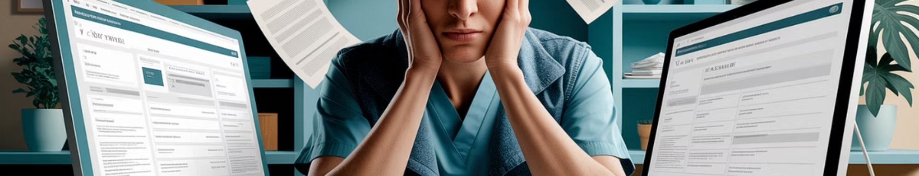




The Challenge: Fragmented Systems
Manual Processes
Error-Prone Workflows
Staff waste valuable time on duplicate data entry across disconnected platforms.
Copying information between systems introduces costly mistakes in billing.
Revenue Leakage
Limited Visibility
Disconnected systems lead to missed charges and delayed reimbursements.
Siloed data prevents comprehensive financial performance analysis.

Slide 3





Seamless Data Flow from Clinical to Billing
Patient Check-in
Clinical Documentation
Claim Generation
Payment Processing
Demographics and insurance captured once in the EHR.
Data flows automatically to billing without manual re-entry.
Reimbursement status updates the patient record automatically.
Providers chart encounters with integrated coding tools.

Slide 4

Real-Time Eligibility Verification
Pre-Visit Verification
Staff can check coverage before patients arrive, reducing surprises at check-in.
Batch Processing
Run eligibility checks for multiple appointments at once, saving administrative time.
Automated Alerts
System flags coverage issues so staff can collect appropriate payments upfront.
Benefit Details
Access to deductible status and coverage specifics helps set patient expectations.

Slide 5








Streamlined Coding and Charge Capture
AI-Powered Suggestions
Smart systems recommend codes based on documentation
Real-Time Validation
Code checks happen as providers document
Gap Analysis
System identifies missing documentation elements
Complete Charge Capture
No more overlooked services or procedures

Slide 6








Integrated Claim Scrubbing and Submission
Claim Creation
Error Detection
System generates claim directly from encounter data
Built-in rules check for missing or invalid information
Correction
Submission
Staff fixes issues before submission, not after rejection
Clean claims sent electronically to payers

Slide 7
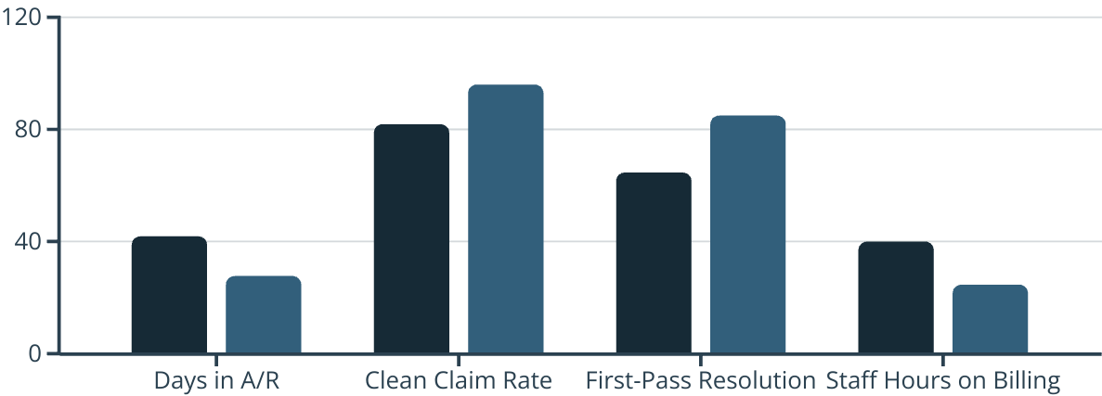
Consolidated Reporting and Analytics
Integrated EHR systems deliver significant improvements across key revenue cycle metrics. Most practices see days in A/R drop while clean claim rates rise dramatically.
Before Integration
After Integration

Slide 8





Easier Compliance and Audit Readiness
Complete Documentation
Audit Trails
Clinical notes, orders, and billing codes are linked for easy review.
System tracks who accessed records and when changes were made.
Required Forms
Automated Timelines
Consent documents and patient acknowledgments are stored with encounters.
System enforces timing requirements for documentation and billing submission.

Slide 9





Key Performance Indicators to Track
Clean Claim Rate
Target: Above 95% of claims accepted on first submission.
Days in Accounts Receivable
Target: Less than 30 days for most specialties.
Denial Rate
Target: Below 5% of total claims submitted.
Collection Rate
Target: Above 95% of expected reimbursement collected.
Billing Cycle Time
Target: Less than 3 days from service to claim submission.

Slide 10

Implementation Best Practices
Workflow Assessment
Map current processes before implementing new technology. Identify inefficiencies and bottlenecks in your revenue cycle.
Cross-Functional Team
Include clinical, administrative, and billing staff in planning. Each perspective is essential for successful integration.
Phased Approach
Implement features incrementally rather than all at once. Start with highest-impact integrations first.
Thorough Training
Invest in comprehensive staff education. The best system fails without proper user adoption.

Slide 11

Cost-Benefit Analysis
35%
A/R Reduction
Average reduction in days in accounts receivable.
8%
Revenue Increase
Typical boost from better charge capture and reduced denials.
20%
Staff Efficiency
Average improvement in billing staff productivity.
12 mos
ROI Timeline
Typical period to recoup integration investment.

Slide 12










Selecting the Right Integration Partner
Specialty-Specific
Interoperability
Choose solutions tailored to your practice type and billing requirements.
Ensure the system supports standard healthcare data exchange protocols.
Accessibility
Look for mobile-friendly options that work across devices.
Scalability
Choose a solution that can grow with your practice's needs.
Support
Evaluate vendor's implementation assistance and ongoing technical help.

Slide 13




Next Steps: Your Revenue Cycle Transformation
Assess Current State
Document existing workflows and pain points
Define Requirements
Create detailed criteria for your integration needs
Select Partners
Choose vendors that best match your criteria
Implement & Optimize
Deploy solutions and continually refine processes
An integrated EHR is more than convenience—it's a strategic asset. Boost productivity, reduce errors, and accelerate payments with the right solution.

Slide 14
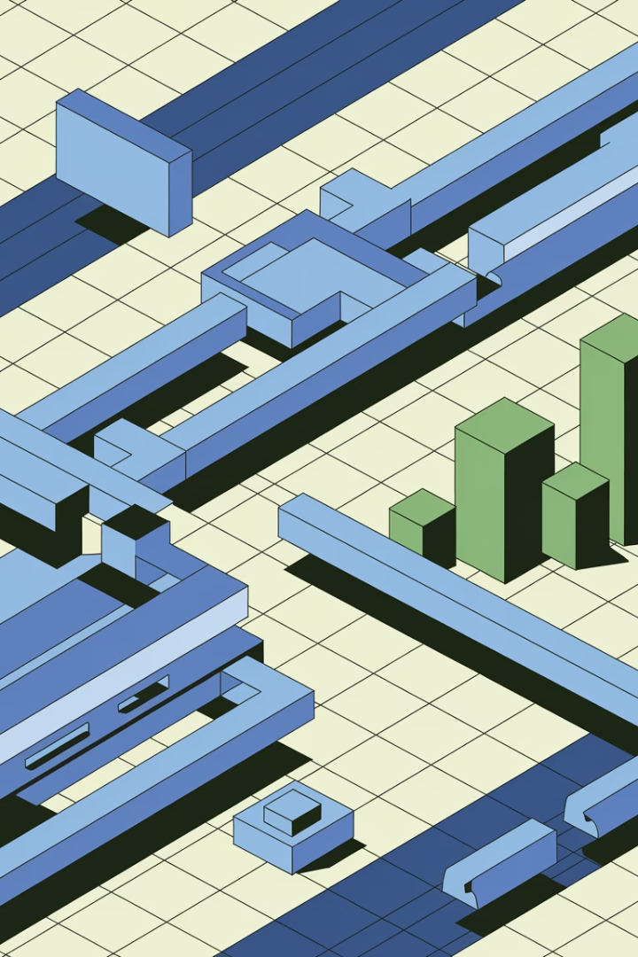
Final Thoughts
An EHR that integrates smoothly with your billing system is more than a convenience—it’s a strategic asset. It boosts productivity, reduces billing errors, and accelerates payment cycles. Whether you're a small practice or a multi-specialty clinic, investing in a fully integrated system will pay dividends in both time and revenue.

Slide 15
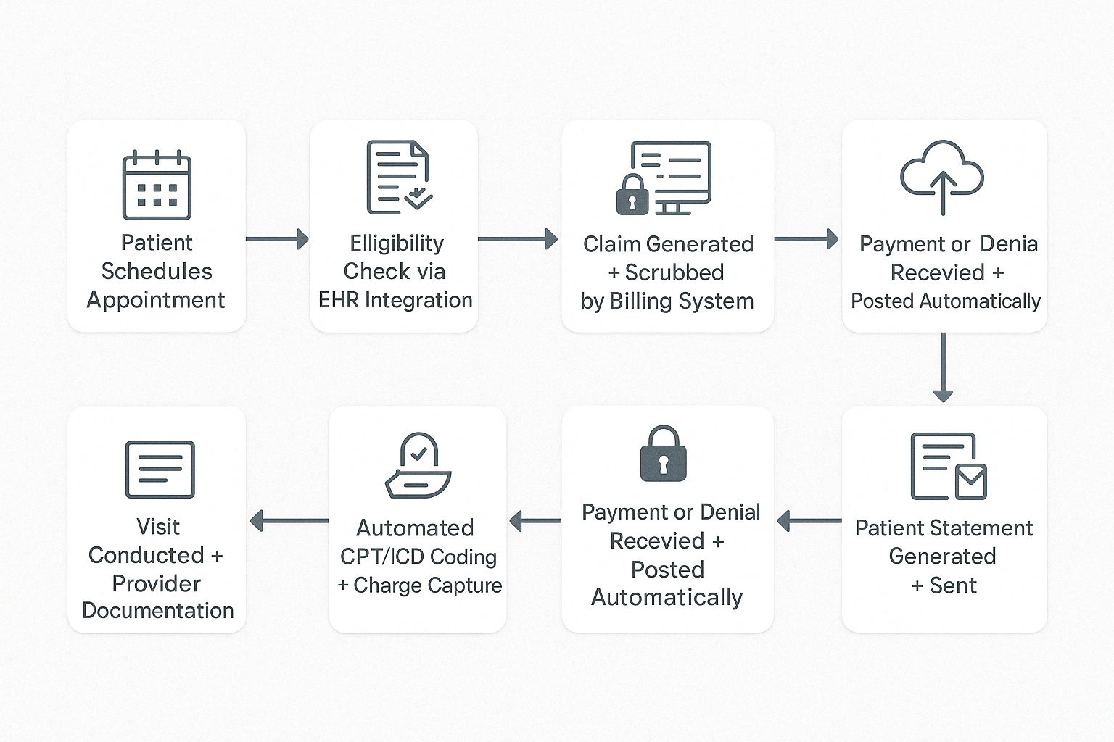
EHR + Billing Integration Workflow
This workflow diagram illustrates the **HIPAA-compliant, end-to-end process** of EHR and billing system integration in a modern healthcare setting. From the moment a patient schedules an appointment to the final posting of payments and generation of patient statements, each step is optimized for both **efficiency and security**. Key touchpoints—like eligibility verification, claim generation, and data posting—are safeguarded with encryption and access controls to protect PHI. When systems are seamlessly connected, practices can accelerate reimbursements, reduce administrative burden, and maintain full compliance with HIPAA standards.

Slide 16
