Slide 1
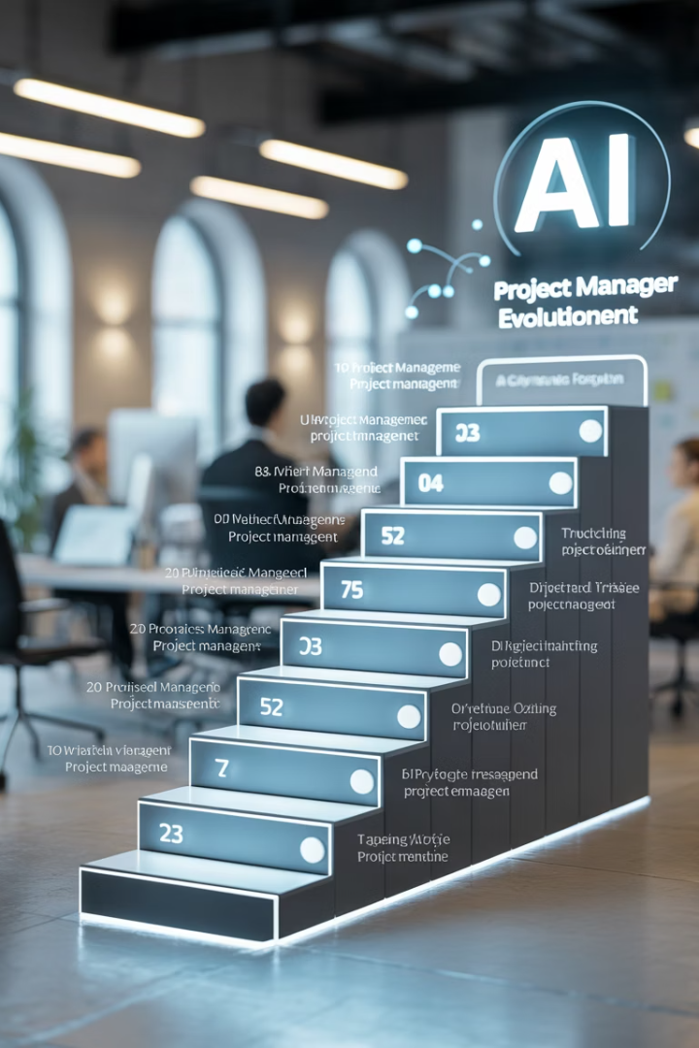
From Waterfall to Generative AI: How Project Managers Are Evolving
👤 ManagingProjectsTheAgileWay.com
#ManagingProjectsTheAgileWay
kW
by kimberly Wiethoff

Slide 2
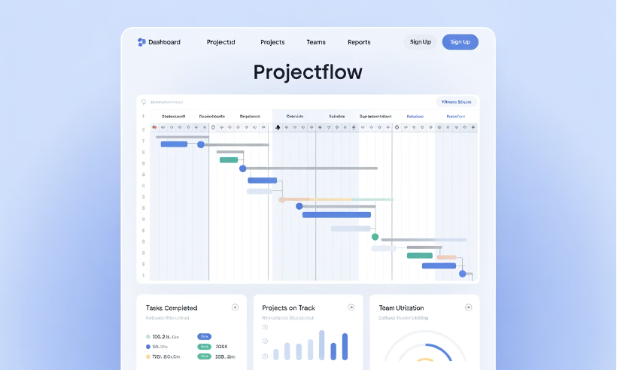
Gantt Charts & Waterfall
Then:
Task sequencing
Fixed scope, fixed schedule
Heavy documentation
Planning-driven
Role of PM: Coordinator and gatekeeper

Slide 3




Agile & Scrum
Iterative delivery
Team empowerment
Continuous improvement
Next Evolution: Iterative delivery, team empowerment, continuous improvement
Role of PM: Servant leader and facilitator

Slide 4






Cloud & DevOps
Real-time visibility
CI/CD pipelines
Cross-functional collaboration
Transformation: CI/CD pipelines, real-time visibility, cross-functional collaboration
Role of PM: Connector and enabler

Slide 5
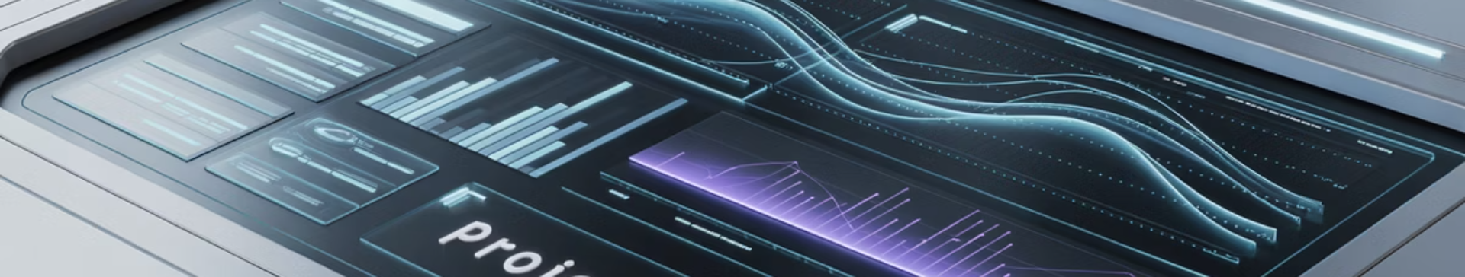
AI & Automation
Predictive scheduling
Risk analytics
Auto-generated reports
AI algorithms that forecast project timelines based on historical data and current progress
Automated identification and assessment of potential project risks
Automated creation of project status reports and documentation
Now: Predictive scheduling, risk analytics, auto-generated reports
Role of PM: Strategic advisor and insight curator

Slide 6






Generative AI & Future Trends
AI-driven planning
Intelligent project roadmaps
Personalized insights
Tailored recommendations
Intelligent assistants
AI-powered project support
What's Emerging: AI-driven planning, personalized insights, intelligent assistants
Role of PM: Decision-making partner & transformation leader

Slide 7



Are You Evolving Too?
Strategic Thinking
The PM of the future is more than a planner—they're a strategist, technologist, and change agent.
Continuous Learning
Read the full blog to stay ahead: Read here
#ProjectManagement #AIInPM #GenerativeAI #AgileLeadership #TechTrends #DigitalTransformation #FutureOfWork #ManagingProjectsTheAgileWay #PMP

