Slide 1
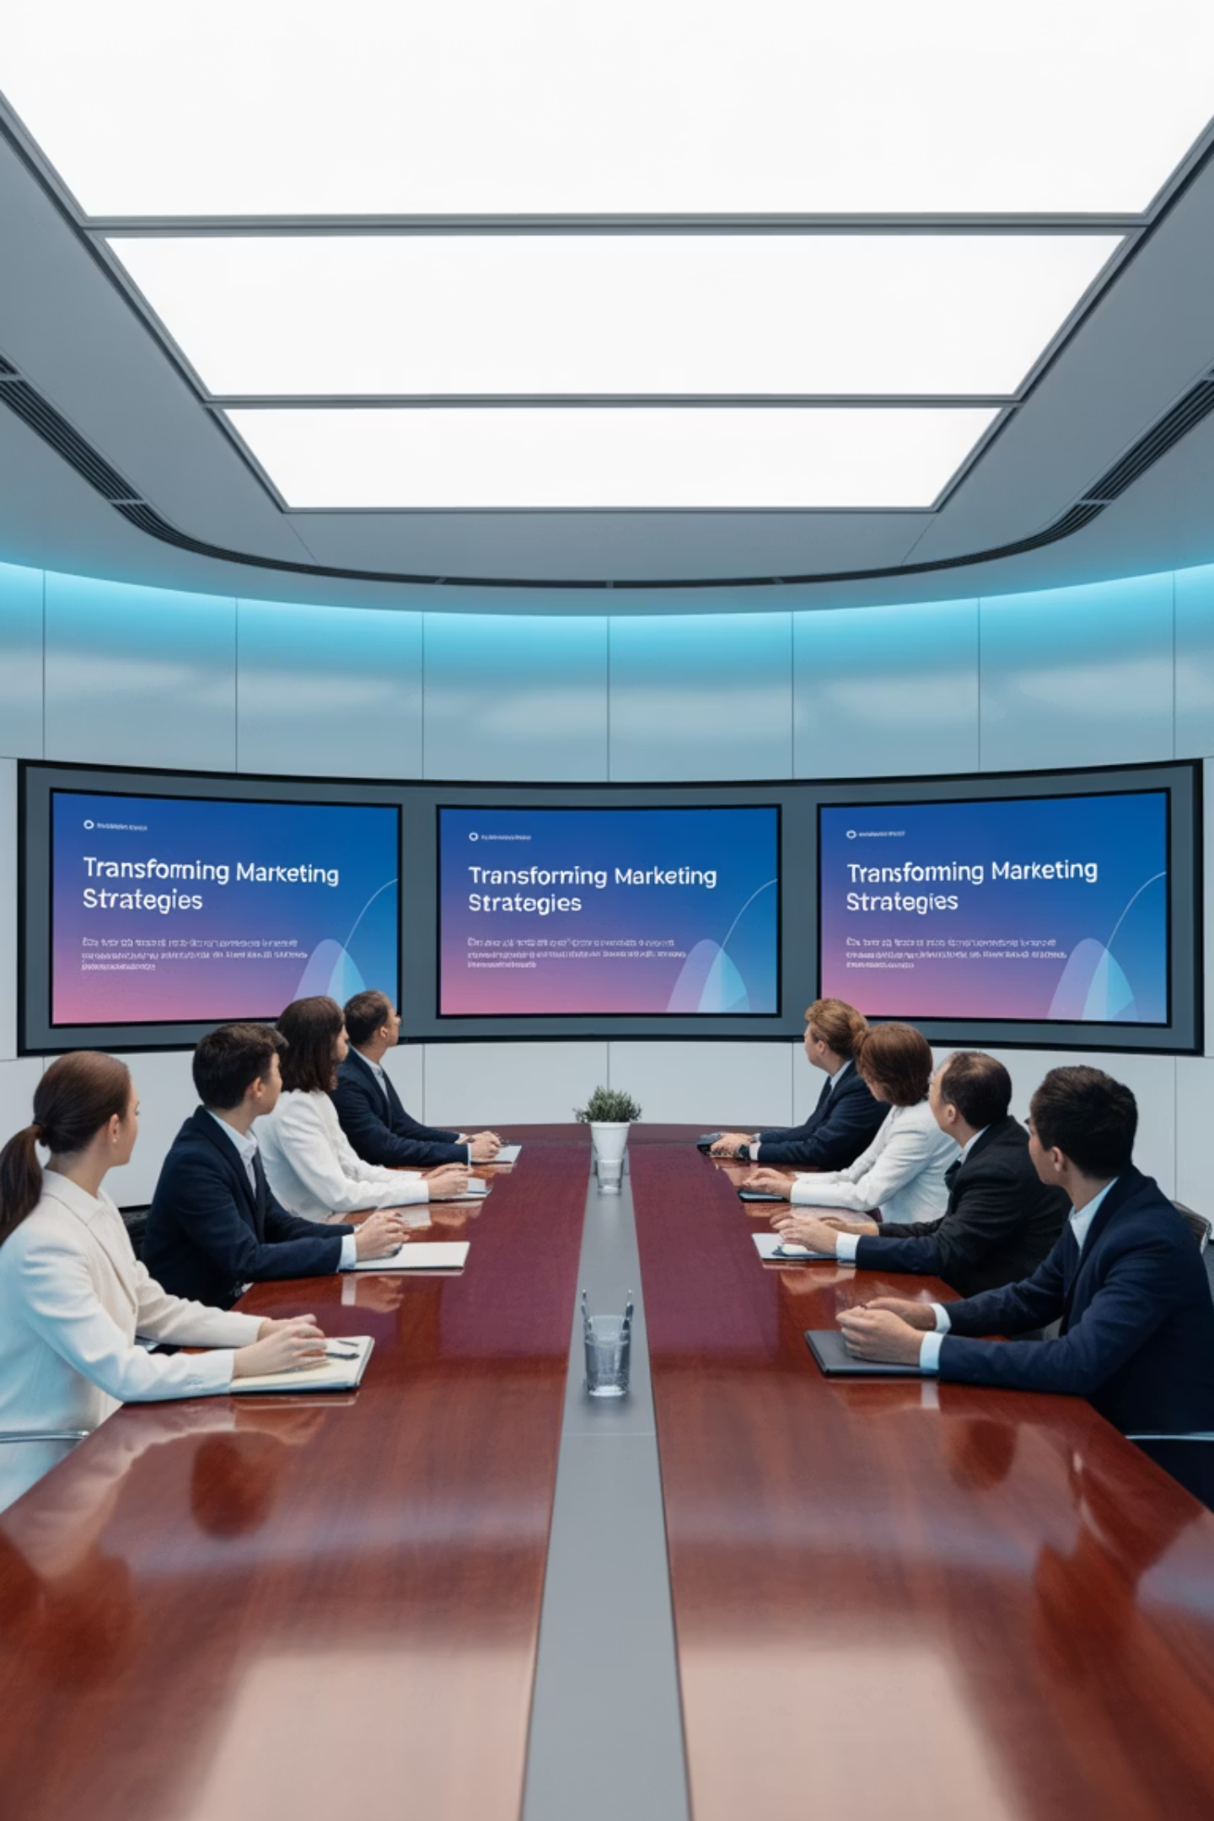
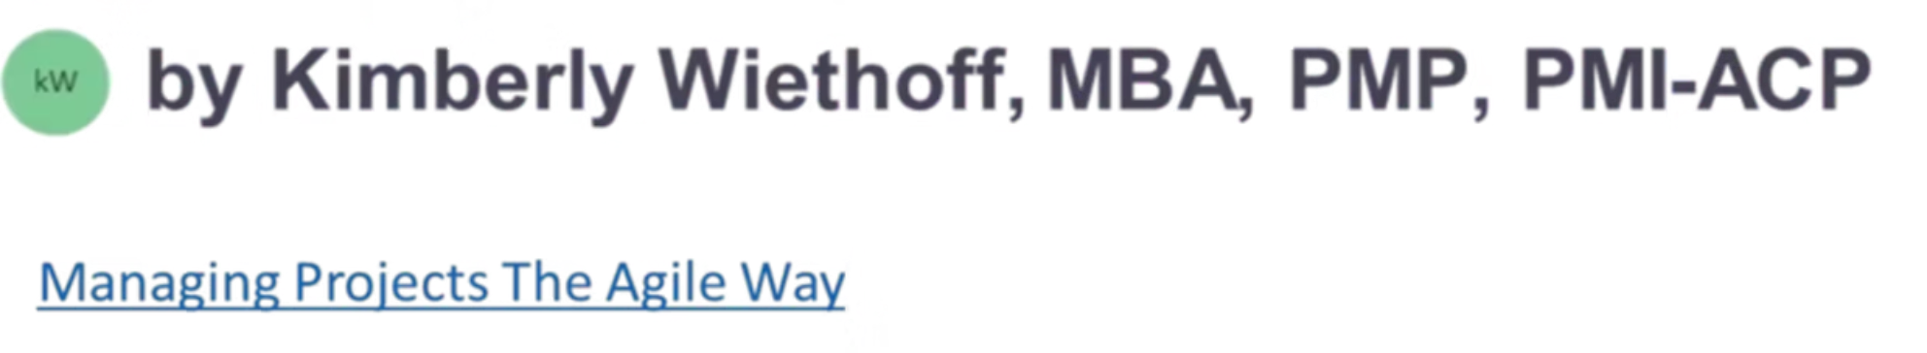
From Vision to Value: Orchestrating Enterprise-Wide Marketing Transformation
Strategic orchestration of people, process, and technology to deliver measurable enterprise value through comprehensive marketing transformation initiatives.
#MarketingTransformation #ProgramLeadership #BusinessValue #DigitalTransformation #StrategicLeadership #EnterprisePMO #MarketingOperations #ExecutiveCommunication #ChangeLeadership #ProjectManagement

Slide 2
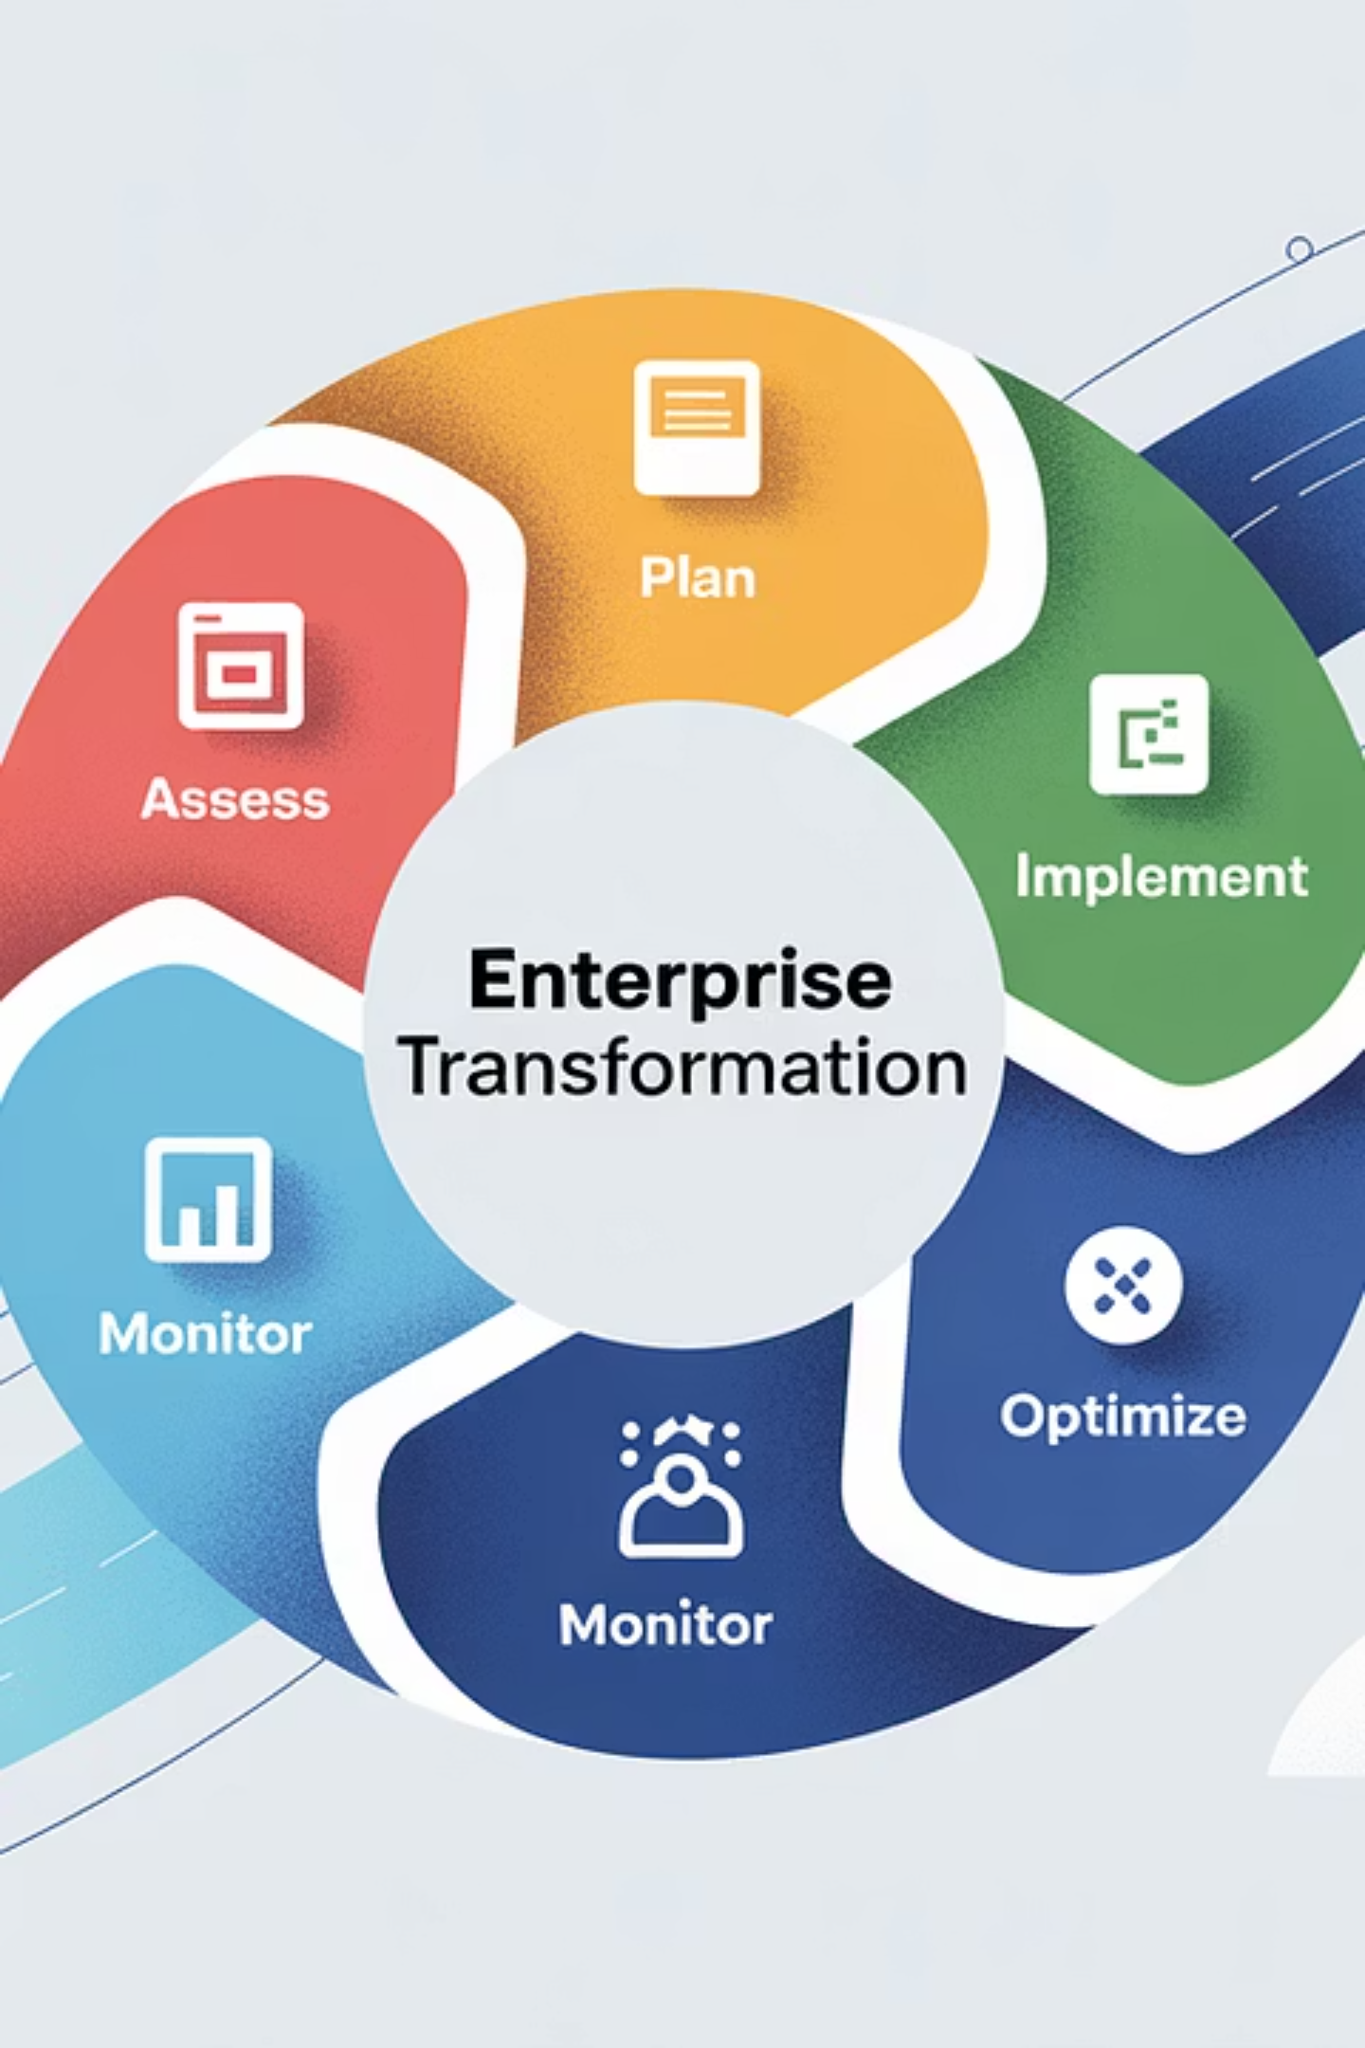
The Strategic Imperative: Beyond Traditional Marketing Projects
Traditional Project Focus
Transformation Program Reality
Isolated campaign launches
Multiple concurrent workstreams
Single system implementations
Cross-functional stakeholder alignment
Departmental process improvements
Enterprise-wide strategic integration
Tactical output measurements
Business impact measurement
Limited scope often results in fragmented value delivery and missed enterprise alignment opportunities.
Comprehensive orchestration creates sustainable competitive advantage through systematic change management.

Slide 3
The Three Pillars of Marketing Transformation Excellence
Holistic Thinking
Enterprise Alignment
Value Orientation
Integration across marketing, sales, and customer experience functions to eliminate silos and create unified customer journeys that drive measurable business outcomes.
Direct linkage between every transformation initiative and corporate growth objectives, ensuring resources are strategically allocated for maximum value creation.
Focus on business impact metrics rather than activity-based outputs, establishing clear ROI frameworks that demonstrate transformation success to executive stakeholders.

Slide 4

Strategic Orchestration
Leadership that guides diverse teams, vendors, and consultants toward shared transformation outcomes through structured governance and adaptive management.

Slide 5



The Strategic Leadership Framework
Clear Vision
Define transformation success metrics that extend beyond operational efficiency to include customer satisfaction, revenue growth, and market positioning improvements.
Structured Governance
Establish comprehensive frameworks for decision-making, escalation protocols, and accountability structures that enable rapid response to program challenges and opportunities.
Adaptive Leadership
Navigate transformation uncertainty while maintaining stakeholder confidence through transparent communication and flexible program management approaches.
Effective orchestration transforms complexity into clarity, ensuring all stakeholders maintain alignment toward shared transformation objectives.

Slide 6

Consulting Partnership Excellence
Strategic partnerships with consulting powerhouses like McKinsey, PwC, and BCG can accelerate innovation and provide external validation, but success requires careful balance between external expertise and internal ownership.
01
02
Leverage Expertise
Maintain Ownership
Utilize consulting insights to validate strategic direction and challenge existing assumptions while maintaining decision-making authority within the enterprise.
Ensure accountability and strategic control remain with internal leadership teams to build sustainable transformation capabilities.
03
Foster Collaboration
Create partnership models where internal teams and consultants complement each other's strengths for optimal transformation outcomes.

Slide 7
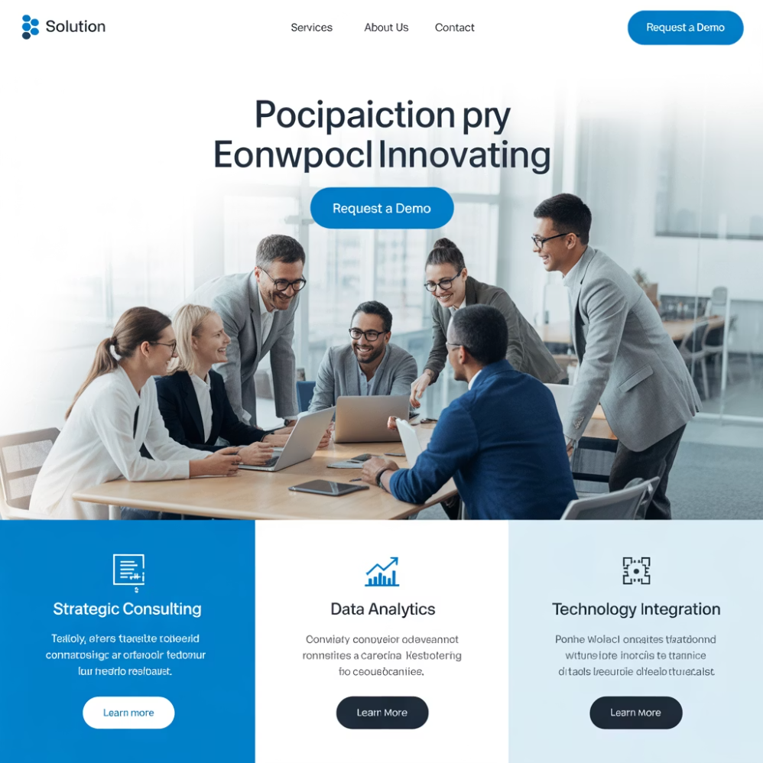

Balancing External Partnership with Internal Leadership
The Partnership Success Formula
The most successful marketing transformation programs achieve optimal balance between external consulting expertise and internal organizational knowledge. This requires establishing clear boundaries, maintaining strategic ownership, and creating collaborative frameworks that leverage the best of both worlds.
"External expertise accelerates innovation, but internal leadership ensures sustainable transformation."
Leaders must actively manage these relationships to prevent over-dependence while maximizing value from consulting investments.
Successful partnerships require clear governance structures that define roles, responsibilities, and decision-making authority from project inception.

Slide 8






Measuring Transformation Success
Transformation value must be continuously measured and communicated across three critical dimensions that demonstrate clear line of sight from program activities to enterprise outcomes.
Operational Efficiency
Reduced campaign cycle times, streamlined marketing processes, and improved MarTech ROI that demonstrate cost optimization and resource effectiveness.
Customer Impact
Enhanced personalization capabilities, improved engagement metrics, and elevated customer experience scores that directly correlate with retention and loyalty improvements.
Business Growth
Revenue acceleration, improved lead conversion rates, and enhanced market differentiation that validate transformation investment through measurable business outcomes.

Slide 9
Key Performance Indicators Dashboard
23%
40%
67%
$2.3M
Revenue Growth
Process Efficiency
Customer Engagement
Cost Savings
Average increase in marketing-attributed revenue during transformation programs
Reduction in campaign development cycle times through automation and optimization
Improvement in personalized marketing response rates across digital channels
Annual operational savings through MarTech consolidation and process optimization
These metrics represent typical enterprise-wide transformation outcomes when orchestrated through strategic program management approaches.

Slide 10

The Power of Strategic Storytelling
Executive Communication Strategy
Strategic storytelling transforms complex program activities into compelling narratives that maintain executive engagement and confidence. Through structured reporting, interactive dashboards, and strategic progress updates, leaders translate technical achievements into business insights.
Effective communication ensures senior stakeholders view transformation not as operational expense but as strategic investment with measurable returns. This narrative approach builds sustained support for long-term transformation initiatives.
1
Connect Activities to Outcomes
2
Demonstrate Progressive Value
3
Maintain Executive Engagement
Link specific program milestones to measurable business impacts
Show cumulative benefit delivery throughout transformation journey
Provide regular strategic updates that reinforce transformation importance

Slide 11





Transformation Success Factors
1
Strategic Vision
2
Executive Sponsorship
3
Cross-functional Alignment
4
Change Management Excellence
5
Technology Integration & Process Optimization
Marketing transformation success builds from foundational technology and process improvements through strategic vision and executive leadership. Each layer requires deliberate orchestration and stakeholder alignment.

Slide 12

Implementation Roadmap
Successful marketing transformation follows a structured approach that balances strategic planning with adaptive execution.
Phase 1: Foundation
Phase 3: Scale Deployment
Establish transformation governance, stakeholder alignment, and baseline measurement frameworks. Duration: 2-3 months.
Expand successful pilot programs across enterprise while maintaining quality and stakeholder engagement. Duration: 6-9 months.
1
2
3
4
Phase 2: Pilot Programs
Phase 4: Optimization
Launch targeted initiatives with selected business units to validate transformation approaches and build organizational confidence. Duration: 3-4 months.
Refine processes, measure outcomes, and establish continuous improvement frameworks for sustained value delivery. Duration: Ongoing.
Remember: Flexibility within structure enables responsive adaptation to changing business requirements while maintaining transformation momentum.

Slide 13

From Vision to Value: The Orchestration Imperative
Key Takeaways
The Path Forward
Marketing transformation succeeds through strategic orchestration, not isolated project execution
Success requires leaders who orchestrate with intent: aligning strategy, guiding execution, balancing partnerships, and relentlessly measuring value. This orchestration transforms marketing vision into measurable enterprise outcomes.
Effective leadership balances external consulting expertise with internal organizational ownership
Value measurement requires linking program activities to enterprise business outcomes
"Transformation is not about implementing tools—it's about orchestrating change that creates sustainable competitive advantage."
Strategic storytelling maintains executive engagement and supports sustained investment
Strategic orchestration turns transformation vision into enterprise-wide value delivery.

