Slide 1
Your First Step into Cloud: The Ultimate Guide to AZ-900
Launch your cloud computing career with Microsoft Azure Fundamentals. This beginner-level certification provides a solid foundation without requiring technical skills.
kW
by Kimberly Wiethoff

Slide 2
What Is the AZ-900 Certification?
Certification Basics
Exam Format
Accessibility
Validates foundational knowledge of cloud computing and Microsoft Azure services. Perfect for beginners and non-technical professionals.
40-60 multiple-choice questions. 60-minute time limit. Passing score: 700/1000.
Cost: ~$99 USD. No prerequisites required. Ideal entry point for cloud careers.

Slide 3
Cloud Concepts (25-30%)
Cloud Computing
Key Benefits
Fundamental principles and delivery models of cloud services
Scalability, elasticity, disaster recovery, high availability
Cloud Models
Service Models
Public, Private, Hybrid deployment options
IaaS, PaaS, SaaS and their use cases

Slide 4
Core Azure Services (15-20%)
Compute
Storage
Networking
Architecture
Virtual Machines, App Services, Azure Functions
Blob, File, Disk storage options
Virtual Networks, VPN Gateway, Load Balancer
Regions, availability zones, resource groups

Slide 5
Core Solutions and Management Tools (10-15%)
IoT & AI Solutions
Azure services for Internet of Things and Artificial Intelligence
Serverless Computing
Event-driven architecture without managing infrastructure
Azure Portal & CLI
Web interface and command-line tools for management
Monitoring Tools
Azure Monitor and Azure Advisor for optimization

Slide 6
Security and Network Features (10-15%)
Security Center
Unified security management and protection
Authentication
Identity verification and authorization controls
Network Protection
Azure Firewall, NSGs, DDoS protection
Key Vault
Secure storage for keys, secrets, and certificates

Slide 7
Identity, Governance, Privacy (20-25%)
Azure Active Directory
Identity and access management service
Governance Tools
Azure Policy, Locks, Tags for resource management
Compliance Features
Microsoft Trust Center, GDPR, Azure Blueprints

Slide 8
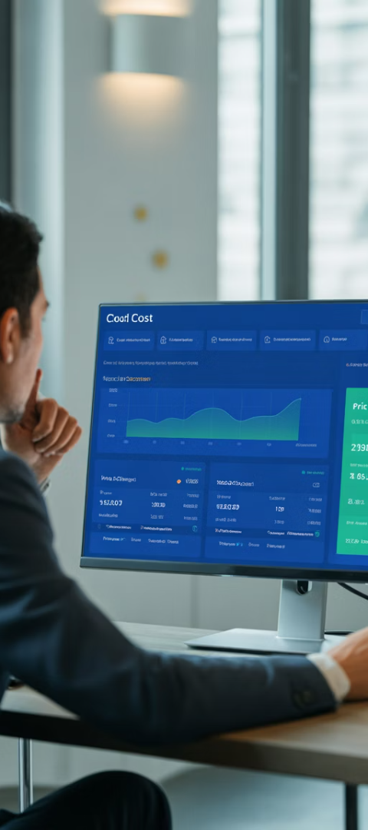
Azure Pricing and SLAs (10-15%)
Subscription Models
Different subscription types and support plans to meet various needs.
Pricing Calculators
Tools to estimate costs and optimize spending on Azure services.
Service Level Agreements
Understanding SLAs and how composite SLAs affect availability guarantees.
Service Lifecycle
How Azure services evolve from preview to general availability.

Slide 9
Best Resources to Prepare
Microsoft Learn
Video Courses
Practice Tests
Free official learning path with interactive modules and quizzes designed by Microsoft trainers.
Udemy courses by Scott Duffy or Alan Rodrigues.
ExamTopics, Whizlabs, and MeasureUp offer mock exams.
LinkedIn Learning for guided instruction.
Simulate the testing environment to build confidence.
Hands-on labs to practice concepts without cost.
Free YouTube tutorials on cloud concepts.

Slide 10
Tips for Success
Hands-On Experience
Use a free Azure account to explore services practically. This reinforces theoretical knowledge with real application.
Focus on Concepts
Understand core principles and service benefits rather than deep configurations or syntax details.
Review Compliance
Study the Microsoft Trust Center for compliance questions. These topics appear frequently on the exam.

Slide 11
Why AZ-900 Matters
Career Gateway
Employment Value
Entry point to cloud certification path
Demonstrates cloud understanding to employers
Knowledge Foundation
Advanced Certifications
Builds essential cloud computing concepts
Prepares for AZ-104, DP-203, AI-102

