Slide 1
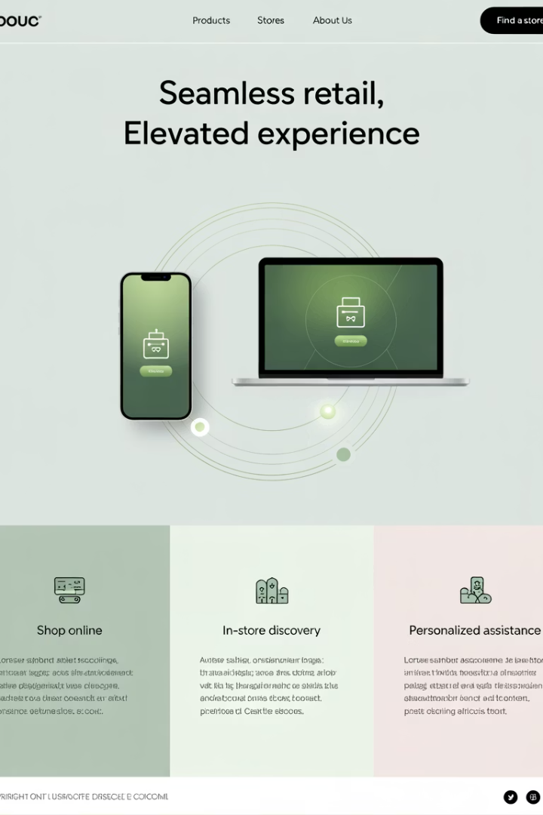
Managing Omnichannel E-Commerce Projects
In today's retail landscape, customers expect seamless experiences across every touchpoint. Project managers play a vital role in orchestrating the systems, departments, and touchpoints that make omnichannel commerce possible.
kW
by Kimberly Wiethoff

Slide 2
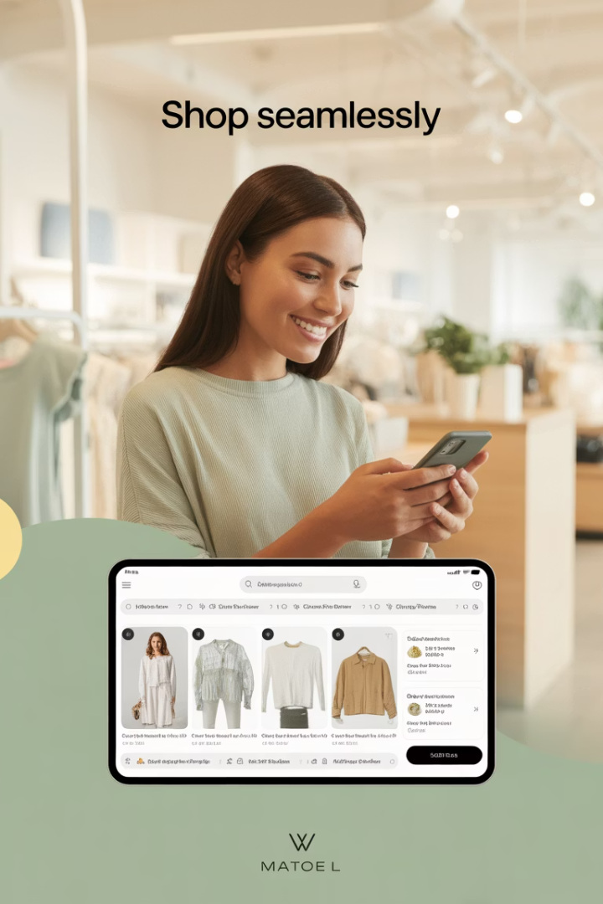
What is Omnichannel E-Commerce?
Consistent Experience
Connected Data
Provides integrated customer experience across all sales channels.
Ensures information flows between systems for a fluid customer journey.
Multiple Touchpoints
Integrates web, mobile, physical stores, marketplaces, and social media.

Slide 3
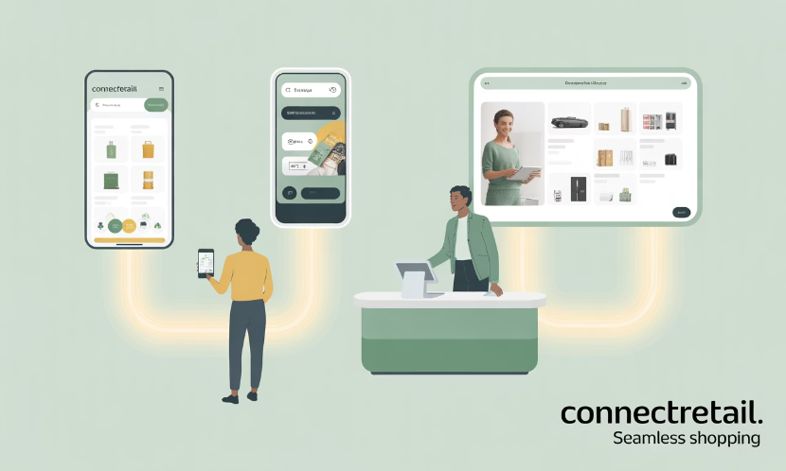
Omnichannel vs. Multichannel
Multichannel
Omnichannel
Each channel operates independently.
All channels are integrated.
Customer data stays within each channel.
Data flows freely between systems.
Disjointed customer experience.
Seamless customer journey.

Slide 4
Data Silos Challenge
Customer Data
Product Data
Purchase history, preferences, and contact information.
Pricing, descriptions, and availability across channels.
Integration
Inventory Data
Connecting POS, ERP, CMS, and CRM systems.
Stock levels across warehouses and stores.

Slide 5
Inventory and Fulfillment Complexity
Online Purchase
Customer orders through website or app.
Fulfillment Options
Ship from warehouse, store, or third-party.
Pickup Options
In-store, curbside, or locker pickup.
Return Options
Mail back or return to any store.

Slide 6
Brand Consistency Challenge
Marketing and design teams must deliver cohesive experiences across email, SMS, web, and physical environments. Without centralized oversight, brand messaging becomes inconsistent.

Slide 7
Cross-Functional Collaboration
IT
Marketing
Ensures systems integration and data flow.
Creates consistent messaging across channels.
Logistics
Coordinates inventory and fulfillment.
Sales
Manages transactions and customer relationships.
Customer Service
Provides support across all channels.

Slide 8
Essential Omnichannel PM Tools
Salesforce Commerce Cloud
Shopify Plus
Supports omnichannel features like POS and marketplace integrations.
Unifies customer journey across web, mobile, social, and in-store.
NetSuite ERP
Zendesk/Gorgias
Centralizes finance, inventory, and order management.
Integrates customer service across multiple channels.

Slide 9
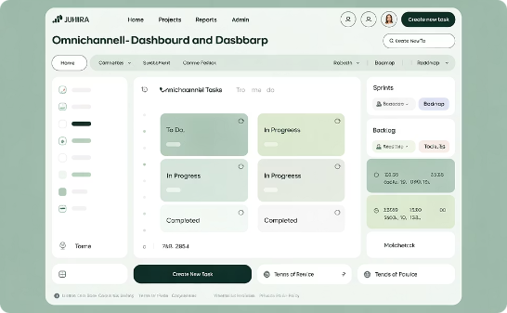
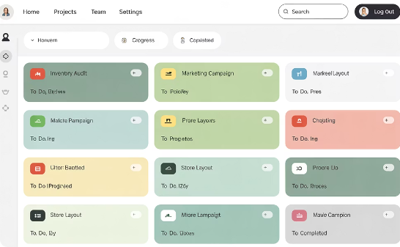
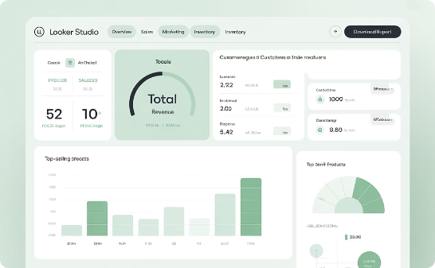
Project Management Tools
Jira
Trello
Looker Studio
Tracks complex workflows and dependencies across teams.
Visual task management for cross-functional collaboration.
Builds centralized dashboards to monitor cross-channel KPIs.

Slide 10
Customer Journey Mapping
Discovery
Customer researches products on social media and website.
Consideration
Browses on mobile app, saves items to wishlist.
Purchase
Visits store to try product, completes purchase.
Fulfillment
Chooses delivery or pickup option.
Loyalty
Receives personalized offers, makes repeat purchases.

Slide 11
Agile for Omnichannel Projects
MVP Release
Launch core functionality across primary channels.
Measure & Learn
Gather customer feedback and performance data.
Iterate & Improve
Enhance features based on insights.
Scale & Optimize
Expand to additional channels and use cases.

Slide 12
Omnichannel KPIs to Monitor
98%
85%
Inventory Accuracy
Order Fulfillment
Consistency between reported and actual stock levels.
Orders delivered on time and accurately.
3.2
24%
Channel Crossover
BOPIS Adoption
Average channels used per customer journey.
Percentage of online orders picked up in-store.

Slide 13
Keys to Omnichannel Success
Customer-Centric Experience
Seamless journey that builds trust and loyalty.
Cross-Functional Collaboration
Aligned teams with clear ownership and communication.
Integrated Systems
Connected platforms sharing real-time data.
Measurable Outcomes
Clear KPIs tracking business value and efficiency.

Slide 14
Final Thoughts
Omnichannel e-commerce isn't just a buzzword—it's a competitive necessity. As a project manager, your role is to connect the dots between platforms, people, and processes. That means more than just managing timelines. It means building an experience that earns customer trust, supports operational efficiency, and delivers measurable business value.
With the right tools, a clear plan, and cross-functional collaboration, you can successfully lead complex omnichannel initiatives and set your organization up for long-term success.
To stay competitive in today's retail landscape, e-commerce leaders need to embrace seamless customer experiences across platforms. This blog explores how project managers can lead complex omnichannel initiatives with the right tools, strategies, and KPIs.

