Slide 1

Running Effective PI Planning: A Project Manager's Survival Guide
Program Increment (PI) Planning is the heartbeat of the Scaled Agile Framework (SAFe®). It's where strategy meets execution, where cross-functional teams align on a shared vision, and where dependencies, risks, and objectives are tackled head-on.
For project managers navigating the world of SAFe, mastering PI Planning is key to driving alignment and delivery across multiple Agile teams. This guide breaks down the process step-by-step and provides actionable tips to help you succeed in this intense, fast-paced, and transformative event.
kW
by Kimberly Wiethoff

Slide 2




What Is PI Planning?
Two-Day Event
Core Purpose
A cadence-based gathering where all Agile teams on an Agile Release Train (ART) come together to plan work for the next increment (typically 8–12 weeks).
Define program objectives, identify team and cross-team dependencies, and plan and commit to the next Program Increment.
Key Outcome
Alignment on business objectives, dependencies, priorities, and delivery plans across all teams in the ART.

Slide 3












Key Participants in PI Planning
Product Management & Business Owners
Scrum Masters & Product Owners
Agile Teams
Break down features into user stories and estimate work
System Architects
Lead team-level planning activities
Present priorities and provide business context
Provide technical guidance and direction
Release Train Engineer (RTE)
Facilitates the entire event and ensures smooth execution
Stakeholders
Review plans and provide feedback

Slide 4

Project Manager's Role in PI Planning
Potential Roles
Key Responsibilities
Release Train Engineer (RTE)
Facilitating breakout sessions
Observer learning Agile practices
Managing risk and dependency tracking
Coordinator managing dependencies
Strategic Advisor ensuring alignment
Supporting alignment between teams
Translating strategy into execution
Value Added
Cross-team coordination
Visibility into dependencies
Risk identification and mitigation
Communication facilitation

Slide 5





Pre-PI Planning: Setting the Stage
Understand the Business Context
Get briefed on portfolio-level epics, upcoming features, and OKRs. Collaborate with Product Management and Business Owners to understand strategic goals.
Confirm Readiness
Ensure features are well defined, teams are staffed and available, and environments and tooling are prepped for collaboration.
Coordinate Cross-Team Dependencies
Work with Scrum Masters and POs to identify handoffs, integration points, and delivery overlaps.
Align Tooling and Logistics
Ensure digital tools are ready. For remote PI Planning, set up breakout rooms, timeboxes, and communication channels.

Slide 6





Day 1 Activities: Supporting Teams
Business Context
Help communicate the vision and priorities to all teams, ensuring everyone understands the strategic direction.
Team Breakouts
Assist teams as they estimate work, identify risks, and begin building their iteration plans for the upcoming PI.
Dependency Identification
Support teams in clarifying dependencies and risks, ensuring cross-team blockers are escalated early in the process.
Draft Plan Review
Coordinate with RTE, Product Managers, and Scrum Masters to review initial plans and address any alignment issues.

Slide 7

Day 2 Activities: Finalizing the Plan
Final Plan Review
Confidence Vote
Ensure each team's plan includes committed objectives, stretch objectives, and team confidence vote. Support the presentation of these plans to leadership and stakeholders.
Risk Management (ROAM)
Facilitate the team confidence voting process, where each team indicates their confidence level in meeting their committed objectives. Address concerns from teams with low confidence scores.
Team Plan Adjustments
Support teams as they refine their plans based on Day 1 feedback and newly discovered dependencies. Help negotiate resources and timing when conflicts arise between teams.
Guide teams through ROAMing risks - categorizing each as Resolved, Owned, Accepted, or Mitigated. Help escalate blockers that affect multiple teams and ensure ownership is clear.

Slide 8






Post-PI Planning: Driving Execution
Track and Communicate Progress
Use dashboards and metrics to keep stakeholders informed
Facilitate ART Syncs and Scrum of Scrums
Ensure ongoing alignment during the PI
Publish and Share the PI Plan
Document objectives and dependencies in a central workspace
After PI Planning concludes, your role shifts to execution support. Document all team objectives and dependencies in a central location like Confluence or Azure DevOps. Support the RTE in facilitating regular ART Syncs and Scrum of Scrums to maintain alignment throughout the PI execution period.

Slide 9








Continuous Improvement
Inspect
Adapt
Review what happened during the PI execution against what was planned
Identify improvements to processes, tools, and approaches
Iterate
Implement
Apply improvements to the next PI Planning cycle
Make concrete changes based on learnings
Participate actively in the Inspect & Adapt workshop at the end of each PI. Encourage honest feedback about what worked and what didn't during both planning and execution. Remember that PI Planning itself is an Agile process - each cycle is an opportunity to improve the event for next time.

Slide 10




Tips for Successful Facilitation
Timebox Religiously
Keep events on track with clear facilitation and scheduled breaks. Respect everyone's time by starting and ending on schedule, and be prepared to make tough calls when discussions run long.
Create Visual Clarity
Use online whiteboards or printed boards for shared understanding. Visual management helps teams quickly grasp dependencies and alignment issues that might otherwise remain hidden.
Foster Psychological Safety
Create an environment where teams feel comfortable speaking up about risks, issues, or blockers without fear of negative consequences or judgment.

Slide 11



Strategic Mindset for Project Managers
Think cross-team
Help identify and resolve blockers across boundaries
Focus on outcomes
Ensure everyone understands the value behind features
Facilitate, don't dictate
Lean into servant leadership to help others succeed
As a project manager in PI Planning, your greatest value comes from enabling others to succeed. Adopt a strategic mindset that prioritizes cross-team coordination and outcome-focused planning. Remember that your role is to facilitate the process, not control it - empowering teams to make their own commitments leads to greater ownership and accountability.

Slide 12


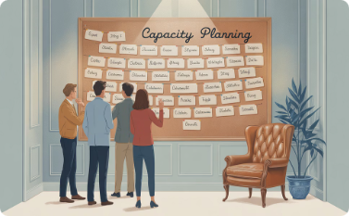
Common PI Planning Challenges
Dependency Overload
When teams discover too many cross-team dependencies, planning becomes complex and risky. Help teams identify the most critical dependencies and negotiate realistic delivery sequences. Consider suggesting API contracts or interface agreements to reduce tight coupling.
Distributed Teams
Remote or hybrid PI Planning introduces communication challenges. Ensure digital tools are accessible to all participants, establish clear communication protocols, and create dedicated facilitators for remote breakout rooms to keep everyone engaged.
Capacity Misalignment
Teams often struggle with balancing ambition and reality in their commitments. Guide teams to use historical velocity data when available, account for all non-feature work, and build in buffers for the unexpected to create realistic plans.

Slide 13
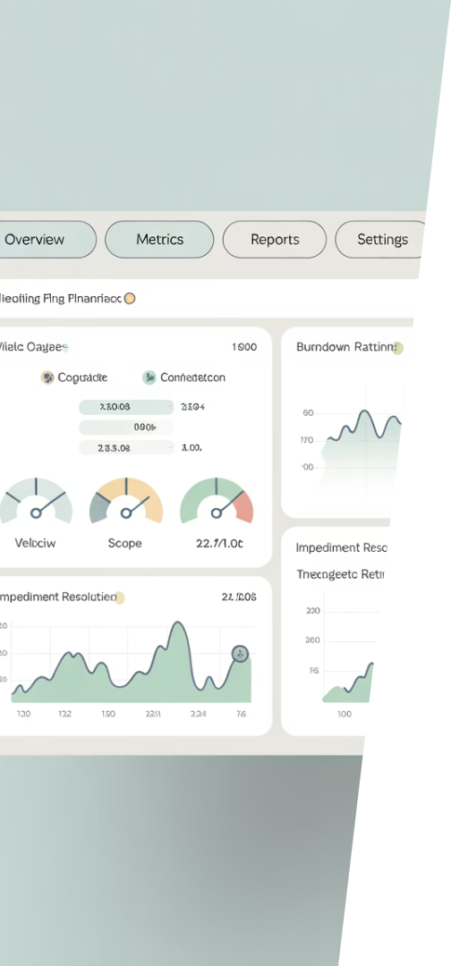
PI Planning Metrics and Success Indicators
85%+
90%
Team Confidence
Dependency Resolution
Average confidence vote across teams should be 8 or higher (on a scale of 1-10) for a healthy plan
Percentage of identified dependencies that have clear owners and delivery dates
75%
100%
Objective Achievement
Risk Categorization
Target percentage of committed objectives completed by the end of the PI
All identified risks should be properly ROAMed with clear ownership
Tracking these metrics helps gauge the health of both your PI Planning event and the subsequent execution. Low confidence votes or unresolved dependencies are early warning signs that should be addressed before finalizing the plan. During execution, monitor objective achievement to identify trends and improvement opportunities.

Slide 14

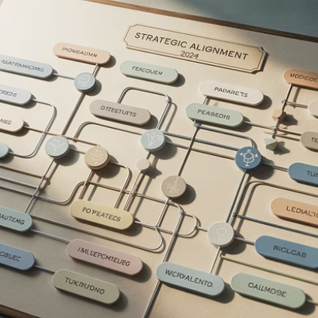


Final Thoughts: PI Planning as an Alignment Engine
PI Planning is more than just a meeting—it's a powerful alignment engine that fuels Agile delivery at scale. As a project manager, your organizational and facilitation skills make you an invaluable asset before, during, and after PI Planning.
Embrace your evolving role, support the Agile Release Train, and help turn strategic vision into synchronized execution. With each PI cycle, you'll build greater organizational agility and deliver more value to customers and stakeholders.

