Slide 1

Navigating the Complexities of Distributed Agile Teams
In today's global workplace, Agile practices face unique challenges as teams spread across time zones, continents, and cultures. While distributed Agile unlocks access to global talent and around-the-clock development, it introduces real-world obstacles in communication, collaboration, and cohesion.
This presentation explores the core challenges and proven strategies for managing distributed Agile teams effectively, providing project managers with practical tools to keep Agile thriving in remote settings.
kW
by Kimberly Wiethoff

Slide 2





The Reality of Distributed Agile
Global Talent Access
Teams may include developers in India, QA in Eastern Europe, product managers in New York, and designers in Brazil, bringing diverse perspectives and continuous work cycles.
Time Zone Gaps
Working across multiple time zones creates scheduling challenges for real-time collaboration, potentially causing delays in decision-making and feedback loops.
Communication Barriers
Cultural misunderstandings, language differences, and limited face-to-face interaction can impede the clear communication that Agile methodologies depend on.
Team Cohesion Challenges
Building trust and maintaining strong team dynamics becomes more difficult when members rarely or never meet in person.

Slide 3
The Agile Paradox in Distributed Teams
Traditional Agile Values
Distributed Reality
Face-to-face interactions
Virtual meetings
Co-located teams
Geographical separation
Real-time collaboration
Asynchronous work
Spontaneous problem-solving
Scheduled discussions
Direct communication
Tool-mediated communication
This fundamental tension requires us to rethink how we implement Agile principles while preserving their core intent. Success comes from adapting the framework to distributed contexts through intentional planning and modified practices.

Slide 4










Top Challenges of Distributed Agile Teams
Team Bonding and Trust
Remote members feel isolated from team dynamics
Lack of Shared Context
Different interpretations of backlog items
Tool Overload
Struggle with versioning and visibility
Time Zone Overlap Issues
Difficulty scheduling key ceremonies
Loss of Informal Communication
No hallway chats or spontaneous ideation
These challenges compound each other, creating a complex environment where traditional Agile practices may falter without thoughtful adaptation. Each challenge represents an opportunity to reimagine how Agile principles can be maintained in a distributed context.

Slide 5
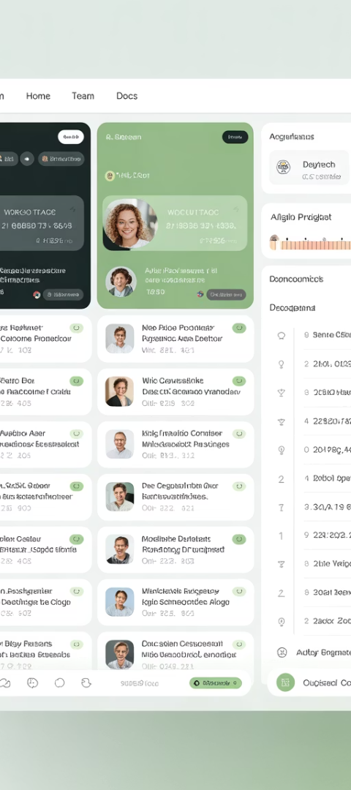
Leveraging Asynchronous Communication
Recorded Updates
Written Standups
Use tools like Loom to record sprint updates, demos, or explanations that team members can watch at their convenience.
Implement text-based daily standups in Slack or Teams where team members post accomplishments, plans, and blockers.
Include visual elements like screen sharing to improve clarity and understanding across language barriers.
Create dedicated channels for different workstreams to keep updates organized and relevant.
Shared Documentation
Maintain comprehensive, accessible documentation in tools like Confluence or Notion that serves as a single source of truth.
Designate documentation champions who ensure critical information is captured and updated.
Combine asynchronous communication with strategically scheduled live meetings per sprint to maintain human connection while respecting time zone differences.

Slide 6








Creating a Unified Tool Ecosystem
Backlog Management
Documentation
Standardize on one platform like Jira or Azure DevOps
Centralize in Confluence or similar knowledge base
Meetings & Workshops
Team Communication
Standardize on Zoom or Teams with Miro/Mural
Unify through Slack or MS Teams
Tool fragmentation creates confusion and reduces productivity. Maintain a clear "one tool per use case" policy and ensure all team members have proper access and training. Document tool usage guidelines and create templates to encourage standardization across locations.

Slide 7





The Documentation Imperative
Decision Records
Acceptance Criteria
Document the what, why, and how of key decisions to provide context for team members who weren't present in discussions.
Create detailed, unambiguous acceptance criteria that leave no room for misinterpretation across cultural and language differences.
Architecture Notes
Sprint Goals
Maintain living documentation of system architecture and technical standards to guide implementation across distributed teams.
Clearly articulate sprint goals and definitions of done to align team efforts regardless of location or time zone.
In distributed teams, documentation becomes the bridge that spans time zones and prevents misalignment. Treat documentation as a first-class citizen of your development process, not an afterthought.

Slide 8
Adapting Agile Ceremonies
Retrospectives
Sprint Reviews
Use tools like Miro that allow both synchronous and asynchronous participation. Consider an extended retrospective period rather than a single meeting.
Daily Standups
Create pre-recorded demos with a structured feedback form, followed by an optional live discussion. Compile and share all feedback regardless of source.
Sprint Planning
Implement a hybrid approach with a written component in a shared tool and optional sync meetings. Consider rotating the timing to share the burden of odd-hours meetings.
Break into multiple sessions: asynchronous backlog refinement followed by a focused live session in the time zone overlap window. Record all sessions for those who cannot attend.
Always follow up asynchronous ceremonies with comprehensive summaries that capture decisions, action items, and outstanding questions to keep everyone aligned.

Slide 9





Fostering Trust and Psychological Safety
Virtual Social Events
Schedule non-work connection time through coffee chats, virtual game sessions, or cultural exchanges.
Recognition Practices
Create dedicated channels for celebrating wins and acknowledging contributions across all locations.
Emotional Check-ins
Begin meetings with brief personal check-ins to build empathy and understanding of team members' contexts.
Failure Tolerance
Explicitly encourage experimentation and create blameless processes for addressing mistakes.
Trust enables teams to ask for help, take initiative, and fail fast—core Agile principles that become even more critical in distributed settings. Leaders must model vulnerability and create space for authentic connection despite physical distance.

Slide 10
Key Roles in a Distributed Agile Team
Role
Traditional Focus
Distributed Focus
Product Owner
Prioritization and value definition
Crystal-clear backlog items and accessible business context
Scrum Master
Process facilitation and impediment removal
Cross-time zone facilitation and cultural bridge-building
Developers/QA
Building and testing features
Proactive communication and comprehensive documentation
Project Manager
Coordination and reporting
Visibility maintenance and stakeholder alignment across regions
In distributed teams, each role takes on additional responsibilities related to communication, documentation, and bridge-building. This expanded focus requires specialized skills and a deep commitment to transparency and inclusivity.

Slide 11
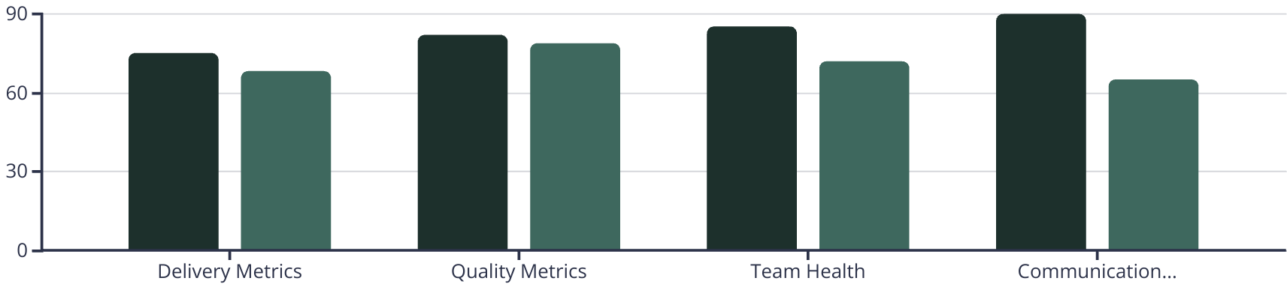
Metrics That Matter in Distributed Agile
Traditional Teams
Distributed Teams
While distributed teams may initially see lower metrics in some areas, implementing the right practices can close these gaps over time. Focus on tracking cycle time, lead time, velocity trends, and team satisfaction rather than activity metrics like hours online, which can encourage unhealthy behaviors.

Slide 12




Communication Strategies Across Time Zones
Create "Core Hours" Overlap
Identify and protect 2-3 hours of team overlap for essential synchronous activities
Implement Meeting Rotation
Fairly distribute the burden of off-hours meetings across all locations
Set Communication SLAs
Establish expected response times for different channels and priorities
Develop Cultural Awareness
Provide training on communication styles across cultures
Effective distributed teams recognize that communication must be intentional, not incidental. Create explicit agreements about how and when to use different communication channels, and regularly revisit these agreements to ensure they still serve the team's needs.

Slide 13
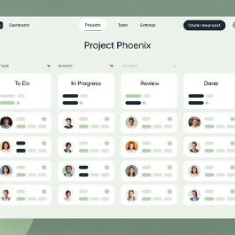


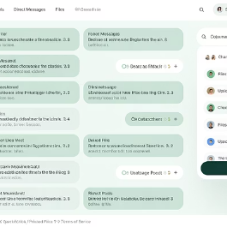
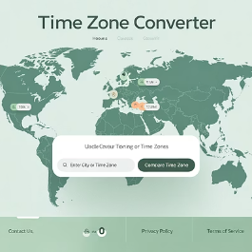
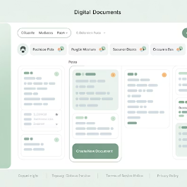
Technology Enablers for Distributed Agile
The right technology stack can dramatically improve distributed team effectiveness. Look for tools that support asynchronous collaboration, provide visibility into work progress, integrate seamlessly with each other, and reduce cognitive load rather than adding to it.
Evaluate your toolset regularly against team needs and be willing to change tools that aren't serving your distributed context well.

Slide 14

Key Takeaways for Distributed Agile Success
1
2
Embrace Asynchronous
Document Rigorously
Make async communication your primary mode, with synchronous as a supplement
Treat documentation as a first-class aspect of your development process
3
4
Build Relationships
Adapt & Evolve
Invest time in creating trust and psychological safety across distances
Continuously improve your distributed practices through regular reflection
Distributed Agile teams are here to stay—and they're thriving when supported with the right mindset, tools, and communication practices. Managing across time zones and cultures isn't a barrier—it's an opportunity to build high-performing, resilient teams that deliver value continuously.
The key? Lead with clarity. Communicate with intent. Empower with trust.

