Slide 1

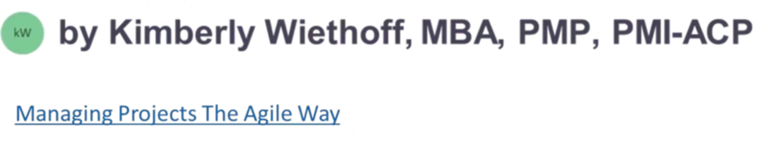
Beyond Velocity: The Agile Metrics That Actually Drive Success
Velocity may be the most well-known Agile metric—but it's also one of the most misunderstood. While useful for internal team planning, velocity alone tells you very little about actual business value, product health, or customer satisfaction.
Let's look beyond velocity and explore the Agile metrics that actually matter.
#AgileMetrics #BeyondVelocity #AgileKPIs #AgileLeadership #DataDrivenPM #ProjectManagementTips #ScrumMastery #LeanAgile #FlowEfficiency #ProductivityMetrics #TeamHealth #CustomerValue #ManagingProjectsTheAgileWay

Slide 2




Business Value Delivered
Why It Matters
Ensures Alignment
Agile isn't just about delivering fast—it's about delivering the right things.
Measures business value per sprint to ensure alignment with organizational goals.
How To Track It
Assign value points (monetary or strategic) to backlog items. Sum delivered value per iteration.

Slide 3
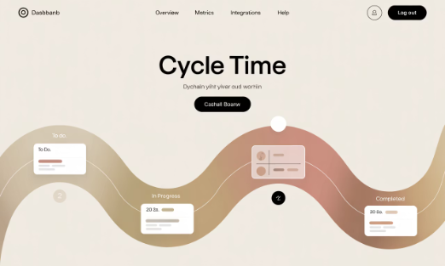
Lead Time & Cycle Time
Why It Matters
Cycle Time
Lead Time
These metrics reveal how long features take from concept to completion.
Start of work → Completion
Request submission → Delivery to user
They reflect system efficiency and bottlenecks far better than velocity.

Slide 4



Sprint Goal Success Rate
Set Clear Goals
Define meaningful sprint objectives beyond just completing tasks.
Track Completion
Measure percentage of sprints where stated goals were fully met.
Focus on Outcomes
Keep teams focused on outcomes, not just output.

Slide 5






Escaped Defects
Production Issues
Bugs found by customers
Quality Assurance
Issues caught during testing
Development Practices
Prevention through better coding
Bugs found in production directly signal product quality. Fewer escaped defects indicate better QA, testing, and team collaboration.

Slide 6








Team Happiness or Health Score
Team Morale
Burnout Prevention
Regular pulse checks on team satisfaction
Early detection of stress and fatigue
Performance
Collaboration
Happy teams deliver better results
Healthy teams work better together

Slide 7

Work in Progress (WIP)
Why It Matters
Benefits of WIP Limits
Too much WIP causes context switching, stress, and delays.
Limiting WIP encourages focus, flow, and faster delivery.
How to Track
Count active stories/tasks at any time. Visualize on kanban boards.

Slide 8





Predictability (Planned vs. Delivered Work)
Sprint Planning
Team commits to specific work items
Execution
Team works through committed items
Completion
Measure % of committed work delivered
Stakeholder Trust
Consistent delivery builds confidence

Slide 9
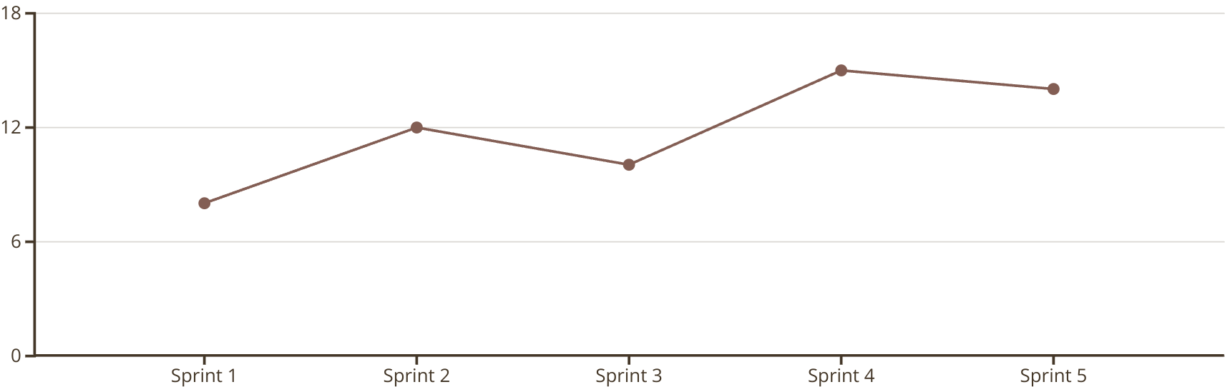
Throughput
Throughput measures completed work overtime—regardless of point estimation. It's a powerful alternative to velocity for Kanban or non-story-point frameworks.

Slide 10

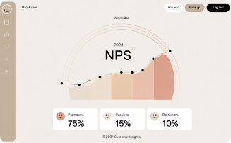

Customer Satisfaction (CSAT/NPS)
User Feedback
Post-release surveys capture direct user sentiment.
NPS Tracking
Net Promoter Score measures likelihood to recommend.
Usability Testing
Direct observation reveals actual user experience.

Slide 11





Time to Market
Ideation
Concept creation and validation
Development
Building the solution
Testing
Quality assurance
Release
Deployment to production
In competitive environments, speed to market can determine product success. This metric shows how quickly your organization adapts and delivers.

Slide 12




Final Thoughts
Velocity is an internal planning tool—not a universal measure of success. Effective Agile metrics reflect flow, quality, team health, and customer impact. When you measure what matters, you improve what matters. Agile isn’t about just doing more. It’s about doing what works, faster, smarter, and with greater value.

Slide 13

Related Reads
Agile Metrics
Top metrics for managing Scrum-based software development projects
KPI Comparisons
Agile KPIs vs. Traditional Project KPIs: What you need to know
Common Mistakes
KPI mistakes in project management—and how to avoid them
Visit ManagingProjectsTheAgileWay.com for more insights on effective Agile practices.

