Slide 1

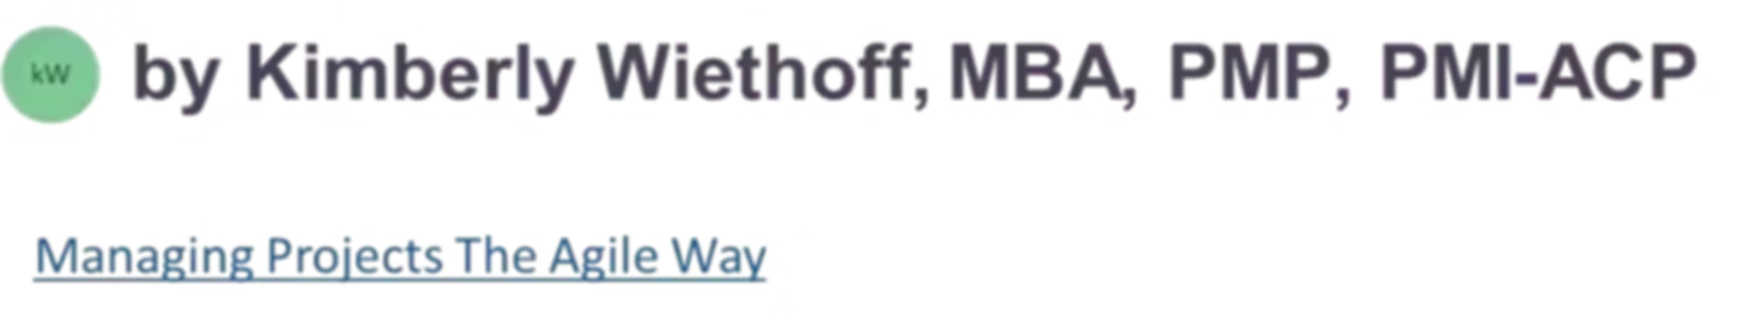
AI in Project Management: Transformative Features That Boost Productivity
Discover how artificial intelligence is revolutionizing project management, enhancing productivity while preserving the irreplaceable value of human leadership and insight.
#AIinProjectManagement #HumanCenteredLeadership #FutureOfWork #DigitalTransformation #AgileLeadership #ProjectManagement #PMThoughtLeadership #ResponsibleAI #LeadershipMatters #ChangeLeadership #EnterpriseDelivery #AgileAtScale #PMOExcellence #ManagingProjectsTheAgileWay

Slide 2
The Human-AI Partnership in Project Management
What AI Excels At
What Humans Bring
Data analysis and pattern recognition
Understanding team dynamics
Predictive modeling for forecasting
Emotional intelligence and empathy
Processing information at scale
Conflict mediation and trust-building
Identifying trends faster than humans
Intuitive decision-making
Automating routine tasks
Adaptability to changing circumstances
AI and human project managers form a complementary partnership. While AI provides powerful analytical capabilities and efficiency gains, human insight remains essential for navigating the complexities of team behavior, motivation, and the interpersonal dynamics that determine project success.

Slide 3

Why Human Leadership Remains Irreplaceable
"AI can alert us to issues and predict burnout based on data trends, but it can't foster the resilience and adaptability that teams often need. Project goals evolve based on external circumstances and client needs—requiring intuition and nuanced understanding that AI alone can't provide."
The so-called 'soft skills'—empathy, conflict resolution, and relationship building—are actually critical competencies that shape how effectively teams collaborate, innovate, and persevere through challenges. These human-centered abilities cannot be replicated by algorithms.

Slide 4






Six Transformative AI Features for Project Managers
Predictive Analytics
Task Automation
Forecast risks and optimize timelines
Smart assignment based on skills
Risk Identification
NLP Communication
Early detection and mitigation
Analyze sentiment and clarity
Real-Time Reporting
Admin Automation
Data-driven insights instantly
Free time for strategic focus

Slide 5

Predictive Analytics: Forecasting with Confidence
AI-powered predictive analytics revolutionize how project managers approach resource allocation and timeline forecasting. By analyzing historical project data and recognizing patterns across multiple variables, AI delivers accurate predictions about potential risks, delays, and bottlenecks.
This capability transforms reactive management into proactive leadership. Instead of responding to problems after they occur, managers can address challenges before they impact timelines or budgets. The result? Optimized project outcomes, more efficient resource utilization, and significantly reduced risk exposure.
Key benefits include: Earlier identification of schedule conflicts, more accurate budget projections, data-backed resource planning, and improved stakeholder confidence through transparent forecasting.

Slide 6




Automated Task Management: The Right Person, Right Task
AI transforms task allocation from a time-consuming manual process into an intelligent, automated system. By analyzing team members' skills, current workload, availability, and past performance, AI can assign tasks with precision that would take hours to achieve manually.
Skills Matching
Workload Balancing
Efficiency Gains
AI analyzes expertise and experience levels
Distributes tasks evenly across the team
Reduces bottlenecks and maximizes output
This automated allocation reduces administrative burdens dramatically, allowing managers to focus on strategic planning rather than scheduling logistics. Teams benefit from better work distribution, reduced burnout, and enhanced productivity through optimized task-to-talent matching.

Slide 7
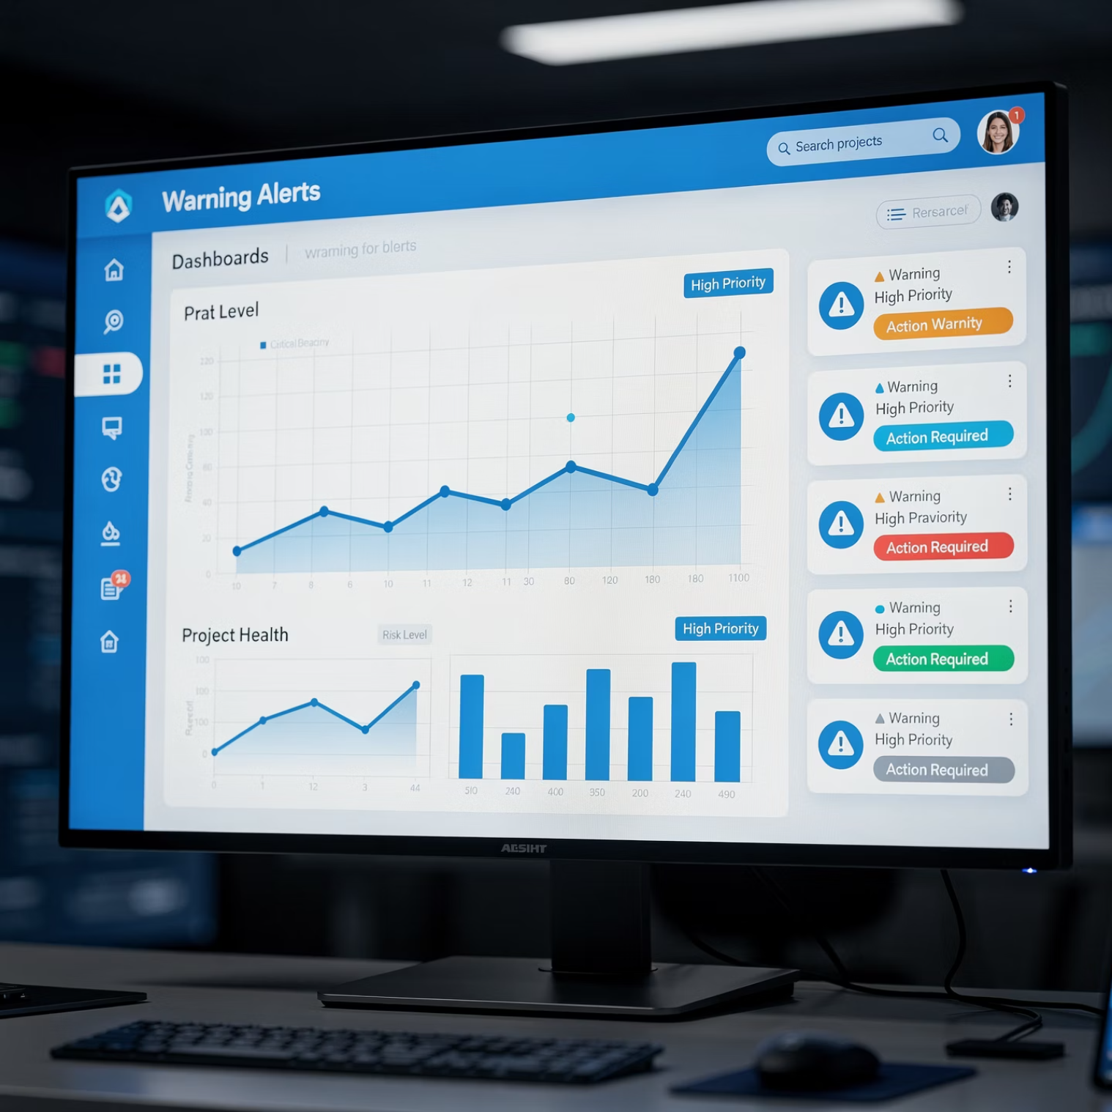

Risk Identification: Your Early Warning System
Continuous Monitoring
AI provides one of its most valuable capabilities through continuous risk monitoring. By tracking project parameters including budget utilization, timeline adherence, resource consumption, and quality metrics, AI serves as a vigilant guardian against emerging threats.
The system alerts managers to anomalies and patterns that signal potential issues—often before they're visible through traditional monitoring. Whether it's budget overruns, schedule slippage, or resource constraints, AI enables preemptive action that can save projects from costly delays or failures.
Real-world impact: Teams using AI risk identification report catching 40% more potential issues in early stages, when they're easiest and least expensive to address.

Slide 8
Natural Language Processing: Understanding Team Communication
01
02
Communication Analysis
Sentiment Detection
AI-driven NLP tools scan project communications across emails, messages, and documents
Algorithms gauge team sentiment, identifying frustration, confusion, or declining morale
03
04
Issue Identification
Manager Intervention
System highlights potential misunderstandings or communication breakdowns
Project managers receive actionable insights to address concerns proactively
For distributed teams spanning time zones and cultures, NLP provides invaluable visibility into team dynamics. By detecting communication patterns that signal problems, managers can intervene early to foster collaboration and maintain a positive work environment—especially critical when face-to-face interaction is limited.

Slide 9
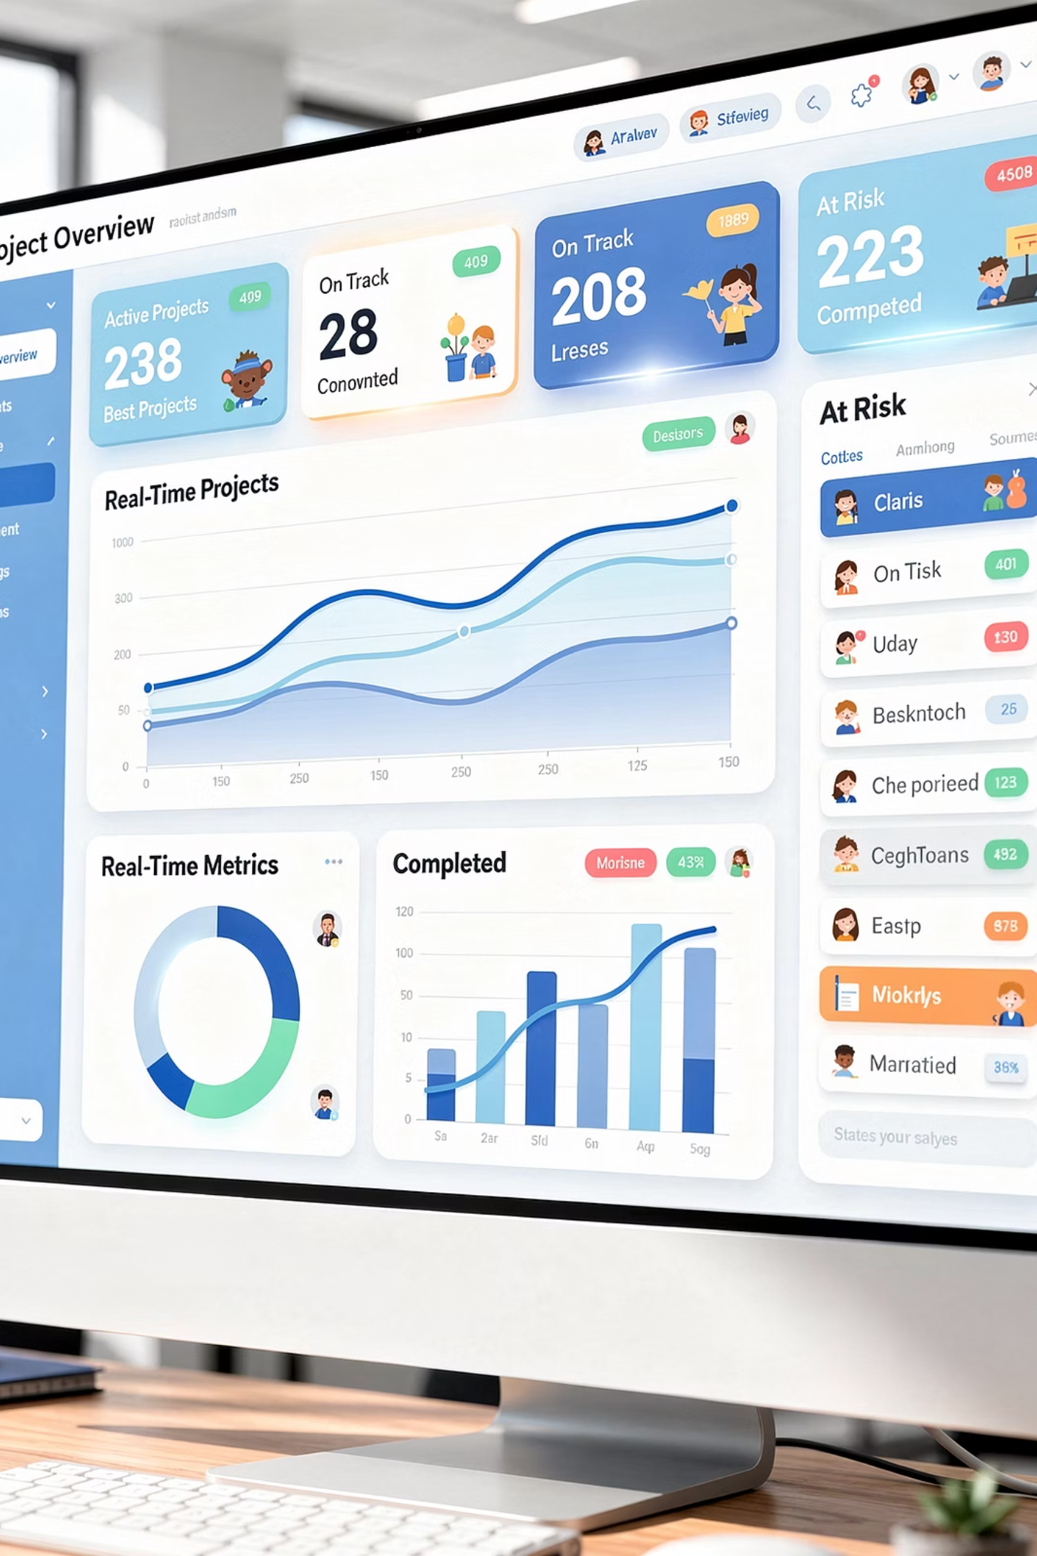
Real-Time Reporting: Data at Your Fingertips
Gone are the days of waiting for weekly status reports or manually compiling project data. AI-powered reporting delivers instant visibility into project health, performance metrics, and team productivity through dynamic, real-time dashboards.
Instant Visibility
Comprehensive Metrics
Access current project status without delay, enabling rapid response to changing conditions and immediate course corrections when needed.
Track everything from budget burn rates to individual productivity, milestone completion, and quality indicators in one unified view.
Informed Decisions
Make strategic adjustments based on the latest data rather than outdated snapshots, supporting more agile and responsive project management.

Slide 10
Reclaiming Time: Automating Administrative Tasks
Tasks AI Can Handle
What Managers Gain
Scheduling and rescheduling meetings based on availability
Strategic planning time
Generating status reports and summaries
Stakeholder relationship building
Updating project timelines automatically
Creative problem-solving opportunities
Sending reminder notifications
Team coaching and development
Documenting meeting notes and action items
Innovation and process improvement
Tracking time and expenses
By automating routine administrative tasks, AI liberates project managers from the minutiae that often consumes 30-40% of their workday. This shift allows leaders to focus on what truly requires human insight: strategic decision-making, stakeholder engagement, and developing their teams.

Slide 11
The Productivity Impact: Measurable Results
35%
42%
28%
51%
Time Savings
Faster Decisions
Risk Reduction
Accuracy Gains
Reduction in administrative overhead through automation
Improvement in decision-making speed with real-time data
Decrease in project delays through early risk detection
Improvement in forecasting accuracy with predictive analytics
Organizations implementing AI-powered project management tools are experiencing significant, measurable improvements across key performance indicators. These gains translate directly to competitive advantages in today's fast-paced business environment.

Slide 12

AI as Enhancement, Not Replacement
AI Cannot Replace
Human empathy, intuition, creative problem-solving, relationship building, adaptability to nuance, ethical judgment, and the ability to inspire and motivate teams through challenges.
AI Empowers Humans To
Make better decisions with data backing, respond faster to emerging issues, focus energy on strategic priorities, lead with greater confidence, and dedicate more time to the human elements that drive success.
"AI is a complementary partner, enhancing our ability to lead by handling routine tasks and data processing, but not a replacement for the human touch that's essential for project success."

Slide 13
Implementing AI: Strategic Considerations
Assessment Phase
1
Evaluate current processes, identify pain points, and determine where AI can provide the most value for your specific project management challenges.
2
Tool Selection
Choose AI solutions that integrate with existing systems, match team skill levels, and align with organizational goals and project complexity.
Team Training
3
Invest in comprehensive training to ensure team members understand both capabilities and limitations, building confidence in AI-assisted workflows.
4
Gradual Rollout
Start with pilot projects, gather feedback, refine processes, and scale successful implementations across the organization systematically.
Continuous Optimization
5
Regularly review AI performance, adjust parameters, incorporate user feedback, and stay current with evolving capabilities and best practices.

Slide 14
Embracing the Future of Project Management
AI has evolved from a futuristic concept to a practical, accessible tool that's actively reshaping project management today. By enhancing team collaboration, automating routine tasks, and providing unprecedented analytical capabilities, AI empowers project managers to elevate their focus toward strategy, creativity, and complex problem-solving.
As organizations navigate increasingly complex and dynamic environments, leveraging AI's transformative features leads to greater efficiency, improved decision-making, and higher-quality project outcomes. The technology handles the data-heavy lifting while human leaders bring the emotional intelligence, adaptability, and strategic thinking that no algorithm can replicate.
The Competitive Advantage
Teams that embrace AI today position themselves to remain agile, competitive, and ready to tackle tomorrow's challenges with innovative solutions and enhanced capabilities.
Embracing AI technology is not just an operational improvement—it's a strategic investment in the future of project management. The question is no longer whether to adopt AI, but how quickly you can integrate it to unlock your team's full potential.

