Slide 1
Microsoft Dynamics 365 for Project Managers
Discover the top features that will transform how you plan, execute, and deliver projects using Microsoft's powerful business platform.
kW
by Kimberly Wiethoff

Slide 2
Project Operations Module
Reporting
Access real-time analytics on project performance
Time Tracking
Log hours against project tasks
Planning
Create detailed project schedules
Quoting
Generate accurate project estimates
The Project Operations Module centralizes all project data. This integration helps you make data-driven decisions throughout the project lifecycle.

Slide 3
Work Breakdown Structures
Monitor Progress
Assign Resources
Track completion against the structured roadmap.
Create Task Hierarchy
Link team members to specific deliverables.
Define Project Scope
Structure tasks and subtasks with clear dependencies.
Break down high-level objectives into manageable components.
WBS provides a clear roadmap of deliverables and timelines. This ensures alignment with project goals and simplifies complex projects.

Slide 4
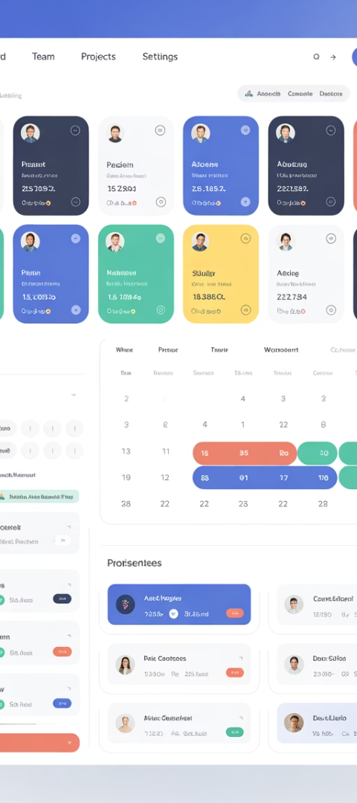
Resource Scheduling and Forecasting
Identify Skills
Match project requirements with team capabilities.
Check Availability
View resource calendars across multiple projects.
Allocate Resources
Assign team members to tasks based on capacity.
Forecast Needs
Predict future resource requirements.
Effective resource scheduling enhances capacity planning. It helps reduce conflicts and bottlenecks across your project portfolio.

Slide 5
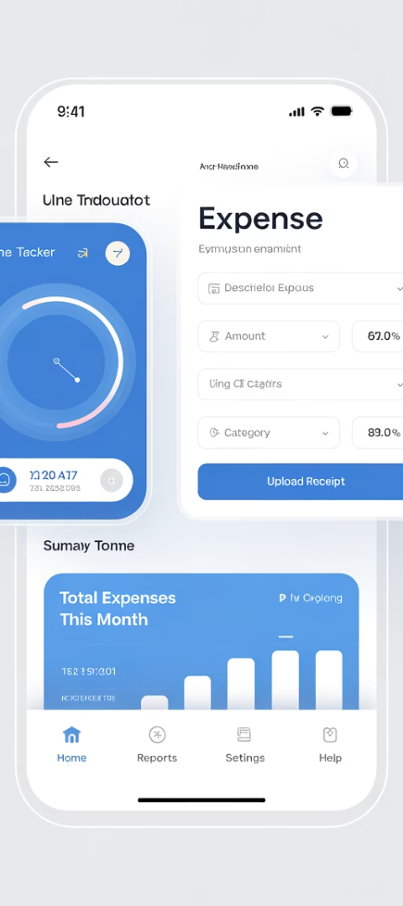
Time and Expense Tracking
Mobile Time Entry
Expense Management
Team members log hours from anywhere using the mobile app.
Capture and categorize project expenses with receipt uploads.
Project-specific timesheets
Receipt scanning
Task categorization
Expense categories
Approval Workflows
Streamline reviews with automated approval routing.
Multi-level approvals
Notification alerts
Accurate time and expense tracking supports precise project costing. This leads to better financial forecasting and client billing.

Slide 6
Project Budgeting and Cost Control
Budget Setup
Real-time Tracking
Variance Analysis
Create detailed project budgets with cost categories and revenue forecasts.
Monitor actual costs against planned expenditures as they occur.
Identify budget deviations early with automated variance calculations.
View burn rates and forecast completion costs with predictive analytics.
Link budgets directly to work breakdown structures for granular control.
Drill down to root causes of overruns for corrective action.
Integrated financial tracking keeps projects on budget. Early variance detection helps prevent costly overruns.

Slide 7
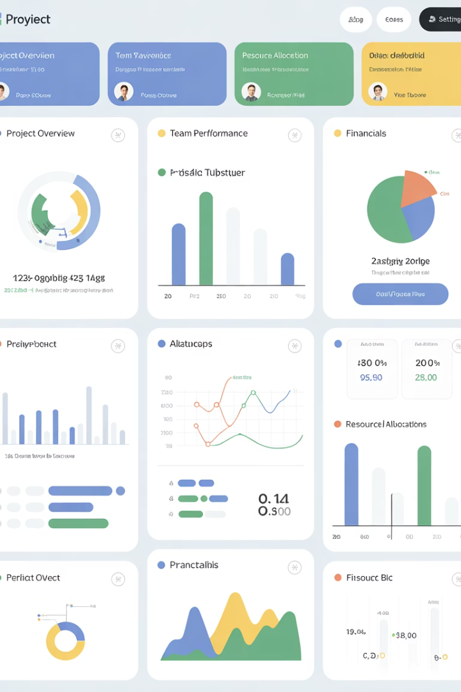
Power BI Dashboards
360°
15+
5min
Project View
KPI Templates
Refresh Rate
Complete visibility across all project dimensions
Pre-built visualizations for instant insights
Near real-time data updates for current status
Power BI dashboards transform complex project data into visual insights. This improves transparency and supports faster, informed decision-making.

Slide 8
Microsoft Teams Integration
Chat & Meetings
Document Sharing
Discuss project details without switching platforms
Access and collaborate on project files
Notifications
Task Updates
Receive alerts about project changes
Update project tasks during team conversations
Teams integration promotes better collaboration and communication. Your team stays aligned without switching between different applications.

Slide 9
Automated Workflows and Alerts
Define Triggers
Configure Actions
Deploy Workflow
Set conditions that initiate automated processes.
Specify what happens when triggers are activated.
Activate the automation throughout your project.
Task completions
Approval requests
Testing deployment
Budget thresholds
Email notifications
User adoption
Timeline milestones
Status updates
Permissions setup
Power Automate integration saves time on repetitive tasks. It ensures compliance with project governance and approval processes.

Slide 10
Risk and Issue Tracking
Identify Risks
Assess Impact
Plan Mitigation
Assign Ownership
Document potential problems before they occur.
Rate probability and consequence for prioritization.
Create response strategies for each risk.
Delegate responsibility for risk management.
Proactive risk management prevents project disruptions. Tracking encourages accountability and ensures timely resolution of issues.

Slide 11
Client Billing and Invoicing
Time-and-Materials
Fixed-Price
Bill clients based on actual hours and expenses.
Invoice based on pre-defined project milestones.
Recurring Billing
Progress Billing
Automate monthly or quarterly client charges.
Generate invoices based on completion percentage.
Automated billing reduces manual errors and administrative time. Direct integration with project data improves cash flow visibility.

Slide 12
Contract Management
Contract Creation
Generate agreements from pre-approved templates
Approval Process
Route contracts through required stakeholders
Digital Signing
Collect electronic signatures securely
Obligation Tracking
Monitor deliverables against contractual terms
Effective contract management ensures project delivery meets legal obligations. This reduces risks and strengthens client relationships.

Slide 13
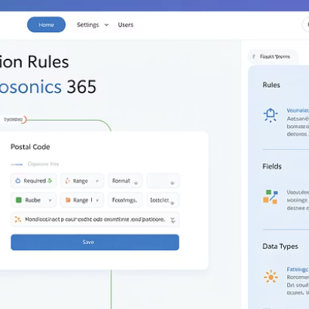
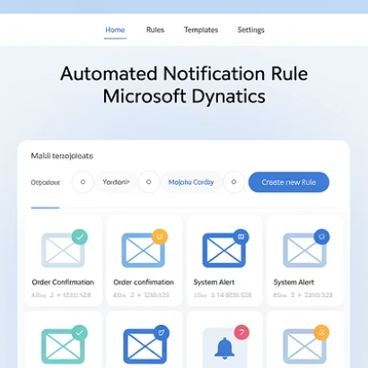
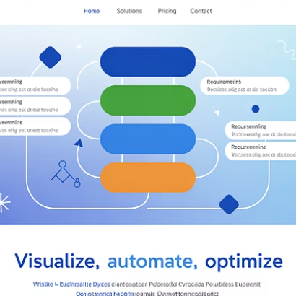
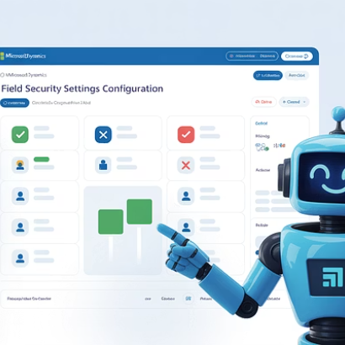
Custom Business Rules
Create custom business rules without coding. Configure validations, notifications, and automated actions that match your project methodology.

Slide 14
Mobile Accessibility
Cross-Platform Access
Offline Capabilities
Use Dynamics 365 on iOS, Android, and Windows devices. Access critical project data from anywhere.
Continue working without internet connection. Changes sync automatically when back online.
Secure Authentication
Push Notifications
Protect sensitive project information with multi-factor authentication. Manage device access controls.
Stay informed with real-time alerts. Receive updates about critical project events immediately.
Mobile access ensures project management continues outside the office. This flexibility improves response times and decision-making.

Slide 15
Next Steps for Project Managers
Microsoft Dynamics 365 transforms how project managers work. Start with proper training, map your processes, then customize the platform to your needs.

Slide 16
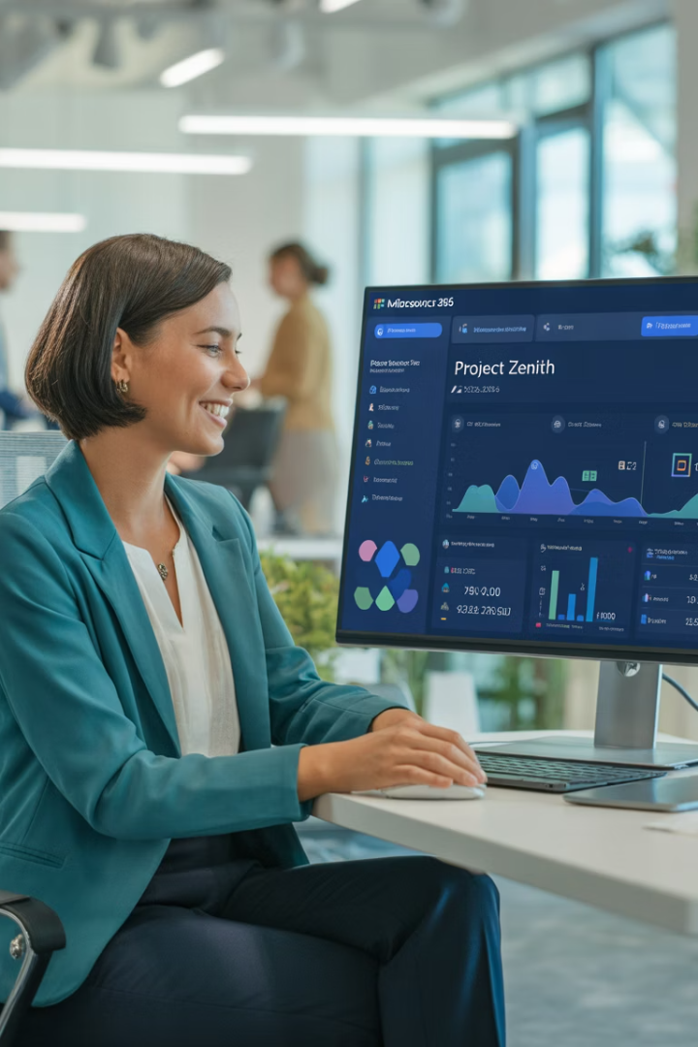
Final Thoughts
Microsoft Dynamics 365 is more than just an ERP or CRM system—it's a comprehensive toolset that empowers project managers to plan better, execute faster, and deliver value more effectively. Mastering these features can elevate your project management game and align execution with strategic business goals.

