Slide 1

Essential Agile Metrics for Scrum Excellence
Welcome to our comprehensive guide on the top Agile metrics that can transform your Scrum-based software development projects. As the Agile landscape continues to evolve, measuring the right things becomes increasingly critical for success.
In this presentation, we'll explore ten powerful metrics that provide actionable insights, enhance predictability, and drive continuous improvement for Scrum teams. Whether you're a seasoned Scrum Master or a Product Owner looking to optimize your processes, these metrics will help you navigate the complex world of Agile project management with confidence.
kW
by Kimberly Wiethoff

Slide 2

Understanding Velocity: Your Team's Delivery Rhythm
24
8
15%
Average Story Points
Sprints
Velocity Variance
Completed per sprint by mature teams
Minimum for reliable velocity baseline
Acceptable fluctuation between sprints
Velocity measures the amount of work a team completes during a sprint, typically measured in story points. This metric establishes a consistent delivery rhythm and serves as the foundation for sprint planning. By tracking velocity over time, teams can more accurately forecast how much work they can commit to in future sprints.
Remember that velocity is unique to each team and should never be used for cross-team comparisons. Focus instead on stability and gradual improvement as indicators of team maturity and process refinement.

Slide 3




Sprint Burndown: Real-Time Progress Visualization
Day 1: Sprint Planning
The Sprint Burndown chart visualizes the remaining work in a sprint, typically showing a downward trend toward zero. This powerful visual indicator helps teams identify whether they're on track to complete all planned work and provides early warning signals when progress stalls.
Establish initial scope and commit to sprint goal
Days 2-9: Daily Progress
Track remaining work against ideal burndown line
Mid-Sprint: Alert Period
Identify potential issues if burndown plateaus
Day 10: Sprint Completion
Evaluate final delivery against commitment

Slide 4
Epic and Release Burndown: Long-term Progress Tracking
1
2
3
4
Sprint 1
Sprint 3
Sprint 5
Sprint 7
Initial feature implementation started, 20% of epic completed
Core functionality delivered, 50% epic completion milestone reached
Integration testing reveals additional requirements, scope adjustment
Epic completion and feature release to production environment
While Sprint Burndown focuses on immediate progress, Epic and Release Burndown charts track advancement toward completing larger initiatives or product releases. These charts visualize the reduction in remaining work across multiple sprints, providing essential transparency for long-term planning.
This broader view helps Product Owners and stakeholders understand progress toward significant business objectives and supports more accurate release forecasting and expectation management.

Slide 5








Lead Time: Measuring End-to-End Efficiency
Idea Creation
Backlog Refinement
User story added to product backlog
Story prioritized and prepared for sprint
Deployment
Development
Story delivered to production
Coding, testing, and review processes
Lead time measures the total duration from when a user story is created until it's delivered to production. This comprehensive metric reveals your overall process efficiency and responsiveness to business needs. Shorter lead times indicate a healthier development pipeline and greater organizational agility.
By analyzing lead time trends, teams can identify upstream bottlenecks that might be invisible in sprint-level metrics, such as backlog refinement delays or approval processes that slow down value delivery.

Slide 6




Cycle Time: Development Process Efficiency
Development Started
Task moved to "In Progress"
Code Review
Pull request submitted and reviewed
Testing Complete
Quality assurance approval
Task Complete
Ready for deployment
Unlike lead time, cycle time focuses specifically on how long it takes to complete a user story once development actively begins. This metric directly reflects your team's development efficiency and helps identify bottlenecks within the implementation process.
Tracking cycle time by work item type (user stories, bugs, technical debt) can reveal valuable patterns about where your team excels or struggles. This insight allows for targeted process improvements that directly impact delivery speed.

Slide 7
Work in Progress (WIP): Maintaining Focused Delivery
Context Switching Costs
Optimal WIP Limits
Flow Efficiency
Studies show that developers lose up to 20% productivity when frequently switching between multiple tasks. Limiting WIP reduces these costly context switches and improves focus.
Most effective teams maintain a WIP limit of 1-2 items per developer. This constraint forces resolution of blockers rather than allowing team members to simply start new work.
Lower WIP correlates with higher flow efficiency as items move through the development process more quickly with fewer delays in intermediate states.
Work in Progress (WIP) tracking ensures teams don't overcommit by limiting the number of items being worked on simultaneously. This constraint forces focus, reduces multitasking, and prevents the inefficiency that comes with context switching.
Effective WIP limits vary by team size and maturity, but the principle remains: fewer items in progress leads to more items actually getting completed.

Slide 8
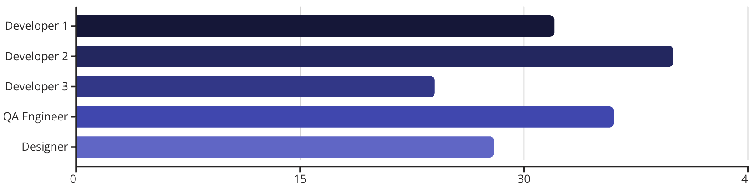
Team Capacity: Realistic Sprint Planning
Team capacity planning accounts for each member's availability during a sprint, considering factors like planned time off, holidays, and non-sprint commitments. This realistic assessment prevents overcommitment and supports sustainable development practices.
By comparing actual capacity with velocity, teams can make more informed decisions during sprint planning and avoid the disappointment of missed commitments. This approach also helps identify resource constraints that might otherwise remain hidden.

Slide 9





Cumulative Flow Diagram: Visualizing Workflow Health
Done
1
Completed work steadily increasing
Testing
Consistent band thickness indicates good flow
In Progress
Expanding band signals potential bottleneck
Ready
Stories prepared for development
Backlog
Total work scope
The Cumulative Flow Diagram (CFD) provides a comprehensive visualization of how work items flow through different states over time. Each colored band represents a stage in your workflow, with the width indicating the number of items in that state.
A healthy CFD shows smooth, parallel bands moving upward over time. Expanding bands signal bottlenecks where work is accumulating, while narrowing bands might indicate starvation or process gaps. This powerful visual tool helps identify workflow issues that might be invisible in other metrics.

Slide 10
Escaped Defects: Maintaining Quality Standards
Defect Categories
Prevention Strategies
Key Indicators
Critical: Service outage or data corruption
Test-driven development practices
Defect escape rate decreasing over time
Major: Significant feature impairment
Automated regression testing
Time to fix trending downward
Minor: Cosmetic or non-critical issues
Dedicated QA resources
Balanced focus between new features and quality
Pre-release user acceptance testing
Escaped Defects tracks bugs discovered after features have been released to production. This critical quality metric reveals gaps in your team's testing practices and helps refine your Definition of Done to prevent similar issues in the future.
Tracking both the volume and severity of escaped defects provides insights into the effectiveness of your quality assurance processes. A mature team should see this metric trending downward over time as testing practices improve and technical debt is addressed.

Slide 11








Sprint Goal Success Rate: Delivering Value, Not Just Tasks
Clear Goal Definition
Team Alignment
Sprint goals should be specific, measurable, and focused on business value
Everyone understands how their work contributes to the sprint goal
Historical Tracking
Success Measurement
Success rate over time reveals team maturity and planning effectiveness
Binary assessment: was the intended value delivered?
Sprint Goal Success Rate measures how often teams achieve the business objectives they committed to during sprint planning. Unlike task completion metrics, this focuses on outcomes rather than outputs, emphasizing the delivery of actual business value.
A consistently high success rate indicates that the team understands business priorities, plans effectively, and delivers meaningful increments of value. Low success rates might signal unclear requirements, overly ambitious planning, or misalignment with business needs.

Slide 12




Implementing Metrics: Best Practices for Success
Balance Metrics
Start Small
Combine throughput, quality, and value metrics to avoid optimizing for a single dimension at the expense of others.
Begin with 3-5 metrics that address your most pressing challenges rather than tracking everything possible.
Ensure Visibility
Discuss Regularly
Make metrics transparent and accessible to the entire team to foster ownership and awareness.
Review metrics during sprint retrospectives to identify trends and improvement opportunities.
Successful metric implementation requires more than just data collection—it demands a thoughtful approach that balances quantitative measurement with team empowerment. Metrics should never be used as performance evaluation tools that create fear or drive unhealthy behaviors.
Instead, treat metrics as learning tools that spark meaningful conversations and guide improvement efforts. Involve the team in selecting and interpreting metrics to build ownership and ensure the data serves the team rather than controlling it.

Slide 13




Warning Signs: When Metrics Become Counter-Productive
Gamification
Micromanagement
Metric Obsession
Team Comparisons
Teams manipulate work to improve metrics rather than deliver value. For example, breaking stories into tiny tasks to inflate velocity or cherry-picking easy items to improve cycle time.
Managers use metrics to control teams rather than empower them, leading to decreased autonomy and motivation. Daily demands for metric explanations signal distrust.
Teams focus exclusively on improving numbers while losing sight of customer value and team health. The metrics become the goal rather than a means to assess progress.
Organizations rank teams based on metrics, creating unhealthy competition and discouraging collaboration. Each team's context is unique, making direct comparisons invalid.
While metrics provide valuable insights, they can become detrimental when misused. Watch for these warning signs that indicate your metrics approach needs adjustment. Remember that metrics should serve the team, not the other way around.

Slide 14




Advanced Metrics for Mature Agile Teams
Business Value Delivery
Technical Health Metrics
Predictability Metrics
Team Health
Beyond story points, measure actual business outcomes like revenue generated, cost savings, or user adoption metrics tied directly to development work. This connects technical delivery to business impact.
Track code quality indicators such as test coverage, technical debt ratio, and deployment frequency. These metrics help ensure sustainable development practices and prevent future slowdowns.
Measure forecast accuracy and commitment reliability over time. Teams with high predictability earn greater trust from stakeholders and gain more autonomy in planning and execution.
Monitor team satisfaction, psychological safety, and sustainable pace metrics. Healthy teams consistently outperform stressed or disengaged teams, making these "soft" metrics critical to long-term success.
As teams mature in their Agile journey, they can incorporate more sophisticated metrics that go beyond basic flow and throughput. These advanced measurements connect development activities more directly to business outcomes and sustainability.
The most mature Agile organizations develop custom metrics specific to their unique context and challenges, often combining quantitative and qualitative data for a complete picture of performance and health.

Slide 15

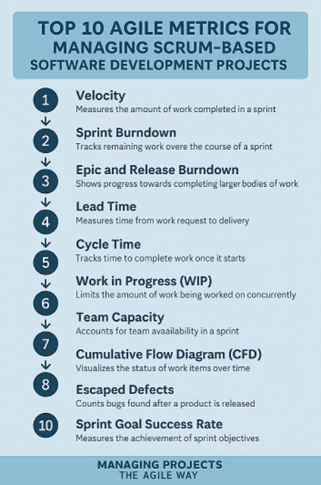
Top 10 Metrics for Agile Excellence
Investing in custom metrics tailored to the organization's needs can provide deeper insights into performance and health. By combining both quantitative and qualitative data, companies can create a holistic view that guides strategic decision-making and drives continuous improvement. Custom metrics also allow companies to adapt their measurement strategies as the organization evolves and faces new challenges.

Slide 16

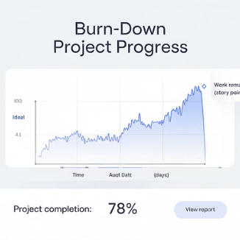



Key Takeaways: Metrics for Agile Excellence
Throughout this presentation, we've explored ten essential Agile metrics that provide a comprehensive view of your Scrum teams' performance, from velocity and burndown charts to lead time and sprint goal success rate. Each metric offers unique insights that, when combined, create a holistic picture of your development process.
Remember that metrics should drive improvement, not judgment. Start by implementing a few key measurements that address your most pressing challenges, then expand as your team matures. Always use metrics as conversation starters that lead to meaningful improvements in how your team delivers value.
Your Agile journey is unique—customize these metrics to fit your specific context and evolve your measurement approach as your team grows. The ultimate goal isn't perfect metrics but better outcomes for your customers.

