Slide 1
Mastering ATS Resume Optimization
In today's competitive job market, a well-crafted resume needs to impress both hiring managers and Applicant Tracking Systems (ATS). These automated systems scan and rank resumes based on relevance to job descriptions, acting as gatekeepers to human reviewers.
Optimizing your resume for ATS systems is no longer optional—it's essential for getting noticed in the digital hiring landscape. This presentation will guide you through proven strategies to improve your resume's ATS score and significantly increase your chances of landing interviews.
kW
by Kimberly Wiethoff

Slide 2
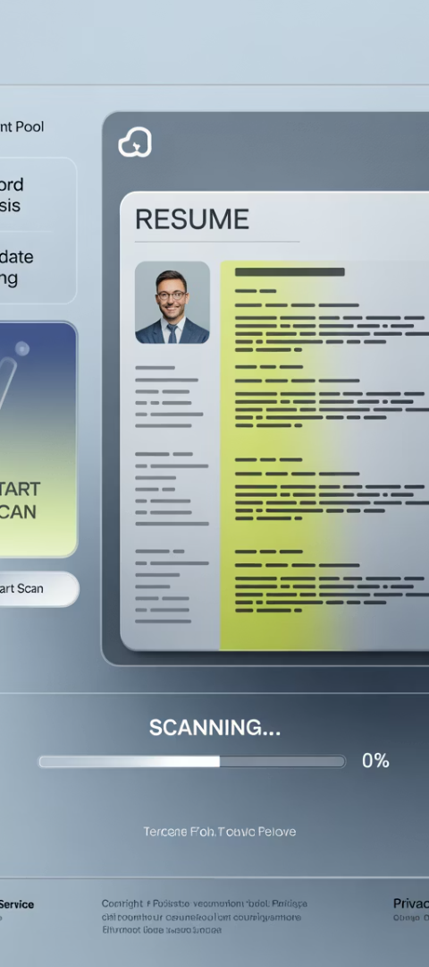
Understanding ATS Systems
Digital Gatekeepers
Keyword Analysis
ATS systems automatically scan and rank resumes based on relevance to the job description before human eyes ever see them.
These systems search for specific keywords, skills, and qualifications that match the job posting requirements.
Format Sensitive
ATS software can struggle with complex formatting, images, and non-standard document structures.

Slide 3
Keyword Optimization Strategies
Tailor Your Resume
Example
Customize your resume for each job by including relevant keywords from the job posting. If the description mentions "cybersecurity" or "cloud technologies," incorporate these terms in your resume.
Instead of simply stating, "Managed IT projects," you could say:
Led Agile IT projects focusing on cloud-based digital transformation, improving efficiency by 20%.
Use different forms of keywords where appropriate. For instance, if the job mentions "Agile methodologies," also include "Scrum" or "Kanban."
This approach naturally incorporates multiple keywords while providing specific, valuable information about your experience.

Slide 4
ATS-Friendly Formatting
Simple Structure
Stick to a clean, straightforward format with common fonts like Arial or Calibri. Avoid images, tables, or unusual bullet points that ATS systems struggle to parse.
Standard Headers
Use standardized section headers like "Work Experience," "Skills," and "Certifications" to help the ATS navigate your resume easily.
Compatible File Formats
Save your resume as .docx or simple .pdf files. Avoid creative formats like .jpg or .png that ATS systems cannot read properly.
Consistent Elements
Use standard bullet points (• or -), not icons or symbols. Maintain consistent formatting throughout the document.

Slide 5
Quantifying Your Achievements
Use Specific Metrics
Add concrete numbers to your accomplishments. If you managed a budget, mention the exact amount. If you improved efficiency, state the percentage.
Focus on Results
Use numbers to demonstrate the impact of your work, giving recruiters and ATS systems a clearer picture of your effectiveness.
Highlight Value
Emphasize percentages, dollar amounts, time saved, or project impact to showcase your contributions in measurable terms.
Example: Instead of saying, "Led a cross-functional team," say, "Led a cross-functional team of 15 to complete an $8M IT project, delivering it 10% under budget and ahead of schedule by 2 weeks."

Slide 6
Writing Impactful Job Descriptions
Prioritize Recent Roles
Focus more on your recent positions and responsibilities that align with the job you're applying for. Keep descriptions for older roles shorter.
Use Action Verbs
Start each bullet point with strong action verbs like "led," "managed," "implemented," or "optimized" to make an immediate impact.
Be Concise
Emphasize your last 10 years of experience with bullet points rather than paragraphs. Avoid generic phrases like "Responsible for..."

Slide 7
Organizing Your Resume Effectively
Work Experience
List your professional history
Education
Detail your academic background
Certifications
Highlight relevant credentials
Skills
Showcase your capabilities
ATS systems are designed to categorize your resume into different sections. Ensure your resume is organized into recognizable sections with standard names. Avoid creative headings like "What I've Done" or "My Journey" that might confuse the system.

Slide 8
Using Industry-Standard Job Titles
Recognize Standard Titles
Translate Unique Titles
Use titles that are recognized in your industry, such as "Senior IT Project Manager" or "Program Manager"
Convert internal or unique titles to commonly used ones that ATS systems recognize
Research Terminology
Maintain Consistency
Look at job postings to identify the most common titles in your field
Ensure job titles match across your resume and LinkedIn profile
Example: Instead of using a title like "Technology Project Leader," use a more standard title like "Senior IT Project Manager" that ATS systems and recruiters are likely searching for.

Slide 9
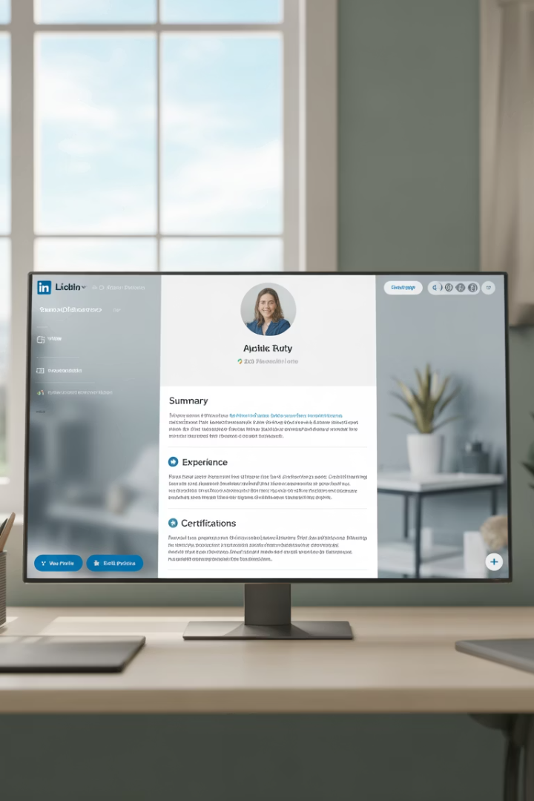
Leveraging Your LinkedIn Profile
Maintain Consistency
Your LinkedIn profile should mirror your resume, including relevant skills, job roles, and accomplishments. Match job titles, dates, and key achievements to create a cohesive professional narrative.
Highlight Certifications
LinkedIn allows you to feature certifications prominently—take advantage of this to showcase qualifications like PMP, PMI-ACP, and Agile certifications that validate your expertise.
Engage Professionally
Regularly update your profile, share industry content, and participate in relevant discussions to boost your profile visibility and demonstrate active engagement in your field.

Slide 10
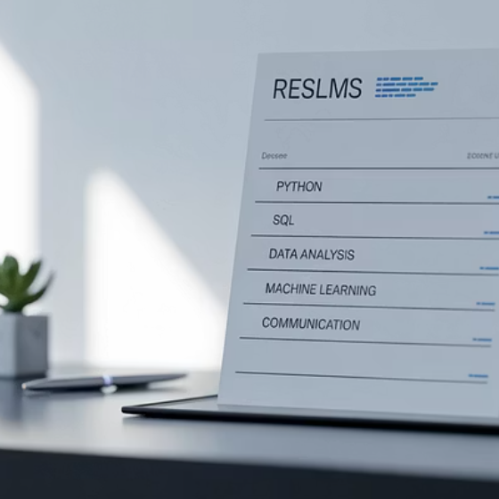
Creating an Effective Skills Section
A dedicated Core Competencies or Skills section improves ATS matching and helps recruiters quickly identify your capabilities. List 10–15 hard skills directly related to the job, including tools, platforms, and frameworks relevant to your field.
Example format: Agile Project Management | ServiceNow | Azure DevOps | Data Analysis | Cybersecurity Compliance | Stakeholder Engagement

Slide 11
ATS-Friendly File Formats
.docx Format
Most compatible with ATS systems
Simple .pdf Format
Widely accepted but avoid complex elements
Plain Text Backup
Useful for copy-pasting into application forms
Ensure your resume is in a format that ATS systems can easily read. The most ATS-friendly formats are .docx and simple .pdf files. Avoid exotic file formats like .jpg or .png that cannot be properly parsed.
Always check the job application instructions for specific format requirements, and consider having multiple versions of your resume ready in different formats.

Slide 12
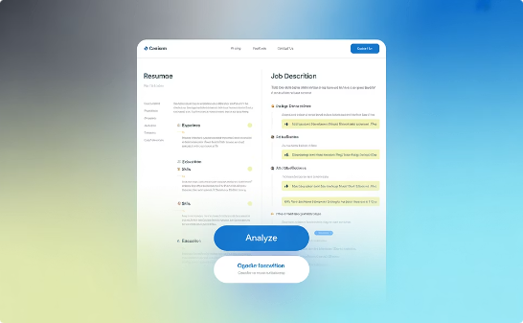
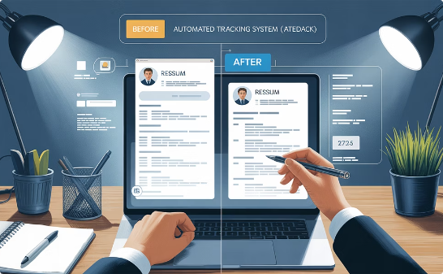
Testing Your Resume's ATS Performance
Use ATS Testing Tools
Compare With Job Descriptions
Revise Based on Feedback
Platforms like Jobscan or ResumeWorded can analyze your resume against specific job descriptions, identifying keyword gaps and suggesting improvements to increase your match rate.
Manually review your resume against target job postings to ensure you've incorporated key terms and requirements. This helps identify areas where your resume might be falling short.
Use insights from ATS tests to refine your resume, focusing on keyword optimization, formatting improvements, and content adjustments that will boost your visibility to recruiters.

Slide 13
Common ATS Resume Mistakes to Avoid
Using tables or columns for layout
ATS systems often can't properly parse these elements
Including images or graphics
Most ATS systems cannot read visual elements
Using headers/footers for contact info
This information may be overlooked by ATS
Fancy fonts or creative formatting
Can confuse ATS and make text unreadable
Submitting incorrect file formats
Some formats cannot be properly scanned
Using acronyms without spelling them out
ATS may not recognize industry-specific acronyms

Slide 14
Key Takeaways for ATS Success
1
2
Keyword Optimization
Clean Formatting
Tailor your resume with relevant keywords from each job description
Use simple, consistent structure with standard section headers
3
4
Quantified Results
Test & Refine
Include specific metrics and achievements with numerical impact
Use ATS testing tools to validate and improve your resume
Optimizing your resume for ATS is a critical step in today's digital job market. By following these strategies, you can ensure your resume not only passes through automated filters but also impresses human recruiters, significantly increasing your chances of landing interviews.

