Slide 1

Implementing an RFID System in a Warehouse: A Guide for Project Managers
Radio Frequency Identification (RFID) technology has revolutionized warehouse management by providing enhanced inventory visibility, improved accuracy, and increased operational efficiency. For project managers tasked with implementing RFID systems in warehouse environments, this presentation offers a comprehensive roadmap.
We'll explore the essential steps for successful implementation, examine potential challenges and their solutions, and highlight best practices to ensure a smooth transition. From defining clear objectives to selecting the right technology and managing organizational change, this guide will equip you with the knowledge to lead a successful RFID implementation project.
kW
by Kimberly Wiethoff

Slide 2




Defining Clear Objectives
Identify Primary Goals
Establish Measurable KPIs
Determine specific objectives such as reducing inventory errors by a target percentage, minimizing theft incidents, or improving tracking accuracy for high-value items.
Create clear metrics for success including inventory accuracy rates, picking speed improvements, and labor cost reductions.
Secure Stakeholder Buy-in
Engage key stakeholders early including operations managers, IT personnel, and finance teams to align expectations and ensure organizational support.
Starting with well-defined objectives creates a solid foundation for your RFID implementation project. These objectives will guide technology selection, determine the scale of implementation, and help justify the investment to upper management. Revisit these goals regularly throughout the project to maintain focus and track progress.

Slide 3
Conducting a Feasibility Study
Infrastructure Assessment
ROI Calculation
Evaluate your current warehouse layout, shelving materials, and potential signal interference sources. Metal racks, concrete walls, and high-moisture environments can impact RFID performance.
Quantify potential benefits including labor savings from automated inventory counts, reduced shipping errors, and improved asset utilization.
Factor in implementation costs such as hardware (readers, tags, antennas), software licenses, integration services, and ongoing maintenance.
Document your existing technology stack including WMS, ERP systems, and network infrastructure to identify integration requirements.
A thorough feasibility study helps identify potential obstacles before significant resources are committed. Work with RFID vendors to conduct site surveys that test signal propagation in your specific environment. This data will inform tag selection and reader placement decisions, ensuring optimal system performance once deployed.

Slide 4
Selecting the Right RFID Technology
Passive RFID
Active RFID
Hybrid Systems
No internal power source
Battery-powered tags
Combines passive and active technologies
Lower cost per tag ($0.10-$1.50)
Higher cost per tag ($5-$50+)
Shorter read range (up to 20 feet)
Extended read range (up to 300+ feet)
Optimizes cost vs. functionality
Customizable for specific warehouse needs
Ideal for high-volume inventory tracking
Best for real-time tracking of high-value assets
Provides flexible implementation options
Your technology selection should align with your specific needs and budget constraints. Consider factors such as the physical properties of your inventory items, environmental conditions, read accuracy requirements, and volume of items to be tracked. Working with an experienced RFID consultant can help navigate these decisions effectively.

Slide 5




Top SaaS Applications for RFID Implementation
Impinj Platform
SOTI Connect
Zebra MotionWorks
Oracle NetSuite WMS
Cloud-based solution offering real-time inventory visibility with enterprise-grade security and scaling capabilities for large warehouses.
Scalable platform for managing RFID devices with remote diagnostics and automated monitoring to minimize downtime.
Comprehensive asset tracking with advanced workforce management tools and actionable analytics for operational optimization.
End-to-end warehouse management solution with robust RFID integration capabilities and customizable workflows.
When selecting software, prioritize solutions that offer easy integration with your existing systems through standard APIs. Look for vendors that provide implementation support, regular updates, and have experience in your specific industry vertical. Cloud-based solutions often provide the most flexibility for scaling and remote management.

Slide 6
Developing a Pilot Program
Refine and Expand
Run Controlled Tests
Analyze results, make necessary adjustments to hardware placement and configurations, then gradually increase the scope before full implementation.
Install Limited Hardware
Execute standard warehouse processes using the RFID system alongside existing methods to compare results. Document read rates, processing times, and error frequencies.
Select Test Area
Deploy readers at strategic locations, tag a subset of inventory, and set up monitoring systems to capture performance data. Focus on quality over quantity for initial deployment.
Choose a controlled section of your warehouse that represents typical operations but is contained enough to manage effectively. This should include a variety of product types and storage configurations.
A well-executed pilot program serves as a proving ground for your RFID implementation strategy. It provides valuable insights into real-world performance and helps identify unforeseen challenges in your specific environment. Use this phase to refine training materials and standard operating procedures based on actual user experiences.

Slide 7




Integrating with Existing Systems
Data Mapping
Middleware Setup
Create detailed mappings between RFID data fields and existing system schemas to ensure proper information flow and prevent data inconsistencies.
Implement middleware solutions to filter, aggregate, and transform raw RFID data before sending to business applications.
API Configuration
Testing Synchronization
Establish secure API connections between RFID middleware and enterprise systems including WMS, ERP, and shipping platforms.
Verify bidirectional data flow through comprehensive testing of real-world scenarios and edge cases.
Seamless integration is critical for realizing the full value of your RFID implementation. Work closely with your IT team and system vendors to ensure proper data synchronization. Consider implementing a message queue architecture to handle high volumes of RFID data without overwhelming existing systems, particularly during peak operations.

Slide 8








Employee Training and Change Management
Technical Training
Process Workshops
Provide hands-on instruction for hardware operation, troubleshooting, and system navigation
Guide teams through new workflows and SOPs with practical exercises
Skills Verification
Change Advocacy
Assess proficiency through practical evaluations before full deployment
Develop change champions within each department to provide peer support
Effective change management is essential for RFID implementation success. Begin training well before full deployment to allow staff to become comfortable with new technology. Create accessible reference materials including quick-start guides, troubleshooting flowcharts, and video tutorials. Consider implementing a tiered support system where basic issues can be resolved by on-site super-users before escalating to technical support.

Slide 9






Overcoming Common Challenges
Optimization
Continuously refine system based on performance data
Mitigation Strategies
Implement solutions for identified issues
Challenge Identification
Recognize potential problems early
Radio frequency interference from metal surfaces, liquids, and other electronic equipment can significantly impact RFID read accuracy. Conduct comprehensive site surveys to identify potential interference sources and implement solutions such as strategic reader placement, specialized tag types, and signal shielding where necessary.
Budget overruns are common in RFID implementations. Consider a phased approach that prioritizes high-value use cases first, allowing for ROI generation before expanding to additional areas. Explore hardware leasing options and scalable licensing models to reduce initial capital requirements while maintaining flexibility for future growth.

Slide 10
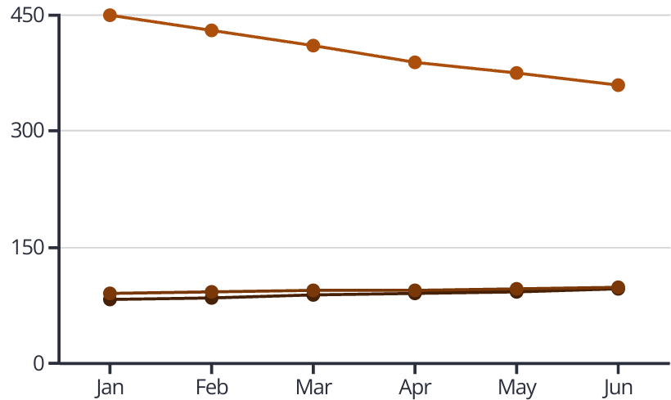
Performance Monitoring and Optimization
Post-implementation monitoring is crucial for measuring ROI and identifying optimization opportunities. Establish a performance dashboard that tracks key metrics like read accuracy rates, inventory count times, and order processing efficiency. Compare these against your pre-implementation baseline to quantify improvements.
Schedule regular system audits to identify underperforming components and process bottlenecks. Leverage the analytics capabilities of your RFID software to gain insights into inventory movement patterns, dwell times, and seasonal variations. These insights can inform layout optimization and staffing decisions beyond just the RFID system itself.
Inventory Accuracy %
Order Fulfillment %
Labor Hours

Slide 11




RFID Implementation Timeline
Planning & Assessment
2-3 months: Requirements gathering, feasibility studies, vendor selection
Pilot Implementation
1-2 months: Limited deployment, testing, and refinement
Phased Rollout
3-6 months: Systematic deployment across warehouse zones
Optimization & Scaling
Ongoing: Performance monitoring, system refinements, expanded use cases
A realistic implementation timeline is essential for managing expectations and resource allocation. The entire process typically takes 6-12 months for a medium-sized warehouse, though this can vary based on complexity and scale. Allow for contingency time in your project plan, particularly during the pilot and initial rollout phases when unexpected issues are most likely to arise.
Consider seasonal business fluctuations when scheduling implementation activities. Avoid deploying major changes during peak operational periods when disruptions would have the greatest impact on business performance.

Slide 12
Key Takeaways for Successful Implementation
20%
99.9%
6-12
Average Efficiency Gain
Inventory Accuracy
ROI Timeline (Months)
Typical improvement in operational efficiency after successful RFID implementation
Potential inventory accuracy achievable with properly configured RFID systems
Typical period for achieving return on investment in warehouse environments
Successful RFID implementation requires a methodical approach with clear objectives, thorough planning, and ongoing optimization. Start with a solid foundation by conducting proper feasibility studies and selecting the right technology for your specific needs. Prioritize integration with existing systems to maximize value and minimize disruption.
Remember that RFID implementation is as much about people as it is about technology. Invest in comprehensive training and change management to ensure employee adoption. Finally, maintain a continuous improvement mindset by regularly reviewing system performance and exploring new use cases that can further enhance your warehouse operations.

