Slide 1

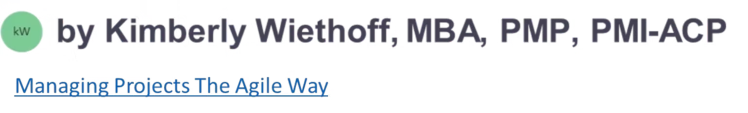
AI for Scrum Masters
Transform your Scrum practice with artificial intelligence. This comprehensive course will equip you with practical AI tools and strategies to enhance team performance, streamline processes, and make data-driven decisions that drive results.
#AIforScrumMasters #AIinAgile #AgileWithAI #ScrumAndAI #ScrumMaster #AgileLeadership #AgileCoach #ArtificialIntelligence #DigitalTransformation #FutureOfWork #ContinuousImprovement #AgileLearning

Slide 2
What You'll Gain From This Course
Course Objectives
Practical Skills
Strategic Advantage
Master AI fundamentals tailored for Scrum environments. Learn to identify opportunities where AI can enhance your facilitation skills and team dynamics.
Gain hands-on experience with AI tools for sprint planning, retrospectives, and performance tracking. Build confidence in implementing AI solutions.
Position yourself as a forward-thinking Scrum Master who leverages cutting-edge technology to deliver superior results for your organization.
By the end of this course, you'll have a comprehensive toolkit of AI-enhanced practices that will elevate your effectiveness as a Scrum Master while maintaining the human-centered approach that makes Agile successful.

Slide 3
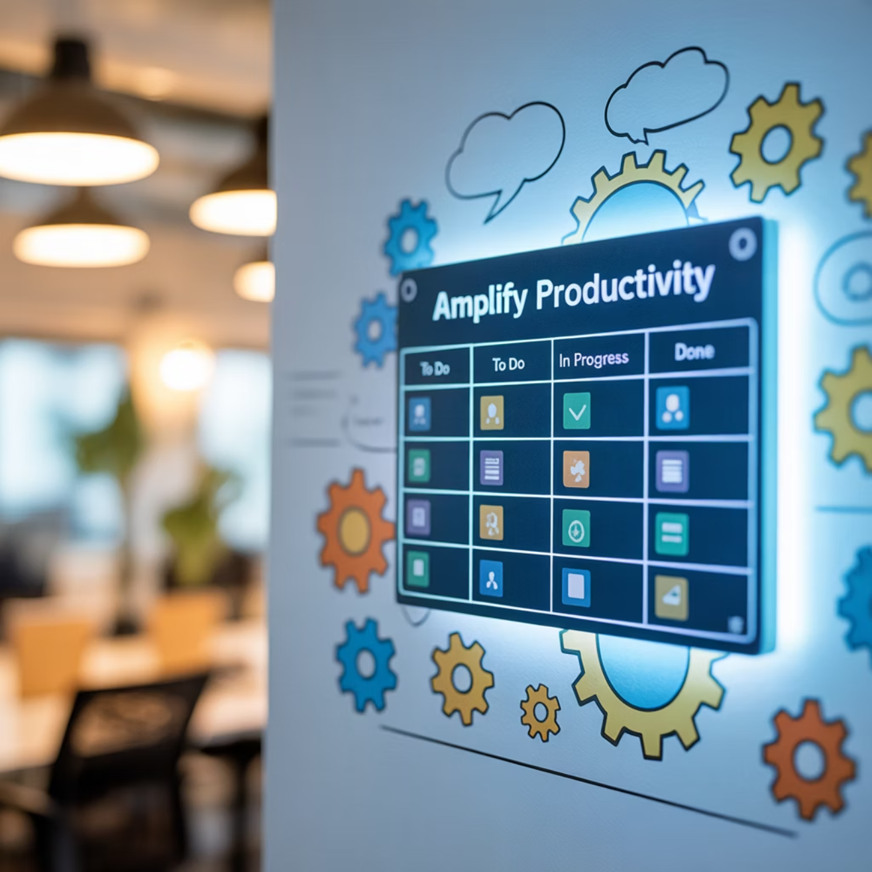
Course Agenda Overview
01
Foundations of AI in Agile
Essential concepts, myths vs. reality, and setting the foundation for AI integration
02
AI Tools for Sprint Planning
Velocity forecasting, capacity planning, and risk assessment automation
03
Enhanced Retrospectives
Sentiment analysis, pattern recognition, and action item prioritization
04
Implementation Strategy
Change management, team adoption, and measuring success
Each module builds upon the previous one, ensuring you develop both theoretical understanding and practical application skills.

Slide 4

Why AI Matters in Scrum
The future of Agile is here, and it's powered by intelligent automation

Slide 5



AI is Transforming Agile Workflows
Process Enhancement
AI automates routine tasks like burndown chart generation, sprint metrics calculation, and status reporting, freeing you to focus on high-value facilitation and coaching activities.
Data-Driven Insights
Advanced analytics reveal hidden patterns in team performance, identify bottlenecks before they impact delivery, and provide predictive insights for better planning.
Team Empowerment
AI tools provide real-time feedback and suggestions, helping team members make informed decisions and continuously improve their practices without waiting for formal ceremonies.

Slide 6

Extending Scrum Master Capabilities
Traditional Approach
AI-Enhanced Approach
Manual data collection and analysis
Automated metrics and real-time dashboards
Reactive problem-solving
Predictive analytics for proactive intervention
Limited visibility into team dynamics
Deep insights into communication patterns
Time-intensive reporting
Intelligent reporting and trend analysis
Subjective performance assessments
Objective, data-backed performance insights
While effective, traditional methods often leave gaps in understanding and consume valuable time that could be spent on strategic facilitation.
AI amplifies your natural facilitation skills with data-driven insights, predictive capabilities, and automated processes that scale your impact.

Slide 7



Supporting the Three Pillars of Scrum
Transparency
Inspection
Adaptation
AI-powered dashboards provide real-time visibility into sprint progress, team velocity, and potential risks. Automated reporting ensures all stakeholders have access to current, accurate information without manual effort.
Advanced analytics help identify patterns and anomalies in team performance. AI tools can surface insights about code quality, collaboration effectiveness, and delivery predictability that might be missed in manual reviews.
Predictive models suggest optimal adjustments to team capacity, sprint scope, and process improvements. AI recommendations are based on historical data and proven patterns from high-performing teams.

Slide 8



Key AI Concepts for Scrum Masters
Machine Learning
Natural Language Processing
Predictive Analytics
Algorithms that learn from your team's historical data to identify patterns and make predictions. In Scrum, ML can forecast sprint completion likelihood, predict velocity trends, and identify factors that correlate with high team performance.
Technology that analyzes text and speech to extract insights from team communications. NLP can analyze retrospective feedback, assess team sentiment, and identify recurring themes in standup discussions or user story descriptions.
Statistical techniques that use current and historical data to forecast future outcomes. For Scrum teams, this means predicting sprint success rates, estimating delivery dates, and identifying potential risks before they impact the team.
These technologies work together to create a comprehensive AI toolkit that enhances every aspect of your Scrum practice, from planning to delivery to continuous improvement.

Slide 9

Myth vs Reality: AI in Scrum
❌ MYTH: AI Replaces Scrum Masters
The fear that artificial intelligence will make Scrum Masters obsolete by automating all facilitation and coaching responsibilities. This misconception assumes that AI can replicate the human elements of leadership, empathy, and complex problem-solving.
✅ REALITY: AI Augments Your Capabilities
AI serves as a powerful assistant that handles routine tasks, provides data-driven insights, and supports decision-making. It enhances your ability to facilitate, coach, and guide teams by giving you better information and more time to focus on human-centered activities.
Your role remains fundamentally human-centered. AI handles the data; you handle the people. AI provides insights; you provide wisdom. AI automates processes; you inspire transformation.

Slide 10

Your Journey Starts Here
Ready to Transform Your Practice?
You now understand the foundational concepts of AI in Agile environments. The next modules will dive deep into practical applications, giving you hands-on experience with the tools and techniques that will elevate your effectiveness as a Scrum Master.
Module 2: Practical AI tools for sprint planning and capacity management
Module 3: AI-enhanced retrospectives and continuous improvement
Module 4: Implementation strategies and change management
The future of Agile is intelligent, and you're ready to lead the way.

