Slide 1
21 CFR Part 11 Compliance: What Every Project Manager Needs to Know
In FDA-regulated industries like biotech, pharma, and medical devices, project managers must go beyond traditional project management. They need to ensure systems support regulatory compliance from day one, with 21 CFR Part 11 being one of the most critical regulations.
Whether implementing electronic quality management systems, digitizing standard operating procedures, or managing cloud-based data platforms, this regulation fundamentally impacts how you plan, document, and validate project deliverables.
kW
by Kimberly Wiethoff

Slide 2
Understanding 21 CFR Part 11
Definition
Scope
A U.S. FDA regulation that establishes requirements for electronic records and electronic signatures, ensuring digital records are as trustworthy, secure, and traceable as paper ones.
Applies to any electronic system storing, signing, or managing documents used in FDA-regulated processes across pharmaceuticals, biotechnology, and medical devices.
Purpose
Creates a framework for data integrity, system security, and electronic signature authenticity that protects both patients and organizations handling sensitive information.
Compliance with Part 11 isn't optional—it's a foundational requirement for any digital system that handles regulated data. Understanding these fundamentals helps project managers build compliance considerations into project planning from inception.

Slide 3
Why Part 11 Matters for Project Managers
Costly Rework
Failed Validation
Addressing compliance gaps after development requires extensive rework, often costing 3-5 times more than implementing properly from the start.
Non-compliant systems cannot pass validation testing, potentially invalidating months of project work and delaying critical business processes.
Project Delays
Audit Exposure
Discovering Part 11 issues late can delay regulatory submissions and system go-lives by weeks or months, impacting organizational timelines.
FDA inspections uncovering compliance gaps can lead to 483 observations, warning letters, and reputational damage beyond the immediate project scope.
Compliance isn't just a quality assurance checkbox—it's central to system validation, audit readiness, and maintaining operational integrity. Project managers who understand these implications can better advocate for necessary resources and timeline considerations.

Slide 4
Electronic Records Management Requirements
Data Integrity
Records remain accurate and consistent throughout their lifecycle
Access Control
Only authorized personnel can view or modify records
Version Control
Complete tracking of all document versions and changes
Electronic records management forms the foundation of Part 11 compliance. Project managers must ensure systems maintain ALCOA+ principles (Attributable, Legible, Contemporaneous, Original, Accurate, plus Complete, Consistent, Enduring, and Available).
When evaluating solutions, verify capabilities for record retention, backup procedures, and data migration pathways. Consider how the system will maintain record integrity through software upgrades and ensure records remain accessible throughout their required retention period.

Slide 5
Electronic Signatures Compliance
Identity Verification
Time Stamping
Uniquely identifies each signer with name, ID, and credentials
Records exact date and time of every signature action
Statement of Intent
Non-Repudiation
Captures the signer's meaning and purpose with each signature
Prevents signature forgery or unauthorized use
Electronic signatures must be as legally binding as handwritten ones. Your system should require each signer to verify their identity through username/password combinations or stronger authentication methods. Each signature execution must include a "meaning" statement (e.g., "approved," "reviewed") and maintain the signature-to-record link throughout the record lifecycle. Project managers should verify that signature workflows include appropriate sequencing, prevent delegation of signing authority, and align with the organization's signature policies.

Slide 6
Implementing Robust Audit Trails
Capture All Changes
Secure Audit Logs
Enable Review
Record every data creation, modification, and deletion event in the system, including the specific values that changed.
Ensure audit trail data is protected from manipulation and unauthorized access.
Make audit trails easily accessible for inspection and regulatory review.
Computer-generated timestamps
Searchable by date ranges and users
Who made the change (username or ID)
Prevention of audit trail deletion
Exportable for audits
What was changed (field-level detail)
Tamper-evident record format
Human-readable format
When it was changed (date/time stamp)
Why it was changed (reason codes or comments)
Audit trails must be system-generated, comprehensive, and tamper-proof. As a project manager, ensure your system creates audit logs automatically without user intervention and maintains them for at least as long as the related records are retained.

Slide 7
System Validation Approach
Validation Planning
Documentation Preparation
Test Execution
Validation Summary
Create a comprehensive validation plan that outlines scope, responsibilities, and acceptance criteria
Develop required validation documents following GAMP 5 methodology
Execute installation (IQ), operational (OQ), and performance (PQ) qualification testing
Compile all evidence into a validation summary report for stakeholder approval
User requirements specification (URS)
Summary of test results
Risk assessment
Test compliance-critical functions
Deviation resolution
Validation strategy document
Functional specifications
Final approval signatures
Resource allocation
Design specifications
Document all deviations
Traceability matrix
Maintain evidence of test results
Computer system validation is the cornerstone of Part 11 compliance. Project managers must collaborate with QA and IT to ensure thorough testing of every feature that impacts data capture, integrity, or compliance. Remember that validation isn't a one-time event—plan for periodic re-validation after system changes.

Slide 8
Security and Access Control
Security Requirement
Implementation Guidance
PM Considerations
Role-Based Access
Define user roles based on job functions with minimum necessary privileges
Schedule time for role mapping workshops with stakeholders
Authentication Controls
Implement strong password policies and consider multifactor authentication
Align with IT security policies; budget for MFA if required
User Management
Establish procedures for onboarding, termination, and periodic review
Document user management SOPs as project deliverables
System Lockout
Configure automatic timeout after periods of inactivity
Test timeout features during OQ validation
Logical Security
Implement firewalls, encryption, and intrusion detection
Coordinate security assessments with IT early in timeline
Robust security controls prevent unauthorized access to electronic records and signatures. Project managers must ensure role-based access control is properly implemented, with permission structures that align with regulatory expectations. Work closely with IT security teams to validate that authentication mechanisms meet both Part 11 requirements and your organization's security policies.

Slide 9
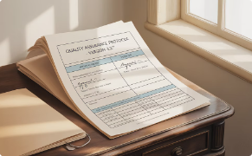
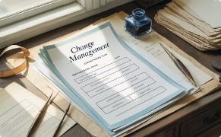
Training and SOP Development
Compliant SOPs
Develop detailed Standard Operating Procedures covering system usage, data entry, record approval, and maintenance activities. Ensure SOPs include sufficient detail for consistent execution and clearly define roles and responsibilities.
Role-Specific Training
Create targeted training materials for each user role, focusing on compliance responsibilities and proper system usage. Include hands-on exercises that simulate actual workflows to reinforce learning and assess competence.
Change Management
Prepare transition plans that address process changes, user adoption strategies, and continuous improvement mechanisms. Document all training activities with attendance records and competency assessments.
Training and SOPs are often underestimated aspects of compliance projects. As a project manager, ensure that your deliverables include comprehensive documentation of system operations, training materials for all user roles, and change management documentation. Plan for regular SOP reviews and updates as part of the system's ongoing maintenance.

Slide 10
Vendor Qualification Process
Initial Assessment
Documentation Review
Agreement Formalization
Ongoing Monitoring
Evaluate vendor's compliance history and capabilities
Analyze validation packages, SOC reports, and quality systems
Maintain oversight of vendor's compliance activities
Establish clear compliance responsibilities in contracts
When utilizing third-party platforms like TrackWise Digital, MasterControl, or Veeva Vault, thorough vendor qualification is essential. Start by obtaining the vendor's validation approach and documentation. Evaluate their experience with FDA-regulated clients and review their SOC reports for security controls.
Project managers should ensure contracts clearly delineate compliance responsibilities between your organization and the vendor. Document this division of responsibilities and incorporate vendor-provided validation documents into your overall validation package. Establish a process for evaluating the compliance impact of vendor updates and patches.

Slide 11
Project Timeline Integration
Initiation Phase
Execution Phase
Closure Phase
Identify if 21 CFR Part 11 applies to the project scope and establish initial compliance requirements. Engage compliance SMEs and include regulatory considerations in project charter.
Build test scripts for audit trails, electronic signatures, and security features. Review system configurations against Part 11 requirements regularly.
Validate final outputs, archive validation logs, and confirm SOP readiness. Conduct formal handover to operations with compliance status report.
5
Planning Phase
Monitoring Phase
Include validation and compliance activities in project scope, schedule, and budget. Develop risk assessment and mitigation strategies for compliance-related risks.
Track validation progress and documentation completion. Conduct periodic compliance reviews against requirements specification.
Don't wait until User Acceptance Testing to address Part 11 requirements. Effective project managers integrate compliance checkpoints throughout the project lifecycle. This proactive approach prevents last-minute compliance gaps that could derail project timelines and budgets.

Slide 12
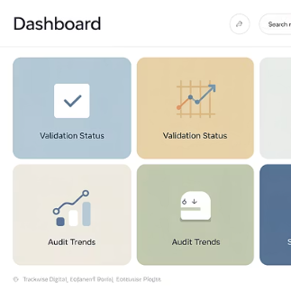
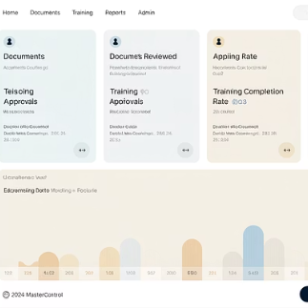
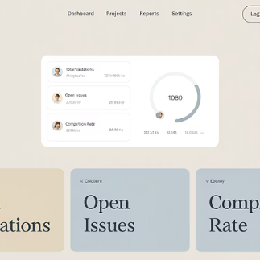
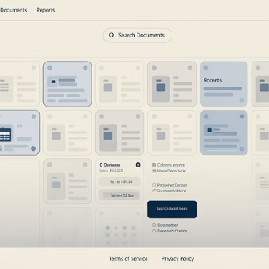
Tools and Resources for Part 11 Projects
As a project manager overseeing Part 11 compliance initiatives, leverage purpose-built tools that simplify validation and compliance. TrackWise Digital offers EQMS modules with pre-validated components. MasterControl excels in document control and training management with built-in Part 11 features. ValGenesis provides comprehensive validation lifecycle management, while properly configured SharePoint can support controlled document processes.
Remember that compliance isn't just about passing audits—it's about protecting patients, data, and organizational integrity. By asking the right questions, involving key stakeholders early, and treating compliance as a fundamental requirement rather than a risk, you can lead your projects with confidence in regulated environments.

