Slide 1

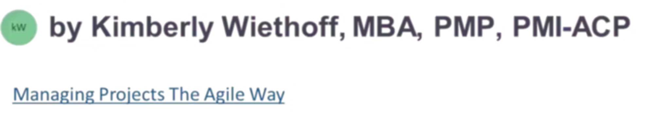
Unveiling the 12 Core Principles of Agile
A Blueprint for Success
#AgilePrinciples #AgileManifesto #AgileProjectManagement #AgileMindset #CustomerSatisfaction #ContinuousDelivery #EmbraceChange #IterativeDevelopment #TeamCollaboration #SelfOrganizingTeams #TechnicalExcellence #SimplicityInAgile #SustainableDevelopment #AgileLeadership #AgileSuccess #ManagingProjectsTheAgileWay

Slide 2
Agile: More Than a Framework—It's a Mindset
In today's rapidly evolving digital landscape, Agile has transformed how teams work. It's no longer just a methodology—it's a fundamental shift in thinking about software development and project management.
At the heart of this philosophy are 12 guiding principles from the Agile Manifesto, offering a modern blueprint for how high-performing teams should operate in an unpredictable world.
These principles aren't rigid rules—they're guiding lights that help teams navigate complexity while staying focused on what truly matters: delivering value to customers.
Agile empowers teams to embrace change, deliver value continuously, and adapt quickly in the face of uncertainty. This approach has revolutionized industries far beyond software development.

Slide 3



The Foundation: Customer-Centric Value Delivery
Principle 1: Customer Satisfaction
Iterative Cycles
Continuous Refinement
Release functional software in small increments, gathering real user feedback early
Reduce waste by refining based on actual needs, not assumptions
Deliver value often through early and continuous delivery of valuable software
Agile teams prioritize customer satisfaction above all else. By delivering working software frequently, they create tight feedback loops that ensure each increment brings customers closer to the solution they truly want. This approach transforms the traditional "build it and hope they come" mentality into a responsive, customer-driven process.

Slide 4




Embracing Change as a Competitive Advantage
Principle 2: Welcome Changing Requirements
Traditional project management treats change as a threat—something to be controlled, minimized, or avoided. Agile flips this paradigm entirely. Change is welcomed, even late in development, because it represents new learning, market insights, or evolving customer needs.
Market Shifts
Respond to competitive pressures and industry changes
Customer Insights
Incorporate new understanding of user needs
Strategic Pivots
Adjust direction based on business priorities
Agile planning builds flexibility into every sprint, making it possible to pivot quickly without derailing the entire project. This adaptability becomes a competitive advantage in fast-moving markets.

Slide 5
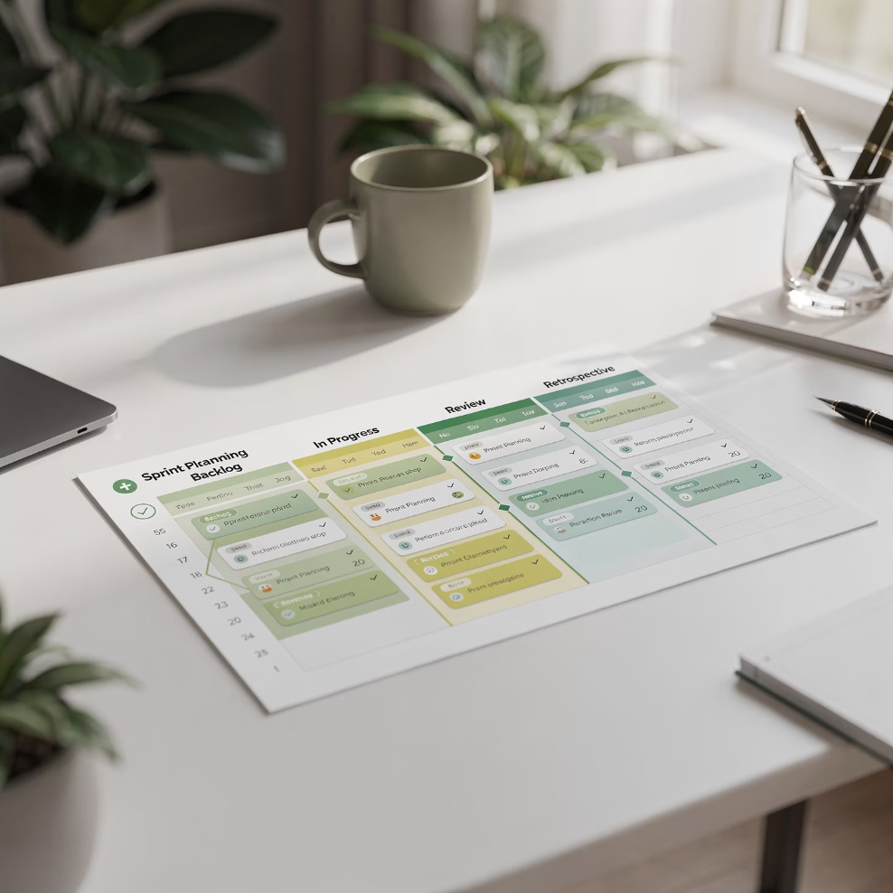

Rhythm and Collaboration: The Agile Heartbeat
Principle 3: Deliver Working Software Frequently
Principle 4: Daily Business-Developer Collaboration
Through time-boxed sprints, teams focus on delivering shippable features every few weeks. This predictable rhythm creates visibility, builds stakeholder trust, and allows for early testing and course correction.
Agile breaks down organizational silos. Daily collaboration between business stakeholders and developers ensures alignment on goals, enables faster decisions, and eliminates misunderstandings before they become costly.
Regular delivery keeps momentum high and prevents the "big bang" integration problems that plague waterfall projects.
The result? Higher quality output, fewer surprises, and solutions that actually meet business needs.

Slide 6
People-Powered Excellence
Principle 5: Build Projects Around Motivated Individuals
Principle 6: Face-to-Face Communication
The most efficient and effective method of conveying information is through direct, rich conversation. Whether in person or via video calls, real-time interaction helps resolve questions quickly, builds rapport, and avoids the miscommunication that often arises from lengthy documentation chains.
Empowered teams deliver better results. Agile recognizes that the best work emerges when teams are trusted, supported, and given autonomy to make decisions. This environment fosters creativity, accountability, and true ownership of outcomes.
Trust team members to make sound decisions
Prioritize synchronous communication for complex topics
Provide the environment and support they need
Use visual aids and whiteboarding
Remove organizational obstacles
Document decisions, not discussions
Celebrate initiative and innovation

Slide 7

Measuring What Matters
Principle 7: Working Software Is the Primary Measure of Progress
Forget vanity metrics like lines of code written, requirements documented, or hours logged. Agile measures success by what truly matters: working, tested, valuable software in the hands of users.
100%
100%
100%
Functional
Tested
Valuable
Software that actually works
Quality assured and reliable
Solves real customer problems
This principle keeps teams laser-focused on business outcomes rather than getting lost in process compliance or task completion theatrics. Progress is tangible, demonstrable, and customer-facing.

Slide 8


Sustainability and Technical Excellence
Principle 8: Sustainable Development Pace
Principle 9: Continuous Attention to Technical Excellence
Long hours and burnout don't equal productivity—they destroy it. Agile promotes a consistent, manageable pace that can be maintained indefinitely.
Clean code, automated testing, and thoughtful architecture aren't luxuries—they're necessities. Teams that invest in technical excellence move faster with fewer errors.
Well-rested, balanced teams deliver higher-quality results, make better decisions, and sustain innovation over time. The marathon mindset beats the sprint-to-exhaustion approach every time.
Technical debt slows everything down. By maintaining high standards and refactoring regularly, Agile teams preserve their ability to adapt quickly to changing requirements.

Slide 9



The Power of Simplicity
Simplicity
Principle 10: The Art of Maximizing Work Not Done
Build What's Truly Needed
Skip Unnecessary Process
Deliver More with Less
Eliminate unnecessary features that don't serve core user needs. Every feature has a cost—in development, testing, maintenance, and complexity.
Remove ceremonies, documentation, and overhead that don't add value. Keep only what helps the team deliver better outcomes.
Focus creates leverage. By saying no to the non-essential, teams can say yes to excellence in what truly matters.
Simplicity is not about being simplistic—it's about being ruthlessly focused on value. The most elegant solutions often come from knowing what to leave out.

Slide 10

Self-Organization: Unleashing Team Potential
Principle 11: Self-Organizing Teams Produce the Best Results
The best architectures, requirements, and designs emerge from self-organizing teams. Agile trusts teams to figure out how to accomplish their goals rather than prescribing every detail from above.
Team Decides How
Internal Task Assignment
Members determine the best approach to accomplish sprint goals
Team members pull work based on skills and capacity
Process Adaptation
Innovation Flourishes
Teams continuously refine their own working agreements
Autonomy creates space for creative problem-solving
This autonomy fosters innovation, resilience, and deep commitment to outcomes. When teams own their process, they own their results.

Slide 11










Continuous Improvement Through Reflection
Principle 12: Reflect and Adjust Regularly
At regular intervals, the team reflects on how to become more effective, then tunes and adjusts its behavior accordingly. This happens through retrospectives—dedicated time to examine what's working and what isn't.
Identify
Reflect
Pinpoint improvements and experiments
Examine recent work and interactions
Commit
Choose specific actions to implement
Assess
Evaluate impact of improvements
Implement
Apply changes in the next sprint
This creates a culture of learning and evolution. Teams don't just do Agile—they continuously improve at it, adapting their approach to their unique context and challenges.

Slide 12

The Agile Mindset in Action
These twelve principles aren't just theoretical ideals—they're practical guidelines that transform how teams work. When woven together, they create a powerful framework for success in today's dynamic environment.
Faster Innovation
Stronger Teams
Satisfied Customers
Rapid cycles and continuous feedback accelerate learning and time-to-market
Empowerment and self-organization build resilient, high-performing groups
Continuous delivery of value ensures solutions that truly meet user needs
Remember: Agile isn't about strict adherence to process—it's about embracing a mindset of collaboration, adaptability, and value delivery. These principles apply to all teams striving for excellence in a fast-paced world.

Slide 13

Your Agile Journey Begins Now
By weaving these principles into the fabric of your organization, you unlock the potential for transformative change. The journey from traditional to Agile thinking isn't always easy, but it's worth it.
Start Small
Begin with one team and one principle
Learn Continuously
Reflect, adapt, and improve with each sprint
Scale Thoughtfully
Expand Agile practices as teams mature
Embrace the Mindset
Let principles guide decisions at every level
The future belongs to teams that can adapt, deliver, and innovate continuously.
Are you ready to embrace the Agile principles and transform how your team works?

