Slide 1

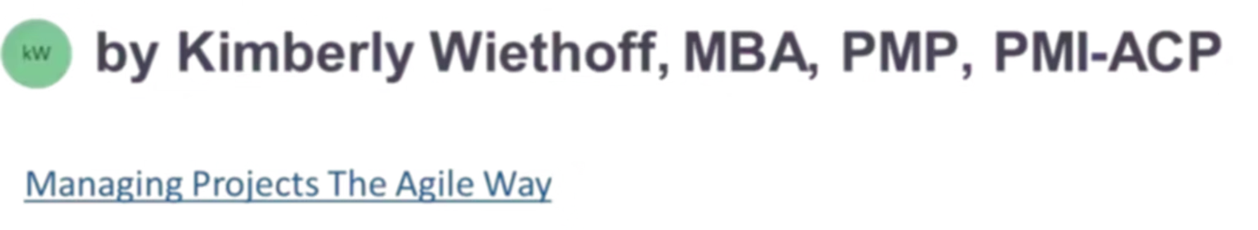
How to Study for the PMI-CPMAI® Certification
A practical guide to passing on your first try and leading AI initiatives with confidence
#PMICPMAI #AIProjectManagement #ResponsibleAI #AIGovernance #DigitalTransformation #ProjectManagement #ProgramManagement #PMI #PMILife #FutureOfWork #AILeadership #EthicalAI #DataDriven #AgileLeadership #ManagingProjectsTheAgileWay #ContinuousLearning #CareerGrowth #ProfessionalDevelopment

Slide 2
CONTEXT
Why This Certification Matters Now
The AI Leadership Gap
The PMI Certified Professional in Managing AI (PMI-CPMAI®) certification provides a structured, responsible, and business-focused framework for managing AI initiatives successfully.
Artificial Intelligence is no longer a future initiative — it's already embedded in how organizations operate, make decisions, and compete. But managing AI initiatives isn't the same as managing traditional IT or digital transformation projects.
If you're a project manager, program leader, product owner, or transformation professional looking to strengthen your credibility in AI-driven environments, this certification validates your ability to lead AI projects from concept to sustainable value delivery.

Slide 3
What Is PMI-CPMAI?
PMI-CPMAI is designed to validate your ability to lead and manage AI initiatives responsibly, from identifying business problems to deploying and sustaining AI solutions. Unlike purely technical AI certifications, this credential focuses on business outcomes, governance, and cross-functional leadership.
Business Outcomes
Governance & Ethics
Data Management
Focus on results, not algorithms
Responsible AI practices
Readiness and lifecycle control
Collaboration
Sustainability
Cross-functional team leadership
Long-term value realization

Slide 4

Who Should Pursue This Certification?
You do not need to be a data scientist or engineer to earn this certification — but you do need to understand how AI initiatives work end-to-end and how to manage them effectively.
This certification is especially valuable for:
Project and program managers leading digital initiatives
Digital transformation leaders driving organizational change
Product managers and product owners defining AI features
Business analysts and AI initiative sponsors
Leaders working with data science and AI teams

Slide 5
EXAM STRUCTURE
Understanding the PMI-CPMAI Exam
Before you start studying, it's critical to understand what PMI expects you to know and how questions are framed. This exam tests how you think, not just what you know — very similar to PMI's other advanced certifications.
Scenario-Based Questions
Decision Focus
Real-world situations requiring judgment and decision-making in context
Emphasis on the best or next action, not memorizing definitions
Ethical & Responsible AI
PMI Mindset Required
Questions consistently prioritize governance, transparency, and value-driven approaches
Alignment with PMI's framework is essential — outside opinions may not apply

Slide 6

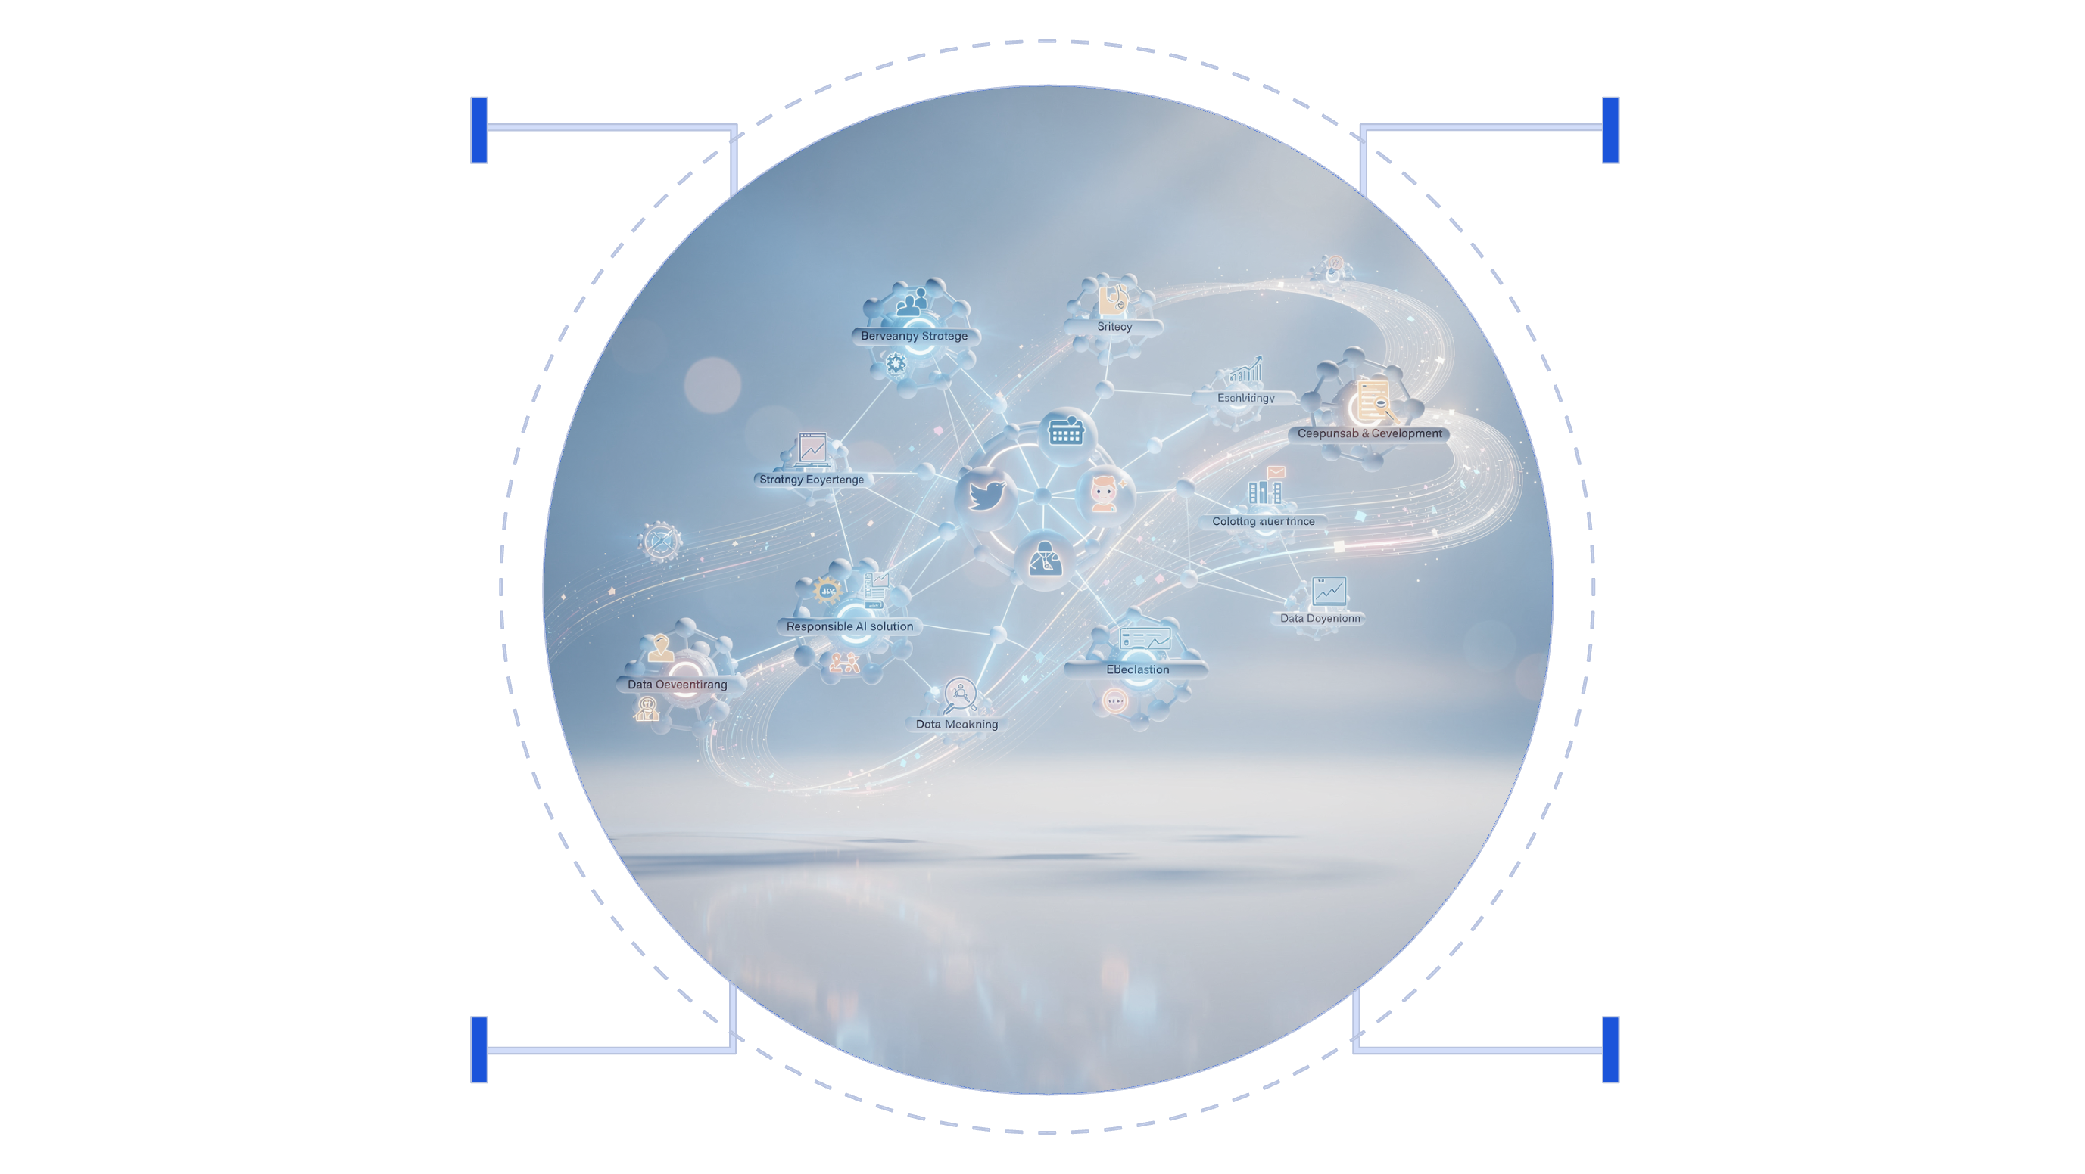
CORE DOMAINS
Five Critical Knowledge Areas
While PMI may update terminology over time, the exam consistently centers around these major capability areas. Mastering these domains is essential for exam success.
Business Strategy
Data Governance
Align AI initiatives with goals
Ensure quality, privacy, and access
Solution Development
Responsible AI
Ethics, fairness, and accountability
Design and build scalable models
Each domain builds on the others, creating a comprehensive framework for managing AI initiatives from strategy through sustainable operations.

Slide 7


Domain 1: Business & AI Strategy Alignment
This domain focuses on ensuring AI initiatives deliver tangible business value and align with organizational goals from the start.
Key concepts include:
Identifying AI-appropriate business problems
Ensuring AI initiatives align to organizational goals
Defining success metrics and measurable outcomes
Prioritizing initiatives based on value potential
💡 Exam Mindset
If an AI solution doesn't clearly tie back to business value, it's not ready to proceed. PMI consistently favors answers that prioritize strategic alignment over technical sophistication.

Slide 8





Domain 2: Data Readiness & Governance
Most AI failures stem from data issues, not model issues.
Data Quality
Availability
Lifecycle Management
Privacy & Compliance
Ensuring accuracy, completeness, and integrity
Access to sufficient, relevant data sources
Regulatory requirements and data protection
From collection through archival and deletion

Slide 9

Domain 3: Responsible & Ethical AI
This domain represents PMI's strongest philosophical stance. The exam consistently prioritizes responsible AI practices, even when they may slow delivery or increase complexity.
Critical topics include:
Bias detection and mitigation strategies
Transparency and explainability requirements
Human oversight and accountability frameworks
Fairness assessment and monitoring
Stakeholder impact evaluation
💡 Exam Mindset
PMI consistently favors responsible AI practices, even when they slow delivery. If an answer ignores ethics or governance, it's likely wrong.

Slide 10


Domains 4 & 5: Development Through Operations
AI Solution Development
Deployment & Sustainability
Model training, validation, and testing processes. Performance metrics and monitoring. Managing experimentation and iteration cycles.
Integrating AI into business processes. Monitoring drift, performance, and business impact. Ensuring long-term value realization.
Balance speed with risk, quality, and governance.
AI is never "done" — continuous improvement required.

Slide 11

STUDY PLAN
A Practical 4-Week Study Approach
Here's a realistic and effective approach to preparing for the exam without overloading yourself. This timeline allows you to build deep understanding while maintaining balance.
Week 1: Foundation
1
Official PMI-CPMAI prep course, understand the AI initiative lifecycle, review Exam Content Outline, identify knowledge gaps
2
Week 2: Deep Dive
Focus one domain per day, create mind maps, take notes in your own words, align with PMI framework
Week 3: Practice
3
Practice exams, analyze right and wrong answers, identify trigger words, study question patterns
4
Week 4: Review
Reinforce weak areas, review summaries, practice time management, build confidence

Slide 12

Week 1: Build the Foundation
Start with the official PMI-CPMAI Exam Prep Course. This is not optional — it establishes PMI's language, framework, and expectations.
Understand the AI initiative lifecycle
Grasp how PMI structures the end-to-end process from business problem identification through sustained operations
Learn PMI-specific terminology
Their vocabulary matters — align your thinking with their language and definitions
Review the Exam Content Outline (ECO)
This document defines what's tested and how heavily each area is weighted
Identify unfamiliar concepts early
Flag areas requiring deeper study so you can allocate time appropriately
📌 Tip: Don't rush this week. PMI exams reward alignment with their framework, not outside opinions.

Slide 13

Weeks 2-3: Deep Dive & Practice
Week 2: Domain Mastery
Week 3: Question Strategy
Now it's time to slow down and go deeper. Focus on one major domain or theme per day.
This is where many candidates underestimate the exam.
Common PMI-CPMAI trigger themes:
For each domain:
Ethics vs speed
Governance vs experimentation
Business value vs technical elegance
Human oversight vs automation
Take notes in your own words
Create simple mind maps connecting concepts
Ask yourself: What decision would PMI expect here?
📌 If you've studied for PMP, PMI-ACP, or PMI-PgMP, this thinking will feel familiar — just applied to AI.
📌 If an answer sounds impressive but ignores ethics, governance, or business alignment — it's probably wrong.

Slide 14
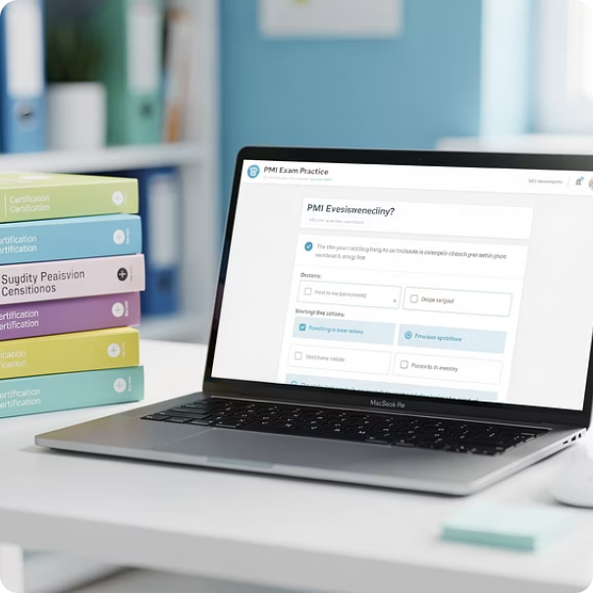

Study Resources & Exam Day Tips
Must-Have Resources
Exam Day Strategy
Essential: Official PMI-CPMAI Prep Course, PMI-CPMAI Exam Content Outline, Official PMI practice questions
Read questions slowly and carefully. Look for what PMI is really asking. Eliminate answers that ignore governance, ethics, or value.
Helpful Supplements: Flashcards for terminology, visual mind maps, real-world AI case studies, study groups
Flag tough questions and return later. Trust your preparation. Most importantly — your first instinct is usually correct if you've studied properly.
You don't need dozens of resources — you need the right ones used consistently.

Slide 15

Why PMI-CPMAI Is Worth the Effort
PMI-CPMAI isn't just another certification — it represents a new leadership skillset that's increasingly critical in today's AI-driven business landscape.
Ask the Right Questions
Challenge assumptions and identify the right problems to solve
Balance Innovation & Responsibility
Move fast while maintaining ethical guardrails
Translate AI to Business Value
Bridge technical and business stakeholders
Govern Ethically & Sustainably
Build trust through responsible AI practices
As AI continues to scale across industries, organizations need leaders who can manage these capabilities responsibly. If that's the kind of leader you want to be, PMI-CPMAI is absolutely worth the effort.

