Slide 1
Navigating Scrum Master Certifications
In today's Agile-driven world, Scrum Masters help teams deliver high-quality products faster. With many certification options available, choosing the right one can make all the difference in your career journey.
kW
by Kimberly Wiethoff

Slide 2
Why Certifications Matter
Industry Recognition
Career Advancement
Certifications provide credibility and validation of your Scrum knowledge.
They open doors to better job opportunities and higher salaries.
Knowledge Expansion
Certification programs deepen your understanding of Agile principles.

Slide 3
Certified ScrumMaster (CSM)
Gold Standard
Interactive Training
One of the oldest and most widely recognized certifications, especially in the United States.
Requires a 2-day course taught by certified trainers.
Servant Leadership
Strong emphasis on coaching and servant leadership principles.
Ideal for beginners building a solid foundation in Scrum with industry-recognized credentials.

Slide 4
Professional Scrum Master (PSM)
PSM I
Entry-level certification demonstrating fundamental Scrum knowledge.
PSM II
Advanced certification for experienced practitioners.
PSM III
Expert-level certification showing mastery of Scrum principles.
Founded by Scrum co-creator Ken Schwaber, Scrum.org offers a tiered program that allows self-study.

Slide 5
SAFe Scrum Master (SSM)
Enterprise Focus
Designed for large-scale implementations
Program-Level Coordination
Covers team and program-level Agile delivery
Fortune 500 Demand
Highly valued in large organizations
With enterprise-scale Agile adoption rising, the SSM credential is valuable for those working in organizations implementing Scaled Agile Framework.

Slide 6
Advanced Certified ScrumMaster (A-CSM)
Prerequisite: CSM
Must first obtain the Certified ScrumMaster certification.
Experience Required
Requires practical experience as a Scrum Master.
Advanced Training
Focuses on team dynamics and advanced Agile practices.
A step up from the foundational CSM, the A-CSM helps experienced Scrum Masters sharpen their facilitation and coaching skills.

Slide 7
Certified Scrum Professional (CSP-SM)
CSM Certification
Start with the foundational certification.
A-CSM Certification
Advance to intermediate level expertise.
CSP-SM Achievement
Reach elite professional status.
One of the highest-level certifications offered by Scrum Alliance, ideal for those aiming for leadership or Agile coaching roles.

Slide 8
PMI-Agile Certified Practitioner (PMI-ACP)
Kanban
Lean
Visual workflow management method.
Focuses on maximizing value while minimizing waste.
Scrum
XP
Framework for complex product development.
Engineering practices for software development.
PMI-ACP validates knowledge of multiple Agile approaches, not just Scrum, making it versatile for diverse environments.

Slide 9
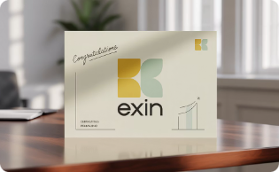
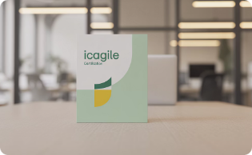
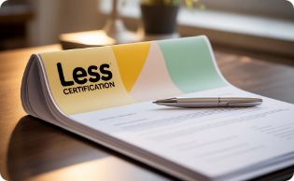
Other Notable Certifications
EXIN Agile Scrum
Popular in European markets with focus on IT service management integration.
ICAgile (ICP)
Part of a learning roadmap with specialized tracks for different Agile roles.
LeSS
Large-Scale Scrum framework for coordinating multiple teams.
These certifications are valuable in niche or international markets and often tie into specific learning paths.

Slide 10
Certification Comparison
Certification
Cost
Training Required
Renewal
CSM
$1,000-$1,500
Yes (2 days)
2 years
PSM I
$150
No
Lifetime
SSM
$995-$1,295
Yes (2 days)
1 year
PMI-ACP
$495
No, but 21 hours required
3 years

Slide 11
Certification by Career Stage
Beginners
CSM or PSM I
Mid-Career
A-CSM, PSM II, or SSM
Advanced
CSP-SM, PSM III, or PMI-ACP
Your career stage and goals should guide which certification path you pursue. Each level builds on previous knowledge.

Slide 12
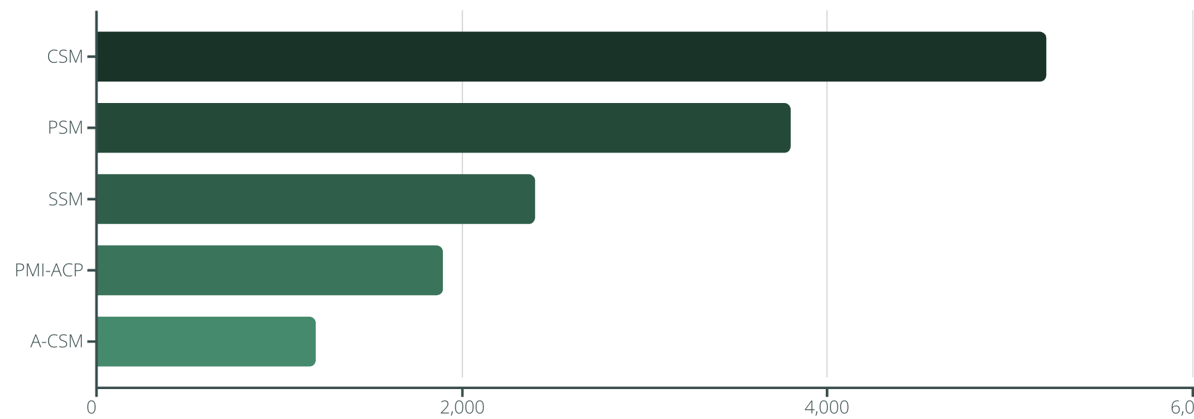
Industry Demand
CSM remains the most requested certification in job listings, followed by PSM and enterprise-focused SSM.

Slide 13
Return on Investment
20%
6 mo
Salary Increase
ROI Timeframe
Average boost after obtaining a Scrum certification.
Typical time to recoup certification investment.
85%
Career Advancement
Professionals reporting positive career impact.
Beyond the credential itself, the knowledge and network gained through certification often provide substantial career benefits.

Slide 14
Making Your Decision
Assess Your Goals
Research Employers
Consider your career aspirations and industry.
Check which certifications target companies value.
Learning Style
Budget Considerations
Choose between structured training or self-study options.
Factor in cost, renewal fees, and training requirements.
Remember that Agile is a mindset, not just a framework. The best certification is one that supports your continuous learning journey.

Slide 15
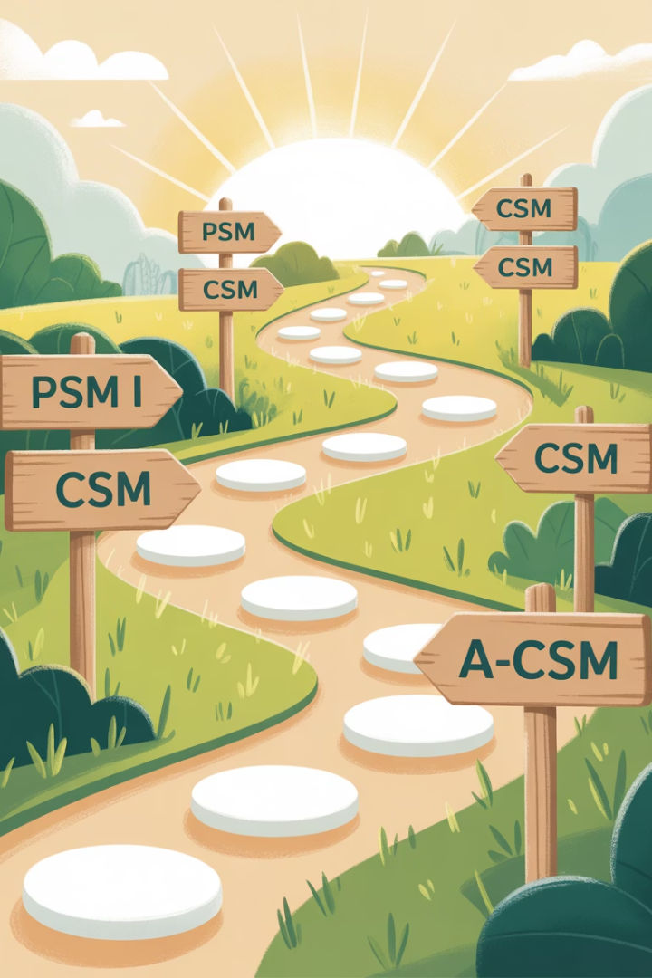
Final Thoughts
Choosing the right Scrum Master certification depends on your career goals, industry, and learning style. If you're just starting out, the CSM or PSM I are top choices for building credibility. For enterprise-level work, SSM or PMI-ACP offer more comprehensive Agile frameworks. And if you're committed to long-term growth, pursuing A-CSM and CSP-SM can position you as a thought leader in Agile practices.
No matter which path you choose, the key is continuous learning and application. After all, Agile is not just about frameworks—it's a mindset.

