Slide 1
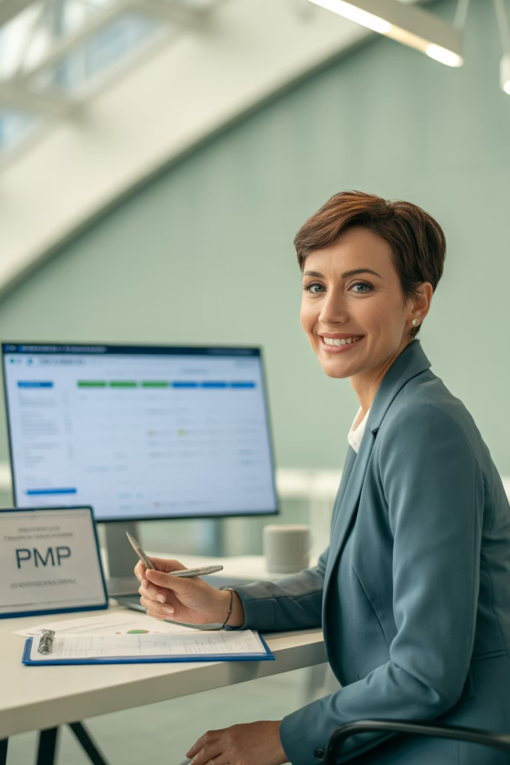
PMP® vs. PMI-ACP®: Which Certification Is Right for You?
Choosing between PMP® and PMI-ACP® certifications can shape your project management career. Let's explore their differences and help you decide.
kW
by Kimberly Wiethoff

Slide 2
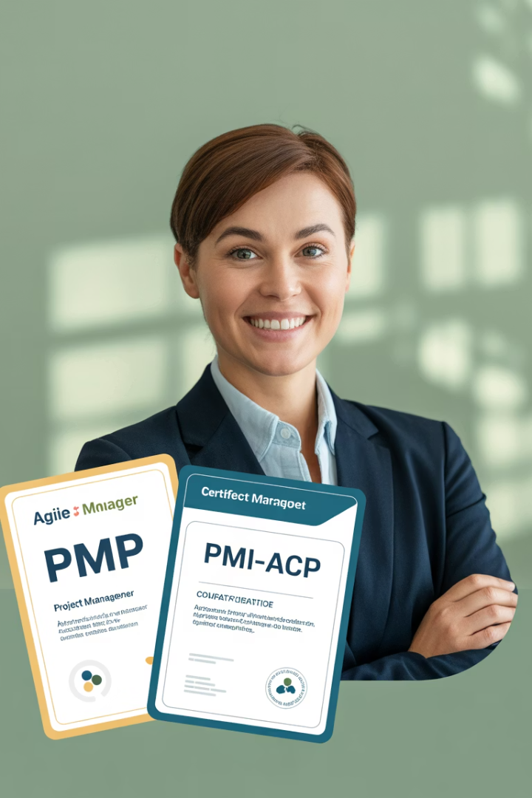
Understanding Project Management Certifications
Project Management Professional (PMP®)
Agile Certified Practitioner (PMI-ACP®)
The gold standard for project managers across industries.
Focuses exclusively on Agile practices from frameworks like Scrum, Kanban, and XP.
Validates ability to manage projects using predictive, Agile, and hybrid approaches.
Ideal for professionals in Agile teams or environments.

Slide 3
PMP® Focus Areas
Project Scope & Schedule
Managing project boundaries and timelines effectively.
Cost & Risk Management
Controlling budgets and mitigating potential issues.
Stakeholder Management
Engaging with all parties involved in the project.
Delivery Models
Implementing predictive, Agile, and hybrid approaches.

Slide 4
PMI-ACP® Focus Areas
Agile Mindset
Value-Driven Delivery
Embracing change and continuous improvement.
Prioritizing features that deliver maximum business value.
Adaptive Planning
Team Performance
Responding to changing requirements through iterative development.
Fostering self-organization and cross-functional collaboration.

Slide 5
PMP® Prerequisites
Education & Experience Path 1
Education & Experience Path 2
Training Requirement
4-year degree plus 36 months of project management experience.
High school diploma plus 60 months of project management experience.
35 hours of formal project management education or CAPM® certification.

Slide 6
PMI-ACP® Prerequisites
Basic Education
General Project Experience
Agile Project Experience
Agile Training
Secondary degree (high school diploma or equivalent).
21 contact hours of formal Agile practices training.
12 months of general project experience within the last 5 years.
8 months of Agile project experience within the last 3 years.

Slide 7
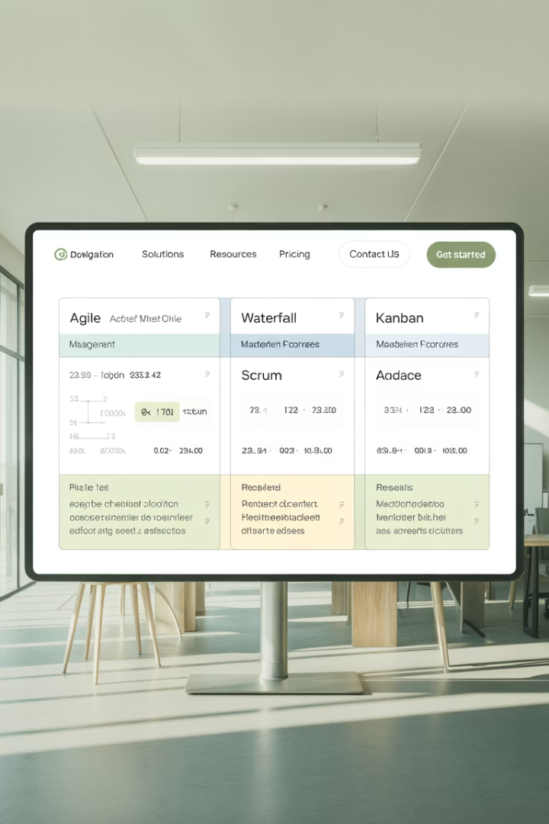
Key Differences Between Certifications
Feature
PMP®
PMI-ACP®
Primary Focus
Predictive, Agile, and Hybrid
Agile Frameworks and Mindset
Exam Length
180 questions, 230 minutes
120 questions, 180 minutes
Frameworks
PMBOK® Guide, Agile, Hybrid
Scrum, Kanban, XP, Lean
Cost
$405–$555
$435–$495

Slide 8
When to Choose PMP®
Complex Projects
Versatile Skills
You're leading cross-functional, complex projects across departments.
You want to validate both Agile and traditional project skills.
Leadership Role
Global Recognition
You're pursuing program or portfolio management positions.
You need a globally recognized credential for career advancement.

Slide 9
When to Choose PMI-ACP®
Agile Team Member
You're part of an Agile or Scrum team.
Tech Industry Focus
You work in tech, product development, or digital transformation.
Framework Expertise
You want to prove your expertise in Agile methodologies.
Agile Leadership
You aim to become an Agile Coach, Scrum Master, or Agile PM.

Slide 10
Exam Comparison
180
120
PMP® Questions
PMI-ACP® Questions
230 minutes to complete the exam
180 minutes to complete the exam
$555
$495
PMP® Max Cost
PMI-ACP® Max Cost
For non-PMI members
For non-PMI members

Slide 11
Why Consider Both Certifications
Career Versatility
Prepared to lead in any project environment
Complementary Skills
Strategic leadership plus agile delivery expertise
Comprehensive Knowledge
Master both traditional and agile methodologies

Slide 12
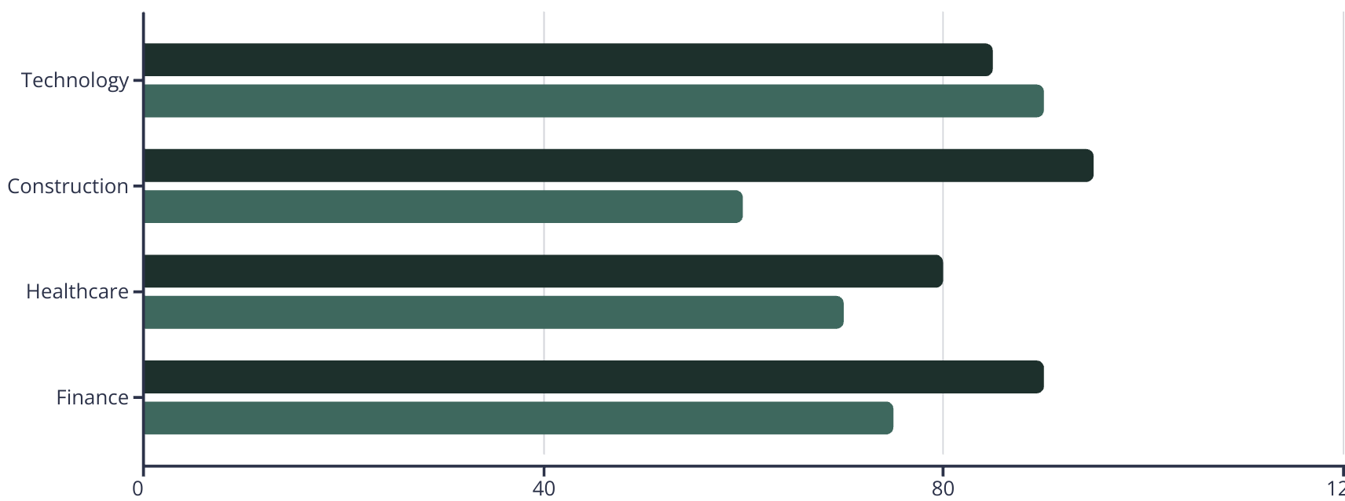
Industry Value of Certifications
PMP® Value
PMI-ACP® Value

Slide 13
Making Your Decision
Assess Your Role
Define Career Goals
Consider your current position and daily responsibilities.
Determine where you want to be in 3-5 years.
Commit to Learning
Evaluate Industry
Both paths require dedication to continuous improvement.
Research which certification is more valued in your field.

Slide 14
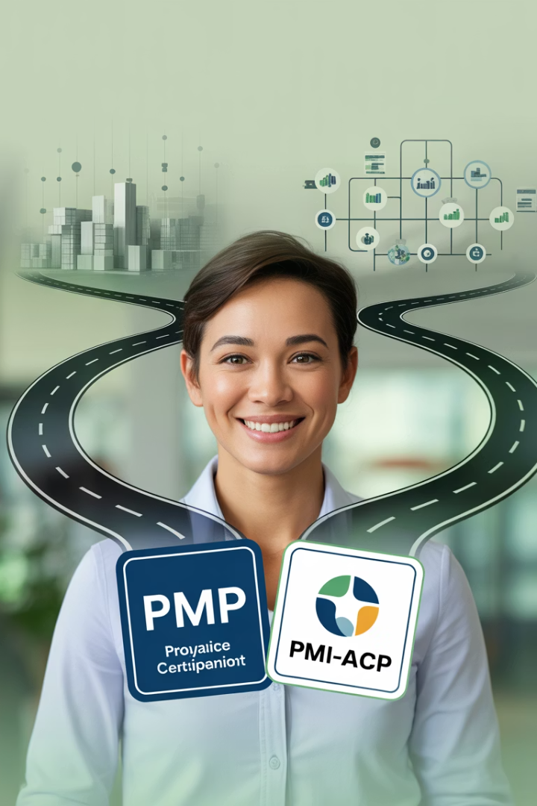
Final Thoughts
The right certification depends on your current role, career aspirations, and the environments you work in. If you're navigating waterfall-heavy projects, PMP is a must. If your world revolves around sprints, backlogs, and user stories, PMI-ACP will feel like home.
Whichever path you choose, both certifications equip you with the tools to drive success in a world where change is constant, and agility is key.

