Slide 1

Beyond the Pilot: How Organizations Can Measure AI Value at Scale
Artificial intelligence is moving rapidly from experimentation to enterprise adoption. But scaling AI successfully requires more than proving that a model, copilot, or agent can perform a task. Organizations need to determine whether those capabilities are creating measurable, sustainable business value across productivity, financial performance, quality, adoption, risk, and operational capacity.
KIMBERLY WIETHOFF, MBA, PMP, PMI-ACP
ENTERPRISE AI VALUE
EXECUTIVE BRIEFING
#AI #ArtificialIntelligence #AITransformation #EnterpriseAI #AIValue #AIROI #AgenticAI #ProgramManagement #ProjectManagement #PMO #PMOLeadership #AIGovernance #BenefitsRealization #DigitalTransformation #AILeadership #ManagingProjectsTheAgileWay

Slide 2
The Measurement Challenge Changes After the Pilot
Pilots Are Controlled
Enterprise AI Is Fundamentally Different
Limited number of users
Clearly defined use cases
Short measurement periods
Highly engaged participants
Close implementation support
Manageable technology costs
An AI capability may eventually affect hundreds or thousands of employees, multiple business processes, customer interactions, operational decisions, compliance requirements, and technology platforms. A generative AI assistant that initially helps 100 employees may eventually support 10,000.
An AI agent that automates one workflow may eventually interact with multiple systems, trigger downstream processes, make decisions, and escalate exceptions. At that point, measuring only hours saved, prompts generated, or tasks automated provides an incomplete picture.

Slide 3

1. Productivity and Capacity
Productivity is one of AI's most visible benefits — but organizations must move beyond asking how many hours did AI save? and connect capacity to measurable business outcomes.
Measure What AI Enables
Ask What Capacity Was Used For
Connect to Business Outcomes
Faster completion, greater volume, reduced admin work, shorter cycle times, fewer bottlenecks, and more time on strategic activities.
Did employees serve more customers, resolve risks earlier, accelerate product development, or reduce work previously outsourced?
Instead of "AI saved 10,000 hours," report: "AI created 10,000 hours of capacity, enabling an 18% increase in transaction volume without adding headcount."

Slide 4

2. Financial Impact
Value Measures
Full Cost of Operating at Scale
Operating cost reduction
Cost avoidance
Revenue growth
Margin improvement
Reduced outsourcing and contractor expenses
Lower cost per transaction
Reduced rework and downtime
Pilots appear inexpensive because enterprise costs haven't materialized. Production introduces platforms, API consumption, cloud infrastructure, data preparation, integration, cybersecurity, governance, monitoring, testing, training, change management, and vendor management.
The right question is not how much value did AI generate? It is: How much net value did AI generate after accounting for the full cost of operating it at scale?

Slide 5



3. Understand the Economics of Scaling
AI value and AI cost may not scale at the same rate. Organizations cannot assume that pilot economics automatically translate into enterprise economics.
Pilot Deployment
Initial Scale
Enterprise Scale
High engagement, close support, and limited costs — early value looks promising.
First 1,000 users may generate strong returns, but later adopters may have different workflows and lower utilization.
Infrastructure, governance, and support costs increase. Marginal value must be measured against marginal cost at each expansion step.
Organizations should continuously ask: What additional value do we receive from the next level of AI adoption compared with the additional cost required to support it? Network effects or organizational learning may accelerate value — or the opposite may occur. Either way, measure it.

Slide 6

4. Quality and Performance
Faster does not automatically mean better. If AI reduces processing time but increases errors, rework, or customer complaints, the productivity improvement may not represent real value. The goal is: Faster + Better + Sustainable.
Operational Quality Metrics
Generative AI–Specific Metrics
Error and defect rates
Rework and first-pass resolution
Service-level performance
Decision consistency
Customer satisfaction
Escalation rates
Factual accuracy and relevance
Hallucination rates
Human override and acceptance rates
Failed or incomplete responses
Output escalations

Slide 7
5. Adoption and Behavior Change
An AI solution cannot generate enterprise value if employees don't use it — or if usage doesn't translate into changed behavior and improved outcomes. Pilot participants are often enthusiastic early adopters; enterprise deployment introduces a much broader population with varying levels of trust and readiness.
Measure Real Adoption
Avoid Vanity Metrics
Close the Value Chain
Track active users, frequency of use, adoption by team and business unit, workflow penetration, abandonment rates, and repeat usage — not just license activations.
"8,000 employees used our AI platform" does not prove value. Ask instead: Are employees using AI achieving better outcomes than comparable workflows without it?
Adoption → Behavior Change → Process Improvement → Business Outcome. If that chain breaks anywhere, value disappears.

Slide 8

6. Risk and Governance
Some of AI's most important value comes from preventing negative outcomes. Governance should not be viewed only as a cost or barrier to innovation — effective governance protects the value organizations are working to create.
Monitor Continuously
Quantify Risk Reduction
Compliance exceptions, security incidents, privacy violations, model drift, bias concerns, audit findings, and unauthorized AI usage.
Preventing a compliance violation, detecting fraud earlier, or avoiding an incorrect business decision may create significant economic value — even if it never appears as revenue.
Track Human Oversight
Human intervention rates, model performance issues, and policy violations are leading indicators of where AI governance needs reinforcement.

Slide 9
7. Agentic AI Requires a New Measurement Model
Traditional generative AI helps a person perform work. Agentic AI can increasingly perform portions of the work itself — changing the metrics organizations need to track.
Key Agent Metrics
From Activity to Business Performance
Tasks completed autonomously
% of workflow completed without intervention
Successful task completion rate
Exception and escalation rate
Human review requirements
Cost per completed transaction
Average processing time
Failed actions and rework generated
Saying "Our AI agent completed 100,000 tasks" tells leadership very little. A stronger measurement connects directly to outcomes:
The AI agent successfully completed 74% of eligible transactions without human intervention, reduced average handling time by 61%, and lowered cost per transaction by 23% while maintaining established quality thresholds.
As organizations deploy more agents, measuring autonomy with quality and control becomes critical.

Slide 10
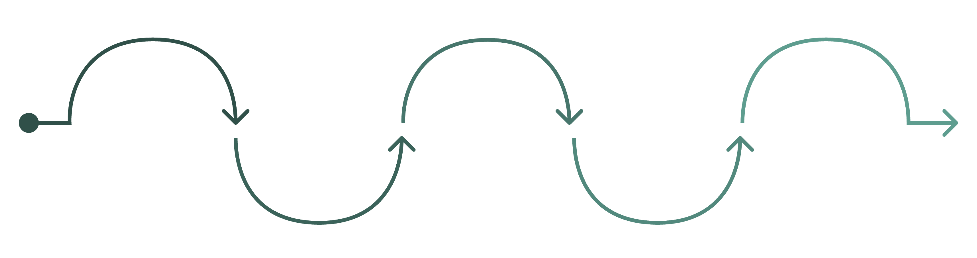
Move From Project Metrics to Value Metrics
Phase 2: Value Metrics
Confirm Requirements
Phase 1: Project Metrics
Transition
Outcomes & Experience
Revenue up, costs down, quality improved
Requirements met and validated
Move focus from delivery to outcomes
On time, on budget, scope complete
Risk reduced; customer and employee experience improved
Traditional project measures confirm successful delivery. But they do not confirm whether the solution delivered value. After implementation, leadership should ask whether business outcomes — revenue, cost, quality, cycle time, risk, customer and employee experience, and organizational capacity — actually improved. That is the difference between measuring AI delivery and measuring AI value.

Slide 11
Establish a Baseline Before Scaling
Meaningful measurement requires comparison. Before expanding any AI solution, capture the performance of the existing process. Without a credible baseline, organizations may know performance changed — but struggle to prove how much value AI actually created.
Measure
Current Baseline
AI Target
Average processing time
45 minutes
20 minutes
Error rate
12%
5%
Cost per transaction
$18
$11
First-pass resolution
68%
85%
Weekly employee capacity
100 transactions
140 transactions
Customer satisfaction
82%
90%
When the existing process is inconsistent, use historical ranges, segment by team or workflow type, and document known variation. The objective is not a perfect baseline — it is a credible baseline.

Slide 12
Watch for Value Leakage
One of the biggest risks after scaling: the AI solution delivers the expected capability, but portions of the expected business benefit disappear between implementation and operations. The technology may be working — but the value chain is not.
Parallel Processing
Ignored Recommendations
AI saves employees time — but employees continue performing the old manual process alongside the AI output.
AI generates recommendations — but managers rarely act on them, so no business improvement materializes.
Exception Overload
Downstream Bottlenecks
An AI agent automates 80% of a workflow — but exceptions require so much manual effort that expected savings disappear.
The model performs well — but downstream systems prevent the organization from acting on results quickly enough to capture the value.

Slide 13
Assign a Benefits Owner
Every major AI initiative should have someone clearly accountable for the business outcome — not the technology, but the benefit. Benefits should not become everyone's responsibility, and therefore no one's responsibility.
Technology Owner
Product Owner
Accountable for whether the AI platform operates reliably, securely, and at scale.
Accountable for whether the capability meets user needs and is fit for purpose.
Business Owner
Benefits Owner
Accountable for whether the underlying process actually improves as intended.
Accountable for whether the expected business value is realized — and for proving it with evidence.

Slide 14
Measure Value Over Time
AI value should never be measured once. Models change, data changes, employees change how they work, and costs evolve. Organizations should measure across three stages to turn AI measurement into an ongoing management discipline.
Pilot
1
Does the technology work? Can it improve the process? Is the model accurate enough?
2
30–90 Days
Initial Value — Is the solution producing expected outcomes immediately after deployment?
6 Months
3
Scaled Value — Do outcomes continue as adoption expands across teams, functions, and processes?
4
12 Months+
Sustained Value — Are the benefits still present as adoption matures and conditions change?

Slide 15
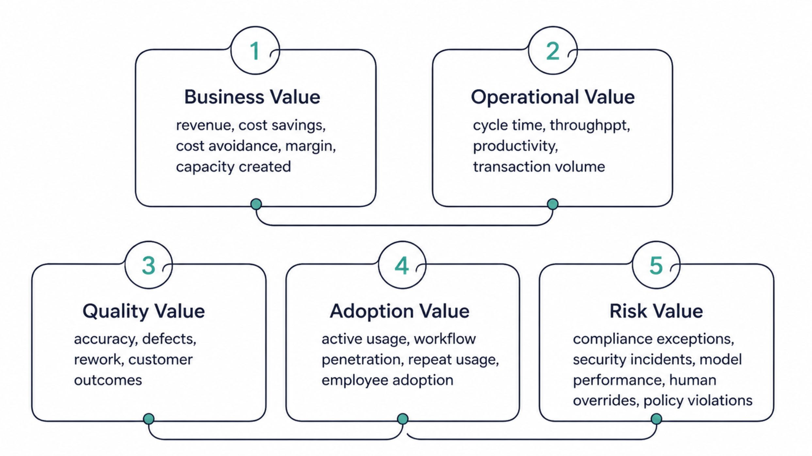
Create an Enterprise AI Value Scorecard
Executives should not review dozens of technical metrics to determine whether an AI investment is working. A practical scorecard brings the most important measures together — tied directly to the business case that justified the investment.

Slide 16
Move From AI Project Management to AI Portfolio Management
Once an organization has dozens of AI initiatives, measuring each independently is no longer enough. Leadership needs a portfolio view — allocating investment based on realized value, not just delivery status.
Initiative A
Initiative B
Initiative C
High value, high adoption, low risk → Scale aggressively
High potential, low adoption → Improve change management
Moderate value, rising costs → Redesign operating model
Initiative D
Initiative E
Low value, high risk → Stop or restructure
Strong pilot, declining scale benefits → Investigate value leakage
The strategic question is not Which AI projects are green? It is: Where should the next dollar of AI investment go?

Slide 17

Know When to Scale — and When to Stop
The most important reason to measure AI value is not to prove that every initiative succeeded. It is to make better investment decisions.
Scale
Improve
Redesign
Initiatives demonstrating strong, sustainable value with proven unit economics across a growing user base.
Initiatives showing potential but missing specific targets — address adoption gaps, workflow redesign, or governance shortfalls.
Solutions where workflows, adoption patterns, quality results, or operating models are limiting the ability to capture value.
Stop
Initiatives that cannot demonstrate sufficient business value. Continuing to fund poor performers because of sunk cost is far more expensive than stopping.

Slide 18
The PMO Has an Important Role in AI Value Realization
AI teams understand models. Technology teams understand platforms. Finance understands financial performance. Business leaders understand operational outcomes. The PMO has a unique opportunity — and responsibility — to connect them all.
From Delivery Oversight
To Enterprise Value Management
Are our AI projects on schedule and on budget? Did we complete the scope and meet the technical requirements?
The PMO can help establish standard value frameworks, baseline requirements, benefits owners, measurement cadences, executive scorecards, portfolio comparisons, benefits realization reviews, and scale/stop decisions — answering the more important question:
Are our AI investments producing the business outcomes we expected?

Slide 19
The Leadership Question Has Changed
During the experimentation phase, organizations asked: "Can we use AI here?" As AI matures, the questions that matter are fundamentally different.
Where is the value?
Should we continue?
Where do we invest next?
What measurable business value are we receiving — and is it increasing or decreasing as we scale?
Should we continue investing in AI here — or redirect resources toward higher-value initiatives?
Which AI investments deserve the next dollar — based on realized outcomes, not deployment activity?
The goal is not to deploy more AI, purchase more copilots, build more agents, or automate more tasks. The goal is to create more business value — and be able to prove it. That is the difference between experimenting with AI and truly operating AI at enterprise scale.

Slide 20
