Slide 1

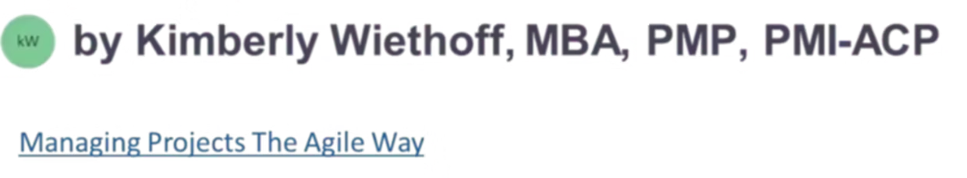
What Project Managers Need to Know About Microsoft Dynamics CRM
A comprehensive guide for project managers navigating the powerful ecosystem of Microsoft Dynamics CRM to drive project success and deliver outstanding customer service.
#MicrosoftDynamicsCRM, #Dynamics365. #PowerPlatform. #CRMImplementation. #DynamicsCRM. #PowerApps. #PowerAutomate, #MicrosoftPowerPlatform #ManagingProjectsTheAgileWay

Slide 2
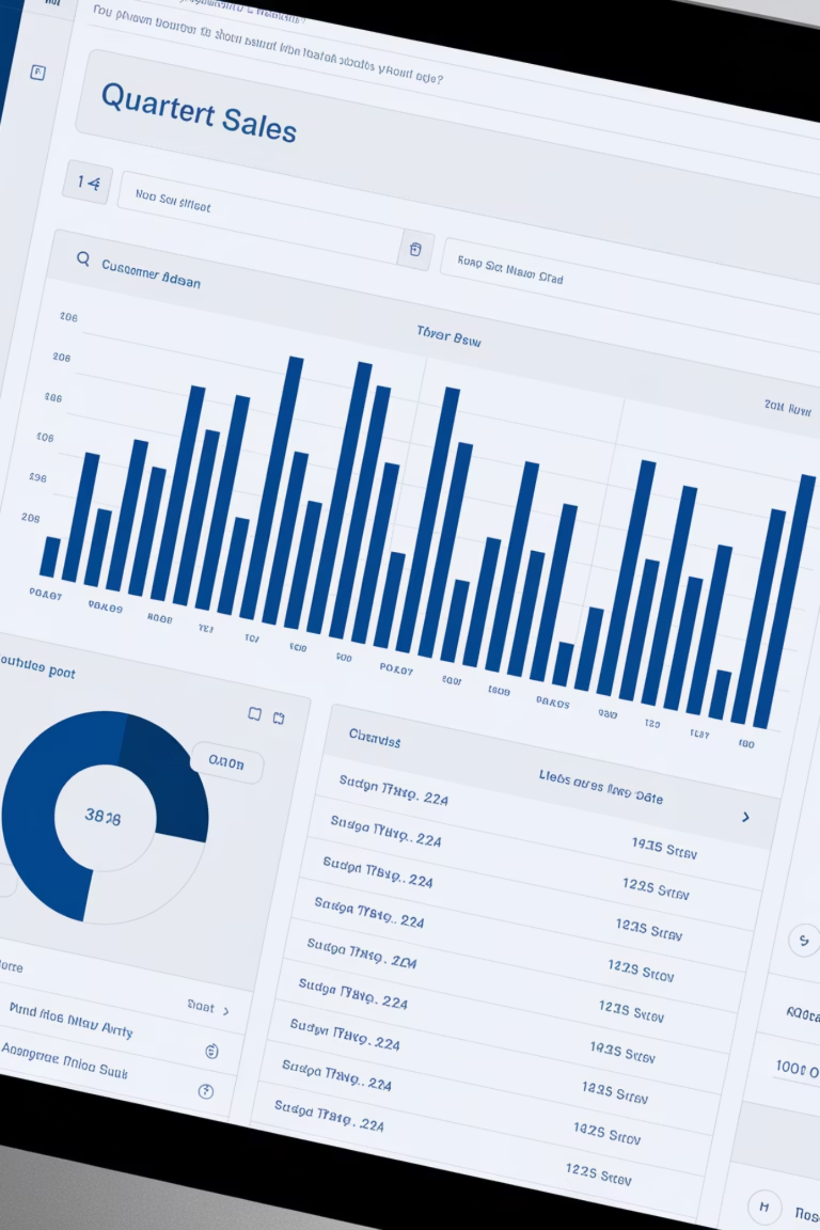
Microsoft Dynamics CRM Overview
In today's customer-centric business environment, CRM systems are essential for growth. Microsoft Dynamics CRM helps streamline sales, marketing, and customer service.
For project managers, it's not just software—it's a robust ecosystem impacting project success.
Streamline Sales
Enhance Marketing
Track leads, opportunities, and customer engagements efficiently.
Drive campaigns, manage events, and nurture leads effectively.
Improve Service
Manage service requests, cases, and support operations seamlessly.

Slide 3



Core Modules
Customer Service
Tracks service requests, cases, and support operations.
Sales
Manages leads, opportunities, accounts, and customer engagements.
Marketing
Drives campaigns, manages events, and nurtures leads.
As a project manager, understand which modules are in scope. Each has unique business objectives, stakeholders, and workflows.

Slide 4




Stakeholder Alignment
Identify Stakeholders
Map all departments involved in the CRM project.
Regular Check-ins
Maintain consistent communication across teams.
Clarify Goals
Create shared understanding of success criteria.
CRM projects span multiple departments—sales, marketing, IT, customer service, and finance. Each has unique expectations.

Slide 5
Out-of-the-Box vs. Customization
Out-of-the-Box Benefits
Customization Considerations
Faster implementation
Easier upgrades
Lower maintenance costs
Microsoft support
Longer development time
Higher maintenance needs
Potential upgrade issues
Specialized support required
Dynamics CRM offers high flexibility. Project managers should encourage out-of-the-box features when possible and manage scope creep proactively.

Slide 6
Integration Planning
Identify Systems
Map all systems needing CRM integration
Assess APIs
Evaluate existing APIs and middleware options
Map Data Flows
Document how data moves between systems
CRM projects often require integrations with ERP systems, email platforms, and marketing tools. These integrations can become complex and cause delays.

Slide 7
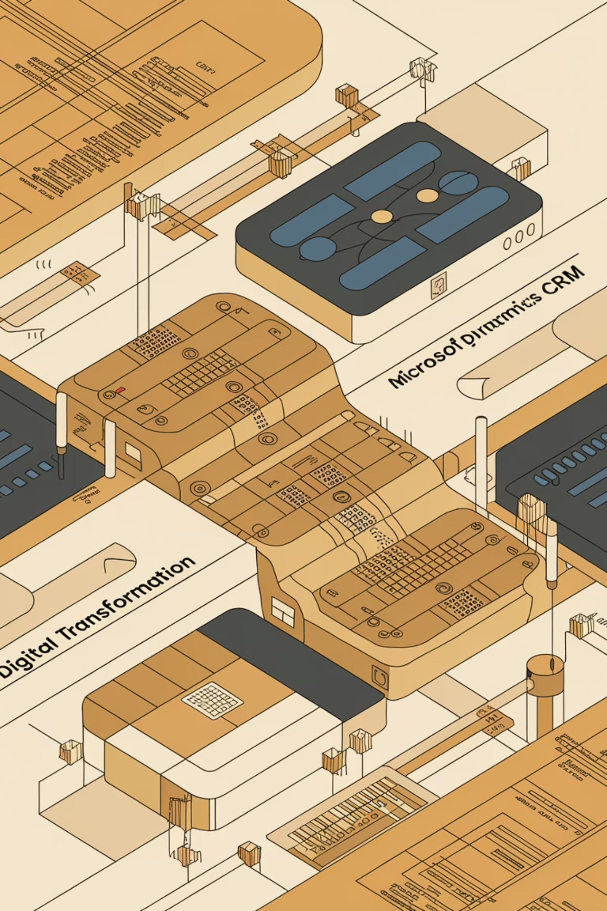
Data Migration
Source Identification
Identify all data sources and owners.
Data Cleansing
Remove duplicates and standardize formats.
Field Mapping
Match source fields to CRM fields.
Validation
Test and verify migrated data.
Never underestimate data migration effort. Treat it as its own workstream with timelines, deliverables, and owners.

Slide 8



User Adoption
Measure Success
Track engagement metrics
Provide Training
Develop comprehensive learning programs
Communicate Value
Explain the "why" behind CRM
Even perfect CRM implementation fails without adoption. Champion change management with training, communication plans, and super users who promote the system internally.

Slide 9




Agile Implementation
Sprint Planning
Development
Prioritize features for each iteration
Build features in short timeframes
Feedback
Showcase
Incorporate stakeholder input
Demonstrate progress to stakeholders
Many Dynamics CRM projects benefit from Agile methodologies. Frequent iterations and feedback cycles ensure alignment with business needs.

Slide 10

Licensing and Environment Management
Environment Strategy
Define Dev, Test, UAT, and Production environments early in the project.
Deployment Schedule
Plan careful timing for moving changes between environments.
License Management
Understand how licensing tiers impact user roles and access.
Don't overlook licensing and environment setup. Coordinate with IT to manage these critical aspects effectively.

Slide 11
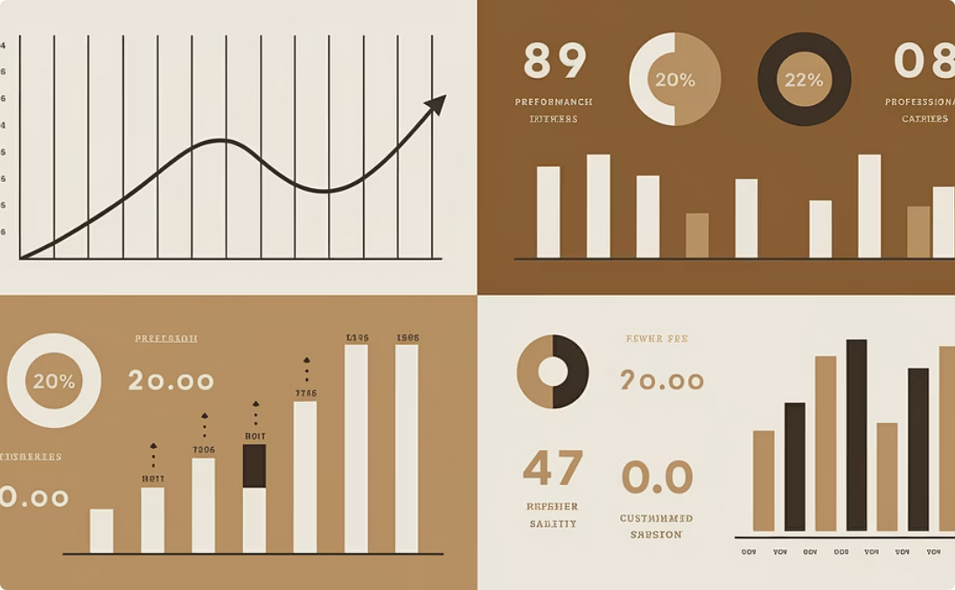
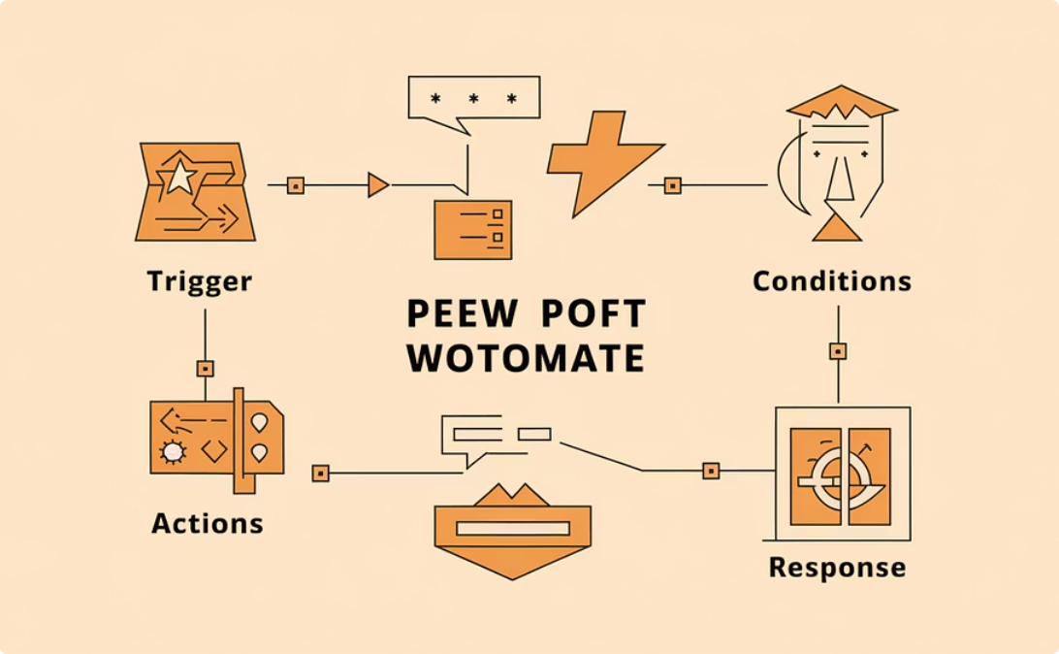
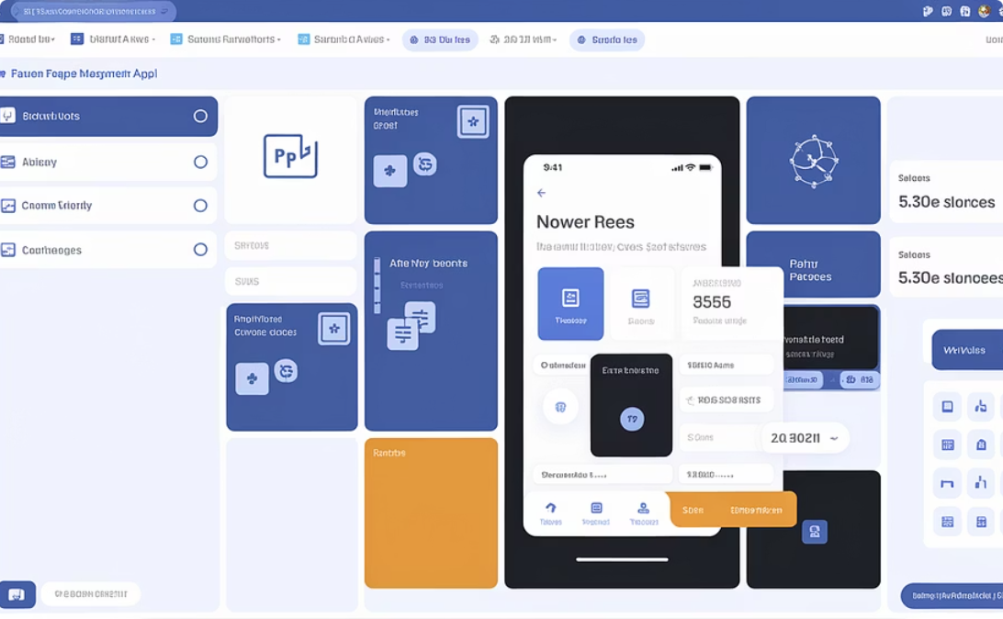
Power Platform Integration
Power BI
Power Automate
Power Apps
Create interactive reports and dashboards to visualize CRM data and track KPIs.
Build automated workflows between apps and services to streamline processes.
Develop custom applications that extend CRM functionality without extensive coding.
Explore how these Power Platform tools can enhance the CRM experience through automation, visualization, and customization.

Slide 12

Final Thoughts
3
5+
Core Modules
Integration Points
Sales, Service, and Marketing form the foundation.
Connect with multiple business systems.
100%
Adoption Goal
Success depends on complete user engagement.
Microsoft Dynamics CRM transforms how organizations manage customer relationships. As a project manager, ensure implementation aligns with business goals and delivers real value.

