Slide 1
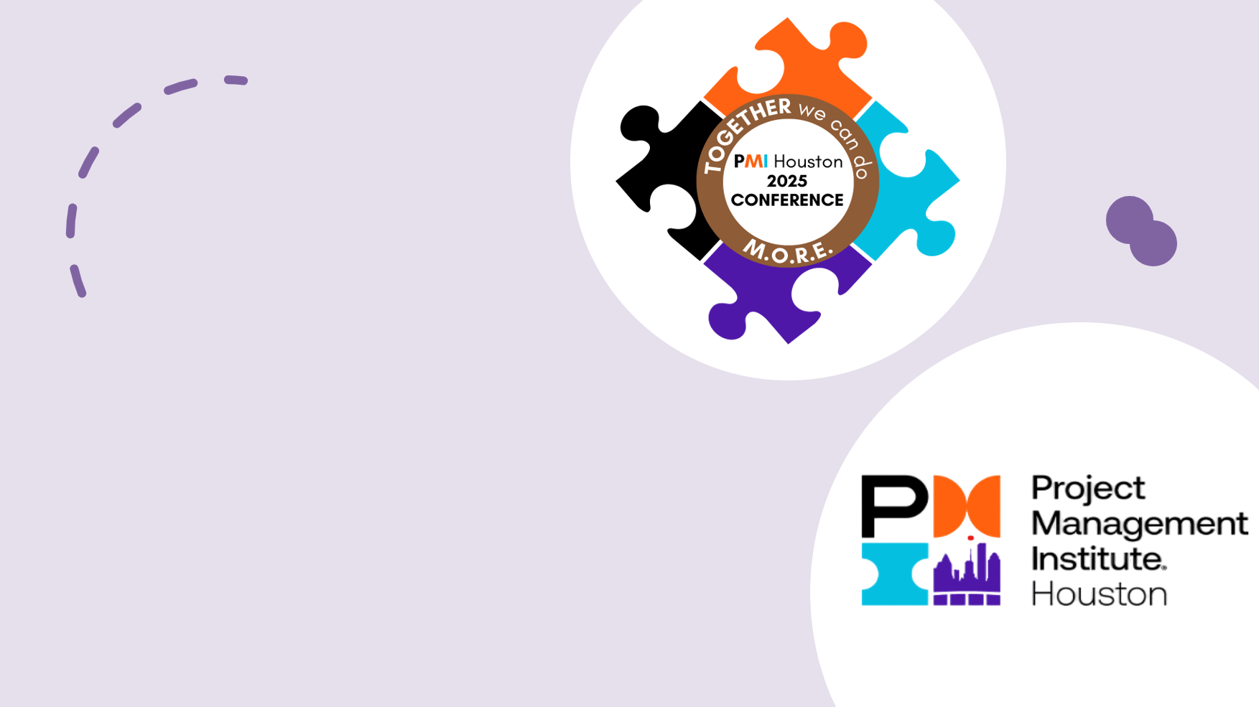
Project Ownership Is a Team Sport
Creating a Culture of Shared Accountability
Notes:
Project Ownership Is a Team Sport.
Creating a culture of shared accountability.

Slide 2

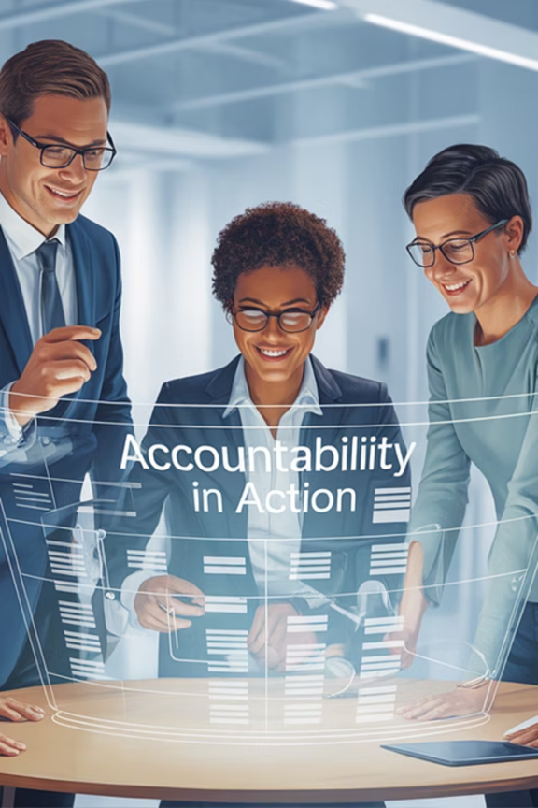
Project Ownership Is a Team Sport
Creating a culture of shared accountability turns project management into a team achievement. When teams' own outcomes, projects deliver faster, with greater stakeholder satisfaction and lasting success.
This session shows how project managers can build teams where everyone feels responsible for the whole project’s success.
Notes:
Slide 3 Project Ownership Is a Team Sport
Have you ever been part of a project where the outcome depended heavily on the project manager doing all the heavy lifting? Where the rest of the team is focused only on their assigned tasks?
The best-run projects—the ones that deliver true value,—have one thing in common: a team that owns the outcome together?
This session is based on a simple idea: Project ownership is a team sport. When everyone—feels responsible for success: delivery improves, risks shrink, and engagement grows.
My goal today is to show you how to build a culture of shared ownership—regardless of whether you’re working in Agile, Waterfall, or hybrid environments.
Shared accountability supports strategic alignment and delivering business value.
Keeps teams focused on the 'why,' aligning daily work with strategic goals.
Encourages cross-functional collaboration to deliver business-relevant outcomes.
Shifts teams from task execution to owning business impact.
Drives strategic alignment through shared responsibility for measurable results.
Tools like collaborative team charters, kickoff strategies, retrospectives, and coaching techniques reinforce shared responsibility and accountability.
When a project succeeds, who gets the credit? More importantly—who should?
Too often, project ownership is viewed as the sole responsibility of the project manager. But the truth is, successful delivery is rarely the result of a single person. It’s the outcome of a coordinated, empowered, and accountable team.
Think about a project you were part of that felt successful. Was it because the PM handled everything? Or was it because the team felt connected, invested, and accountable for the outcome together?
Project success requires more than planning and scheduling. It requires a culture of shared accountability.
According to PMI’s Pulse of the Profession, only 35% of projects are considered 'successful' in terms of meeting scope, time, and cost goals—and many of those still fall short on value delivery.
That tells us something: getting things done isn’t enough. Ownership must extend beyond the PM’s role.
As we go through the session, I invite you to think about a current or past project you’ve worked on. Ask yourself: How could shared accountability have changed that experience?

Slide 3
The Problem with Siloed Ownership
Task Focused Mindset
Unowned Problems
Decision Paralysis
Declining Morale
Notes:
Slide 4 The Problem with Siloed Ownership
Why is Shared Accountability so important? If you’ve ever been on a project where deliverables were met but value wasn’t delivered, you already know something was missing. That missing piece is often accountability—real accountability, not just assigned responsibility.
When accountability stays in silos, you get Task Focused Mindsets, Unowned Problems, Decision Paralysis, and Declining Morale.
These patterns show up all the time, even in mature organizations. They feel normal—but they quietly derail projects from within.
Many teams are still operating with an outdated mindset: the project manager manages, and everyone else completes assigned tasks.
Here’s what I often see in struggling projects:
The PM juggles deadlines while the team focuses only on their own tasks.
Issues arise, but no one speaks up early.
Decisions stall due to unclear ownership.
Morale drops—work feels like box-checking, not impact-driven.
The result?
Outcomes take a backseat to task completion
Issues go unaddressed until escalated
Decision-making lacks clarity
Collaboration feels hollow, not purposeful
This model might get you to the finish line—but rarely with stakeholder satisfaction, speed, or sustainability.
This isn’t about people being lazy or unskilled, it’s about the way we structure accountability.
Most project environments unintentionally encourage transactional thinking: 'I did my part, so I’m done.
But successful projects require transformational thinking: 'What are we trying to achieve—and how do I contribute to that?’
The good news? We can shift this. When we move from isolated task completion to collective ownership, projects don’t just finish—they thrive.
That’s why today’s session isn’t just about better task management—it’s about changing how we work together.
Teams often focus on “What do I need to finish?” instead of “What are we trying to achieve?”
This leads to task completion without real value delivery.
👉 Ever seen a project finish on time—but the user was unhappy?
Small issues fall between roles and go unaddressed.
People think, “Not my job,” so problems escalate.
👉 In accountable teams, small issues are everyone’s problem.
No one’s sure who should decide, so nothing moves.
Momentum stalls and ownership becomes unclear.
👉 This isn’t just a delay—it’s a team-level leadership gap.
When work feels siloed, people disengage.
They don’t see their impact or feel empowered.
👉 “Just doing your job” gets old without connection to outcomes.
These four patterns are symptoms of the same root issue: a lack of shared accountability. These patterns can be reversed with intentional strategies—starting with how we frame ownership from day one.

Slide 4
What Shared Accountability Looks Like
Pillars Of Shared Accountability
Clarity
Commitment
Courage
Coaching
01
02
03
04
Notes:
Slide 5 What Shared Accountability Looks Like
Now that we’ve seen the impact of siloed ownership, let’s shift to what shared accountability looks like.
It’s not about more work—it’s about shared purpose, value, and ownership. In this culture, everyone—from developers to sponsors—feels responsible for the project’s success, not just their role.
Shared accountability rests on four pillars: Clarity, Commitment, Courage, and Coaching.
Clarity
People can’t own what they don’t understand.
Everyone should know their role, their impact, and how it connects to the outcome.
👉 Can your team explain success beyond their task list?
Commitment
True accountability is emotional, not just procedural.
Teams care about the user, the value, and each other.
They step up because they believe in the mission.
Courage
Accountability takes bravery: to raise issues, challenge assumptions, and collaborate across silos.
👉 The best teams aren’t perfect—they’re proactive and honest.
Coaching
Accountability isn’t assigned—it’s nurtured.
Leaders model, reinforce, and celebrate outcome-driven behavior.
👉 Use standups and retros as coaching moments—not just status checks.
When these four elements are present, ownership becomes embedded in team culture, not just assigned.
Now that we’ve defined what shared accountability looks like, let’s walk through how to build it in—starting from day one with a powerful, intentional kickoff.

Slide 5
Start Strong with the Kickoff
1. Define Success by Outcomes
2. Clarify Decision-Making
3. Use Ownership Language Early
4. Tackle Risks Together
Notes:
Slide 6 Start Strong with the Kickoff
One of the most overlooked opportunities to build shared accountability is the project kickoff. The way you start a project often defines how you’ll finish it.
If we treat kickoff like a logistics meeting—assigning tasks, timelines, and deliverables—we miss the chance to establish ownership behaviors early.
A kickoff should be more than a calendar review—it should be a culture-setting event.
It’s our first opportunity to:
set expectations around shared responsibility,
clarify how decisions will be made,
and build trust and alignment between cross-functional partners
A Kickoff should:
First: Define Success by Outcomes
Go beyond scope and timeline—ask: What impact do we want?
Example: Not just “launch the tool,” but “boost scheduling efficiency by 25%.”
Second: Clarify Decision-Making
Define who decides what—and how.
Set clear escalation paths and trade-off criteria.
👉 Use tools like a Decision Matrix or RAPID model to prevent bottlenecks.
Third: Use Ownership Language Early
Talk about we, outcomes, value, and shared responsibility.
Say: “Everyone contributes to the whole project’s success—not just their task.”
Fourth: Tackle Risks Together
Don’t avoid risk—invite the team to surface it.
Ask: “What could challenge us—and how will we respond together?”
This builds trust and shared problem-solving from day one.
When you model transparency, trust, and shared ownership at the kickoff, you normalize that behavior for the rest of the project.
Don’t wait until delivery problems emerge to introduce these ideas, include them in the beginning.
Now, let’s explore how a collaborative team charter can build shared accountability.

Slide 6
Collaborative Team Charter
Shared Purpose and Success Criteria
Defined Roles and Decision Boundaries
Working Agreements and Norms
Risk Identification and Mitigation
Notes:
Slide 7 Collaborative Team Charter
A well-crafted team charter isn’t just paperwork—it’s the launchpad for shared ownership. It turns a group of individuals into a unified, purpose-driven team.
It is easy to treat the team charter as a checkbox—one more artifact to be archived. But a truly effective charter is not just a document—it’s a living shared agreement created by the team, for the team. It becomes your internal contract for how you’ll work, collaborate, and solve problems together.
The key to success is co-creation. Don’t hand your team a pre-written charter. Instead, facilitate a workshop where the team builds it together. This process creates buy-in, trust, and clarity.
👉 When people help define the rules, they’re more likely to follow the, and hold others accountable to them.
Let’s Walk Through the Key Elements of a Strong Team Charter:
Shared Purpose and Success Criteria
→ Teams align faster when everyone knows why they’re here and what success looks like in measurable terms.
Defined Roles and Decision Boundaries
→ Clarity on “who does what” and “who decides what” prevents confusion and empowers action.
Working Agreements and Norms
→ These set expectations for how we operate and resolve conflict—before issues escalate.
Risk Identification and Mitigation
→ Great charters don’t ignore risk—they address it early and define how the team will respond together.
Team charters reduce miscommunication, finger-pointing, and hidden assumptions.
They help onboard new team members quickly and serve as a reference point when accountability starts to slip.
The team charter isn’t set in stone—it should evolve as the project evolves. Revisit it at retrospectives, major milestones, or anytime dynamics shift.
Once the team charter provides clarity and alignment, the next step is clarifying how each role contributes to the bigger picture.

Slide 7
Clarifying Roles with Purpose
RACI Matrix
Role Maps
Decision Authority Matrix
Workflow Diagrams
Effective Role Clarification Tools:
Clear Roles = Confident Teams
Prioritize better
Make smarter tradeoffs
Collaborate with greater confidence
Hold each other accountable
Results
Notes:
Slide 8 Clarifying Roles with Purpose
Whether you’re in Agile, hybrid, or Waterfall, role ambiguity kills accountability.
Use tools like a RACI matrix or visual role maps to ensure everyone knows:
What they own
Who they depend on
What decisions they can make
Regardless of your delivery method, unclear roles lead to:
Duplicated work
Missed handoffs
Decision bottlenecks
And ultimately, project delays or blame cycles
👉 Have you ever been on a project where three people thought someone else was responsible—and no one followed through?
Roles are more than job descriptions. High-performing teams define roles by outcomes, not just tasks—connecting each role to the broader goal.
Visual tools can be used to reduce guesswork and clarify boundaries. Let’s look at a few.
🟦 RACI Matrix – Defines responsibility, prevents confusion.
🟦 Role Maps – Show interdependencies across teams.
🟦 Decision Authority Matrix – Clarifies who decides what.
🟦 Workflow Diagrams – Visualize handoffs across functions.
Clear Roles = Confident Teams
When people know their purpose, they:
Prioritize better,
make smarter tradeoffs,
collaborate with greater confidence, and
hold each other accountable.
As projects shift, revisit your role tools in retros or reviews to stay aligned.
👉 Role clarity should live alongside your team charter.
With clear roles, the next step is helping teams own the outcomes, not just the tasks.

Slide 8
Shifting from Tasks to Outcomes
Task focus
Transition Questions
Outcome Focus
Outcome Focus builds stronger engagement, innovation, and accountability.
When people understand the intended result, they:
Make better decisions in the moment
Collaborate more purposefully
Raise concerns proactively
Notes:
Slide 9 Shifting from Tasks to Outcomes
One of the most impactful shifts in thinking is moving from completing tasks to delivering outcomes.
Tasks don’t guarantee success—results do. Help your team connect their work to impact:
When people focus only on tasks, they check boxes but miss the bigger picture. But when they focus on outcomes, take ownership and understand the ‘why’—that’s where real value gets delivered.
Here, the purpose of the task is clear. People understand the why behind the work.
To help teams shift, introduce questions like:
What problem are we solving?
Who benefits from this work?
What does success look like when this is done well?
How will we know it added value?
If no one can answer these questions, the task needs reframing.
👉 It’s not just about getting things done—it’s about doing the right things for the right reasons.
These questions take 10 extra seconds—but they rewire how the team thinks about impact.
As a project leader, model outcome thinking in your language.
Instead of: “Let’s finish the UAT scripts,”
Say: “Let’s ensure our scripts catch issues early so users aren’t surprised later.”
When you lead with the why, your team will start doing it too.
This shift builds stronger engagement, innovation, and accountability.
When people understand the intended result, they:
Make better decisions in the moment
Collaborate more purposefully
Raise concerns proactively
👉 Shared accountability thrives in outcome-driven cultures—because people are aligned on impact, not just effort.
Once your team adopts an outcome mindset, your role is to reinforce it—especially during meetings and Agile ceremonies. That’s where coaching makes the difference.

Slide 9
Coaching the Team Mindset
Use Daily Standups, Sprint Reviews, Demos, and Retrospectives
Ask Empowering Questions
Model Accountability
Celebrate Ownership
Normalize the Discomfort of Growth
Notes:
Slide 10 Coaching the Team Mindset
Once your team starts to understand the difference between tasks and outcomes, your job shifts from managing timelines to coaching accountability. That means helping the team internalize ownership—not just assigning it.
👉 Think of yourself less as a traffic cop and more as a mindset coach. You’re there to guide—not micromanage.
You don’t need to create new meetings—use the ones you already have more intentionally.
In Daily Standups, Don’t just ask, 'What did you do yesterday?' Ask:
'What outcome are you driving today?'
'Is there anything that’s slowing your impact?’
Shift the language from activity to purpose.
Use sprint reviews and demos to connect deliverables to business value. Ask:
'How did this move us closer to our goal?'
'What feedback did we get that shows it met the need?’
Reinforce the idea that success is measured in outcomes, not volume.
We’ll go deeper into retrospectives next, but they’re your best opportunity to reflect on ownership behaviors.
Create space for the team to identify not just process gaps, but mindset gaps.
Ask Empowering Questions
Coaching doesn’t mean having all the answer, it means asking the right questions. Try these:
'What’s the impact if this doesn’t get done?'
'Who else needs to be involved to make this successful?'
'What would ownership look like in this situation?’
Model Accountability
Team members watch how you handle setbacks and gray areas. If you own mistakes, ask for feedback, and support proactive behaviors, they’ll follow your lead.
Celebrate Ownership, Not Just Output
When someone steps up, solves a problem, or collaborates outside their role—call it out. That reinforcement teaches others what 'good' looks like.
👉 You get what you reward. So reward ownership—not just checklists and velocity.
And finally, Normalize the Discomfort of Growth - Coaching accountability isn’t always easy, it means helping team members move beyond their comfort zones.
That could mean
taking the initiative,
raising a concern, or
admitting a mistake.
Make it safe to do those things.
Now let’s look at retrospectives as accountability mirrors—a space to reflect on both delivery and team behavior.

Slide 10
Retrospectives as Accountability Mirrors
Accountability-Focused Retro Questions
Make Retros Ownership-Driven
Behavior
Mindset
Impact
Notes:
Slide 11 Retrospectives as Accountability Mirrors
Retrospectives are often thought of as purely Agile tools for improving processes. But in reality, they’re so much more than that—they're accountability checkpoints that help teams look inward at how they’re owning outcomes, not just tasks.
👉 If you're only using retros to ask ‘what went wrong?’ you're missing the bigger picture. Use them to ask, ‘who owned this—and how did we show up?’
A good retro doesn’t just identify problems, it helps the team reflect on their behavior, mindset, and impact.
It’s where shared accountability either gets strengthened—or eroded.
Offer Accountability-Focused Questions to Embed Ownership Thinking:
Where did we take ownership this sprint or phase?
Where did we defer or wait when we could have leaned in?
What helped or hurt our shared commitment?
How did our individual actions support or block team results?
What assumptions stopped us from stepping up?
👉 Use these questions in retros monthly or quarterly, even if your team runs shorter delivery cycles.
4. To make retrospectives a true engine for accountability, try these simple yet powerful practices:
✅ Rotate Facilitation - Let team members lead retros—it reinforces shared accountability.
✅ Team-Defined Metrics - Let teams define and track what accountability looks like. Go beyond burndown charts.
✅ Celebrate Ownership - Call out moments when someone stepped up, unblocked others, or went above and beyond.
✅ Spot Patterns Over Time - Use retros to track cultural trends. Are the same issues repeating? Is ownership growing?
Even in Waterfall or hybrid projects, use post-mortems as accountability check-ins. Ask: Did we act as a team or just a set of roles?
Retrospectives aren’t just feedback—they’re a pulse check on ownership. Ask:
Where did we take initiative?
Where did we hold back?
What helped or hurt team commitment?
Let teams lead the conversation. When they own the reflection, they start owning the results.
Now that we’ve covered sustaining accountability through retros, let’s see how these practices adapt across Agile, Hybrid, and Traditional projects.

Slide 11
Accountability Beyond Agile Environments
Traditional Waterfall Projects
Hybrid Approaches
Agile Environments
Clarity of roles
Commitment to outcomes
Coaching for mindset
Courage to speak up
Notes:
Slide 12 Accountability Beyond Agile Environments
You might be thinking, “This sounds great—but we’re not Agile,” or “We use hybrid—does this still apply?”
Absolutely. Shared accountability isn’t about the framework—it’s about behavior.
These practices flex across all models:
In Traditional: Build ownership into gate reviews and updates
In Hybrid: Use sprints for delivery, charters for cohesion
In Agile: Focus on outcomes, not just velocity
Let’s look at how this works in any environment.
🔷 Agile environments includes built-in support for shared ownership—but it’s not automatic. To make it real:
Use sprint goals to align on outcomes, not tasks
Let Product Owners balance delivery with team health
Reinforce ownership in ceremonies:
Standups: surface blockers to value
Reviews: tie demos to impact
Retros: reflect on behavior, not just process
👉 Agile provides the tools—how we use them shapes accountability.
🔷 Hybrid teams mix Agile delivery with Waterfall structure—like sprints inside phase gates.
To foster shared ownership:
Use team charters to align squads with leadership
Add retros to phase transitions or releases
Track value delivery, not just task status
👉 Hybrid models need alignment across teams and leadership—shared accountability connects both.
🔷 In traditional or Waterfall projects, shared accountability can be harder—but it’s essential.
To build it:
Use gate reviews to spot ownership gaps, not just track milestones
Let team leads influence decisions—not just report status
Involve stakeholders in working sessions, not just updates
👉 Embed ownership early—in kickoffs and post-mortems—not just at delivery.
2. Across all three environments, the tools may differ—but the principles remain the same:
Clarity of roles
Commitment to outcomes
Coaching for mindset
Courage to speak up
👉 Accountability isn’t tied to your framework—it’s tied to your culture.
Now let’s explore how to measure shared accountability —because as Peter Drucker said, “What gets measured gets managed.”

Slide 12
Measuring Shared Accountability
Issue Resolution Time
Proactive Risk Detection
Stakeholder Satisfaction
Team Engagement
Beyond traditional metrics, look for qualitative behavioral indicators that show a shift is happening:
More volunteering for high-visibility work
Cross-functional collaboration without being asked
Stronger retrospectives with open, honest feedback
Teammates checking in on each other’s blockers
Notes:
Slide 13 Measuring Shared Accountability
How do we know if shared accountability is working?
We can’t assume culture is improving—we need to observe, measure, and adapt.
Traditional metrics track scope, time, and cost. But shared ownership reveals itself in more subtle, yet powerful, ways.
Here are a few indicators that show your team is shifting from task execution to shared accountability.
✅ Issue Resolution Time: - Accountable teams solve problems quicker—they flag issues early and act without waiting.
✅ Proactive Risk Detection: - Team members spot and raise issues before they escalate, reducing fire drills.
✅ Stakeholder Satisfaction: - Teams that own outcomes deliver better results and smoother collaboration.
✅ Team Engagement: Ownership boosts pride, support, and retention—both during and after projects.
Beyond metrics, look for qualitative behavioral indicators that show a shift is happening:
More volunteering for high-visibility work
Cross-functional collaboration without being asked
Stronger retrospectives with open, honest feedback
Teammates checking in on each other’s blockers
Use feedback mechanisms like OKRs and value delivery reviews to track value beyond traditional metrics:
Traditional metrics show if we built it right; OKRs show if we built the right thing.
Value delivery reviews shift focus to business outcomes and enable real-time adjustments.
OKRs align team output with strategy and track realized value.
Regular value reviews help teams adapt and stay aligned with stakeholder needs.
Tie retrospectives or reviews to value measurement, not just process improvement:
Retrospectives should ask if we delivered business value, not just what went wrong.
Use them to assess alignment with strategic goals and measurable impact.
Focusing on value over velocity fosters an outcome-driven culture.
Value-based reflection connects daily work to long-term success.
👉 When ownership grows, you’ll feel it in the team energy—before it shows up in the data.
Of course, measurement is just one piece of the puzzle. To sustain shared accountability, you’ll also need to build the skills, address resistance, and lead with intention.
Up next, we’ll look at what gets in the way of shared ownership—and how to overcome the most common resistance patterns on your team.

Slide 13
Overcoming Resistance to Shared Accountability
The Overworked Specialist
The Authority Gap
The Process Advocate
Listen first
Reframe their concerns
Offer support, coaching and structure
Notes:
Slide 14 Overcoming Resistance to Shared Accountability
Not everyone embraces shared accountability right away—and that’s normal.
Resistance isn’t defiance—it’s human. The key is to listen, understand the concern, and build trust.
👉 When someone resists, they’re usually not being difficult, they’re just being human.
It is important to understand the common personas that show resistance to shared accountability.
The Overworked Specialist
"I’m already overwhelmed. I can’t own more."
This stems from seeing shared accountability as extra work.
👉 Reframe it: It’s not more work—it’s better collaboration that prevents rework and fire drills.
The Authority Gap
"I don’t have the power to influence outcomes."
They want to help but feel they can’t.
👉 Empower them: use tools like decision matrices and recognize when they take initiative.
The Process Advocate
"That’s not how we’ve always done it."
Comfort with legacy roles creates hesitation.
👉 Don’t tear down the old—enhance it. Add ownership into existing workflows, not new structures.
Across all these personas, the key is to: listen first, reframe their concerns, and offer support through coaching and structure.
People don’t resist accountability; they resist uncertainty, overload, or exclusion.
Show them that shared ownership makes work smoother, not harder. When people feel safe and supported, they lean in.
Once we’ve reduced resistance, the next step is to build the skills that support a culture of ownership. Let’s look at what those are.

Slide 14
Cultivating Accountability Skills
Self-Awareness
Communication Skills
Systems Thinking
Problem Ownership
Focus on outcomes that support business goals and strategic priorities.
Help stakeholders see progress in terms of impact, not effort.
Tie project milestones to measurable business outcomes.
Reinforce that success is delivering what matters most to the organization and its customers.
Notes:
Slide 15 Cultivating Accountability Skills
One of the biggest myths about accountability is that it’s either something you have—or you don’t.
But just like communication, conflict resolution, or leadership—accountability is a skill. And like any skill, it can be cultivated with practice, feedback, and coaching.
We can talk about shared ownership all day, but unless we give people the tools to practice it, they’ll default to their comfort zones.
Let’s break down the core skill areas that support a culture of accountability.
🟩 1. Self-Awareness
Help people see how their behavior affects the team.
Tools like 360° feedback, working style assessments (e.g., DISC, MBTI), and retro reflections build insight.
👉 The goal isn’t blame—it’s awareness that drives growth.
🟩 2. Communication
Ownership thrives on clear, respectful, and timely conversations.
Encourage the team to:
Speak up early
Give feedback without blame
Ask for help
👉 Model constructive conflict resolution in your own interactions.
🟩 3. Systems Thinking
Show how individual work connects to the bigger picture.
Use tools like impact maps, journey maps, or workflow diagrams.
👉 When people see the ripple effect, they prioritize value—not just tasks.
🟩 4. Problem Ownership
Shift from “That’s not my job” to “How can I help?”
Recognize initiative and support with tools like root cause analysis and 5 Whys.
👉 Ownership means taking action—without waiting to be asked.
Don’t expect mastery overnight. Start with small, low-risk scenarios where people can flex these muscles before it’s mission-critical. Your role is to create the psychological safety where learning is possible.
Instead of focusing on activity or velocity, shift the conversation to how the project outcomes support business goals and strategic priorities.
Frame updates around value delivered, not just tasks completed—help stakeholders see progress in terms of impact, not effort.
Use language that ties project milestones to measurable business outcomes to set clearer, more meaningful expectations.
Reinforce that success isn’t just finishing fast—it’s delivering what matters most to the organization and its customers.
Now let’s look at the leadership behaviors that either reinforce—or weaken—accountability.

Slide 15
Leadership Behaviors That Foster Accountability
Behaviors that Build Shared Accountability
Behaviors that Block Shared Accountability
Model what matters, what’s rewarded, and what’s safe to say or do.
Notes:
Slide 16 Leadership Behaviors That Foster Accountability
You can have the best processes, charters, and metrics in place—but if leadership behavior doesn’t reinforce accountability, the culture won’t shift. As leaders, we are constantly sending signals—about what matters, what’s rewarded, and what’s safe to say or do.
👉 Your actions are always louder than your agenda.
Let’s talk about the leadership behaviors that either build or block accountability.
🟢 To build it:
Be real. Admit when something didn’t go as planned—it creates trust and safety.
Ask, don’t answer. Use questions like “What’s the root cause?” or “How would you approach it?” to spark ownership.
Reward early warnings, not just fixes. It encourages people to raise issues before they escalate.
Share leadership. Let team members run standups or retros to build confidence and accountability.
Focus on learning, not blame. Mistakes are growth opportunities.
Be transparent. Explain why decisions were made—it drives alignment.
Give specific praise. “Thanks for raising that blocker early” goes further than “great job.”
🔴 Behaviors that hurt accountability:
Fixing everything yourself creates dependence.
Vague roles lead to confusion and blame.
Praising heroics over teamwork fuels burnout.
Making decisions in a vacuum lowers engagement.
Quick fixes ignore root causes.
Overemphasis on deadlines encourages shortcuts.
A fear of mistakes stops people from stepping up.
Your actions set the tone. Model what accountability looks like—so your team feels safe to follow.”
If you want a culture of ownership, model it—especially in how you handle challenges, bad news, and team problem-solving.
👉 People notice how you lead when things go wrong more than when they go right.
As you think about your own leadership, ask:
What signals am I sending about accountability?
Where might I unintentionally be blocking it?
What’s one behavior I can change this week to create more ownership in my team?
Let’s wrap up with a few final reflections and a set of practical actions you can take tomorrow to bring shared accountability to life.

Slide 16
Accountability Mindset Checklist
Project Ownership Is a Team Sport
Start Early With Kickoffs and Team Charters
Coach for Outcomes, Not Just Activity
Use Retrospectives to Keep Ownership Visible
Ask the Ownership Question
Add a Mini-Charter to Your Next Kickoff
Use One Outcome-Framing Question per Day
Recognize Ownership Behavior
Notes:
Slide 17 Project Ownership Is a Team Mindset
Before we close, I want to highlight four key takeaways that summarize what we’ve explored together today. Think of this as your accountability mindset checklist—something you can use whether you’re leading a sprint, kicking off a Waterfall project, or building a new team.
🔑Project Ownership Is a Team Sport
Project success doesn’t belong to the project manager alone.
When ownership is shared across roles, functions, and titles, teams become more resilient, adaptive, and outcome-driven.
This mindset shift transforms the PM from a task manager into a facilitator of impact.
👉 Everyone on the team should be able to say: ‘I’m responsible for making this project successful.’ Not just *‘I finished my task.’
🔑Start Early With Kickoffs and Team Charters
Ownership doesn’t emerge magically halfway through a project—it has to be designed in from the start.
Use your kickoff to define shared goals, clarify roles, and set the tone for collaboration.
And build a collaborative team charter to make those expectations explicit, visible, and mutual.
🔑Coach for Outcomes, Not Just Activity
Project leaders are also mindset coaches.
Use every touchpoint—standups, reviews, retrospectives—to reinforce the importance of outcomes over activity.
Recognize team members who step up, collaborate across boundaries, or solve problems proactively.
👉 Accountability is contagious—when you coach it, model it, and celebrate it, it spreads.
🔑Use Retrospectives to Keep Ownership Visible
Retrospectives are your team’s mirror. Use them not just to fine-tune your backlog, but to reflect on behaviors, decisions, and team dynamics.
Let your team define their own accountability metrics—and track ownership trends over time.
Reinforce the Practicality
The tools we talked about today—collaborative team charters, kickoff strategies, retrospectives, and coaching techniques —aren’t complicated. What matters is how you use them—with intention, consistency, and a belief that everyone contributes to success.
Let’s close with one question: What’s one thing you can do today to build shared accountability?
You don’t need a full framework—just intentional conversations and small behavior shifts.
🟩 Ask the Ownership Question
Who owns the outcome of this deliverable?
Start inserting this question into your team meetings, standups, and planning sessions.
It invites reflection, alignment, and clarity—because sometimes what’s missing is simply asking the right question.
👉 Ask this out loud the next time something gets stuck—it often reveals gaps or opportunities for collaboration.
🟩 Add a Mini-Charter to Your Next Kickoff
Even if you don’t have time for a full-blown team charter, carve out 15–20 minutes during your next kickoff or sprint planning to align on:
Shared goals
Team expectations
Decision boundaries
This can prevent weeks of misalignment later.
🟩 Use One Outcome-Framing Question per Day
What problem are we solving?
How will we know we’ve delivered value?
What impact will this have on the customer?
Pick one and use it in your next standup or status meeting. See how it shifts the conversation.
🟩 Recognize Ownership Behavior
Look for—and call out—examples of proactive collaboration, cross-functional support, or early risk flagging.
You get more of what you praise. Highlight the behavior you want the team to replicate.
👉 Celebrating ownership moments is one of the fastest ways to normalize them.
Small actions, taken consistently, create cultural change. Every great culture of shared accountability started with a few people deciding to think and behave differently.
I invite you to choose just one action from this list—and try it this week. Whether you're a Scrum Master, project manager, team lead, or individual contributor—you can influence how your team shows up.
Let’s open it up—what’s resonating with you? Where do you see an opportunity to strengthen accountability in your own team?

Slide 17
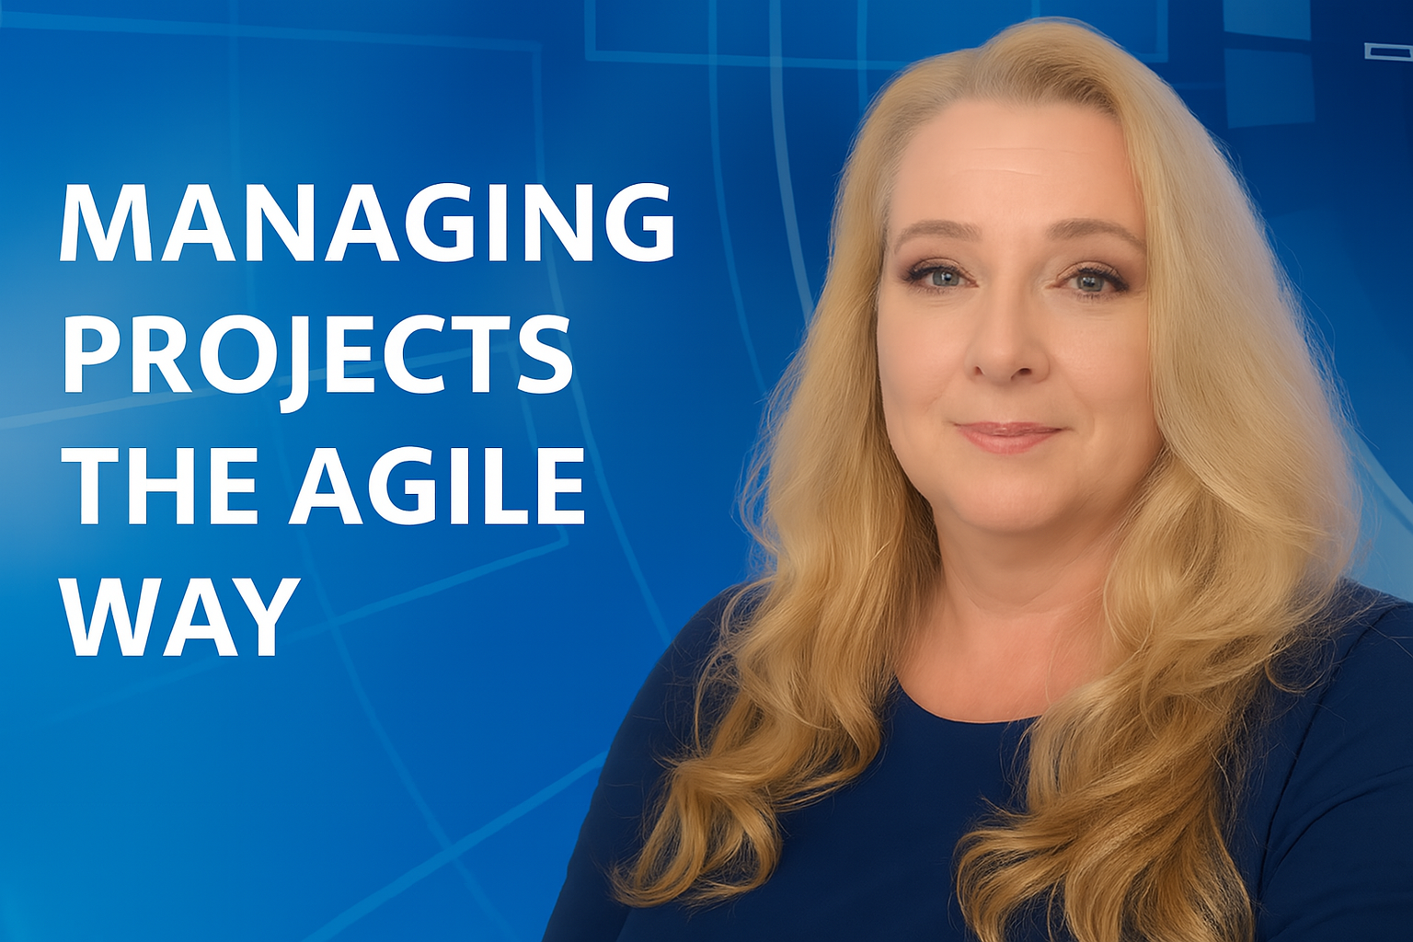
Introduction
Agenda
The Problem with Siloed Ownership
What Shared Accountability Looks Like
  Accountability Focused Kickoff
  Collaborative Team Charter
  Clarifying Roles with Purpose
  Shifting from Tasks to Outcomes
  Coaching the Team Mindset
Accountability Beyond Agile
Measuring Shared Accountability
Overcoming Resistance
Cultivating Accountability Skills
Modeling Leadership Behaviors
Final Thoughts and Key Takeaways
By Kimberly Wiethoff, MBA, PMP, PMI-ACP
Managing Projects The Agile Way
Innovantage Technologies – Elevating Possibilities Through Innovative Technologies

