Slide 1
Advantages of Agile Project Management
Agile project management offers numerous advantages that cater to the dynamic needs of modern businesses. Its flexibility and adaptability allow teams to respond swiftly to changing requirements, ensuring that projects remain aligned with client expectations.
In today's fast-paced business world, organizations seek ways to deliver projects faster and adapt to change effectively.
Agile project management has emerged as a powerful methodology to address these challenges.
kW
by Kimberly Wiethoff

Slide 2
Flexibility and Adaptability
Iterative Development
Embraces Change
Teams view change as a natural part of the development process.
Allows teams to respond quickly to changing requirements and market conditions.
Adjustable Course
Enables teams to deliver value incrementally and pivot as needed.

Slide 3
Customer-Centricity
Early Involvement
Frequent Feedback
Customers participate from the beginning of development.
Regular input informs product direction.
Higher Satisfaction
Greater Trust
Products better align with customer needs.
Transparency builds stronger relationships.

Slide 4
Faster Time to Market
Smaller Chunks
Work broken into manageable pieces.
Prioritized Features
Focus on high-value items first.
Frequent Releases
Incremental updates delivered regularly.
Competitive Edge
Organizations seize market opportunities faster.

Slide 5
Improved Quality
Continuous Improvement
Agile promotes a culture of ongoing enhancement throughout development.
Shared Responsibility
Teams collectively own quality, fostering accountability for delivering excellent work.
Built-in Quality Practices
Test-driven development (TDD)
Continuous integration (CI)
Regular inspections and reviews
Reduced Technical Debt
Quality built from the outset minimizes defects and rework.

Slide 6
Enhanced Team Collaboration
Cross-functional Teams
Open Communication
Diverse skills and expertise combined.
Regular dialogue breaks down silos.
Creative Problem-solving
Collective Delivery
Multiple perspectives lead to innovative solutions.
Shared ownership of outcomes.

Slide 7
Improved Team Morale
Job Satisfaction
Higher levels of workplace happiness
Pride in Work
Sense of accomplishment and ownership
Team Camaraderie
Strong bonds between team members
Self-organization
Empowerment to make decisions

Slide 8
Greater Visibility and Transparency
Regular Iterations
Consistent checkpoints show progress.
Product Demonstrations
Stakeholders see working features.
Progress Reports
Real-time updates on project status.
Stakeholder Engagement
Informed decisions based on current information.

Slide 9
Product Quality Improvement
Integration
Continuous system integration
Testing
Ongoing verification of functionality
Enhancement
Incremental product improvement
Inspection
Team examines each iteration

Slide 10
Greater Customer Satisfaction
User Involvement
Real-time Demos
Continuous Feedback
End users engaged throughout development process.
Clients view product deliverables as they're completed.
Suggestions incorporated to better meet needs.

Slide 11
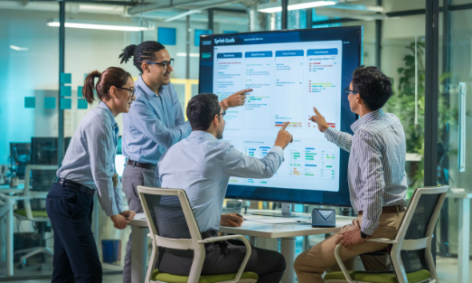
Increased Worker Motivation
Self-managed Teams
Democratic Decision-making
Agile teams facilitate their own development activities. This autonomy allows for greater creativity and innovation.
Teams select items to work on from a prioritized backlog. This participation in planning increases buy-in.
While supervisors and leaders still exist, teams have more freedom to determine how work gets done.
Team members feel valued when their input matters to project direction.

Slide 12
Relevant Metrics
Traditional
Agile

Slide 13
Greater Control and Cost Reduction
100%
0%
Iterative Delivery
Complete Failure Risk
Working code delivered in stages, providing value incrementally.
Real-time fixes eliminate the cost of total project failure.
40%
Rework Reduction
Functionality agreed upon during development, reducing changes.

Slide 14
Collaborative Work Environment
Daily Meetings
Teams discuss yesterday's accomplishments, today's plans, and any obstacles.
Brief stand-ups keep everyone aligned and informed.
Group Problem-solving
Issues are discussed openly within the team.
Multiple perspectives lead to workable solutions faster.
Joint Planning and Execution
Every action is planned and carried out collectively.
Shared responsibility creates stronger commitment to outcomes.

Slide 15
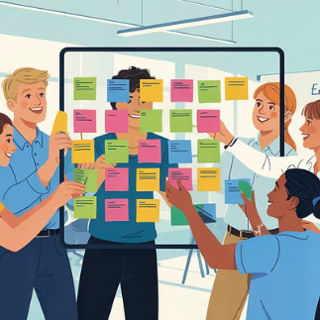
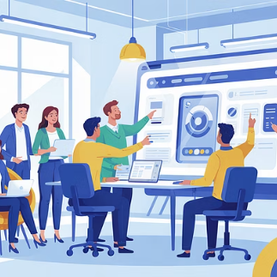
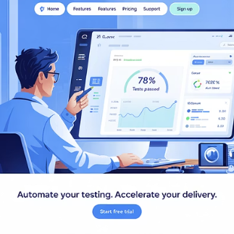
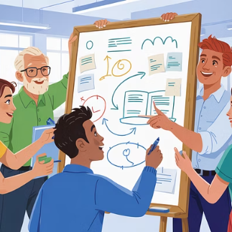
Unlocking Agile's Full Potential
Agile project management enables teams to thrive in today's dynamic business environment through flexibility, customer focus, and collaboration.
Organizations can achieve project success with confidence and efficiency by embracing these powerful advantages.

