Slide 1
Using Lean Principles to Supercharge Agile Software Development
This presentation explores how incorporating Lean principles into your existing Agile practices can transform your software development process, leading to increased efficiency, reduced waste, and faster delivery of high-quality products.
kW
by kimberly Wiethoff

Slide 2
What Are Lean Principles?
Eliminate Waste
Build Quality In
Create Knowledge
Defer Commitment
Focus on removing activities that don't add value to the customer.
Embed quality checks and practices throughout the process to minimize defects.
Encourage learning and adapt processes as you go.
Make decisions based on real-time data, avoiding premature commitments.
Deliver Fast
Respect People
Optimize the Whole
Prioritize speed to deliver value to customers quickly.
Empower teams and foster a collaborative environment.
Focus on end-to-end processes, not just individual steps.

Slide 3
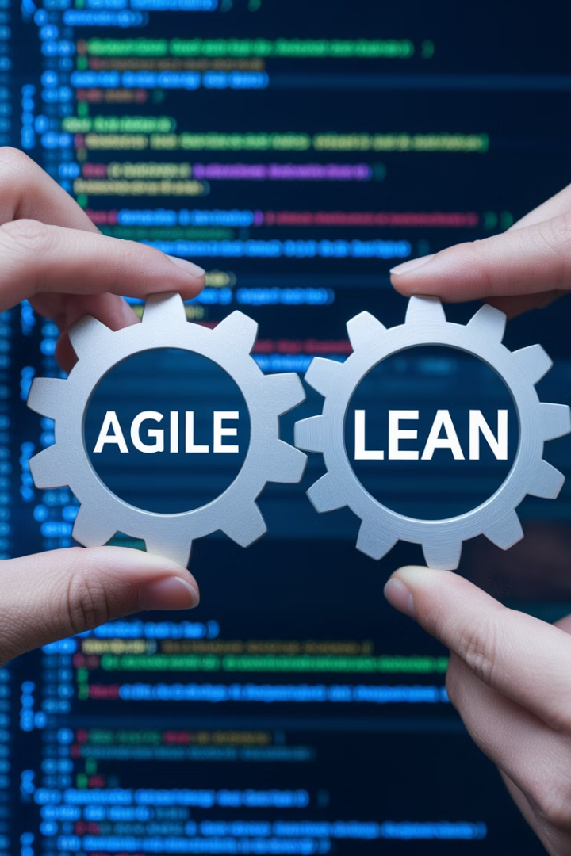
Lean Meets Agile: A Perfect Partnership
While Agile focuses on flexibility, iteration, and responsiveness, Lean complements it by enhancing efficiency and ensuring every effort aligns with delivering customer value.

Slide 4
Eliminating Waste in Sprints
1
Identify and eliminate bottlenecks in workflows.
2
Avoid overproduction, such as building unnecessary features.
3
Minimize context switching by prioritizing work-in-progress limits on Kanban boards.
This could involve optimizing task dependencies, streamlining communication, or automating repetitive tasks.
Focus on delivering features that provide real value to customers and avoid developing features that are unlikely to be used or are not aligned with the current sprint goal.
This helps teams focus on fewer tasks at a time, reducing the time spent switching between different tasks and improving overall productivity.

Slide 5
Building Quality Into Every Iteration
Automated Testing
Peer Reviews
Continuous Integration
Automated tests can be run regularly to identify bugs and regressions early in the development process.
Having another developer review code before it is merged into the main branch can help catch potential issues and improve code quality.
CI pipelines automatically build, test, and deploy code changes, ensuring that code is always in a working state.

Slide 6
Delivering Value Faster
Break down work into smaller increments.
Prioritize high-value features.
Implement continuous delivery practices.
Focus on delivering the features that will have the biggest impact on customers first.
This allows teams to deliver features more quickly and gather feedback sooner.
Automate the release process to reduce lead times and enable faster deployment of new features.

Slide 7
Optimizing the Whole System
1
2
3
Identify dependencies across teams.
Optimize for end-to-end flow.
Implement cross-functional collaboration.
Focus on reducing bottlenecks and inefficiencies throughout the entire value stream, not just within individual teams.
This helps teams understand how their work impacts other teams and allows for better coordination and communication.
Bring together developers, testers, product owners, and other stakeholders to work together on a single goal, improving communication and reducing handoffs.

Slide 8
Empowering Agile Teams
Decision-Making Autonomy
1
2
Experimentation & Innovation
Self-Organization
3
Empowering teams to make decisions, experiment, and self-organize fosters a culture of ownership and continuous improvement.

Slide 9
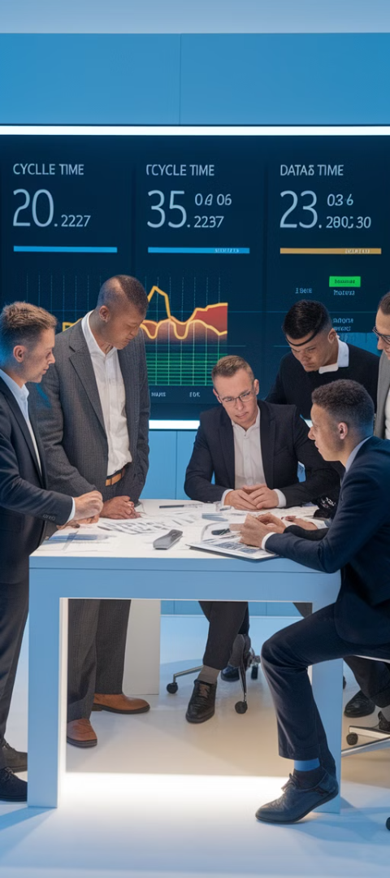
Key Metrics for Lean-Agile Success
Lead Time
Cycle Time
Time to Delivery
Task Completion
Time taken from work initiation to delivery.
Time to complete individual tasks.
Throughput
CFD
Completed Tasks
Cumulative Flow Diagram
Number of completed tasks in a given period.
Visualize work in progress and identify bottlenecks.

Slide 10
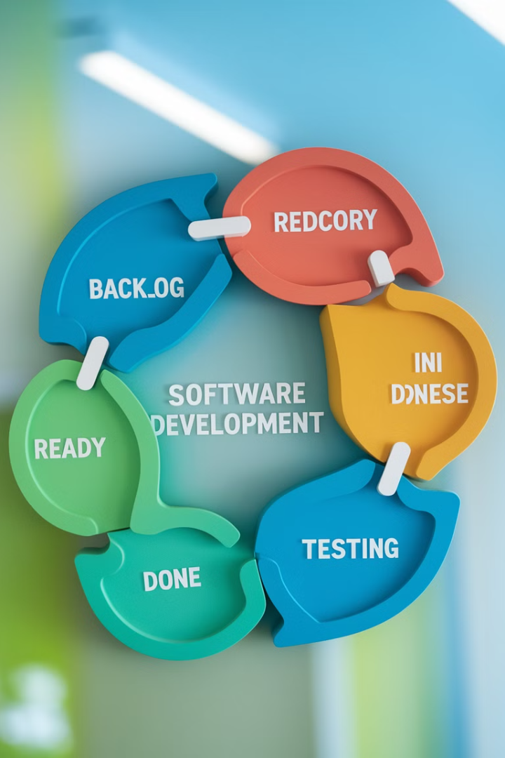
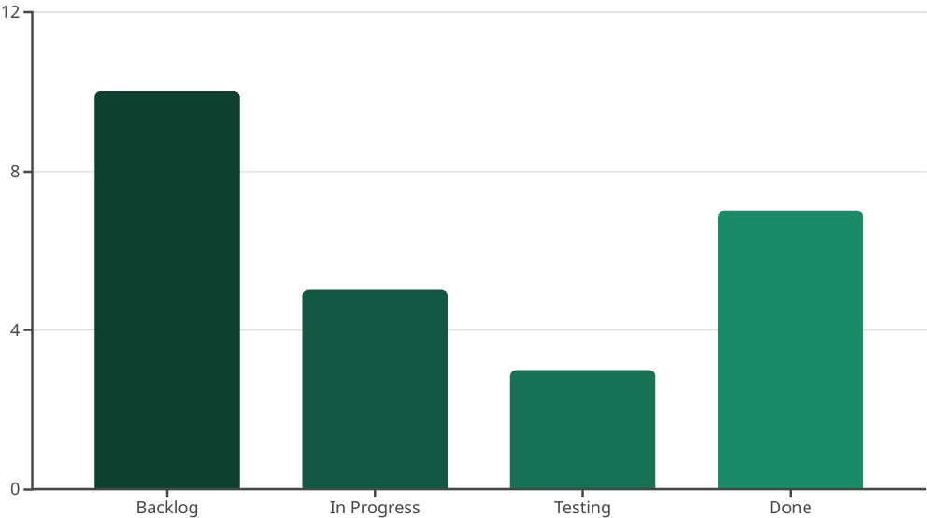
Cumulative Flow Diagram
A cumulative flow diagram helps visualize work in progress and identify bottlenecks in the software development process.

Slide 11
Final Thoughts
By integrating Lean principles into your Agile practice, you'll not only eliminate waste but also deliver higher value to your customers, faster. This creates a powerful synergy that enables software development teams to achieve peak performance.

