Slide 1


The Patient at the Center: Unlocking the Promise of Value-Based Care
Healthcare has long been structured around systems, processes, and providers—but not always around the people it serves. Value-Based Care (VBC) changes that fundamental equation, placing patients at the heart of everything we do.
#ValueBasedCare #PatientCenteredCare #HealthcareInnovation #PatientExperience #DigitalHealth #HealthcareTransformation #ManagingProjectsTheAgileWay

Slide 2

The Healthcare Journey: Then vs. Now
Traditional Healthcare
Value-Based Care
Patients often felt like passive participants in a complex and fragmented healthcare journey. The system was designed around provider convenience, not patient needs.
VBC fundamentally redefines what it means to deliver care by making patients active partners in their healthcare experience and outcomes.
Coordinated care teams
Disconnected care episodes
Proactive patient engagement
Limited patient engagement
Prevention-focused strategies
Reactive treatment approaches
Outcome-driven incentives
Volume-driven incentives

Slide 3
Why the Patient Must Come First
Traditional fee-for-service models created a system focused on quantity over quality, leading to fragmented and impersonal care experiences.
Volume-Based Problems
Fragmented Experience
Limited Accountability
Providers rewarded for seeing more patients, ordering more tests, performing more procedures—regardless of outcomes.
Patients navigated disconnected systems with little coordination between providers and specialists.
No single entity responsible for long-term patient outcomes or overall health improvement.
In contrast, Value-Based Care rewards providers for keeping patients healthy and achieving measurable improvements in well-being, making the patient the driver of success metrics.

Slide 4
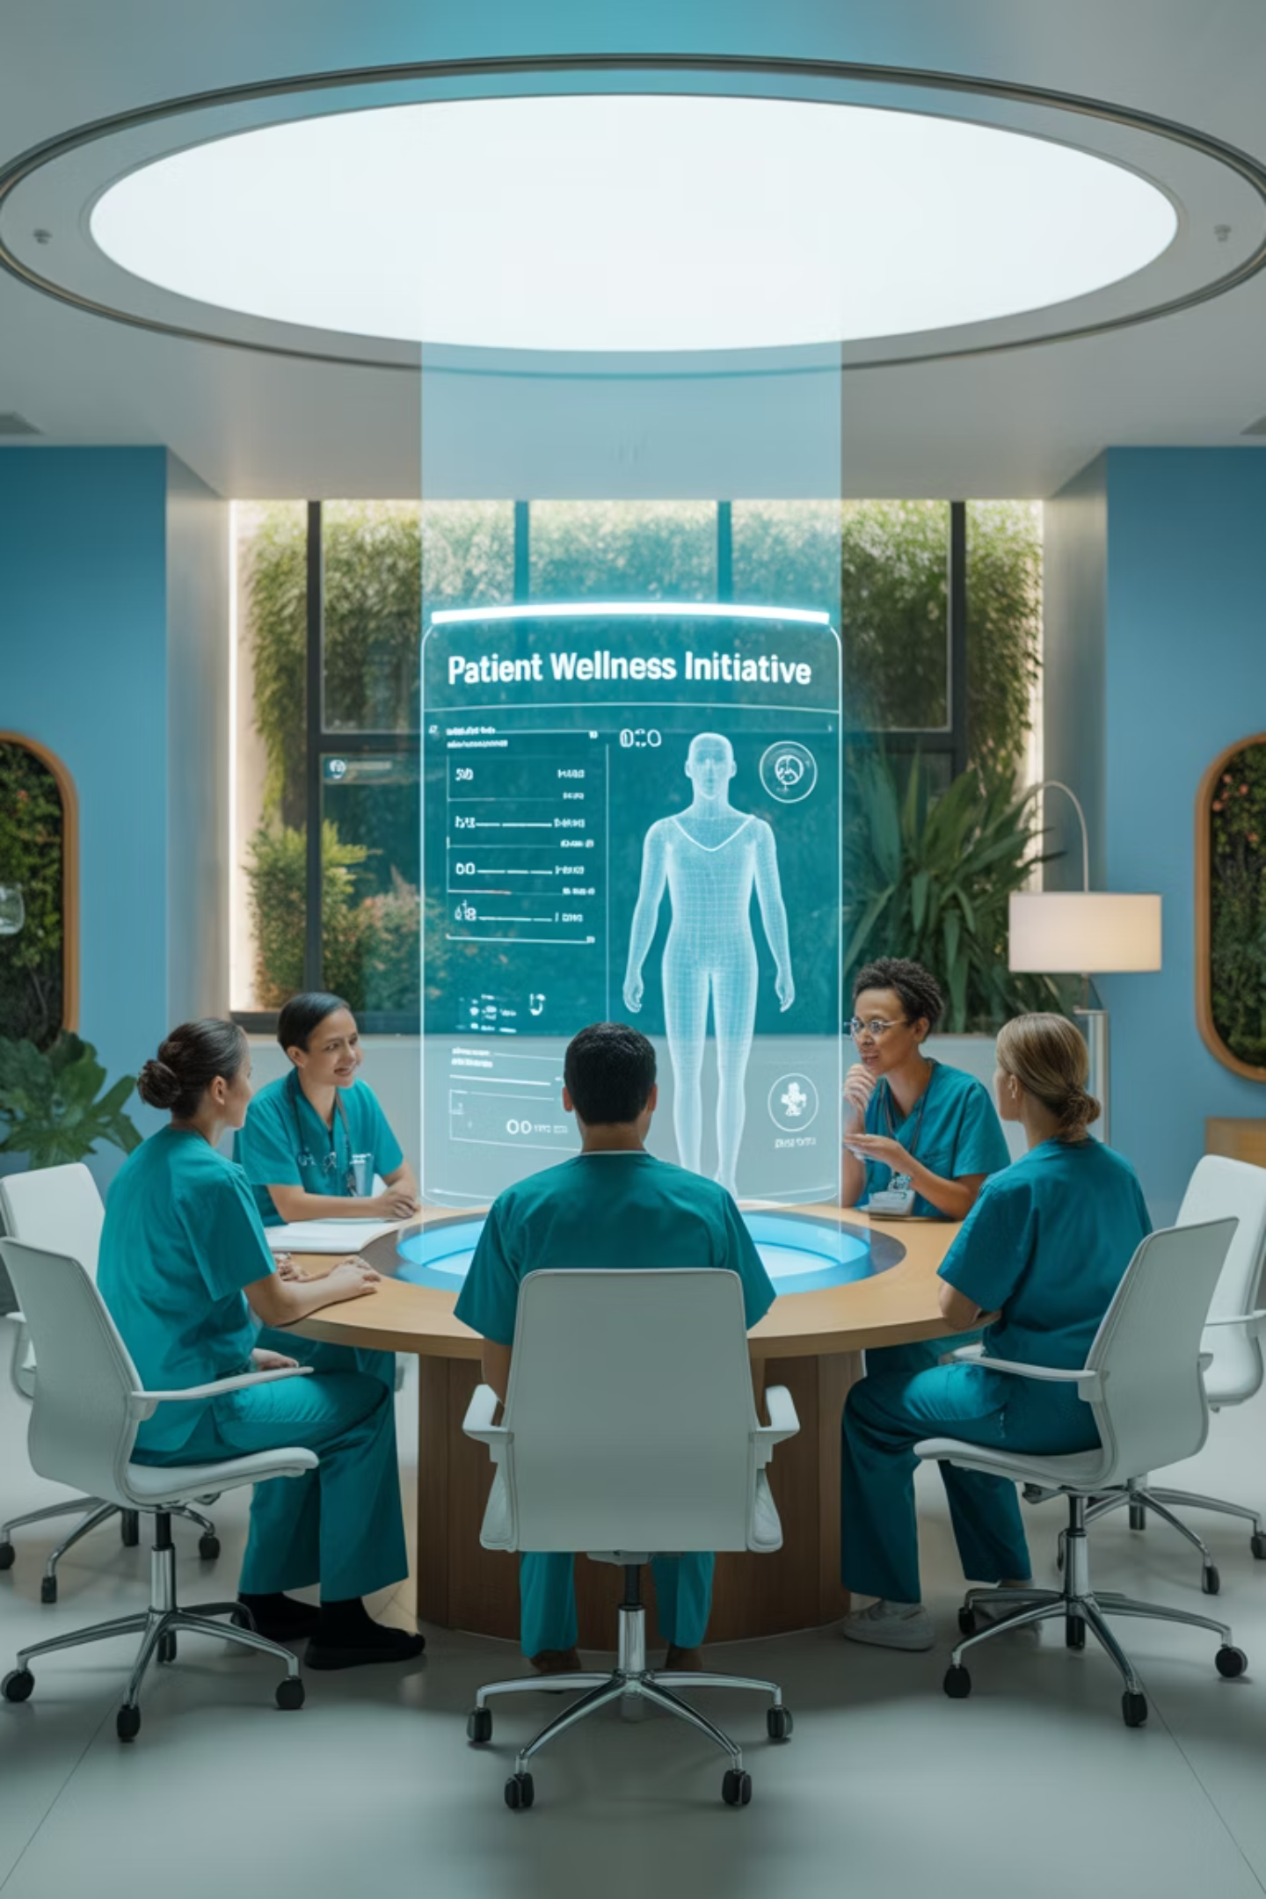
Patient-Centered Care in Action
When we truly put patients first, care delivery transforms from transactional encounters to meaningful partnerships focused on health and well-being.

Slide 5

Personalized Care Plans
Each patient is unique, and their care should reflect that individuality. Value-Based Care ensures treatment plans are tailored to individual needs, health history, lifestyle factors, and personal preferences—moving far beyond one-size-fits-all approaches.
Key Elements of Personalization:
Comprehensive health risk assessments
Cultural and social determinants consideration
Patient goals and preferences integration
Continuous plan adjustment based on progress

Slide 6








Coordinated Care Delivery
Instead of patients navigating multiple disconnected providers, care teams work as an integrated unit with shared accountability for patient outcomes.
Primary Care Physician
Specialists
Central coordinator managing overall health strategy and care plan oversight.
Expert consultation and treatment for specific conditions within the care team framework.
Support Services
Care Managers
Pharmacy, social work, nutrition, and other services integrated into care delivery.
Ongoing patient support, education, and care coordination between visits.

Slide 7




Prevention First: A Proactive Approach
The fundamental goal shifts from treating illness to maintaining wellness. This prevention-first mindset transforms how we think about healthcare delivery and resource allocation.
Wellness Programs
Comprehensive programs addressing lifestyle factors, stress management, and health education.
Preventive Screenings
Regular, risk-stratified screenings to catch conditions early when treatment is most effective.
Early Interventions
Rapid response to risk factors and early symptoms to prevent progression to serious conditions.

Slide 8

Ongoing Patient Engagement
Patients become engaged partners in their care through continuous communication, education, and support that extends far beyond traditional office visits.
Digital Health Platforms
Regular Check-ins
Patient portals, mobile apps, and telehealth services provide 24/7 access to care teams and health information.
Scheduled follow-ups, health coaching sessions, and progress reviews keep patients connected to their care team.
Proactive Communication
Automated reminders, health alerts, and educational content delivered when patients need it most.

Slide 9
The Ripple Effect: Benefits Across the System
When patients are truly at the center, the positive impact cascades throughout the entire healthcare ecosystem, creating value for all stakeholders.
87%
23%
$2.8K
92%
Patient Satisfaction
Readmission Reduction
Cost Savings per Patient
Provider Satisfaction
Patients feel heard, supported, and empowered in their healthcare journey
Better outcomes through coordinated care and chronic disease management
Preventive care reduces expensive hospitalizations and emergency visits
Clinicians renewed in purpose, rewarded for meaningful outcomes

Slide 10
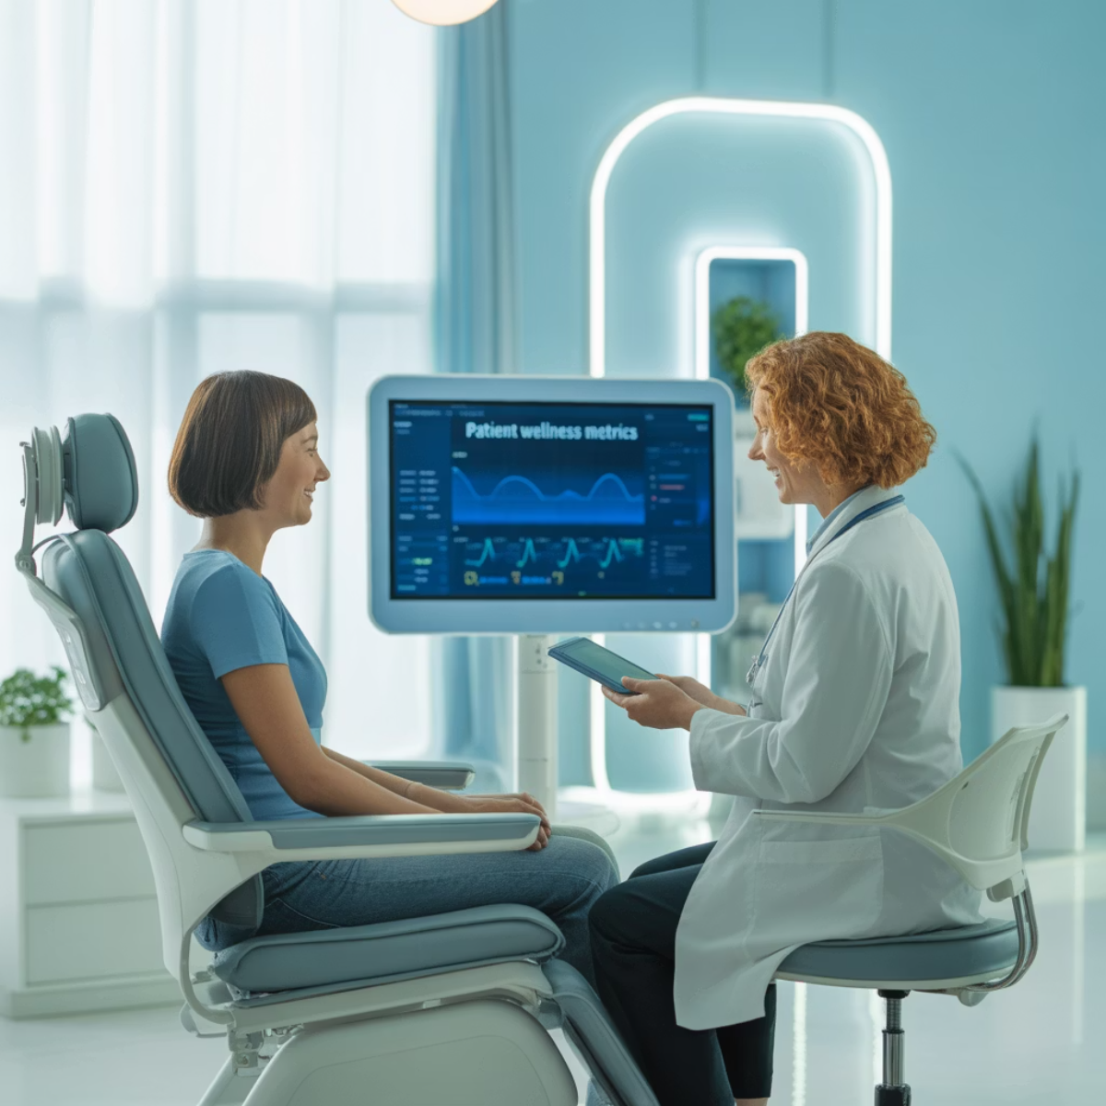
Technology as a Patient Ally
Technology serves as the backbone of patient-centered VBC, enabling seamless coordination, predictive insights, and continuous engagement. Digital tools transform how we deliver care and support patients in achieving their health goals.
Key Technology Enablers:
Electronic health records with interoperability
Predictive analytics for risk identification
Mobile health applications
Remote patient monitoring devices
Care coordination platforms

Slide 11



Technology Capabilities in Practice
Risk Prediction
Patient Education
Real-Time Monitoring
Advanced analytics identify at-risk patients before complications arise, enabling proactive interventions and preventing costly emergency situations.
Continuous, personalized health education and engagement tools keep patients informed and motivated to manage their health effectively.
Track progress toward health goals in real time through wearable devices, patient-reported outcomes, and integrated health data.

Slide 12

The Promise of Value-Based Care
The true promise of VBC is a healthcare system where patients no longer feel like numbers. Instead, they are active participants in their care, supported by a coordinated team focused on one mission: better health outcomes.

Slide 13




Transforming Healthcare From the Inside Out
By placing the patient at the center, Value-Based Care is fundamentally transforming healthcare delivery and unlocking a future where success is measured in lives improved, not services billed.
Patient-Centered Mission
Coordinated Care Teams
Sustainable Success
A healthcare system that rewards value creation, not volume production, ensuring long-term viability
Every decision, process, and outcome focused on improving patient health and experience
Providers working together with shared accountability for patient outcomes and satisfaction
This is the future of healthcare—where every patient receives the coordinated, personalized, and proactive care they deserve. The transformation begins with putting patients first.

