Slide 1
Transitioning from Project Manager to Release Train Engineer
Ready to trade your Gantt chart for a PI board? This guide will help project managers make the leap to becoming a Release Train Engineer in SAFe organizations.
kW
by Kimberly Wiethoff

Slide 2
What Is a Release Train Engineer?
Servant Leader
Coaches the Agile Release Train (ART) rather than directing it.
Cross-Team Coordinator
Facilitates collaboration across 5-12 Agile teams working together.
Communication Bridge
Connects business, technology, and leadership stakeholders.
Cadence Driver
Ensures teams deliver value through Program Increments (PIs).

Slide 3
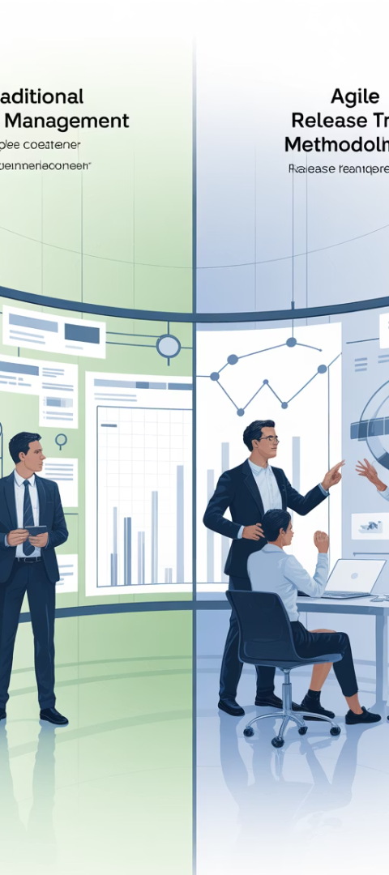
Project Manager vs. Release Train Engineer
Project Manager
Release Train Engineer
Owns project timelines, scope, budget
Facilitates program-level value flow
Empowers teams to self-organize
Assigns tasks and tracks progress
Communicates PI status across ART
Reports status to leadership
Resolves cross-team dependencies
Mitigates risks and resolves dependencies
Orchestrates delivery across teams
Drives delivery milestones

Slide 4
Core Takeaway: Facilitation Over Direction
Less Directive
More Facilitative
RTEs don't assign tasks or make decisions for teams. They create space for teams to self-organize.
Focus shifts to removing impediments and enabling teams to deliver value independently.
Coaching Mindset
RTEs guide teams toward improvement rather than dictating how work should be done.

Slide 5
Transferable Project Management Skills
Facilitation
Cross-team Coordination
Leading effective meetings, retrospectives, and planning sessions.
Juggling timelines and dependencies across multiple teams.
Risk Management
Identifying and resolving blockers proactively.
Stakeholder Engagement
Building relationships across business and technical teams.
Status Reporting
Communicating progress and outcomes to leadership.

Slide 6
Step 1: Understand SAFe Framework
Portfolio
Strategic alignment and investment funding
Large Solution
Complex product development coordination
Program
Agile Release Train operations
Team
Agile teams delivering value
Start with SAFe 6.0 framework from Scaled Agile Inc. Learn how all layers align to deliver enterprise value.

Slide 7
Step 2: Experience PI Planning
Big Room Planning
Dependency Management
Plan Review
Volunteer to help facilitate Program Increment Planning sessions where teams align on objectives.
Learn how teams identify and resolve cross-team dependencies during planning.
Observe how teams present their plans to management for final approval.

Slide 8
Step 3: Build Team Relationships
Observe Team Ceremonies
Attend standups and retrospectives
Understand Team Challenges
Learn about blockers and pain points
Offer Support
Help remove impediments without taking over
Build Trust
Establish yourself as a servant leader

Slide 9
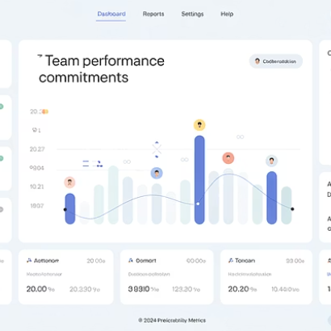
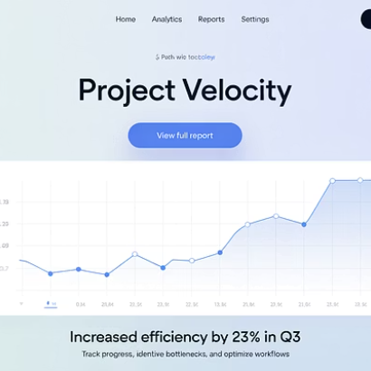
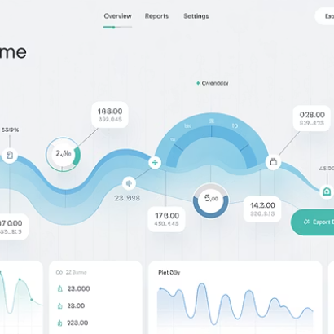
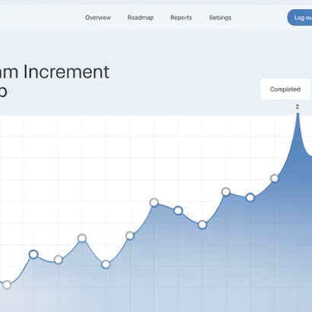
Step 4: Master Agile Metrics
RTEs use flow metrics like predictability, throughput, cycle time, and PI burn-up charts to measure ART performance.

Slide 10
Agile Tools for RTEs
Jira Align
Azure DevOps
Power BI
Tableau
Enterprise agile planning tool that connects strategy to execution.
End-to-end solution for planning, tracking, and delivering value.
Create custom dashboards to visualize program metrics and trends.
Advanced analytics and reporting for program performance insights.

Slide 11
Step 5: Develop Coaching Skills
Ask Powerful Questions
Lead teams to their own solutions rather than providing answers.
Practice Active Listening
Understand team concerns before offering guidance.
Facilitate Effectively
Run productive Inspect & Adapt workshops and system demos.
Foster Continuous Improvement
Help teams identify and implement meaningful changes.

Slide 12
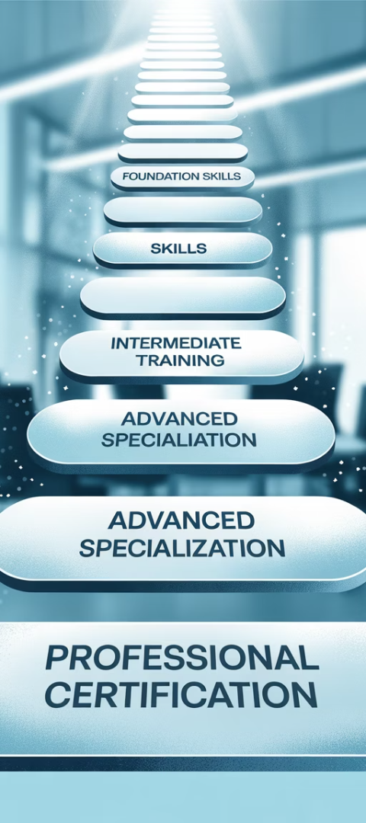
Certification Pathway
SAFe for Teams
Start with foundational knowledge about how teams work in SAFe.
SAFe Scrum Master
Learn facilitation skills and how to support Agile teams.
SAFe Advanced Scrum Master
Develop skills for coaching multiple teams.
SAFe Release Train Engineer
Specialized training for the RTE role and responsibilities.

Slide 13
The Value of Your Transition
5-12
50+
Teams Impacted
People Influenced
RTEs typically support 5-12 Agile teams, multiplying your impact.
Your leadership reaches dozens of professionals across the ART.
100%
Career Growth
RTE roles represent the future of scaled Agile leadership.
Transitioning to RTE isn't about giving up control—it's about gaining influence, alignment, and impact across the enterprise.

Slide 14
Final Thoughts
Transitioning from Project Manager to Release Train Engineer is one of the most valuable and future-forward moves you can make in a SAFe organization. The RTE role enables you to lead Agile at scale, improve cross-team delivery, and help organizations achieve real business agility.
It's not about giving up control—it's about gaining influence, alignment, and impact across the enterprise.
So if you're ready to trade your Gantt chart for a PI board, the RTE path might just be your next big leap.

