Slide 1

Common KPI Mistakes: What Project Managers Get Wrong
Key Performance Indicators drive project success when used correctly. But poor KPI practices can derail even the best teams.
This guide will help you identify and fix the most common KPI mistakes.
kW
by Kimberly Wiethoff

Slide 2

Tracking Vanity Metrics
What are vanity metrics?
Common examples
Meetings held, emails sent, documents produced, or team size.
Numbers that look impressive but don't inform decisions or reflect true performance.
Better alternatives
Budget variance, on-time delivery rate, defect rates, and stakeholder satisfaction.

Slide 3






KPI Overload
Focus on vital few
3-5 core KPIs that drive decisions
Apply 80/20 rule
Which metrics provide most insight?
Eliminate noise
Remove duplicative or low-value metrics
When everything is important, nothing is. Limit your KPIs to what truly matters.

Slide 4





Misalignment with Business Goals
Start with objectives
Identify organizational and project goals first
Create clear connections
Each KPI should directly support a specific goal
Test the relationship
Ask: "How does this measure drive project success?"
Eliminate outliers
Cut KPIs without clear alignment to objectives

Slide 5





Vague KPI Definitions
Calculation method
Define the exact formula used to derive the metric.
Data source
Specify where the information comes from and who provides it.
Update frequency
State how often the KPI is measured and reported.
Responsible owner
Assign a clear owner accountable for the KPI's accuracy.

Slide 6
Missing Context and Benchmarks
The Problem
The Solution
Raw numbers tell an incomplete story. Is 85% completion good or bad?
Always compare current performance to meaningful benchmarks:
Without context, stakeholders can't interpret KPI meaning or importance.
Historical trends
Targets and goals
Industry standards
Similar projects

Slide 7




Outputs vs. Outcomes
Activities
Work performed (lowest value)
Outputs
Deliverables completed
Outcomes
Business changes achieved
Impact
Value created (highest value)
Move beyond tracking what you produce. Measure what you achieve.

Slide 8








Static, Outdated KPIs
Regular reviews
Adjust as needed
Schedule KPI assessments during project gates
Modify metrics when project conditions change
Introduce new metrics
Remove irrelevant KPIs
Add KPIs that address emerging project needs
Don't hesitate to retire metrics that no longer add value

Slide 9





Poor KPI Communication
Know your audience
Tailor KPI presentations to stakeholder needs and knowledge.
Simplify visuals
Use clear dashboards and visualizations that highlight key insights.
Tell the story
Explain what the metrics mean, not just what they are.
Recommend actions
Always connect metrics to decisions and next steps.

Slide 10

Effective KPI Selection Framework
Define project objectives
Clearly articulate what success looks like for your project.
Identify critical success factors
Determine what must go right to achieve those objectives.
Select relevant metrics
Choose KPIs that measure those critical success factors.
Test and refine
Validate that selected KPIs drive the right behaviors.

Slide 11










Balanced KPI Portfolio
Cost
Time
Budget performance, ROI
Schedule variance, milestone completion
Quality
Defect rates, technical debt
Value
Business outcomes, benefits realization
Satisfaction
Stakeholder feedback, team morale

Slide 12
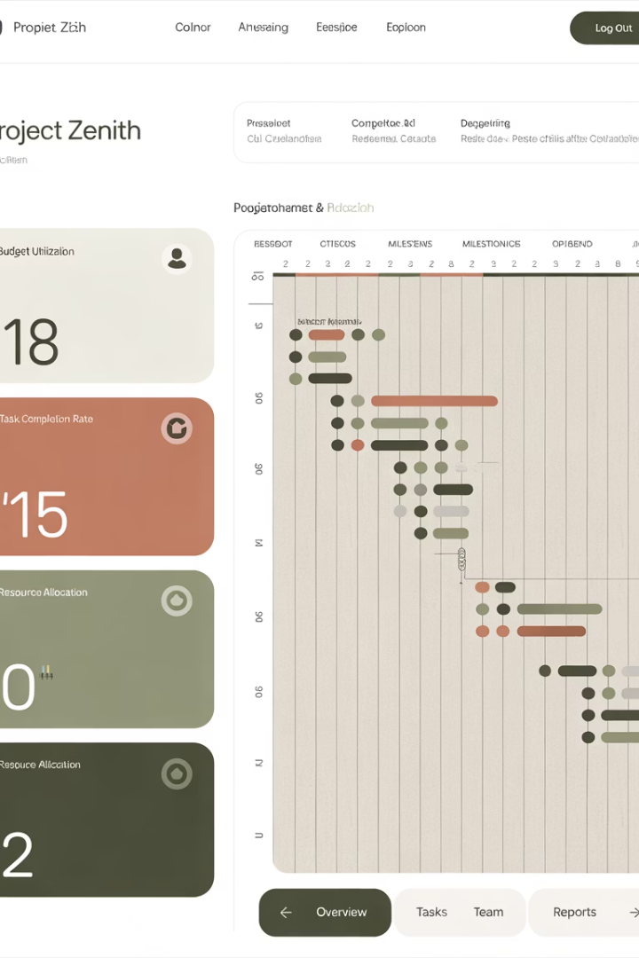




KPI Visualization Best Practices
Choose appropriate charts
Use color meaningfully
Select visualization types that match your data and message.
Apply consistent color coding for status and performance levels.
Create visual hierarchy
Ensure accessibility
Make dashboards viewable on different devices and for all users.
Highlight the most important metrics visually.

Slide 13

Key Takeaways
5
100%
2x
Max KPIs
Alignment
Impact
Focus on fewer, more meaningful metrics.
Ensure each KPI connects to business goals.
Outcome metrics deliver twice the value of output metrics.
KPIs can be powerful drivers of project clarity, accountability, and performance—but only when used thoughtfully. Avoiding these common pitfalls helps ensure that your metrics provide real insights, spark the right conversations, and support better decisions.
Great KPIs don't just measure work—they drive success. Start applying these principles in your next project review.

